Slide 1

Intelligent Vehicular Emergency Communication System
KPR Institute of Engineering and Technology
INNOVSENSE 2026
Team Head & Dept : PRAWIN V S (III ECE B)
Department | Students
III ECE B 2) III ECE B 3) III ECE B 4) III ECE B 5) III CSE C | 1) Prawin V S (23EC084) 2) Sanjay Narayanan (23EC101) 3) Sarvesh R (23EC105) 4) Rithik M (23EC091) 5) Sanjey S (23CS152)

Slide 2

Problem Statement
Automatic accident detection and emergency calling systems are currently limited to high-end luxury vehicles.
There is a need for an affordable, hardware-integrated system that not only detects accidents but also automatically initiates voice calls to emergency contacts without human intervention.
Tech Domain: IoT-Driven Automotive Safety & Emergency Response (Sensor Tech)

Slide 3
Novelty
Existing method | Suggested method | Reference
GSM module sends SMS to emergency contacts | Integrates automatic voice calling | Vehicle Accident Emergency Alert System” – IOP Conference Series (2021)
Uses smartphone accelerometer & GPS, Detects impact using g-force threshold | Dedicated ESP32 + sensor hardware, Independent of smartphone battery or placement | Swift Aid: Real-Time Accident Detection and Emergency Alert System” – IRJET (2025)
Uses embedded sensors, Sends data to central monitoring hub/server, Uses machine learning to assess severity | Faster emergency initiation, Lightweight, affordable architecture Designed for easy installation in any vehicle | An IoT-Based Approach to Vehicle Accident Detection and Alerting” – IJCNIS (2025)

Slide 4
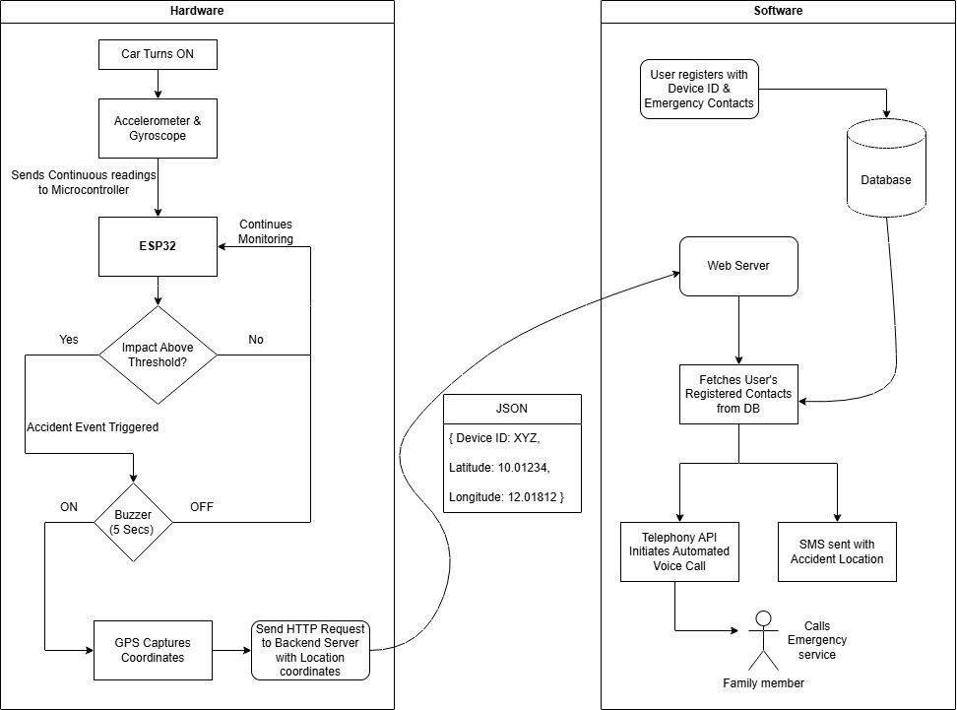
Methodology/Flow

Slide 5
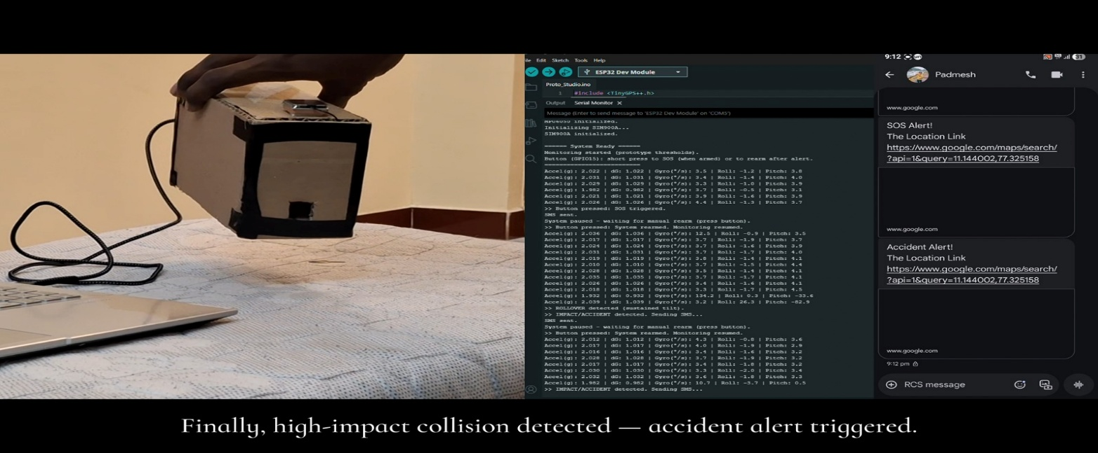

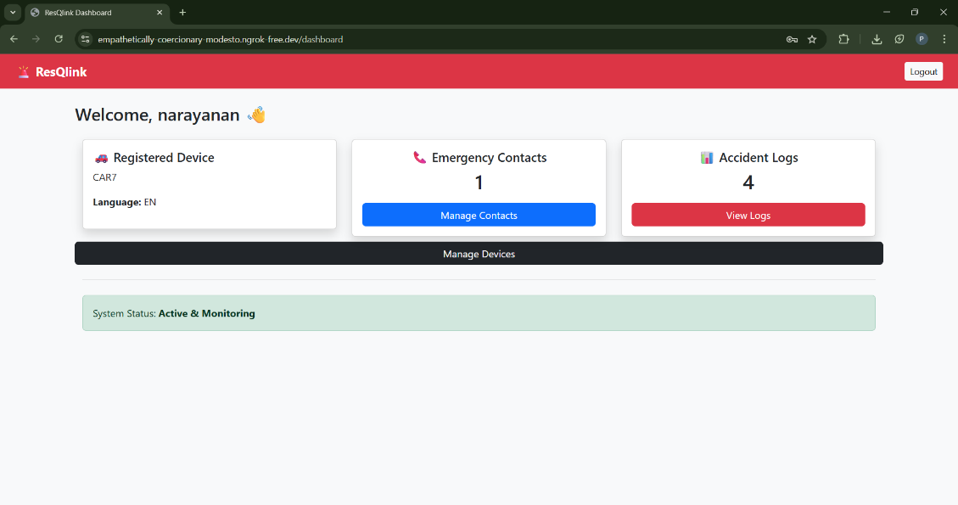
Simulation developed

Slide 6
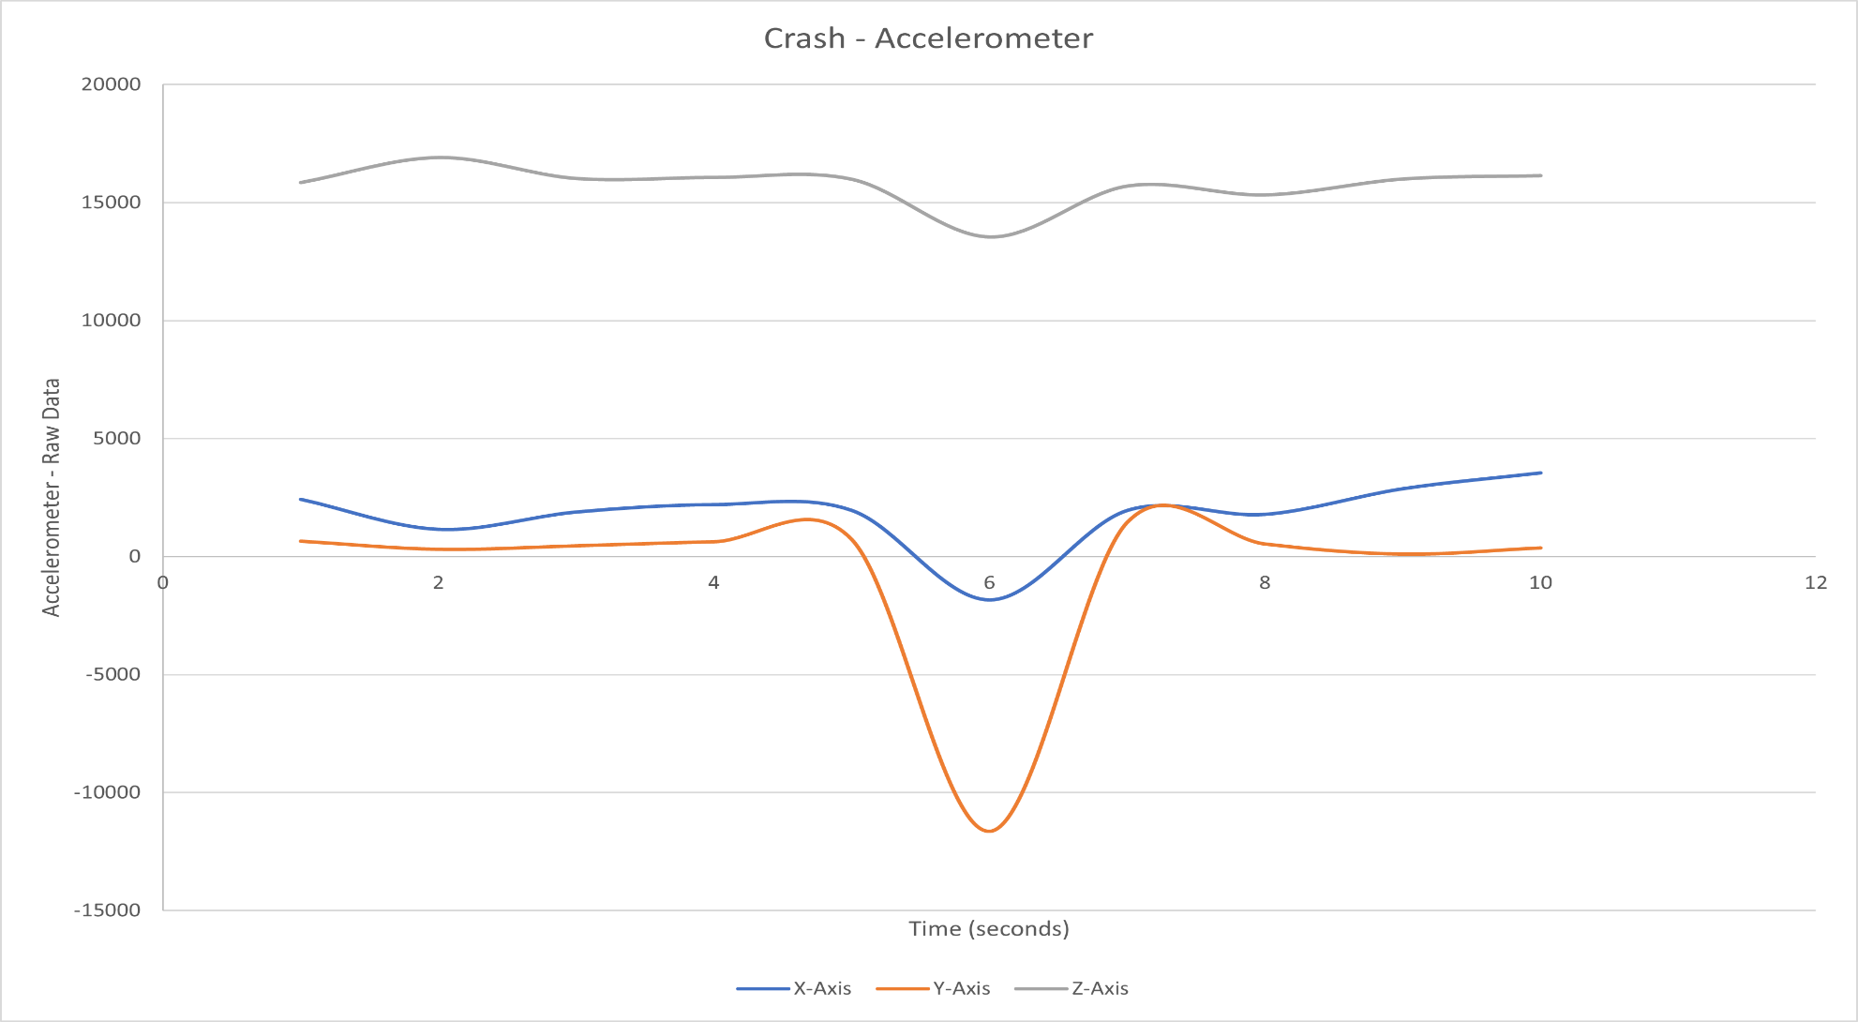
Output Generated
Graphical Representation of Crash Detection through Accelerometer

Slide 7
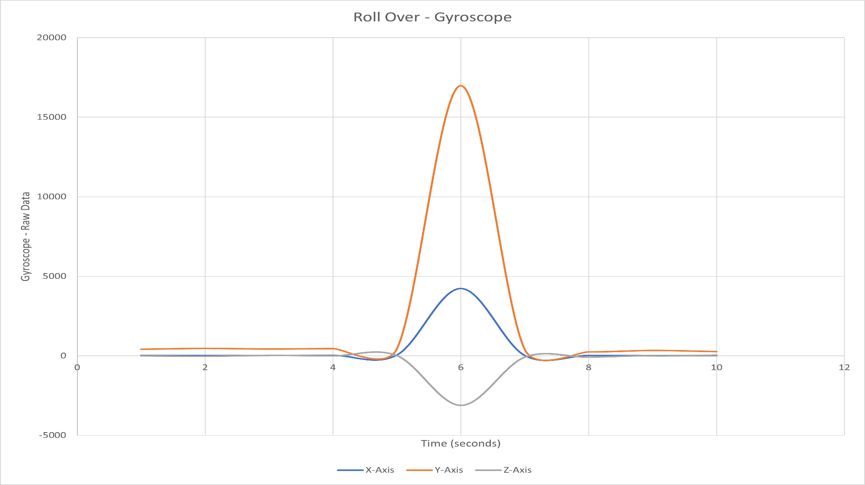
Output Generated
Graphical Representation of Roll Over Detection through Gyroscope

Slide 8
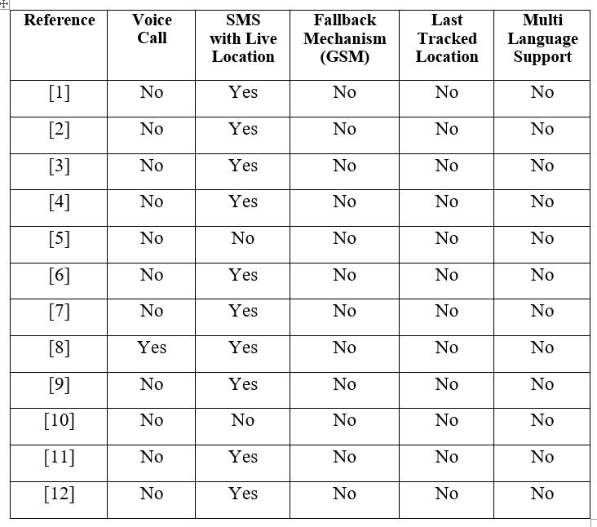
Output Generated
Comparing with existing Researches and Publishments
(References)

Slide 9
References
“Accident detection using Automotive Smart Black-Box based Monitoring system”, Elsevier Measurment: Sensors 27, 2023.
“An IoT-Based Approach to Vehicle Accident Detection and Alerting”, International Journal of Communication Networks and Information Security (IJCNIS), vol. 17, pp. 21-26, Apr. 2025.
“Accident Alert and Vehicle Tracking System”, International Journal of Engineering Research and Technology (IJERT), vol. 9, pp. 358-362, Nov. 2020.
“Accident Detection and Emergency Alert System”, International Journal of Research Publication and Reviews (IJRPR), vol. 6, pp. 185-191, Dec. 2025.
“Intelligent accident detection system by emergency response and disaster management using vehicular fog computing”, Journal of Control, Measurement, Electronics, Computing and Communications, vol. 65, pp. 117-129, 2024.
“Swift Aid: Real-Time Accident Detection and Emergency Alert System”, International Research Journal of Engineering and Technology (IRJET), vol. 12, pp. 101-107, Dec. 2025.

Slide 10
References
“An IoT-Based Automatic Vehicle Accident Detection and Visual Situation Reporting System”, Wiley: Journal of Advanced Transportation. vol. 2024, May 2024.
“Android accident detection and alert system”, ICMED: MATEC Web of Conferences, vol. 392, 2024.
“Enhancing Vehicle Safety: A Comprehensive Accident Detection and Alert System”, International Journal of Advanced Computer Science and Applications, vol. 14, pp. 28-41, 2023.
“IoT-Based Smart Accident Detection and Early Warning System for Emergency Response and Risk Management”, International Journal of Advanced Computer Science and Applications, vol. 16, pp. 660-673, 2025.
“Car Accident Detection System And Alert”, International Journal of Advanced Research in Science, Communication and Technology (IJARSCT), vol. 5, pp. 7-11, Apr. 2025.
“Vehicle Accident Emergency Alert System”, RJACT: IOP Conf. Series: Materials Science and Engineering, vol. 1012, 2020.

Slide 11
Rate the project Suitability for/patent/research/product/Startup on scale 1(low) -3(High)
Suitability | Scale | Comment
Patent | 2 | Integration of sensors, GPS, and GSM with hybrid communication shows moderate patent potential
Research | 3 | Uses sensor data analysis for accident detection with scope for further research
Product | 3 | Strong real world application for vehicle safety and emergency response
Startup | 2 | Can evolve into a safety product for fleet monitoring and smart vehicles
Which industry will use this product? | Emergency Services, Transportation Safety
Are you willing to make the project as a startup? | Yes

