Slide 1
Analyzing Public Sentiment Towards COVID-19 Vaccines: Insights From Twitter Opinions Batch No. 22
R p sankararaman
S kalaimaran
NATIONAL INSTITUTE OF TECHNOLOGY PUDUCHERRY

Slide 2
Outline
Title
Introduction
Motivation
Literature Survey
Drawbacks
Objectives
Proposed Method
System Architecture
Algorithms
Data Set
Experimental Setup
Performance Metrics
Results
Conclusion
Future Work
References

Slide 3
Introduction
Through the utilization of Natural Language Processing (NLP) and advanced sentiment analysis techniques, we meticulously analyze a substantial Twitter dataset related to COVID-19 vaccines. This rigorous analysis results in the systematic classification of tweets into positive, negative, or neutral sentiments, providing a comprehensive assessment of the ever-shifting public opinion landscape on vaccines.
Machine Learning (ML) serves as a cornerstone in our data analysis, empowering us to predict future outcomes. Foundational ML concepts, such as supervised and unsupervised learning, come into play, with a specific emphasis on supervised machine learning in this paper. Additionally, we explore the capabilities of various ML techniques, including LR, SVM, and NB, aiming to extract nuanced insights and enhance our understanding of sentiment dynamics. The overarching objective of this project is to offer valuable insights into the sentiments of Twitter users regarding COVID-19 vaccines, leveraging emerging machine learning algorithms.

Slide 4
Introduction
This section serves as an introduction to our project, setting the stage for the subsequent sections. Section 2 encompasses a comprehensive literature review of reference papers, while Section 3 details the methodology employed in our analysis. The outcomes of the project are deliberated in Section 4, and Section 5 covers the project's conclusion and future avenues for exploration. Finally, Section 6 provides a detailed list of references that informed our research. Join us on this exploration of sentiment analysis and machine learning in unraveling the multifaceted landscape of public opinions on COVID-19 vaccines.

Slide 5
Motivation
Public Health Impact: Vaccination campaigns are a cornerstone of public health measures against the virus. To successfully achieve widespread vaccination, it's crucial to understand the factors influencing public willingness to get vaccinated.
Policy Implications: The data-driven insights derived from this study can inform policymakers in crafting effective strategies to address public concerns, build trust, and increase vaccine acceptance rates.

Slide 6
Literature Survey
[1] aims to analyse sentiments of different people throughout the pandemic by combining sentiment analysis and algorithms for NLP. The ML Models that were used to analyse the sentiments were (1) linear classifiers (SVM and NN ), probabilistic classifiers (NB (Naive bayes) and Bayesian Network), and decision tree classifiers(2) Lb (lexicon based) way which includes a corpus-based approach (Statistical and Semantic) and a dictionary-based approach(3) a hybrid way of classifier model which combines the previous two approaches[1].
[2], By Aasif Ahmad Mir and Rathinam Sevukan illustrates the Indian people's attitudes toward 'Covid-19 vaccines,' gains some insights into overall public communication about the topic, and adds to the existing literature. It can help health policymakers and administrators understand the polarity (positive, negative, and neutral) of Tweets about Covid-19 vaccines on Twitter in order to garner public awareness regarding vaccine misinformation and health concerns.
[3] used Pandas library to convert the dataset into data frames, simplifying data manipulation and analysis within the proposed system that also used the Nltk which is a natural language toolkit. This computational package focusing on linguistics offers simple interfaces to numerous lexical resources. NLTK was used for text pre-processing which includes stemming, stopword removal, lemmatization, tokenization, Lexicon-based Analysis of emotions , and analysis of sentiments (NLTK Sentiment Intensity Analyzer). Matplotlib was used to generate interactive and elaborate data visualisations[3].

Slide 7
Literature Survey
[4] By Md Tarique Jamal Ansari and Naseem Ahmad Khan employs Tweepy, a Python tool that allows users to browse the Twitter API after creating a Twitter Developer profile and obtaining access credentials, was used in this research study. Sentiment Analysis was carried out using the TextBlob library after the data was available. As per the TextBlob documentation, TextBlob employs the Naive Bayes (NB) categorization model. On NLTK (Natural Language ToolKit), NB classification has been taught to recognize the valence of collected tweets. The data was classified as positive sentiment and negative sentiment[4].
[5] used an approach involving purposive sampling to select all Tweets containing defined hashtags (e.g., #2019nCoV) related to COVID-19 on Twitter, observational study design Natural language processing methods to identify key COVID-19 topics and terms were used. The Twitter data mining strategy included data preparation as well as data analysis. Data preparation consisted of three steps: (1) sampling, (2) data collection, and (3) raw data pre-processing. The data analysis stage after pre-processing the raw dataset has (1) unsupervised machine learning, (2) qualitative methods, and (3) sentiment analysis[5].
[6].By Teagen Nabity-Grover, Christy M.K. Cheung, Jason Bennett Thatcher provides a report on the concept of online self-disclosure and summarises relevant literature for studying this construct during a pandemic. To explain self-disclosure online from the netizens during the pandemic, The concepts of self-focus and other focus has been used in this project[6].

Slide 8
Outcome of the Literature Survey/ Drawbacks
We were able to find a few problems while performing the literature review and those are Contextual Understanding: All three algorithms NB , SVM , and LR struggled to capture language and context nuances. Tweets frequently contain slang, sarcasm, and cultural references which could have been challenging for these models to interpret accurately, reducing sentiment analysis precision. Data Quality and Noise: Tweets can be noisy, with spelling mistakes, abbreviations, and incomplete sentences. NB, SVM, and LR struggled with noisy data, resulting in misclassification or biassed sentiment analysis results. Generalisation to New Hashtags: Because the algorithms were trained on specific COVID-19 vaccine-related hashtags, the classifier models may not generalise or scale well to new hashtags or emerging trends in vaccine-related discussions.

Slide 9
Objectives
The primary aim of this study is to create a predictive model for categorising tweets about COVID-19 vaccines into three major sentiment categories: positive, neutral, and negative. Through various methodologies and approaches, the study aims to enhance the accuracy of these sentiment predictions. The paper aims to contribute to more precise and reliable sentiment classification by addressing the challenges and issues associated with sentiment analysis in the context of covid 19 vaccine-related tweets. This proposal is compulsory for the better understanding of public sentiment, facilitating data-driven decision-making, and increasing the overall effectiveness of the sentiment analysis models which were used, ultimately assisting in the evaluation of public perceptions and attitudes regarding COVID-19 vaccines.

Slide 10
Proposed Method
Data Is Collected By Downloading Data From Kaggle.
Data Preprocessing -
Data Cleaning Is Done.
Urls Is Removed.
Punctuation Marks Is Removed.
Special Characters Is Removed.
Unnecessary White Spaces Is Removed.
Feature Extraction -
Done Using Td-Idf.
Sentiment Analysis -
Done Using Logistic regression , SVM , Naive Bayes Models.
Result Evaluation -
Using Sentiment Classification.

Slide 11
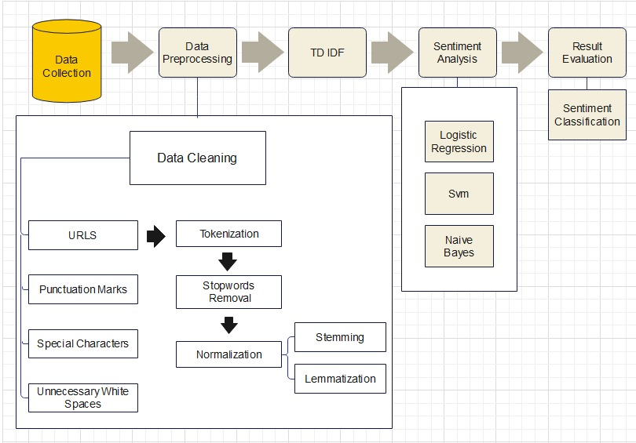
System Architecture

Slide 12
Algorithms
Pandas (pd): Used for data manipulation and analysis.
NumPy (np): Used for numerical computations and data manipulation.
scikit-learn (sklearn ): A machine learning library in Python used for various tasks such as splitting data, feature extraction, and training classifiers.
Support Vector Machine (SVM) classifier, a popular machine learning algorithm for classification tasks.
Logistic Regression: Logistic regression is a commonly used classification algorithm.
Matplotlib (plt): A Python library for creating data visualizations and plots.
NLTK: The Natural Language Toolkit, used for natural language processing tasks such as tokenization and working with Stopwords .
Stopwords : A module from NLTK for accessing a list of common stopwords.
Tweet Tokenizer: A tokenizer from NLTK specialized for processing social media text.
Regular Expressions (re): Used for text preprocessing and cleaning tasks.

Slide 13
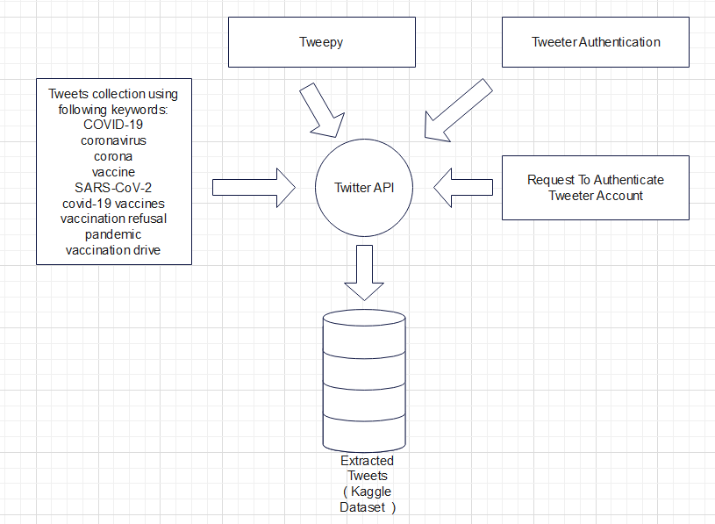
Data Set
Tweets (opinions) about covid-19 vaccines were downloaded from kaggle. The dataset which was used was extracted for the project from twitter using tweepy (with Twitter API )[4]. A set of hashtags were given to extract the tweets related to Covid-19. Then, Twitter authentication was requested and was given. And the required data was extracted and was stored as a dataset.

Slide 14
Experimental Setup
The extracted Twitter data is converted into a sentimental score using pre-trained classifier algorithms such as Logistic Regression, SVM, and Naive Bayes. The extracted data was cleaned up by removing urls, punctuation, special characters, and unnecessary white spaces, followed by tokenization, stopword removal, and Normalisation. The dataset is being divided into two sections 80% training and 20% testing sections. The model’s accuracy helped assess the prediction capability of the classifier models.

Slide 15
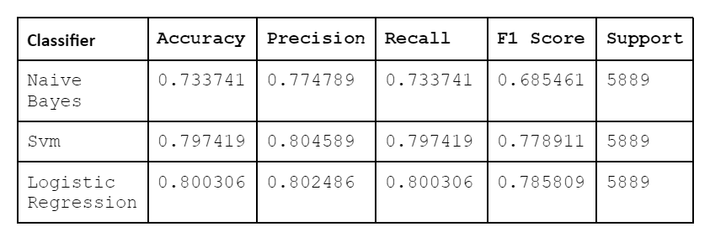

Performance Metrics
Accuracy , Precision , Recall and F1 score are used for Performance Metrics
$Accuracy=TN+TP/TN+FP+TP+FN$
$Precision=TP/TP+FP$
$Recall=TP/TP+FN$
$F1=2∗ ( Precision∗Recall/Precision+Recall )$

Slide 16
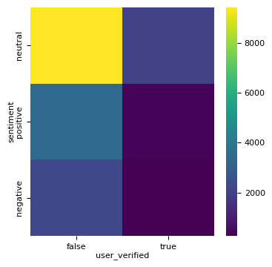
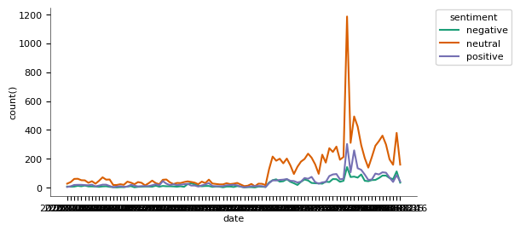
Results
The output of this proposed model of analysis is the predicted sentiments for the twitter opinions. The accuracy for the predicted sentiments is also found. When the three classifier models are compared, we can say that the 'Logistic Regression' classifier model’s accuracy is the highest in relation to recall and F1 score. However, its precision is lower than that of the (SVM).

Slide 17
Conclusion
Within this paper, We used three distinct classifier models to perform sentiment analysis of twitter opinions (covid-19 vaccines). Logistic Regression was the most effective classifier model as the accuracy of sentiment analysis of logistic regression was the highest. The project shows that many people across the globe have shown a neutral sentiment, many people across the globe have shown positive sentiment and few people have shown a negative sentiment towards the covid-19 vaccines.

Slide 18
Future Work
This project can be helpful as a reference in future if we are in a pandemic situation again as many people around the globe are showing hesitation towards vaccines. A hybrid model can be developed with an user interface which gives us the sentimentally analysed output through which a normal citizen can get to know what common people think about a vaccine in social media platforms.

Slide 19
References
[1] Sarirete, A. Sentiment analysis tracking of COVID-19 vaccine through tweets. J Ambient Intell Human Comput (2022). https://doi.org/10.1007/s12652-022-03805-0
[2] Mir, A. A., & Sevukan, R. (2022). Sentiment analysis of Indian Tweets about Covid-19 vaccines. Journal of Information Science, 0(0). https://doi.org/10.1177/01655515221118049
[3] P. Chinnasamy, V. Suresh, K. Ramprathap, B. Jency A. Jebamani, K. Srinivas Rao, M. Shiva Kranthi, COVID-19 vaccine sentiment analysis using public opinions on Twitter ,Materials Today:Proceedings,Volume 64, Part 1,2022 https://doi.org/10.1016/j.matpr.2022.04.809.
[4] Ansari MTJ, Khan NA. Worldwide COVID-19 Vaccines Sentiment Analysis Through Twitter Content. Electron J Gen Med. 2021;18(6):em329. https://doi.org/10.29333/ejgm/11316

Slide 20
References
[5] Xue J, Chen J, Chen C, Zheng C, Li S, Zhu T (2020) Public discourse and sentiment during the COVID 19 pandemic: Using Latent Dirichlet Allocation for topic modelling on Twitter. PLoS ONE 15(9): e0239441. https://doi.org/10.1371/journal.pone.0239441
[6] Teagen Nabity-Grover, Christy M.K. Cheung, Jason Bennett Thatcher,Inside out and outside in: How the COVID-19 pandemic affects self-disclosure on social media,International Journal of Information Management,Volume 55,2020https://doi.org/10.1016/j.ijinfomgt.2020.102188.
[7] Gaur, P., Vashistha, S., Jha, P. (2023). Twitter Sentiment Analysis Using Naive Bayes-Based Machine Learning Technique. In: Shakya, S., Du, KL., Ntalianis, K. (eds) Sentiment Analysis and Deep Learning. Advances in Intelligent Systems and Computing, vol 1432. Springer, Singapore. https://doi.org/10.1007/978-981-19-5443-6_27
[8] Improving sentiment reviews classification performance using support vector machine-fuzzy matching algorithm Vivine Nur Cahyawati, Zuriani Mustaffa https://doi.org/10.11591/eei.v12i3.4830
[9] Miftahul Qorib, Timothy Oladunni, Max Denis, Esther Ososanya, Paul Cotae, Covid-19 vaccine hesitancy: Text mining, sentiment analysis and machine learning on COVID-19 vaccination Twitter dataset,Expert Systems with Applications,Volume 212,2023, https://doi.org/10.1016/j.eswa.2022.118715.

