Slide 1
Multipurpose Internet Mail Extension (MIME) Protocol
Santanu Mondal
M.Tech. NIS
Pondicherry University

Slide 2
What is MIME?
It is an Internet standard that extends email formats to support: Text in character sets other than ASCII
Non-text attachments (images, audio, video, etc.)
Message bodies with multiple parts
Unicode support
MIME was proposed by Bell Communications in 1991 in order to expand the limited capabilities of email.

Slide 3
Why do we need MIME?
Limitations of Simple Mail Transfer Protocol (SMTP):
SMTP has a very simple structure
Its simplicity however comes with a price as it only sends messages in plain 7-bit ASCII text.
It cannot be used for languages that do not support 7-bit ASCII format such as French, German, Russian, Chinese and Japanese, etc.
No support for attachments, formatted text, multimedia
MIME allows emails to carry rich content like images, documents, and videos

Slide 4
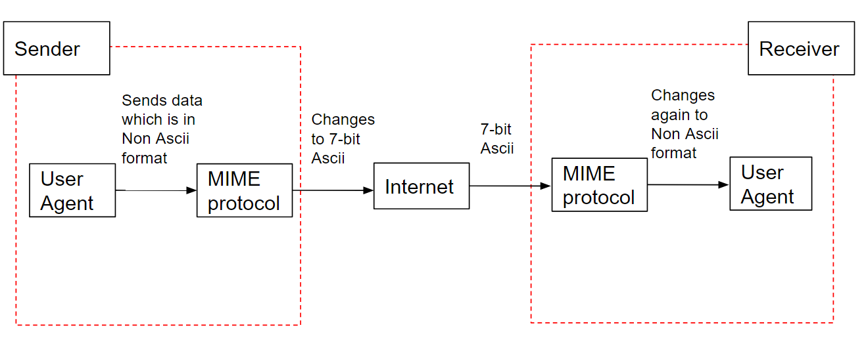
MIME Working Principle
Encoding: Converts non-ASCII content to a 7 bit NVT ASCII format
Headers: MIME adds specific headers to email messages
Decoding: The recipient’s email client decodes the content

Slide 5
MIME Headers
MIME introduces several new headers in email messages:
MIME-Version: 1.0 → Defines the version of the MIME protocol.
Content-Type: Specifies the type of content (text, image, audio, etc.)
Content-Transfer-Encoding: Defines encoding (Base64, Quoted-Printable, etc.)
Content-Description: Suggests how content should be displayed (inline, attachment)
Content-Id: It is used for uniquely identifying the email message.

Slide 6
MIME Content Types
MIME supports various content types, including:
Text: text/plain, text/html, text/css
Image: image/jpeg, image/png, image/gif
Audio/Video: audio/mp3, video/mp4
Application: application/pdf, application/zip
Multipart: multipart/mixed, multipart/alternative (for emails with both text & HTML)

Slide 7
MIME Encoding Techniques
MIME uses different encoding methods to convert non-ASCII data:
Base64 Encoding: Converts binary files (images, PDFs) into ASCII characters
Quoted-Printable Encoding: For text with special characters
7-bit and 8-bit Encoding: Used for textual data with limited character sets

Slide 8
MIME Multipart Messages
MIME allows multiple types of content in a single email
Common multipart types:
multipart/mixed → Contains multiple independent parts (text + image + PDF)
multipart/alternative → Different formats of the same message (plain text & HTML)
multipart/related → Related resources like HTML and embedded images

Slide 9
MIME in Modern Applications
MIME is widely used in:
Email Clients (Gmail, Outlook, Thunderbird)
Web Browsers (MIME types define how content is handled)
File Transfers (HTTP uses MIME types to determine file handling)
APIs & Web Services (REST APIs use MIME for data exchange)

Slide 10
MIME & HTTP
MIME is not just for emails but also used in HTTP
Web servers use Content-Type to describe files sent to browsers
Example:
Content-Type: text/html (HTML file)
Content-Type: application/json (JSON data)

Slide 11
Security Issues in MIME
Email Spoofing & Phishing: Attackers misuse MIME to create deceptive emails
Malicious Attachments: Viruses can be embedded in MIME attachments
MIME Header Injection: Manipulating headers to exploit email systems
Protection Measures: Email filtering, antivirus scanning, authentication (DKIM, SPF, DMARC)

Slide 12
Conclusion
MIME is essential for modern email and web communication
It allows rich media content in emails
Plays a vital role in HTTP and web technologies
Security measures must be implemented to prevent abuse

Slide 13
References
RFC 1341 (Original MIME Standard)

Slide 14
Thank You

