Slide 1
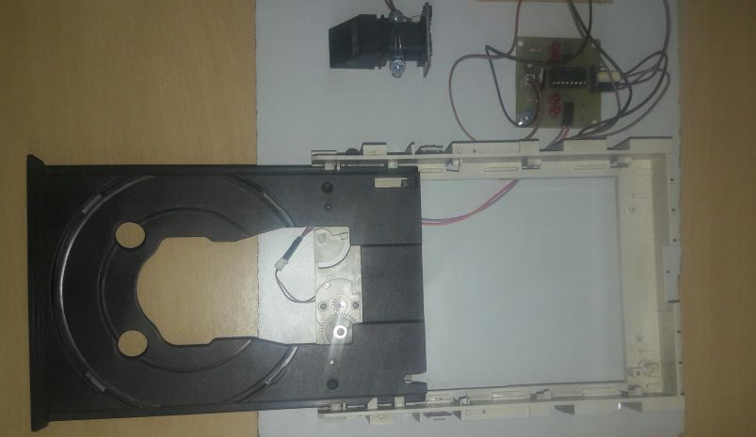
Fingerprint Scanner
Door Unlocked

Slide 2
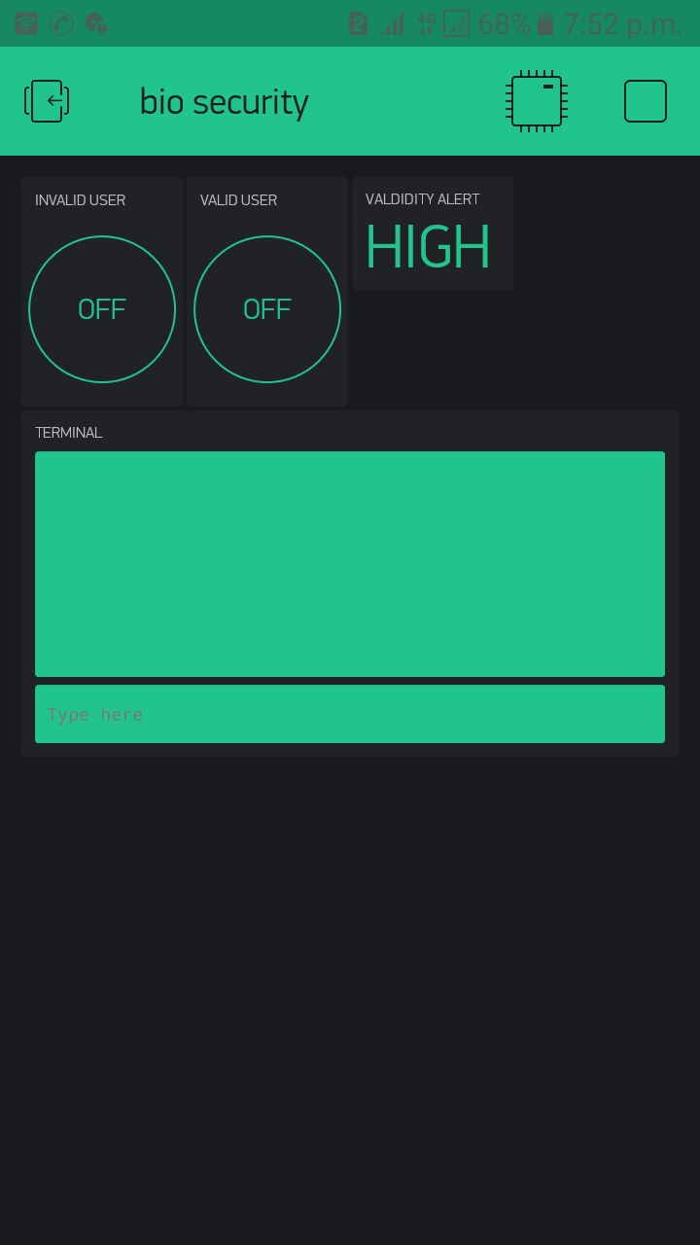
Validity Alert
After pressing it door will be unlocked
After pressing it door will be remain locked

