Slide 1

Solidity
CS1951 L
Spring 2019
19 February 2019
Maurice Herlihy
Brown University

Slide 2

Solidity Tutorial
Solidity is usual high-level language for the EVM
Based on Javascript
Here, example-based tutorial
Use on-line docs and compiler to learn

Slide 3
Coin Example
pragma solidity ^0.5.2;
contract Coin {
address minter;
mapping (address => uint) balances;
…
}

Slide 4
Coin Example
pragma solidity ^0.5.2;
contract Coin {
address minter;
mapping (address => uint) balances;
…
}
This program needs compiler version 0.5.2 or later

Slide 5
Coin Example
pragma solidity ^0.5.2;
contract Coin {
address minter;
mapping (address => uint) balances;
…
}
A contract is like a class.
This contract manages a simple coin

Slide 6
Coin Example
pragma solidity ^0.5.2;
contract Coin {
address minter;
mapping (address => uint) balances;
…
}
A contract encompasses long-lived state
that lives in the EVM’s storage

Slide 7
Coin Example
pragma solidity ^0.5.2;
contract Coin {
address minter;
mapping (address => uint) balances;
…
}
Name of an account (person or contract).

Slide 8
Coin Example
pragma solidity ^0.5.2;
contract Coin {
address minter;
mapping (address => uint) balances;
…
}
Name of an account (person or contract).
Here, only one allowed to mint new coins.

Slide 9
Coin Example
pragma solidity ^0.5.2;
contract Coin {
address minter;
mapping (address => uint) balances;
…
}
Like a hash table

Slide 10
Coin Example
pragma solidity ^0.5.2;
contract Coin {
address minter;
mapping (address => uint) balances;
…
}
Like a hash table
Initially, every address maps to zero

Slide 11
Coin Example
pragma solidity ^0.5.2;
contract Coin {
address minter;
mapping (address => uint) balances;
…
}
Like a hash table
Initially, every address maps to zero
Tracks client balances

Slide 12
Coin Example
pragma solidity ^0.5.2;
contract Coin {
address minter;
mapping (address => uint) balances;
constructor() public {
minter = msg.sender;
}
}
Initializes a contract

Slide 13
Coin Example
pragma solidity ^0.5.2;
contract Coin {
address minter;
mapping (address => uint) balances;
constructor() public {
minter = msg.sender;
}
}
address of contract making the call

Slide 14
Coin Example
pragma solidity ^0.5.2;
contract Coin {
address minter;
mapping (address => uint) balances;
constructor() public {
minter = msg.sender;
}
}
Remember the creator’s address.

Slide 15
Coin Example
pragma solidity ^0.5.2;
contract Coin {
address minter;
mapping (address => uint) balances;
…
function mint(address owner, uint amount)
public {
if (msg.sender != minter) return;
balances[owner] += amount;
}
…
}
A function is like a method.

Slide 16
Coin Example
pragma solidity ^0.5.2;
contract Coin {
address minter;
mapping (address => uint) balances;
…
function mint(address owner, uint amount)
public {
if (msg.sender != minter) return;
balances[owner] += amount;
}
…
}
If the caller is not authorized, just return.

Slide 17
Coin Example
pragma solidity ^0.5.2;
contract Coin {
address minter;
mapping (address => uint) balances;
…
function mint(address owner, uint amount)
public {
if (msg.sender != minter) return;
balances[owner] += amount;
}
…
}
Otherwise credit the amount to the owner’s balance

Slide 18
Coin Example
pragma solidity ^0.5.2;
contract Coin {
address minter;
mapping (address => uint) balances;
…
function send(address receiver, uint amount)
public {
if (balances[msg.sender] < amount) return;
balances[msg.sender] -= amount;
balances[receiver] += amount;
}
…
}
One party transfers coins to counterparty

Slide 19
Coin Example
pragma solidity ^0.5.2;
contract Coin {
address minter;
mapping (address => uint) balances;
…
function send(address receiver, uint amount)
public {
if (balances[msg.sender] < amount) return;
balances[msg.sender] -= amount;
balances[receiver] += amount;
}
…
}
Quit if insufficient funds

Slide 20
Coin Example
pragma solidity ^0.5.2;
contract Coin {
address minter;
mapping (address => uint) balances;
…
function send(address receiver, uint amount)
public {
if (balances[msg.sender] < amount) return;
balances[msg.sender] -= amount;
balances[receiver] += amount;
}
…
}
transfer amount from one account to the other

Slide 21
The Flippening
Alice and Bob want to flip a fair coin
Each one is willing to cheat
Obvious sources of randomness:
time, block hashes, etc. don’t work
Let’s try sometihng else

Slide 22
Coin Flip Contract
pragma solidity ^0.5.1;
contract CoinFlipMaybe {
address[2] player;
mapping (address => uint) vote;
mapping (address => bool) played;
bool result;
bool done;
…

Slide 23
Coin Flip Example
pragma solidity ^0.5.1;
contract CoinFlipMaybe {
address[2] player;
mapping (address => uint) vote;
mapping (address => bool) played;
bool result;
bool done;
…
declare contract and compiler version

Slide 24
Coin Flip Example
pragma solidity ^0.5.1;
contract CoinFlipMaybe {
address[2] player;
mapping (address => uint) vote;
mapping (address => bool) played;
bool result;
bool done;
…
will want to restrict interactions to the two players

Slide 25
Coin Flip Example
pragma solidity ^0.5.1;
contract CoinFlipMaybe {
address[2] player;
mapping (address => uint) vote;
mapping (address => bool) played;
bool result;
bool done;
…
each player contributes to the result

Slide 26
Coin Flip Example
pragma solidity ^0.5.1;
contract CoinFlipMaybe {
address[2] player;
mapping (address => uint) vote;
mapping (address => bool) played;
bool result;
bool done;
…
each player gets one move only

Slide 27
Coin Flip Example
pragma solidity ^0.5.1;
contract CoinFlipMaybe {
address[2] player;
mapping (address => uint) vote;
mapping (address => bool) played;
bool result;
bool done;
…
remember outcome

Slide 28
Coin Flip Example
pragma solidity ^0.5.1;
contract CoinFlipMaybe {
…
constructor (address alice, address bob)
public {
player[0] = alice;
player[1] = bob;
}
…

Slide 29
Coin Flip Example
pragma solidity ^0.5.1;
contract CoinFlipMaybe {
…
constructor (address alice, address bob)
public {
player[0] = alice;
player[1] = bob;
}
…
constructor just remembers players

Slide 30
Coin Flip Example
function play(uint _vote) public {
require(msg.sender == player[0] ||
msg.sender == player[1]);
require(!played[msg.sender]);
vote[msg.sender] = _vote;
played[msg.sender] = true;
if (played[player[0]] && played[player[1]]) {
done = true;
result = ((vote[player[0]] ^
vote[player[1]]) % 2) == 1;
}
}

Slide 31
Coin Flip Example
function play(uint _vote) public {
require(msg.sender == player[0] ||
msg.sender == player[1]);
require(!played[msg.sender]);
vote[msg.sender] = _vote;
played[msg.sender] = true;
if (played[player[0]] && played[player[1]]) {
done = true;
result = ((vote[player[0]] ^
vote[player[1]]) % 2) == 1;
}
}
require(condition)
means abort computation if condition not satisfied.
Like throwing an exception

Slide 32
Coin Flip Example
function play(uint _vote) public {
require(msg.sender == player[0] ||
msg.sender == player[1]);
require(!played[msg.sender]);
vote[msg.sender] = _vote;
played[msg.sender] = true;
if (played[player[0]] && played[player[1]]) {
done = true;
result = ((vote[player[0]] ^
vote[player[1]]) % 2) == 1;
}
}
Only Alice and Bob allowed to play

Slide 33
Coin Flip Example
function play(uint _vote) public {
require(msg.sender == player[0] ||
msg.sender == player[1]);
require(!played[msg.sender]);
vote[msg.sender] = _vote;
played[msg.sender] = true;
if (played[player[0]] && played[player[1]]) {
done = true;
result = ((vote[player[0]] ^
vote[player[1]]) % 2) == 1;
}
}
Each player can play only once

Slide 34
Coin Flip Example
function play(uint _vote) public {
require(msg.sender == player[0] ||
msg.sender == player[1]);
require(!played[msg.sender]);
vote[msg.sender] = _vote;
played[msg.sender] = true;
if (played[player[0]] && played[player[1]]) {
done = true;
result = ((vote[player[0]] ^
vote[player[1]]) % 2) == 1;
}
}
record player’s vote

Slide 35
Coin Flip Example
function play(uint _vote) public {
require(msg.sender == player[0] ||
msg.sender == player[1]);
require(!played[msg.sender]);
vote[msg.sender] = _vote;
played[msg.sender] = true;
if (played[player[0]] && played[player[1]]) {
done = true;
result = ((vote[player[0]] ^
vote[player[1]]) % 2) == 1;
}
}
record that player voted

Slide 36
Coin Flip Example
function play(uint _vote) public {
require(msg.sender == player[0] ||
msg.sender == player[1]);
require(!played[msg.sender]);
vote[msg.sender] = _vote;
played[msg.sender] = true;
if (played[player[0]] && played[player[1]]) {
done = true;
result = ((vote[player[0]] ^
vote[player[1]]) % 2) == 1;
}
}
we are done if both players voted

Slide 37
Coin Flip Example
function play(uint _vote) public {
require(msg.sender == player[0] ||
msg.sender == player[1]);
require(!played[msg.sender]);
vote[msg.sender] = _vote;
played[msg.sender] = true;
if (played[player[0]] && played[player[1]]) {
done = true;
result = ((vote[player[0]] ^
vote[player[1]]) % 2) == 1;
}
}
remember we are done

Slide 38
Coin Flip Example
function play(uint _vote) public {
require(msg.sender == player[0] ||
msg.sender == player[1]);
require(!played[msg.sender]);
vote[msg.sender] = _vote;
played[msg.sender] = true;
if (played[player[0]] && played[player[1]]) {
done = true;
result = ((vote[player[0]] ^
vote[player[1]]) % 2) == 1;
}
}
take XOR of votes

Slide 39
Coin Flip Example
function play(uint _vote) public {
require(msg.sender == player[0] ||
msg.sender == player[1]);
require(!played[msg.sender]);
vote[msg.sender] = _vote;
played[msg.sender] = true;
if (played[player[0]] && played[player[1]]) {
done = true;
result = ((vote[player[0]] ^
vote[player[1]]) % 2) == 1;
}
}
flip value is parity of XOR of votes

Slide 40
Coin Flip Example
function getResult() public view returns (bool) {
require (done);
return result;
}

Slide 41
Coin Flip Example
function getResult() public view returns (bool) {
require (done);
return result;
}
anyone can request outcome

Slide 42
Coin Flip Example
function getResult() public view returns (bool) {
require (done);
return result;
}
make sure outcome is ready

Slide 43
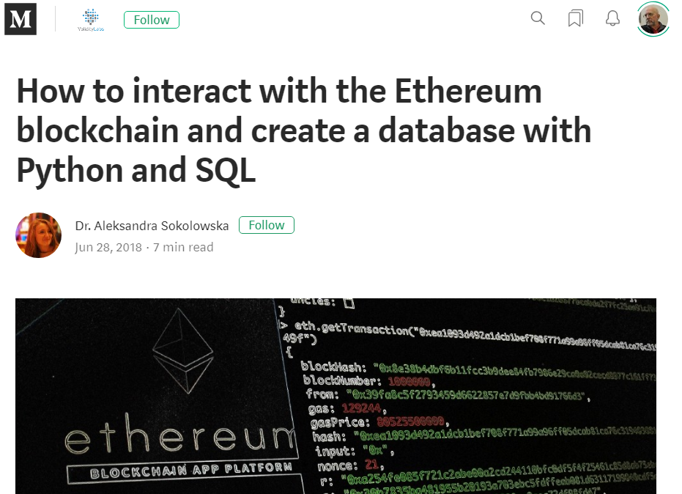
This Contract is Insecure
Suppose Alice plays first
Bob then observes contract state on Etherscan.io
Picks his vote after seeing hers
Bob controls coin flip outcome

Slide 44
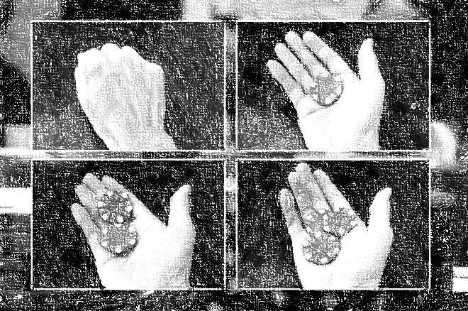
Commit-Reveal Pattern
Step One: commit to a value without revealing it
you cannot change your value
Step Two: Wait for others to commit
Step Three: reveal your value
you can check validity

Slide 45
Commit-Reveal Pattern
Alice generates a random value r
Alice commits to r by sending hash(r) to contract
Alice waits for Bob to commit
All done
off-chain!
Alice reveals r to contract
Compute outcome when Bob reveals

Slide 46
Commit-Reveal Flip
contract CoinFlipCR {
address[2] player;
mapping (address => uint) commitment;
mapping (address => uint) revelation;
mapping (address => bool) committed;
mapping (address => bool) revealed;
bool result;
bool done;

Slide 47
Commit-Reveal Flip
contract CoinFlipCR {
address[2] player;
mapping (address => uint) commitment;
mapping (address => uint) revelation;
mapping (address => bool) committed;
mapping (address => bool) revealed;
bool result;
bool done;
track both commit and reveal

Slide 48
Commit-Reveal Flip
function commit(uint _commit) public {
require(msg.sender == player[0] ||
msg.sender == player[1]);
require(!committed[msg.sender]);
commitment[msg.sender] = _commit;
committed[msg.sender] = true;
}

Slide 49
Commit-Reveal Flip
function commit(uint _commit) public {
require(msg.sender == player[0] ||
msg.sender == player[1]);
require(!committed[msg.sender]);
commitment[msg.sender] = _commit;
committed[msg.sender] = true;
}
members only

Slide 50
Commit-Reveal Flip
function commit(uint _commit) public {
require(msg.sender == player[0] ||
msg.sender == player[1]);
require(!committed[msg.sender]);
commitment[msg.sender] = _commit;
committed[msg.sender] = true;
}
You only commit once

Slide 51
Commit-Reveal Flip
function commit(uint _commit) public {
require(msg.sender == player[0] ||
msg.sender == player[1]);
require(!committed[msg.sender]);
commitment[msg.sender] = _commit;
committed[msg.sender] = true;
}
close the deal

Slide 52
Coin Flip Example
function reveal(uint _reveal) public {
require(msg.sender == player[0] ||
msg.sender == player[1]);
require(!revealed[msg.sender]);
require(
commitment[msg.sender]==hash(_reveal));
revelation[msg.sender] = _reveal;
revealed[msg.sender] = true;
if (revealed[player[0]] &&
revealed[player[1]]) {
done = true;
result = ((revelation[player[0]] ^
revelation[player[1]])
% 2) == 1;
}
}

Slide 53
Coin Flip Example
function reveal(uint _reveal) public {
require(msg.sender == player[0] ||
msg.sender == player[1]);
require(!revealed[msg.sender]);
require(
commitment[msg.sender]==hash(_reveal));
revelation[msg.sender] = _reveal;
revealed[msg.sender] = true;
if (revealed[player[0]] &&
revealed[player[1]]) {
done = true;
result = ((revelation[player[0]] ^
revelation[player[1]])
% 2) == 1;
}
}
Usual preconditions
(do we actually care?)

Slide 54
Coin Flip Example
function reveal(uint _reveal) public {
require(msg.sender == player[0] ||
msg.sender == player[1]);
require(!revealed[msg.sender]);
require(
commitment[msg.sender]==hash(_reveal));
revelation[msg.sender] = _reveal;
revealed[msg.sender] = true;
if (revealed[player[0]] &&
revealed[player[1]]) {
done = true;
result = ((revelation[player[0]] ^
revelation[player[1]])
% 2) == 1;
}
}
make sure reveal is sincere

Slide 55
Coin Flip Example
function reveal(uint _reveal) public {
require(msg.sender == player[0] ||
msg.sender == player[1]);
require(!revealed[msg.sender]);
require(
commitment[msg.sender]==hash(_reveal));
revelation[msg.sender] = _reveal;
revealed[msg.sender] = true;
if (revealed[player[0]] &&
revealed[player[1]]) {
done = true;
result = ((revelation[player[0]] ^
revelation[player[1]])
% 2) == 1;
}
}
record revelation

Slide 56
Coin Flip Example
function reveal(uint _reveal) public {
require(msg.sender == player[0] ||
msg.sender == player[1]);
require(!revealed[msg.sender]);
require(
commitment[msg.sender]==hash(_reveal));
revelation[msg.sender] = _reveal;
revealed[msg.sender] = true;
if (revealed[player[0]] &&
revealed[player[1]]) {
done = true;
result = ((revelation[player[0]] ^
revelation[player[1]])
% 2) == 1;
}
}
If done, compute outcome as before

Slide 57
Solidity Details

Slide 58
Scalar Types
int8, … int256 = int
uint8, …, uint256 = uint
bool
address
bytes1, …,bytes32

Slide 59
Enums
enum Actions{ GoLeft, GoRight, GoStraight}
Actions choice;
Actions constant default = Actions.GoStraight.

Slide 60
Static Arrays
uint[8] a; // 8 256-bit uints

Slide 61
Dynamic Arrays
uint[] a = new uint[](8); // 8 256-bit uints

Slide 62
Structs
struct Funder { address addr; uint amount; }
struct Funder { address addr; uint amount; }
struct Funder {
address addr;
uint amount;
}

Slide 63
Mappings
struct Funder { address addr; uint amount; }
struct Funder { address addr; uint amount; }
struct Funder { address addr; uint amount; }
struct Funder { address addr; uint amount; }
mapping (address => uint)
Every key implicitly bound to all-zero value
binding always defined

Slide 64
Call Opcode
Contract A
Contract B
A calls B’s function …
which runs in B’s address space

Slide 65
DelegateCall Opcode
Contract A
Contract B
Contract B’s
code
A delegatecalls B’s function …
which runs in A’s address space

Slide 66
Library
library SafeMath {
…
}
Syntactic sugar
Contract where every function call
is a delegate call

Slide 67
Abstract Contracts
contract Config {
{// defined
function name() public
returns (string) return “Config”;
}
// undefined
function lookup(uint id) public
returns (address);
}
At least one function implementation missing
Compiler type-checking, inheritance

Slide 68
Interfaces
interface Config {
function lookup(uint id) public
returns (address);
}
All function implementations missing
Compiler type-checking, inheritance

Slide 69
Inheritance
contract Feline {
function utterance()
public returns (bytes32);
}
contract Cat is Feline {
function utterance()
public returns (bytes32) {
return "meow";
}
}
Like other languages

Slide 70
Events
An event is a public record that something happened
event Deposit(address from, uint value);
…
emit Deposit(msg.sender, msg.value);
Events can be monitored from outside the blockchain

Slide 71
Function Visibility
External: only from outside
Public: only internal or external
Internal: only current or derived contracts
Private: only current not derived contracts

Slide 72
Fallback Function
Transaction data includes:
Function selector (hashed name)
Function arguments

Slide 73
Fallback Function
contract Example {
uint x = 0;
function foo() public {
x = 1;
}
function () public payable {
x = 2;
}
}

Slide 74
Fallback Function
contract Example {
uint x = 0;
function foo() public {
x = 1;
}
function () public payable {
x = 2;
}
}
named
regular
function

Slide 75
Fallback Function
contract Example {
uint x = 0;
function foo() public {
x = 1;
}
function () public payable {
x = 2;
}
}
named
regular
function
nameless
fallback
function
Often used to receive payments

Slide 76
Fallback Function Idiosyncrasies
Limited to 2300 gas
function () {
balances[msg.sender] += msg.value;
}
This will not work

Slide 77
Fallback Function Idiosyncrasies
function () {
revert();
}
function deposit() external {
balances[msg.sender] += msg.value;
}
This works

Slide 78
Function Call
Contract A
Contract B
not me!
call “bar”
fn foo()
me!
fn bar()
fn ()
A calls B’s “foo” function …

Slide 79
Fallback Function
Contract A
Contract B
not me!
call “xyzzy”
fn foo()
not me!
fn bar()
fn ()
me, by default
A calls B’s “xyzzy” function …

Slide 80
Sending Ether to a Payable Fallback Function
address.send(amount);
Limited to 2300 gas
Protects against re-entrancy attack
requires near-trivial fallback function
If transfer fails, returns Boolean
Programming pitfall

Slide 81
Sending Ether to a Payable Fallback Function
address.transfer(amount);
Limited to 2300 gas
Protects against re-entrancy attack
requires near-trivial fallback function
If transfer fails, reverts transaction
Safer programming practice

Slide 82
Sending Ether to a Payable Fallback Function
address.call.value(amount).gas(extra);
Can specify how much gas
No re-entrancy protection
non-trivial fallback functions OK
If transfer fails, reverts transaction
Safer programming practice

Slide 83
Sending Ether to a Payable Named Function
address.fun.value(amount)(args);
Uses as much gas as needed
No re-entrancy protection
If transfer fails, reverts transaction
Safer programming practice

Slide 84
Sending Ether to a Payable Named Function
address.fun.value(amount).gas(limit)(args);
Limits gas as shown
No re-entrancy protection
If transfer fails, reverts transaction
Safer programming practice

Slide 85
Moral
Payment breaks abstaction
You don’t know how to call a fallback function …
unless you know what it does
See later lectures on pitfalls!

Slide 86
require() and assert()
Roll back if condition fails
require(msg.sender == owner)
require() might fail if input is bad
assert(msg.sender == owner)
assert() should never fail

Slide 87
Function Modifiers
modifier ownerOnly() {
require (msg.sender == owner);
_;
}
If test passes …
Execute function body

Slide 88
Function Modifiers
If test passes …
function pay(address _payto, uint amount)
public
ownerOnly() {
balance[_payTo] += amount;
}
Execute function body

Slide 89
Self Destruction
selfDestruct(sendMoneyTo)
terminates contract
sends remaining balance to argument
beneficiary cannot refuse

Slide 90
Data Location
storage or memory
memory is default for arg & result passing
storage is default for local vars
assignment across regions is copying

Slide 91
Ethereum Storage
2²⁵⁶-1
A very, very big array
Initially all 0s
0
32 bytes

Slide 92
Variables
contract aContract {
uint256 a;
…
}
a
0

Slide 93
Static Arrays
uint256[2] b;
a
b
b
0
1
2

Slide 94
Structs
struct aStruct{
uint256 id;
uint256 value;
}
aStruct c;
a
b
b
c
c
0
1
2
3
4

Slide 95
Dynamic Arrays
struct aStruct{
uint256 id;
uint256 value;
}
aStruct d[];
d.length
d[0]
d[0]
d[1]
d[1]
5
Hash(5)

Slide 96
Mappings
mapping(uint256 => uint 256) e;
empty
e[123]
e[345]
6
Hash(123,6)
Hash(345,6)

Slide 97
Simple Variable
declaration
T v;
value
location
v
v’s slot

Slide 98
Fixed-Size Arrays
declaration
T[10] v;
value
location
V[1]
(v’s slot)+i*(sizeof T)

Slide 99
Dynamic Arrays
declaration
T[10] v;
value
location
v[i]
hash(v’s slot)+i*(sizeof T)
v.length
v’s slot

Slide 100
Mappings
declaration
mapping(T1 => T2) v;
value
location
v[i]
hash(i.(v’s slot))
https://programtheblockchain.com/posts/2018/03/09/understanding-ethereum-smart-contract-storage/

Slide 101

Ideas we covered in this lecture
Coin example
Data types
Modifiers
require() and assert()
Various Features
Datatype layouts in EVM memory

Slide 102
Ideas we covered in this lecture
Public vs Private keys
Encryption and signatures
Public vs Private blockchains
Consensus

Slide 103
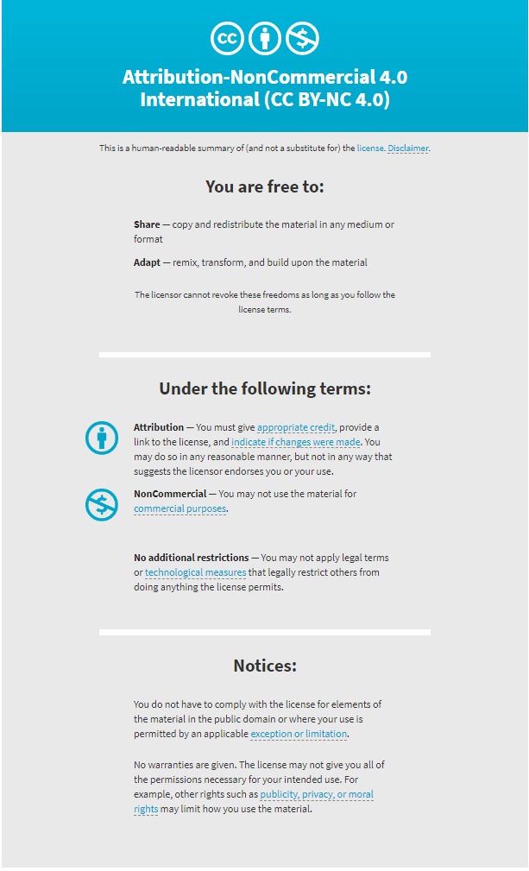

Slide 104
Variables
pragma solidity ^0.5.2;
contract Coin {
address minter;
mapping (address => uint) balances;
constructor() public {
minter = msg.sender;
}
function mint(address owner, uint amount) public {
if (msg.sender != minter) return;
balances[owner] += amount;
}
function send(address receiver, uint amount)
public {
if (balances[msg.sender] < amount) return;
balances[msg.sender] -= amount;
balances[receiver] += amount;
}
function queryBalance(address addr)
public view returns (uint balance) {
return balances[addr];
}
}

