Slide 1
Project on
EDA – Analysis of AMCAT Data
Employment about the expectations & realities among engineer employees:
the AMEO employment outcome report case study.
Presented by: Satve Pukhraj Magan.

Slide 2
Agenda
Business Problem.
Goals and objectives of the Project.
Description of the data.
Data Preparations.
Univariate analyses.
Bivariate analysis.

Slide 3
Business Problem.
Problem Statement.
“India increases the population of engineering students by 1.5 million every academic year. What are their chances of getting jobs and paid after graduating from university?”
Evaluate the extent of barriers to employment and wage differentials of holders of engineering degrees, and how these variations affected wages and job content supported by data sourced from Connections: Case studies in the Occupational Outlook Handbook published by The Times of India.

Slide 4
Objective of the Project.
Assume that it is your main purpose to be mathematically sound when performing EDA for AMEO data.
Seek to validate the magazine The Times of India regarding its claims on salaries and occupations for those who graduated as engineers.
Explore as well those who get to work and how much they earn.

Slide 5
Critical Aspects of the Collection of
Share Information on Data Slide
Dataset: Aspiring Mind Employment Outcome 2015 (AMEO)
Target population: Engineer Graduates
For the outcome: Salary, Status, Location
For the explanatory: cognitive skill, technical skill, personality skill, age

Slide 6
Data Cleaning
Superfluous columns were deleted.
Attributes were converted into more useful attributes.
Incorrect data types were substituted with correct data types.
Obvious errors in typing were rectified (the use of city names in the Job city attribute).
Looks variations for Board types and specializations were standardized.

Slide 7
1.Univariate Analysis
Salary: Overall, the largest proportion of this group earns less than ₹1,000,000.
10th Standard: The majority of the scores scored by the individuals fall within the range of 75%-85%.
12th Standard: The majority of the scores scored between 70%-75%.
AMCAT Scores: Most individuals scored English, Logical, and Quant parts in the range of 500-600.
Engineering Subjects: All mean-scored subjects of Computer Science, Mechanical and Electrical Engineering have low mean scores as it is most underrated.
Personality Scores: Most of the people's average personality scores lie between -1 and 1.

Slide 8
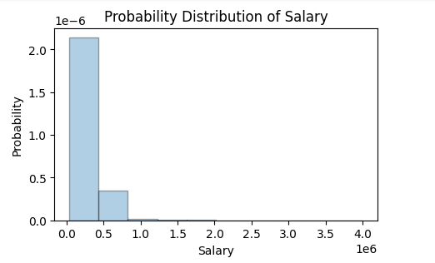
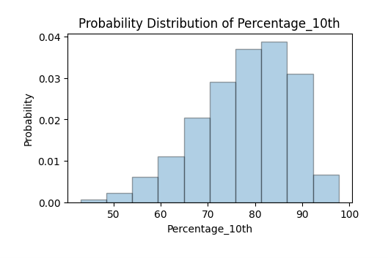
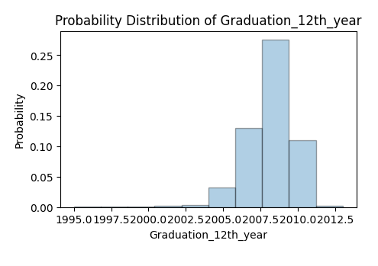
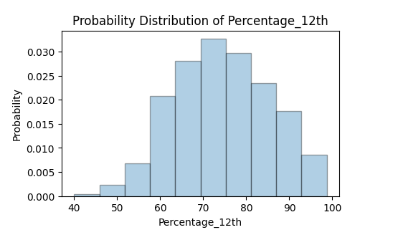
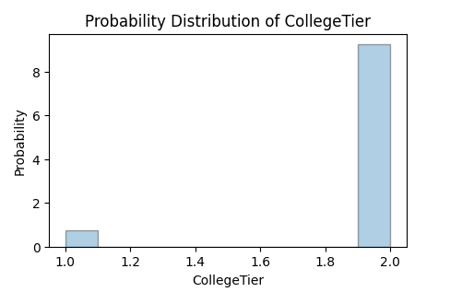
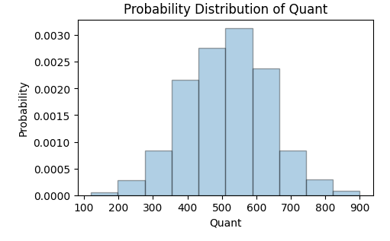

Slide 9
2.Univariate Analysis.
Gender: There are more males than females in the data set.
10th and 12th boards: Mostly from the state board or CBSE.
Degree: Mostly B.Tech/B.E.
Specialization: Most of the engineers are from CS, IT, and Electronics Communication.
Geographic: Most appeared for the MCAT from Uttar Pradesh.

Slide 10
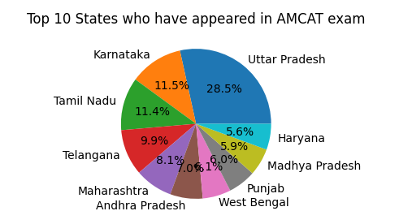

Slide 11
Bivariate analysis
College GPA vs Salary: Most have a GPA between 60 and 90 and earn between ₹2 lakh and ₹10 lakh per annum.
Degree Type: M.Tech graduates earn higher salaries as compared to B.Tech.
Gender and Knowledge: No significant differences were found.
Wages by gender: slightly higher wages for men compared to women.
Those who do not give details of the 12th Board or earn more than ICSE.

Slide 12
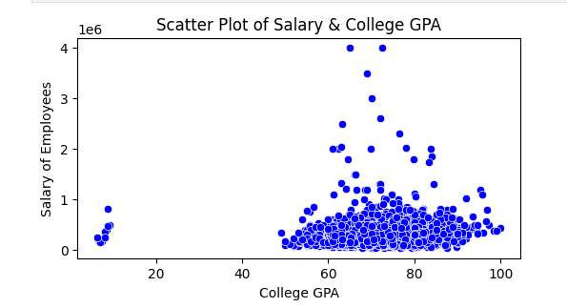
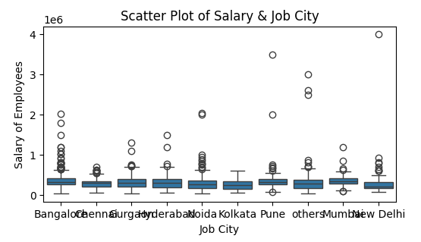

Slide 13


