Slide 1
"Hello, I’m Satve Pukhraj. In this project, I have applied my knowledge of SQL queries to analyze and solve a problem related to pizza sales."
Pizza Sales Analysis using SQL Queries

Slide 2
QUESTIONS
Retrieve the total number of orders placed.
Calculate the total revenue generated from pizza sales.
Identify the highest-priced pizza.
Identify the most common pizza size ordered.
List the top 5 most ordered pizza types along with their quantities.
Join the necessary tables to find the total quantity of each pizza category ordered.
Determine the distribution of orders by hour of the day.
Join relevant tables to find the category-wise distribution of pizzas.
Group the orders by date and calculate the average number of pizzas ordered per day.
Determine the top 3 most ordered pizza types based on revenue.
Calculate the percentage contribution of each pizza type to total revenue.
Analyze the cumulative revenue generated over time.
Determine the top 3 most ordered pizza types based on revenue for each pizza category.

Slide 3
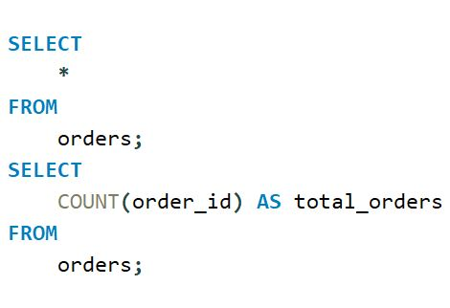

01 Retrieve the total number of orders placed.

Slide 4
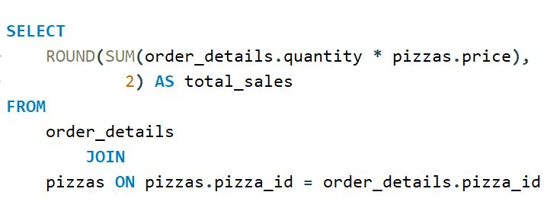

02 Calculate the total revenue generated from
pizza sales.

Slide 5
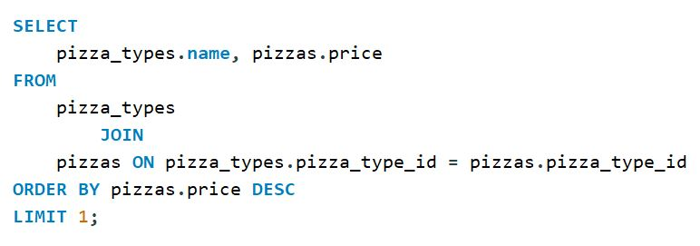

03 Identify the highest-priced pizza.

Slide 6
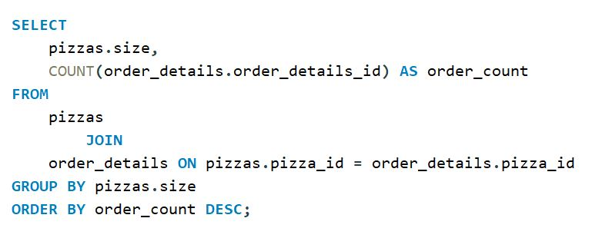
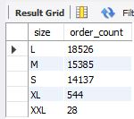
04 Identify the most common pizza size ordered.

Slide 7
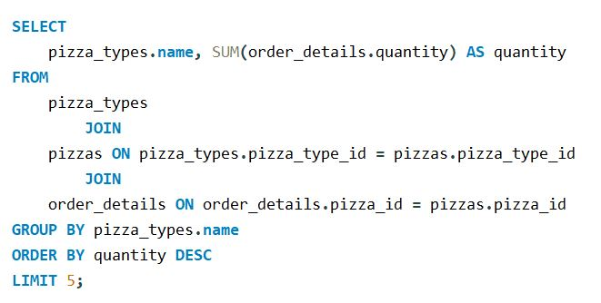
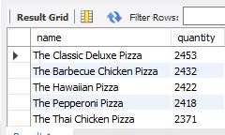
05 List the top 5 most ordered pizza types along
with their quantities.

Slide 8
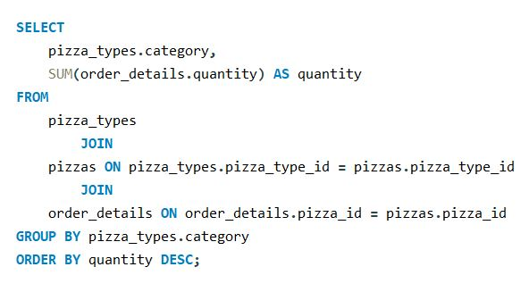
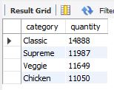
06 Join the necessary tables to find the total
quantity of each pizza category ordered.

Slide 9
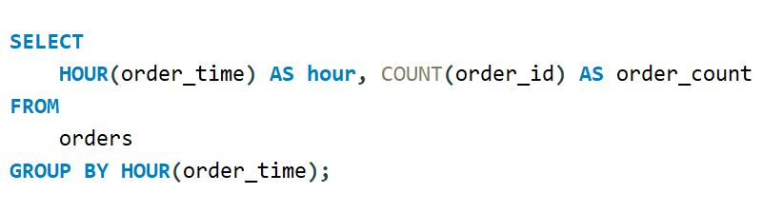
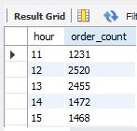
07 Determine the distribution of orders by hour
of the day.

Slide 10
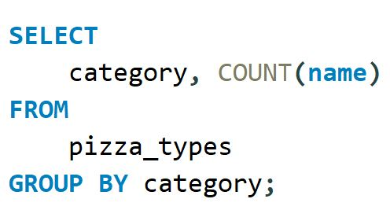
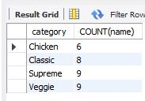
08 Join relevant tables to find the category-wise
distribution of pizzas.

Slide 11
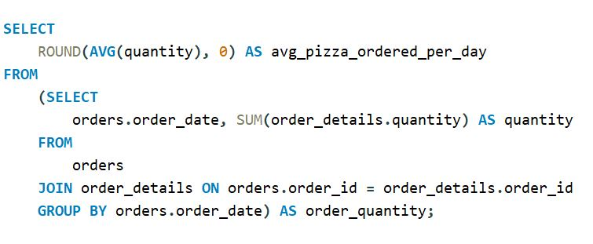

09 Group the orders by date and calculate the
average number of pizzas ordered per day.

Slide 12
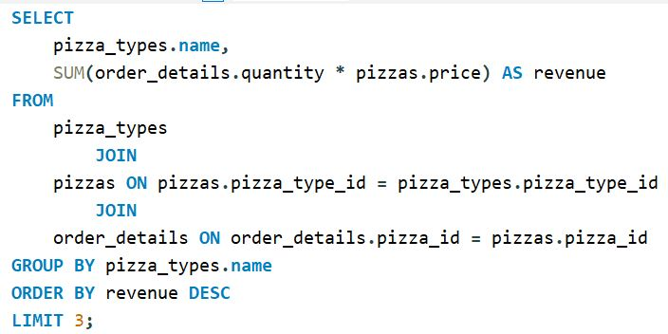
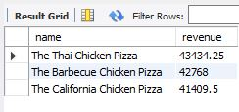
10 Determine the top 3 most ordered pizza types
based on revenue.

Slide 13
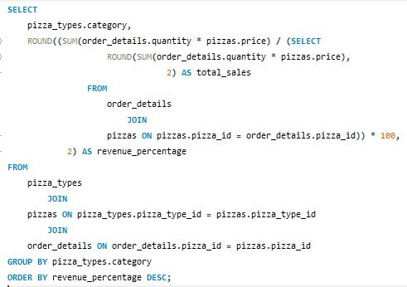
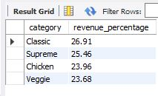
11 Calculate the percentage contribution of each
pizza type to total revenue.

Slide 14
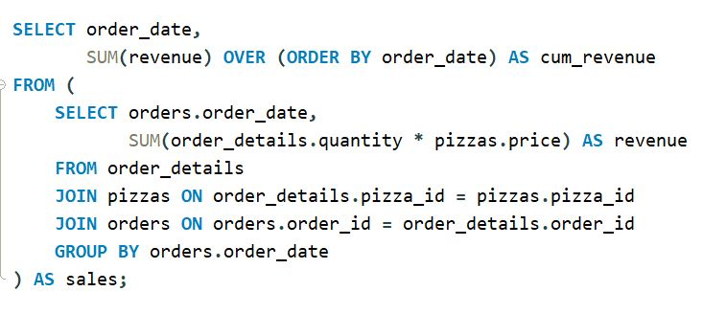
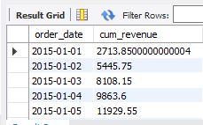
12 Analyze the cumulative revenue generated
over time.

Slide 15
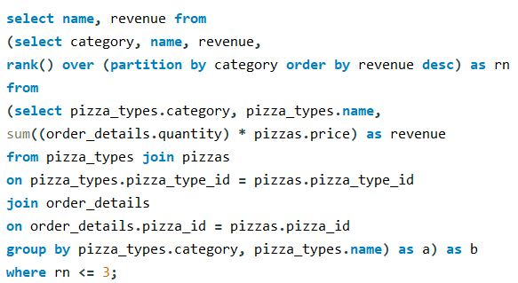
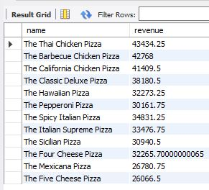
13 Determine the top 3 most ordered pizza types
based on revenue for each pizza category.

Slide 16
THANK YOU

