Slide 1
MDFE MetLife Data Flow Engine Engine that moves data within MetLife Data Hub

Slide 2


MDFE Overview
2.8
SORs
MetLife Data Hub
APIs
RDZ
(Raw Data Zone)
MDH’s Landing Zone
EOS
(Enterprise Online Store)
MDH’s Speed Layer
MDFE
MetLife Data Flow Engine is a configuration and metadata driven framework that moves data within the MetLife Data Hub environment. Current version of MDFE is built using custom spark code.

Slide 3
What does MDFE solve for?
MDFE Solves for
Data move from RDZ (file, messages) to EOS
Validation rules
Transformation to conform to target model
Attribute level transformation
Relation between objects / entities
Aggregate multiple components into an entity
Relationship management
Direct relationships (foreign keys)
Inferred – rule based (post processing logic)
Orphaned relationships (dirty records)
Data flow tracking
Meta data about source at record / vertex level
Process Management
Run logs, metrics, rows / vertexes tied to the process
Key Constraints
SORs can communicate data async
Changes can come in out of sequence
Latency can change in future
SOR object hierarchy and EOS object hierarchy can be different

Slide 4
MDFE Coding vs. Config Common operations through config
Configuration driven
Attribute level Validations
Attribute mapping
Attribute Transformations
Key generation
Relationships
Composite objects
Externalization to feed into data lineage analysis
Code Driven
Complex aggregations
Pluggable rules / post processing
SOR file level nuances
UIS delta file vs. one time differences
Generating inferred plan versions for UDS
Vs.
Note: Graph schema is configured in MDFE, but Titan indexes are created and managed outside MDFE

Slide 5
Key MDFE concepts are borrowed from NiFi World …
NiFi
MDFE
Flow
Data Provenance
Process Mgmt.
Job
Meta data management
Process Mgmts.
Processor Group
Vs.
Controller
Processor
Processor
MDFE was originally created for NiFi … and then refactored and optimized for Spark
(even the naming conventions of the processors follow NiFi conventions)

Slide 6
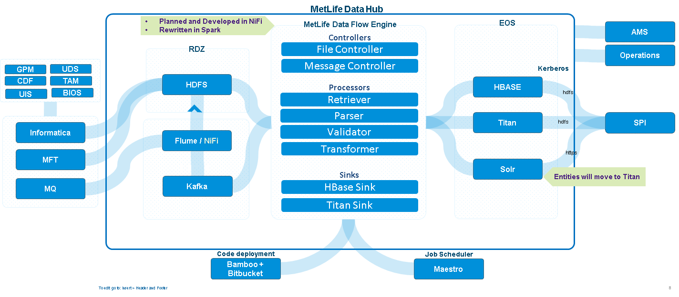
MDH Data Flow – A high level view

Slide 7
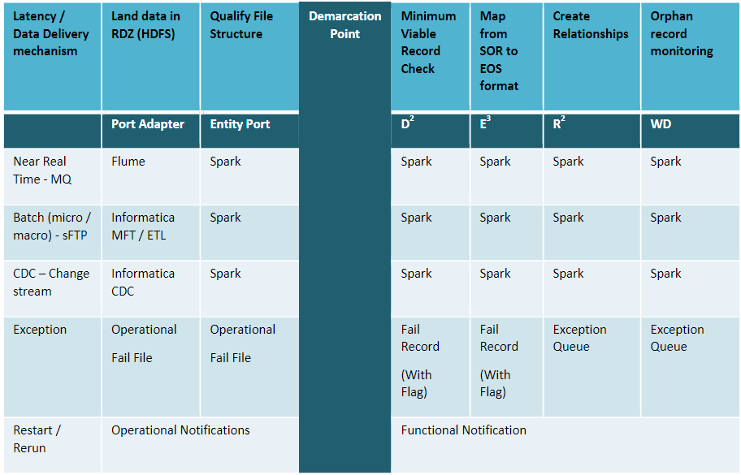
Why MDFE?
To make data coming from disparate SOR systems in various formats and latencies available on MDH’s speed layer, along with Metadata, Metaprocess and relationships attached to it.
Latencies - Near real time: <5 min, Micro batch: 5-60 min, Macro batch: >60 min and < 24hrs

Slide 8
What does it do ?
EOS
HBase
Data Flow Engine
Distributed File System
File Listener
Validation
Data Quality
Transformation
Entity Relationship
TitanDB
Copybook
UI Configuration Toolkit
Bridge Doc
MDFE Ingesting data into EOS, a simplified view

Slide 9
MDFE Code Structure

Slide 10
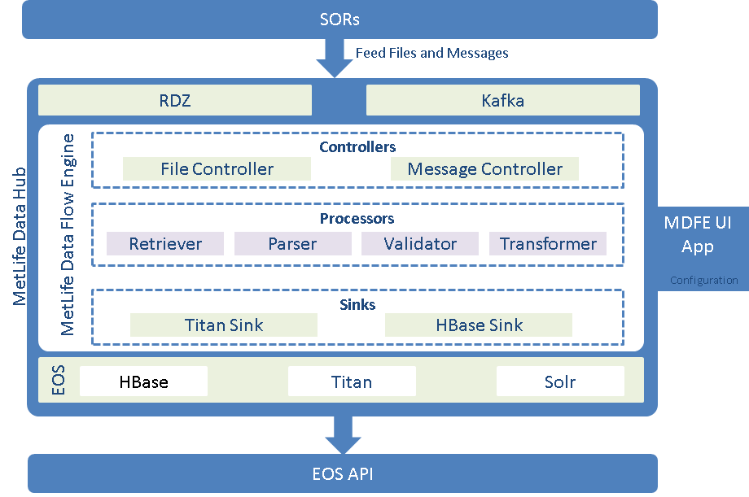
MDFE Component Structure

Slide 11
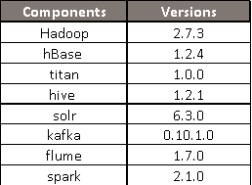
Tech Stack
MDFE is a spark based engine, which runs on IBM Big Insights Platform.

Slide 12
MDFEController.scala
START
If argument = null
Check trigger folder, Get the RDZ path from the Configuration Table
If trigger folder present
Initialize the Spark Context
Convert feed file to Dataset
TRUE
TRUE
STOP
MDFEPutTitanBulk.scala
MDFEPutJsonHbase.scala
DStreamController.scala
Check/Parse & Iterate the Job Configuration Json
Create Graphson for the Harmonized JSON
Put the checksum in HBase Recon Table
Orchestrate processor Instantiation & Initialization
Put the data in the Watchdog Table
Create Vertex and Edges in Titan
Put the data in HBase Entity Table
GetData.scala
THINGS TO DO BEFORE STARTING THE DATA PIPE:
Configuration table ‘fileregister’ should be populated with all the configurations assigned to a particular application ID we are running.
Trigger file should be present in the trigger folder of the RDZ path.
Trigger file should be of the same name with the data feed file.
Call the GetData processor to pass the Dataset to the next processor
MDFEProcessor.scala
Fingerprinting the harmonized JSON
Call the MDFEProcessor with Dataset
Transform raw JSON to harmonized JSON
Check the file type
JSON
COPYBOOK
Do custom transformation on raw JSON
FIXED FILE
Parse the JSON with a JSON Parser
Parse the File with Fixed Length File Parser
Parse the File with Copy Book Parser
Validate the Data according to the Regex present in Validation Configuration
Create checksum & add Meta Data to the Data

Slide 13
MDFEController.scala
DStremController.scala
GetData.scala
MDFEProcessor.scala
Parser.
Dataset
Dataset
Dataset
Dataset
String
Map
DQValidator.java
Map & Config
Map
TransformUtil.java
CustomTransformerUtil.java
Transformers
Map & Config
Map & Config
Map & Config
Map
Map
KeyGenerator.java
Map
Map
Map
Dataset
MDFEPutJsonHbase.scala
MDFEPutJsonHbaseHelper.scala
Dataset
Map
Map
Dataset
MDFEPutTitanBulk.scala
MDFETitanProcessor.scala
TitanSinkProcessor.scala
Dataset
String
String
String
String
Dataset

Slide 14


How do we build and Deploy
Plan
Code
Build
Test
Release
Deploy
Run
JIRA
BitBucket
Bamboo
Bamboo
UDeploy
UDeploy
Maestro
1
Build & Package : Bamboo
Build Jar
Create tar file containing Jar and script files
Create a release version
URL:
DevOps Flow
1
Push Code
2
2
Deploy
Dev
Repository : Bitbucket
Development Branch: depends on the relase
Baselined Version : ***
URL:
BitBucket
Developer
Builds
INT
3
Tools / Technologies
Scala
Java
Spark
Eclipse
Titan
HBase
Solr
Deploy
Deploy : Udeploy [Not in Prod]
Create a Snapshot of the baselined version - Eg: 10856-MDFE-Rel2018.1.0-<relDate>
Open tickets and get necessary approvals to run Prod deployment procedure
Bamboo
4
Release
Deploy
QA
Run: Maestro
Deploy
UDeploy
Prod
JIRA tracker URL :
MetLife Data Flow Engine is a custom built engine that moves data within the MetLife Data Hub environment.

Slide 15
Review Process
Typical reviews include
High level and detailed design document reviews and manual and automated code reviews and security reviews (veracode scans)
Architecture reviews to confirm that the development confirms to the architecture
Current status
MetLife and Cognizant Architecture and Development teams have completed few rounds of review
Knowledgent has completed design and code reviews
Design Document Reviews
Sharepoint links ->
Code Reviews
Bitbucket location ->

Slide 16
Appendix

Slide 17
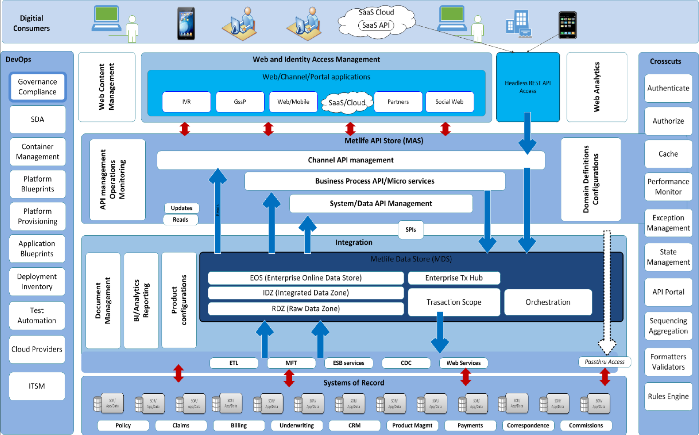
GTO Platform Reference Architecture

Slide 18
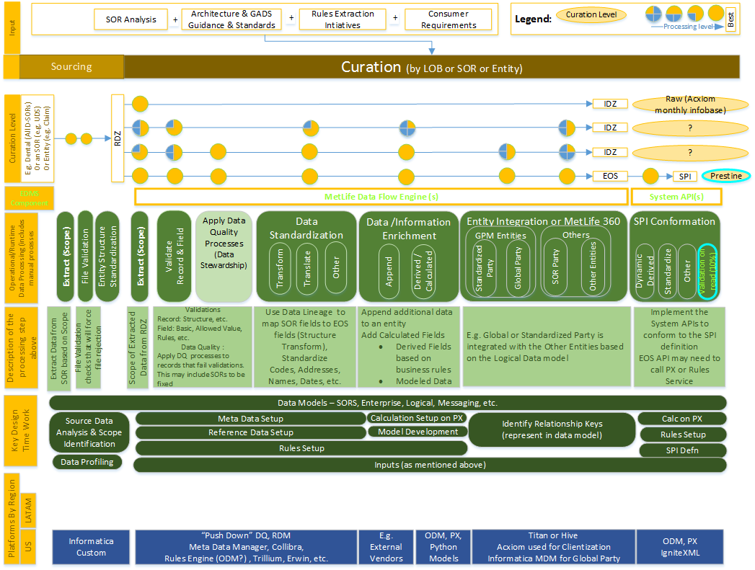
Data Curation

