Slide 1


Proposal: STEM education outreach program for the underprivileged
BY - SAURABH SINGH

Slide 2

Why Education is important ?
NSS IIT Delhi has 5 major domains of work namely Education , Environment , Health , Society and Innovation.
Among these 5 , education is the most crucial one for several reasons:
It acts as a catalyst for innovation.
Promotes environmental awareness and sustainability.
Empowers individuals with knowledge about healthy lifestyle.
It promotes equality in the society irrespective of socioeconomic status , gender or ethnicity.

Slide 3






Why STEM education is important ?
Economic growth: STEM fields are the driving force behind innovation, technological advancements, and economic growth.
Career opportunities: By providing STEM education, we open doors for students to pursue careers in diverse fields such as engineering, computer science, medicine, data analysis, and more.
Solving complex challenges: From climate change to healthcare, poverty to sustainable development, STEM professionals play a vital role in developing solutions and driving progress.
Technological and Scientific literacy: Technological literacy is crucial for removing the digital divide. Scientific literacy empowers individuals to engage with scientific issues and contribute to evidence-based decision-making in areas such as public health, environmental policy, and technological regulation.

Slide 4

Target audience
The target audience for this initiative are high school students from underprivileged communities who have limited access to educational resources and opportunities .This could include construction worker kids , beneficiary of VIDYA NGO , EDJUSTICE NGO , Saraswati Sewa foundation , deprived kids living in slums of Munirka .By focusing on underprivileged communities, we aim to bridge the educational gap and provide equal access to space exploration knowledge and inspiration.

Slide 5

Objective:
Inspire and educate
Inspire and educate students from underprivileged communities about space exploration, science, and technology.
Foster
Foster interest in STEM (Science, Technology, Engineering, and Mathematics) fields among the target audience.
Empower
Empower students to pursue careers in space-related industries or academic paths

Slide 6

Action plan:
Partner with local schools and community centers in underprivileged areas to host the workshops.
Recruit and train a team of volunteers with expertise in space exploration, science, and technology to serve as workshop facilitators.
Develop a curriculum for the workshops that includes hands-on activities, interactive demonstrations, and engaging presentations.
Arrange transportation for students from their schools or community centers to the workshop venues.
Secure necessary resources, such as educational materials, space models, and interactive tools, for the workshops.(Arranging logistic)

Slide 7

Conduct a series of workshops over a designated period, ensuring regular engagement with the target audience.
Organize field trips to local science museums, planetariums, or research facilities to further enhance the learning experience
Partner with universities, organizations, and corporations to secure scholarships and internship opportunities for exceptional participants, further encouraging their pursuit of higher education and professional development in STEM fields.

Slide 8

Timeline:
Partner
Month 1: Partner with schools and community centers, recruit and train volunteers, arrange logistics and finalize the workshop curriculum and schedule.
Conduct
Months 2-5: Conduct the workshops, field trips, and mentorship sessions.
Evaluate
Month 6: Evaluate the impact of the initiative and make any necessary adjustments for future iterations.

Slide 9
Impact assessments:
Pre and post wokshop assessment
Measure participants knowledge and interest in space exploration, science and technology before and after the workshops.
Surveys and feedback form
Gather feedback from students, teachers, and volunteers to assess the effectiveness of the workshops and identify areas for improvement.
Long-term tracking
Monitor the number of students who pursue STEM-related education or careers after participating in the workshops.
Alumni success stories
Collect and share stories of individual students who were inspired and positively impacted by the initiative.

Slide 10

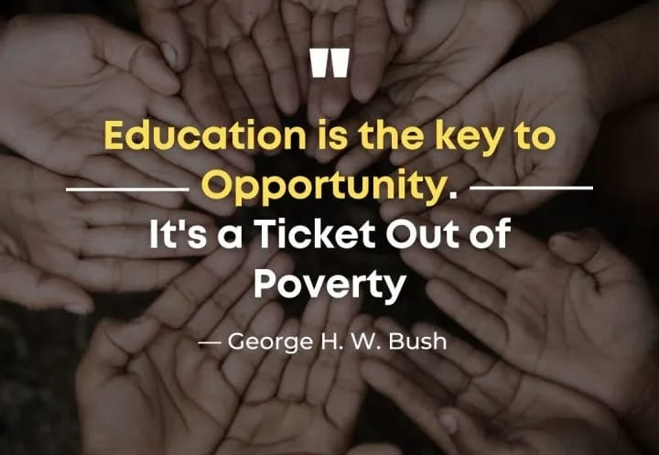
Conclusion:
By implementing this STEM Empowerment Program for Underprivileged Youth, the Outreach Team would aim to make a meaningful and lasting impact on the lives of underprivileged youth in the following ways:
Breaking the cycle of poverty
Developing critical thinking and problem-solving skills
Increasing opportunities for higher education
Fostering creativity and innovation
Bridging the digital divide
Encouraging diversity and inclusion

Slide 11

THANK YOU!!!!

