Slide 1


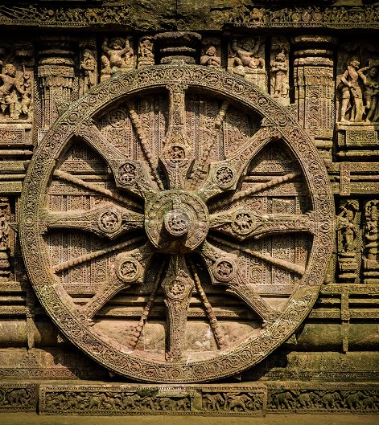
What is the current NSS logo based on ?
The logo for the NSS has been based on the giant Rath Wheel of the world famous Konark Sun Temple (The Black Pagoda) situated in Orissa, India.
The eight bars in the wheel of NSS logo represent the 24 hours of a day. The red colour indicates that the volunteer is full of young blood that is lively, active, energetic and full of high spirit.
The navy blue colour indicates the cosmos of which the NSS is tiny part, ready to contribute its share for the welfare of the mankind.
.

Slide 2
Amendments :
As per me , a total of 3 amendments can be made in the logo of NSS IIT Delhi :
Modernization in design
Incorporation of color green in the logo
Change in Font style

Slide 3

Modernization in DEsign
Streamline the logo design by simplifying the shapes and elements. A cleaner and more minimalistic design can make it visually appealing and easily recognizable.
Consider updating the logo to give it a more contemporary and fresh look. This can be achieved by using current design trends, such as flat design or abstract forms.

Slide 4
Incorporation of green color
Color scheme used in NSS logo represents its vision and values.
Colors are used in a logo to evoke positive emotions, convey inclusivity, and show alignment with the organization's purpose
NSS has 5 domains of work namely Education , Environment , Health , Society and Innovation. Colors associated with each domain are as under :
Education – Light Blue
Environment – Green
Innovation – Blue
Health – Green
Society – White
The current logo uses Blue and Red colors but the color green which is associated with two important domains i.e. health and environment is missing in the logo .
Incorporation of color green in the logo would make the logo even more visually appealing to the audience and it will also have a hidden meaning associated with it i.e. focus on health and environment.

Slide 5
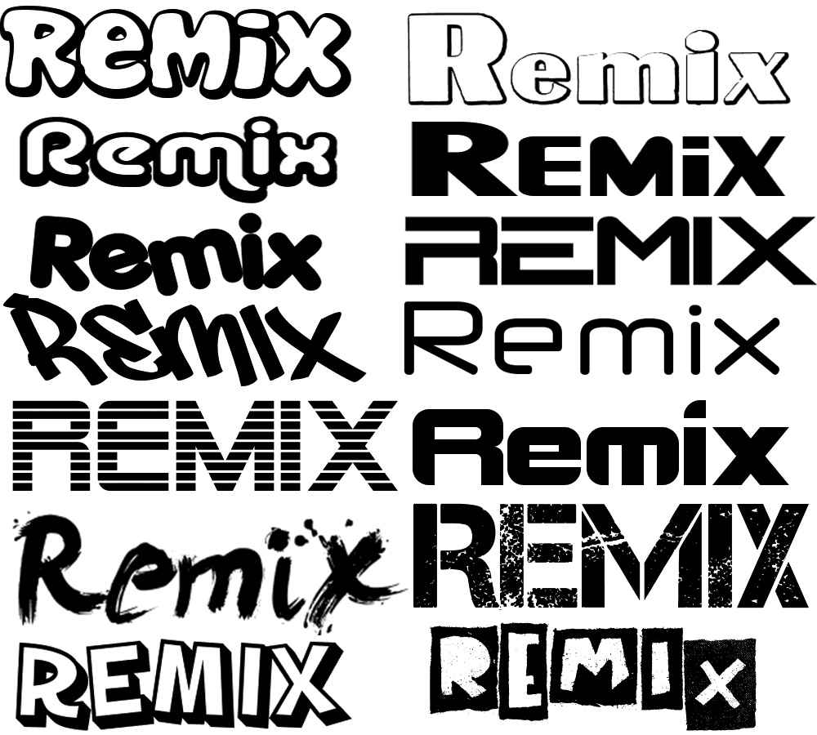
Change in font style
The typography used should be legible and aligns with the organization's identity. It should communicate the NSS's values effectively.
The logo should work well across various mediums and platforms, including print, digital, and social media. It should be scalable, recognizable, and retain its visual impact at different sizes.
It should also give a modern and professional look to the logo design

Slide 6
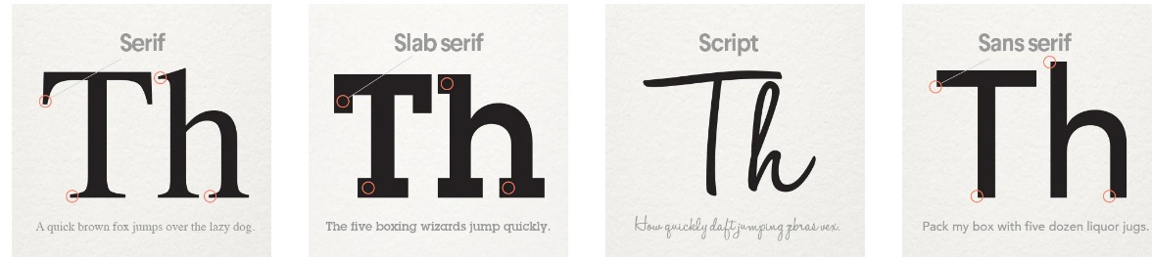
In this regard serif fonts are considered to best :
Serif logo fonts have decorative “feet” at the ends of each letterform and evoke a polished, classic feeling.
Slab serif logo fonts are bolder, louder serifs with large letterforms designed to be seen from a long distance.
Script logo fonts are both formal and casual typefaces that have the loops and flourishes of script handwriting.
Sans-serif logo fonts lack the “feet” at the ends of each letterform and are considered more modern than their serif counterparts.
Analyzing all these font options , we find that script logo font is a bit casual while serif logo font is old-school type.
Slab serif logo is more recognizable while sans serif logo is modern and recognizable at the same time. So one of these two fonts can be used in the present NSS logo.

Slide 7
☺ Thank you ☺

