Slide 1

Welcome to
New age upskilling platform for high growth careers
By Urvshi Singla

Slide 2
Session Agenda
React Routing

Slide 3
REACT ROUTING
What is React Router DOM?
Install react-router: npm install --save react-router-dom.
How to create multiple webpages in a client-side
Link b/w Routes
Routing Parameters
How to use third party API

Slide 4
React Router DOM
React Router DOM is an npm package that enables you to implement dynamic routing in a web app. It allows you to display pages and allow users to navigate them. It is a fully-featured client and server-side routing library for React
A <BrowserRouter> stores the current location in the browser's address bar using clean URLs and navigates using the browser's built-in history stack.

Slide 5
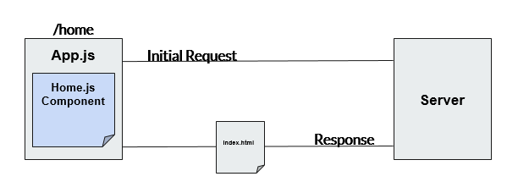
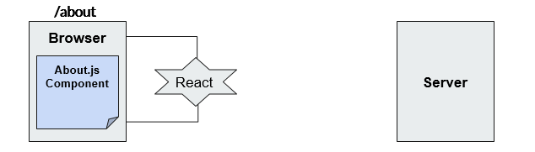
REACT ROUTER DOM
ROUTING
REACT-ROUTER DOM

Slide 6
HTML
HIGHER ORDERED COMPONENTS
HOC are methods that give super powers component to it.
A higher-order component (HOC) is an advanced technique in React for reusing component logic.
A higher-order component is a function that takes a component and returns a new component.
Supercharged Component
Component
HOC
About.js
About.js
ColorChanger

Slide 7
Q & A

Slide 8
Thank You

