Slide 1
High Performance Network Intrusion Detection System
PIP2001 Capstone Project
Review-0
Batch Number:
Roll Number | Student Name
20221LCS0024 | Vishal G Dhavali
20221LCS0023 | Sayeed
20211CSE0517 | RamaKrishana
20211CSE0500 | Tejas S P
20211CSE0300 | Aditya Gupta
Under the Supervision of,
Ms. Thabassum Khan
Professor,
School of Computer Science and Engineering
Presidency University
Name of the Program: B.Tech(CSE)
Name of the HoD: Dr.Asif Mohammed H.B
Name of the Program Project Coordinator: Mr. Amarnath J.L & Dr. Jayanthi. K.
Name of the School Project Coordinators: Dr. Sampath A K / Dr. Abdul Khadar A / Mr. Md Ziaur Rahman

Slide 2
Content
Problem Statement
GitHub Link
Analysis of Problem Statement
Introduction
Literature review
Objectives
Methodologies
Technology stacks and components
Expected outcomes
Timeline of the Project
Conclusion
References

Slide 3
Problem Statement Number:PSCS26
Organization: Quick Heal
Category : Software
Problem Description: Develop a network Intrusion Detection system with high network throughput. The system should scan ,classify and monitor the network traffic in real-time without affecting the network throughput. Following are feature-Real time Traffic analysis- Protocol analysis-Content Searching-Detect variety of attacks and probes
Difficulty Level: Complicated

Slide 4
Github Link
https://github.com/iamsayeed/Capstone

Slide 5
Analysis of Problem Statement
INTRODUCTION:
The evolving nature of cybersecurity threats demands advanced intrusion detection systems. Traditional signature-based NIDS struggle with novel attacks like zero-day exploits, while anomaly-based systems often generate excessive false positives. This project proposes a hybrid NIDS that combines the precision of signature detection with the adaptability of anomaly-based techniques, enhanced by machine learning and real-time packet inspection, to deliver scalable and effective network security. Role of NIDS in Network Security:
• Threat Detection: NIDS identifies suspicious activities like unauthorized access attempts, malware infections, and denial-of-service attacks.
• Real-time Alerts: It provides timely notifications to security teams, enabling prompt response to incidents.
• Incident Investigation: NIDS can assist in investigating security breaches by capturing and analyzing network traffic related to the incident.

Slide 6
Analysis of Problem Statement(conti..)
Importance of High-Performance NIDS:
1. Real-Time Detection: High-performance NIDS ensures timely detection of threats by processing large volumes of network traffic in real-time, enabling immediate response to potential cyberattacks and minimizing damage.
2. Scalability: Scalable NIDS can seamlessly adapt to growing network demands, handling increased traffic and complexity while supporting modern technologies like IoT and cloud computing.
3. Performance Optimization: Optimized NIDS leverage advanced algorithms and hardware to detect threats accurately, reduce false positives, and maintain efficiency without overloading network resources.
Challenges and Requirements for Effective NIDS:
Performance: NIDS must be able to process large amounts of data without compromising detection accuracy.
Accuracy: NIDS should minimize false positives and false negatives, providing accurate and reliable threat detection.
Scalability: NIDS should be able to handle the increasing volume and complexity of network traffic.
Cost-Effectiveness: NIDS should offer a good balance between performance, features, and cost. elaborate this matter

Slide 7
Objective
Project Scope and Goals:
Real-Time Threat Detection: Develop a system that identifies and mitigates suspicious activities within milliseconds of detection.
High Detection Accuracy: Leverage a hybrid detection approach combining signature-based and machine learning-driven anomaly detection to achieve comprehensive threat coverage.
Scalability for High-Speed Networks: Design the system to handle high traffic volumes without packet loss or significant performance degradation.
Evasion Resistance: Incorporate techniques to detect and neutralize advanced evasion methods, including encrypted traffic, polymorphic malware, and fragmented payloads.
Enhanced Network Visibility and Monitoring: Provide a centralized dashboard for real-time traffic monitoring, threat alerts, and detailed analytics.
Future-Proofing and Adaptability: Integrate modular components that can be upgraded to adapt to evolving threats and network architectures.
Quantitative and Qualitative Performance Metrics: Measure and optimize KPIs like packet processing speed, detection-to-response time, and computational overhead.

Slide 8
Literature Review
Relevant Research Papers:
Paper 1: "Ahmad, Z., Khan, A. S., Shiang, C. W., Abdullah, J., & Ahmad, F. (2020). Network intrusion detection system: A systematic study of machine learning and deep learning approaches. Transactions on Emerging Telecommunications Technologies, 32(1), e4150. https://doi.org/10.1002/ett.4150"
Paper 2: "R. Samrin and D. Vasumathi, "Review on anomaly based network intrusion detection system," 2017 International Conference on Electrical, Electronics, Communication, Computer, and Optimization Techniques (ICEECCOT), Mysuru, India, 2017, pp. 141-147, doi: 10.1109/ICEECCOT.2017.8284655."
Paper 3: "Garuba, Moses, Chunmei Liu, and Duane Fraites. "Intrusion techniques: Comparative study of network intrusion detection systems." Fifth International Conference on Information Technology: New Generations (itng 2008). IEEE, 2008.“
Paper 4: “Farnaaz, Nabila, and M. A. Jabbar. "Random forest modeling for network intrusion detection system." Procedia Computer Science 89 (2016): 213-217”
Paper 5:” Shun, Jimmy, and Heidar A. Malki. "Network intrusion detection system using neural networks." 2008 fourth international conference on natural computation. Vol. 5. IEEE, 2008”

Slide 9
Literature Review
Current Status: Literature review is in progress.
Relevant Research Papers:
Paper 6: " Ashiku, Lirim, and Cihan Dagli. "Network intrusion detection system using deep learning." Procedia Computer Science 185 (2021): 239-247. "
Paper 7: " B. Mukherjee, L. T. Heberlein and K. N. Levitt, "Network intrusion detection," in IEEE Network, vol. 8, no. 3, pp. 26-41, May-June 1994, doi: 10.1109/65.283931. keywords: {Intrusion detection;Computer networks;Protection;Computer security;Data security;Computer science;Computer crime;Information security;Real time systems;Prototypes}."
Paper 8: " Shanmugavadivu, R., and N. Nagarajan. "Network intrusion detection system using fuzzy logic." Indian Journal of Computer Science and Engineering (IJCSE) 2.1 (2011): 101-111.“
Paper 9: “Albasheer, Hashim, et al. "Cyber-attack prediction based on network intrusion detection systems for alert correlation techniques: a survey." Sensors 22.4 (2022): 1494.”
Paper 10: ” Alzahrani, A. O., & Alenazi, M. J. (2021). Designing a Network Intrusion Detection System Based on Machine Learning for Software Defined Networks. Future Internet, 13(5), 111. https://doi.org/10.3390/fi13050111”

Slide 10
Issues with Existing Systems
Traffic Volume Limitation: Many traditional IDS solutions are not built to handle high-volume traffic, which makes them unsuitable for high-speed networks.
Real-time Processing Gaps: Due to limited processing speed, many systems resort to sampling instead of analyzing all traffic, which can miss critical threats.
Detection Accuracy vs. Speed: Improving detection accuracy often leads to slower processing times, creating a trade-off between performance and security.
Limited Protocol Support: Some existing systems don’t fully support deep protocol analysis or struggle with complex, encrypted traffic.

Slide 11
Methodology
Technology Stack: The NIDS system is built upon a robust and versatile technology stack, carefully chosen for efficiency, scalability, and ease of implementation.
Detection Mechanisms: The system employs a hybrid detection approach, combining signature-based methods and anomaly detection techniques. This ensures a balance between detecting known threats and identifying novel attack patterns.
Anomaly Detection:
Analysis process: A network traffic, including normal and anomalous packets, is prepared for training.
Feature Extraction: Relevant features are identified to distinguish normal traffic from anomalies.
Strengths: The ability to detect unusual behaviors that signature-based methods might miss.
Limitations: Anomaly detection systems may have higher false positive rates and require continuous retraining to improve accuracy.
Quantitative Metrics: The effectiveness of the Network Intrusion Detection System (NIDS) is measured using metrics specifically tailored to its signature-based detection approach and overall system performance.

Slide 12
Methodology
To Improve Detection Accuracy: Regular updates to the rule set are essential, incorporating the latest known threats and vulnerabilities.
Rule Precision and Coverage:
Rule Precision: Measures how specific the rules are in detecting threats without triggering false alarms. Higher precision indicates fewer false positives.
Rule Coverage: Indicates the breadth of attack types the system can detect. A robust signature set ensures better coverage against a wide range of threats.
Packet Processing Speed
The system’s ability to process network packets in real time is critical for detecting and responding to threats without delays. Key metrics include:
• Latency: Average time taken to process a single packet, from capture to detection.
• Throughput: Maximum number of packets the system can handle per second under high traffic conditions. These metrics ensure the system can scale effectively and handle peak traffic loads.

Slide 13
Technology Stacks and Components:
System Overview:
The Network Intrusion Detection System (NIDS) is designed as a modular architecture, ensuring scalability, reliability, and efficient handling of network traffic. The core system workflow comprises the following phases: Packet Capture, Detection Engine, Response System, and Logging.
The proposed NIDS architecture will consist of the following key components:
Packet Capture Module → Captures traffic and forwards it to the Detection Engine.
Detection Engine → Processes traffic through rules and ML models, classifies anomalies, and triggers alerts.
Database Module → Stores detected threats and system logs.
User Interface → Visualizes data from the database, enabling user interaction.
Response System → Engages countermeasures, such as firewall updates or administrator notifications.

Slide 14
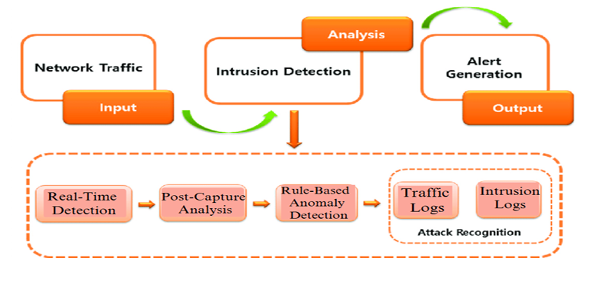
Technology Stacks and Components:
Diagram Description: The diagram illustrates packet flow starting from the capture module, passing through detection, and ending at the logging or response modules. Each connection is annotated to explain the data transformation at every stage.

Slide 15
Expected Outcomes:
Advanced Anomaly Detection: The research may lead to the development of more sophisticated anomaly detection techniques that can accurately identify previously unknown threats.
Enhanced Threat Intelligence: The findings could contribute to the development of more comprehensive threat intelligence databases and sharing platforms.
Scalable and Adaptable NIDS: The developed NIDS architecture may be highly scalable and adaptable, capable of handling large-scale networks and evolving threats.
Enhanced Threat Prevention: The research could lead to the development of more effective threat prevention strategies, reducing the risk of successful attacks.
Improved Incident Response: The findings may enable organizations to respond more quickly and effectively to security incidents.
Increased Trust and Confidence: Enhanced network security can foster trust and confidence among customers and stakeholders.

Slide 16
Hardware/Software
Hardware Requirements: 1GB RAM, 2 CPU cores, 1 NIC, and 100GB disk space.
Software :VS code(IDE)
Programming Languages:
• Python: A popular choice for data analysis and machine learning due to its extensive libraries and ease of use.
• C/C++: For performance-critical components like packet capture and preprocessing, offering lower-level control and efficiency.
Libraries and Frameworks:
• Scikit-learn: A comprehensive machine learning library for Python, providing a wide range of algorithms and tools.
• TensorFlow: A popular deep learning framework for building and training complex neural networks.
• NumPy: A fundamental library for numerical computing in Python.
• Pandas: A data manipulation and analysis library for Python.

Slide 17
Implementation Details
The implementation of the NIDS system involves several steps, from setup to deployment and testing.
Steps in System Implementation
Environment Setup.
Module Development.
System Integration.
Response Mechanisms.
Testing.
Testing Environment Setup
Network Configuration: A local network is set up to simulate traffic, including normal and malicious packets.
Tools like Wireshark or Tcpreplay are used to replay captured traffic for testing.
Performance Metrics: The system is tested for accuracy, speed, and resource usage under varying traffic loads.

Slide 18
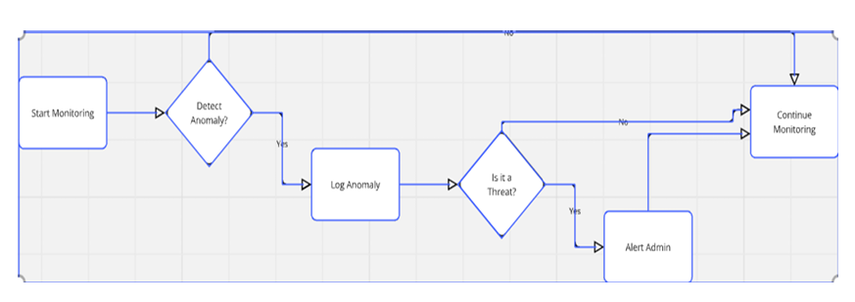
Implementation Details
Data Flow Diagram:

Slide 19
Timeline of the Project (Gantt Chart)
The project will follow a condensed 4-month timeline.
Phase 1 (Weeks 1-4): Research & Requirement Gathering
Phase 2 (Weeks 5-10): System Design & Development
Phase 3 (Weeks 11-14): Testing & Optimization
Phase 4 (Weeks 15-16): Deployment & Final Review

Slide 20
Gantt Chart: Phases 1 & 2
Task | Duration | Week 1 | Week 2 | Week 3 | Week 4 | Week 5 | Week 6 | Week 7 | Week 8 | Week 9 | Week 10
Research & Requirement Gathering | 4 Weeks | X | X | X | X
System Design | 3 Weeks |  |  |  |  | X | X | X
Prototype Development | 3 Weeks |  |  |  |  |  | X | X | X

Slide 21
Gantt Chart: Phases 3 & 4
Task | Duration | Week 11 | Week 12 | Week 13 | Week 14 | Week 15 | Week 16
Testing & Optimization | 4 Weeks | X | X | X | X
Final Deployment & Review | 2 Weeks |  |  |  |  | X | X

Slide 22
Phase 1: Research & Requirement Gathering (Weeks 1-4)
Objectives:
Conduct research on existing intrusion detection systems and their performance bottlenecks.
Identify the types of attacks to be detected, including DDoS, port scans, and SQL injections.
Finalize system requirements (throughput, accuracy, supported protocols, etc.)
Outcome: Clear technical and functional requirement document.

Slide 23
Phase 2: System Design & Development (Weeks 5-10)
Objectives:
Create the system architecture, selecting appropriate hardware and software tools.
Develop the core traffic monitoring and scanning system, ensuring support for high-speed networks.
Implement basic attack detection mechanisms and content analysis.

Slide 24
Phase 3: Testing & Optimization (Weeks 11-14)
Objectives:
Test the system under varying traffic loads and different network conditions.
Validate the accuracy of threat detection using simulated attack scenarios.
Optimize performance to ensure minimal latency and resource consumption.

Slide 25
Phase 4: Deployment & Final Review (Weeks 15-16)
Objectives:
Deploy the system in a test environment and monitor real-time traffic for effectiveness.
Conduct a final project review, addressing any performance gaps.
Outcome: Final project report and handover.

Slide 26
References (IEEE Paper format)
1. Alsharafat, W. 2022. A Study of Network Intrusion Detection Systems Using Artificial Intelligence. Applied Sciences, 12(22), 11752. https://www.mdpi.com/2076-3417/12/22/11752 2. Patel, A., Patel, D., Sharma, D., and Patman, J. 2022. Network Intrusion Detection System Using Machine Learning with Data Preprocessing. International Journal for Research in Applied Science and Engineering Technology, 10(5), 1680-1684. https://www.ijraset.com/research-paper/network-intrusion-detection-system-using-machine-learning 3. Ferrag, M.A., Maglaras, L., Moschoyiannis, S., and Janicke, H. 2021. Network Intrusion Detection System using Deep Learning. Procedia Computer Science, 190, 593-598. https://www.sciencedirect.com/science/article/pii/S1877050921011078 4. García-Teodoro, P., Díaz-Verdejo, J., Maciá-Fernández, G., and Vázquez, E. 2009. Anomaly-based Network Intrusion Detection: Techniques, Systems and Challenges. Computers & Security, 28(1-2), 18-28. 5. Neupane, S. 2022. Building Your Own Intrusion Detection System for Small Businesses. LinkedIn Pulse. https://www.linkedin.com/pulse/building-your-own-intrusion-detection-system-small-sagar-neupane/

Slide 27


