Slide 1
SDN Data plane with Openflow

Slide 2
Technical Background

Slide 3
Software-Defined Networking (SDN) Overview
Unlike OSPF, SDN divides the control plane from the data plane
Remote Controller : Makes routing and forwarding decisions centrally
Data Plane - SDN Switches : Simple forwarding devices without complex routing logic
Key Advantages : Enhanced network visibility and management capabilities
Remote Controller
values in arriving
packet header
0111
1
3
2
Switch

Slide 4
SDN vs Traditional OSPF
Metric | Traditional OSPF | SDN Controller | Improvement
Control Messages | O(n²) broadcasts | O(n) unicast | 90% reduction
Convergence Time | 30-60 seconds | <5 seconds | 10x faster
Path Control | Link weights only | Per-flow granular | Full flexibility
CPU Usage | High on all routers | Low on switches | Centralized
Traffic Engineering | Limited | Programmable | 100% control

Slide 5

OpenFlow Protocol
Industry-standard protocol enabling SDN implementation
Defines communication between control plane (controller) and data plane (switches)
OpenFlow Message Types
Controller-to-Switch: Flow-Mod, Packet-Out, Stats-Request, Config, Barrier
Switch-to-Controller: Packet-In, Flow-Removed, Port-Status, Error
Symmetric: Echo Request/Reply, Experimenter (Not recommended since openflow is made for centralization)
OpenFlow Controller

Slide 6
Link Layer Discovery Protocol (LLDP)
Vendor-neutral Layer 2 discovery protocol (IEEE 802.1AB)
Enables automatic network topology discovery and mapping
Discovery Process
Controller sends LLDP packet via Packet-Out to each switch port
Neighboring switch receives LLDP and sends Packet-In to controller
Neighboring switch receives LLDP and sends Packet-In to controller
Repeated periodically to detect topology changes
OpenFlow Controller
LLDP

Slide 7
LLDP vs OpenFlow
OpenFlow Controller
Aspect | OpenFlow | LLDP
Layer | Control plane (L4-7) | Data plane (L2)
Purpose | Control and programming | Neighbor discovery
Communication | Controller ↔ Switch | Switch ↔ Switch
Direction | Bidirectional | Unidirectional broadcast
Transport | TCP (port 6633/6653) | Ethernet frames
Message Type | Structured protocol messages | TLV-based advertisements
Topology Role | Orchestrates discovery | Carries discovery information
Scope | Entire network view | Direct neighbors only
LLDP

Slide 8

Spanning Tree Protocol (STP) for Loop Prevention
IEEE 802.1D protocol for preventing Layer 2 loops
Automatically blocks redundant paths while maintaining backup links
Used to prevent Broadcast storm
Broadcast Storm: Exponential multiplication of broadcast frames in Layer 2 networks with loops
a
a
d
b
d
b
c
c

Slide 9
Lab Setup Environment

Slide 10
Quick Start for Windows Users
Prerequisites
Docker Desktop installed and running
Git Bash
Step-by-Step Execution
# Step 1: Git clone https://github.com/network-2025/network-lab1.git
# Step 2: Navigate to project directory
# Step 3: Open Docker Desktop and run the startup script ./start_sdn_docker.sh
Available Script Options
# Main commands
./start_sdn_docker.sh start
# Full setup and auto-run ring topology
./start_sdn_docker.sh run [topology]
# Run demo with specific topology
# Options: ring, diamond, graph
./start_sdn_docker.sh attach
# Reattach to existing tmux session
./start_sdn_docker.sh connect
# Open bash shell in container
./start_sdn_docker.sh logs
# Show controller logs
./start_sdn_docker.sh stop
# Stop everything and cleanup

Slide 11
Quick Start for Linux Users
Prerequisites
Docker Desktop installed and running
Git Bash
Step-by-Step Execution
# Step 1: Git clone https://github.com/network-2025/network-lab1.git
# Step 2: Navigate to project directory
# Step 3: Run the startup script ./start_sdn_demo.sh

Slide 12
tmux Usage Guide for SDN Lab
Command | Action
tmux attach -t sdn_demo | Connect to SDN session
Ctrl+b ↑ | Move to upper pane (controller)
Ctrl+b ↓ | Move to lower pane (Mininet)
Ctrl+b d | Detach (keep running)
Ctrl+b z | Zoom current pane
Ctrl+b % | Split vertical
Ctrl+b " | Split horizontal
Command | Action
Ctrl+b c | Connect to SDN session
Ctrl+b n | Next window
Ctrl+b p | Previous window
Ctrl+b [0-9] | Switch to window
Ctrl+b z | Zoom current pane
Ctrl+b x | Close current pane
Ctrl+b o | Cycle through panes

Slide 13
Requirements.txt Dependencies Explained
Package | Version | Purpose
ryu | 4.34 | SDN controller framework - handles OpenFlow protocol
eventlet | 0.30.2 | Async networking library - CRITICAL version for Python 3.8
networkx | 3.1 | Graph algorithms - Dijkstra path computation
msgpack | 1.1.1 | Binary serialization - controller communication
oslo.config | 9.6.0 | Configuration management - Ryu settings
ovs | 2.17.0 | Open vSwitch bindings - switch control
Notes:
In networking, Control Plane and Data Plane are two fundamental concepts used to describe how data is handled and routed through network devices like routers and switches.
The Control Plane decides how to route traffic.
The Data Plane does the actual moving of packets based on that decision.
1. Data Plane (Forwarding Plane)
What it does: Moves packets from source to destination.
Where it operates: Inside the router or switch hardware (fast path).
Responsibilities:
Forwards incoming data packets based on rules.
Applies actions like dropping, modifying, or forwarding packets.
Speed: Very fast; optimized for high performance.
Example: A router receives a packet and forwards it to the correct next hop using an already-built forwarding table.
2. Control Plane
What it does: Makes decisions about where traffic should go.
Where it operates: Inside the CPU/software of the network device.
Responsibilities:
Runs routing protocols (e.g., OSPF, BGP, RIP).
Builds and updates the routing table.
Updates the forwarding table used by the data plane.
Speed: Slower than the data plane because it involves computation and protocol exchanges.
Example: A router exchanges BGP messages to learn the best path to a network and updates its routing table accordingly.

Slide 14
Project File Organization
network-lab1/
├── 🚀 Startup Scripts
│ ├── start_sdn_demo.sh # Linux/Ubuntu native execution
│ ├── start_sdn_docker.sh # Windows/Docker execution
│ └── demo_dijkstra_routing.sh # Automated test demo
│
├── 🎮 Controller Logic
│ ├── ryu-controller/
│ │ ├── main_controller.py # Basic Dijkstra implementation
│ │ └── main_controller_stp.py # With STP loop prevention
│ │
├── 🌐 Network Topologies
│ ├── mininet/
│ │ ├── ring_topology.py # 10-switch ring (main demo)
│ │ ├── diamond_topology.py # 4-switch diamond
│ │ └── graph_topology.py # Complex mesh topology
│ │
├── 📦 Configuration Files
│ ├── requirements.txt # Python dependencies
│ ├── docker-compose.yml # Docker container config
│ └── Dockerfile # Container build recipe
│
└── 📚 Documentation
└── SDN_LAB_COMPREHENSIVE_GUIDE.md
Script | Use Case
start_sdn_demo.sh | Ubuntu/Linux users
start_sdn_docker.sh | Windows users
main_controller.py | SDN logic
ring_topology.py | Test network
Notes:
In networking, Control Plane and Data Plane are two fundamental concepts used to describe how data is handled and routed through network devices like routers and switches.
The Control Plane decides how to route traffic.
The Data Plane does the actual moving of packets based on that decision.
1. Data Plane (Forwarding Plane)
What it does: Moves packets from source to destination.
Where it operates: Inside the router or switch hardware (fast path).
Responsibilities:
Forwards incoming data packets based on rules.
Applies actions like dropping, modifying, or forwarding packets.
Speed: Very fast; optimized for high performance.
Example: A router receives a packet and forwards it to the correct next hop using an already-built forwarding table.
2. Control Plane
What it does: Makes decisions about where traffic should go.
Where it operates: Inside the CPU/software of the network device.
Responsibilities:
Runs routing protocols (e.g., OSPF, BGP, RIP).
Builds and updates the routing table.
Updates the forwarding table used by the data plane.
Speed: Slower than the data plane because it involves computation and protocol exchanges.
Example: A router exchanges BGP messages to learn the best path to a network and updates its routing table accordingly.

Slide 15
Docker Installation Guide (If Not Installed)
Docker Desktop Installation (https://herojoon-dev.tistory.com/120?category=964211)
Download Docker Desktop
https://docker.com/products/docker-desktop
Enable WSL2
Install Docker Desktop
Verify Installation
docker --version

Slide 16
Basic Exercises

Slide 17
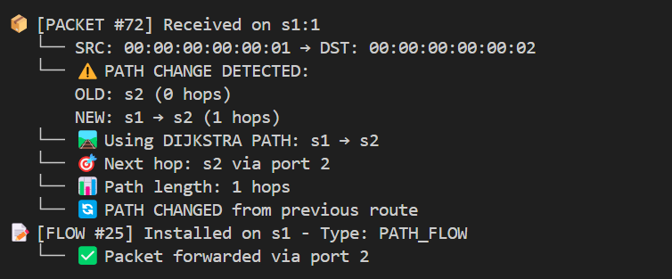
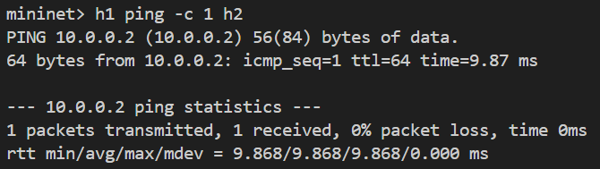
Basic Connectivity Testing
Input (Lower Pane)
Packet (Upper Pane)

Slide 18
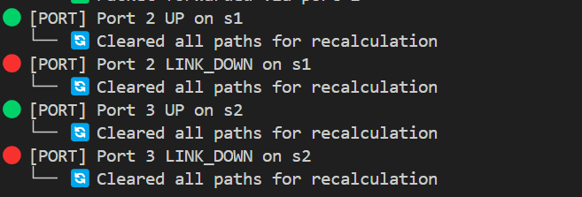
Link Failure & Rerouting
Input (Lower Pane)
Packet (Upper Pane)

Slide 19
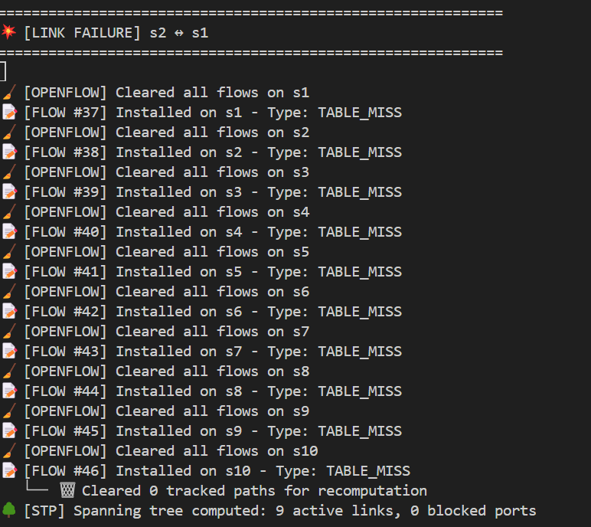
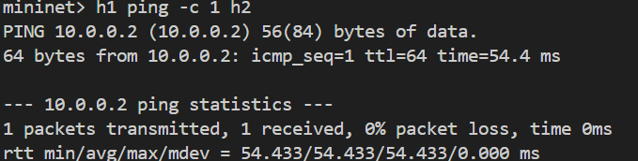
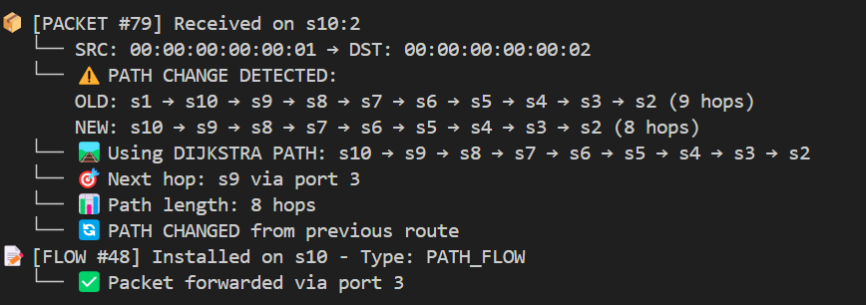
Link Failure & Rerouting
Input (Lower Pane)
Packet (Upper Pane)

Slide 20
Future Enhancements

Slide 21
Future Enhancements & Possibilities
Multi-Controller Architecture
Master/slave architecture
East-West synchronization
Load balancing
High availability

Slide 22
Summary
SDN, OpenFlow, LLDP, STP
Docker installation
Experiments with Link Failure Scenario
Future Works for assignment

