Slide 1
Housing Prices : Advance Regression Techniques
Big Data Analysis and Project
Shubham Gupta
A1787223

Slide 2


Problem Definition
Data from 2919 house, 79 explanatory variables
1460 for training, 1459 for testing.
Predicting the SalePrice of the house given its features.
The Ames Housing dataset was compiled by Dean De Cock for use in data science education

Slide 3

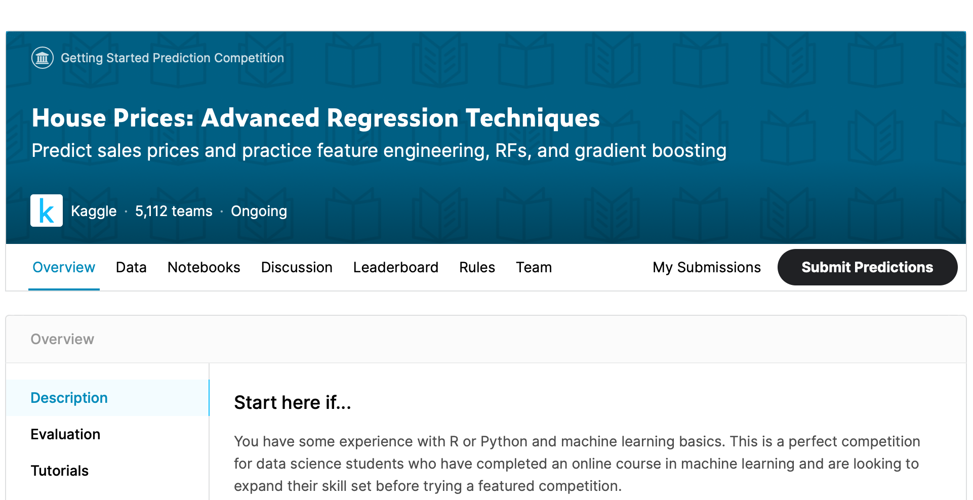
Database
It is a popular dataset on Kaggle.
Evaluate the performance of my model based on score received by submission.
Over 5000 submissions
Aim is to achieve lowest RMSE score and the best possible rank in the competition.

Slide 4
Environment
Anaconda - Jupyter Notebook , Python3 Kernel
Numpy and Pandas
Regression model – as we are predicting a real value.
Report made using Latex.
Slide – Powerpoint
Presenatation - Zoom

Slide 5
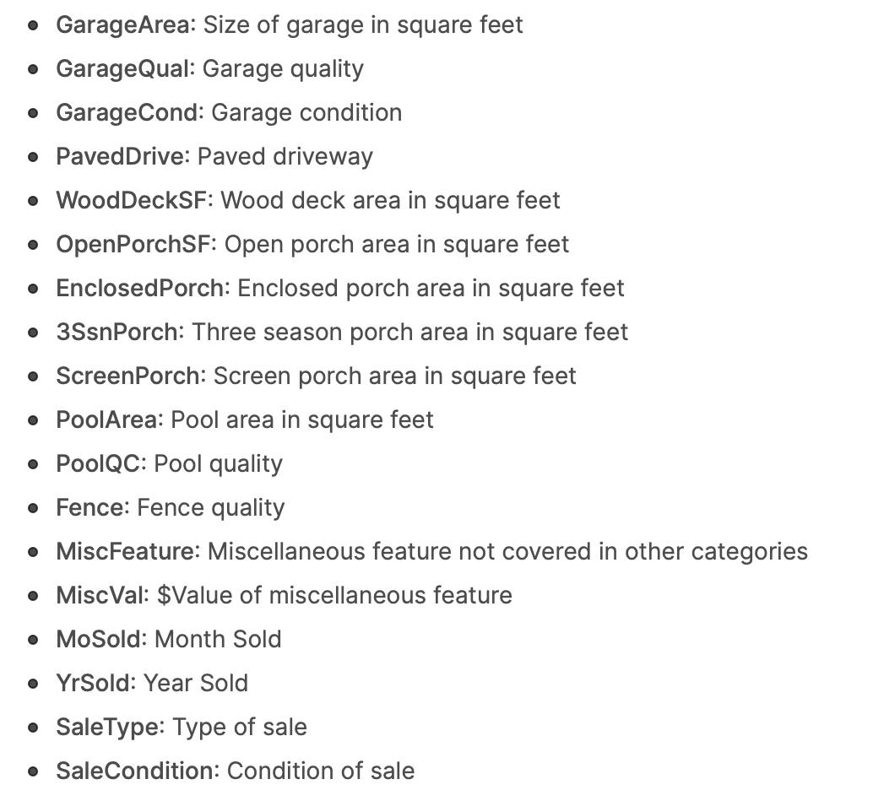
Features
The features of the house ranges from categorical features such as MSSubClass, Kitchen Quality
To numerical category such as PoolArea.
There are also some Miscellaneous features such as MiscFeature, OverallQual and OverallCond

Slide 6
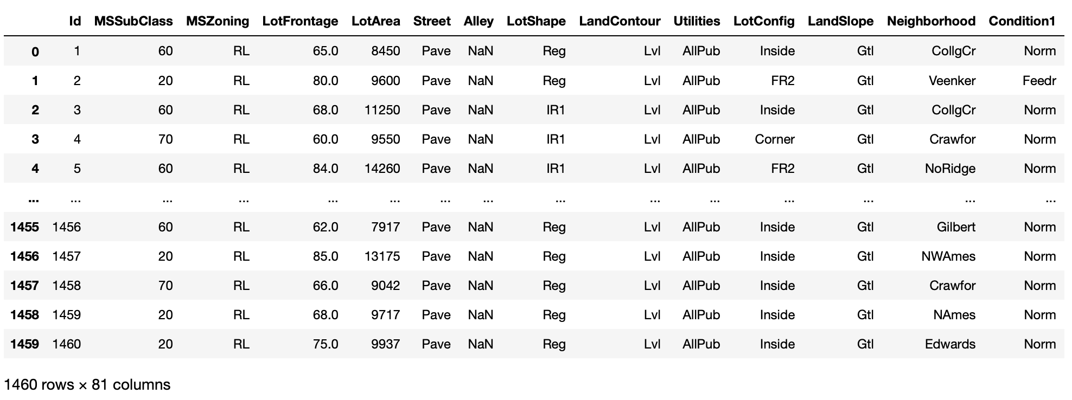
Training Data

Slide 7
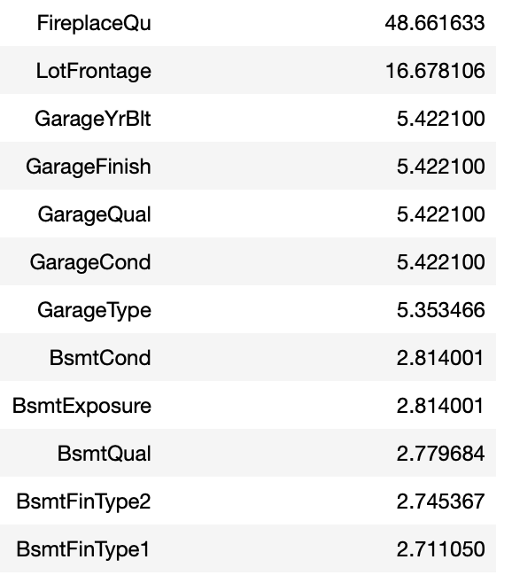
Problems
% Missing Values
Data is not clean i.e. contains lots of missing values.
In training as well as test data.
Also contains categorical data.
In order to apply machine learning algorithms we need clean numerical data.

Slide 8
Approach
Concatenate the training and test data
Allows for efficient cleaning of data
Won’t have to handle data separately.
Imputate the missing values on the whole dataset.
After cleaning separate the training and test data.
Apply machine learning algorithms and submit the best algorithm.

Slide 9
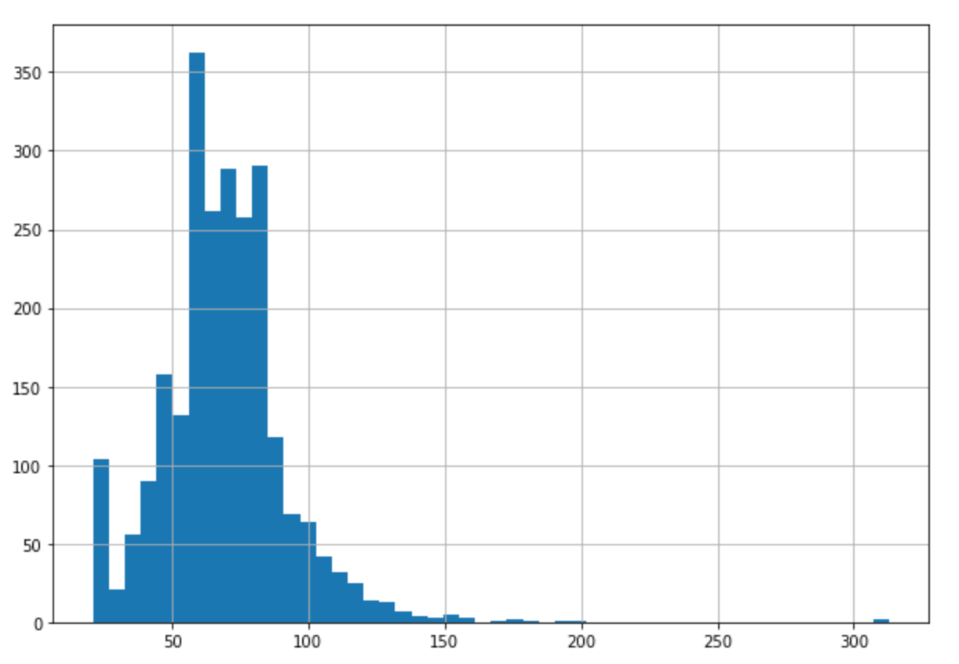
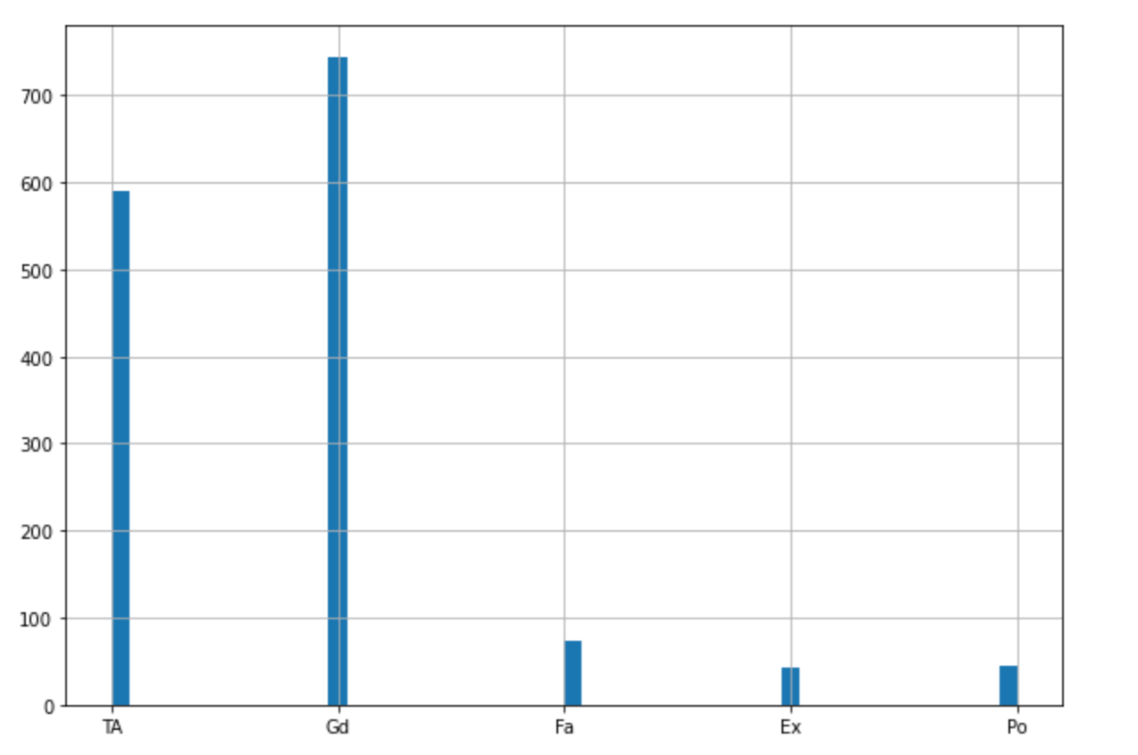
Data Preprocessing
Dropping features with more than 80% missing values.
Separating categorical and numerical features for better data imputation.
Checking the distribution of each & every feature individually.

Slide 10
Data Imputation
Most of the categorical features were filled with mode of the feature.
Mode is most the most frequent category in a feature
Most of the numerical features were filled with either median or mean of the numerical feature.

Slide 11
Categorical Data
Machine Learning models cannot understand categorical data i.e text data.
So we need to convert each categorical feature into numerical one.
Many ways to do it – OrdinalEncoder, OneHotEncoder, GetDummy.
For this model I chose GetDummy.
This converts categorical variable into dummy/indicator variables and keep the numerical data intact.

Slide 12
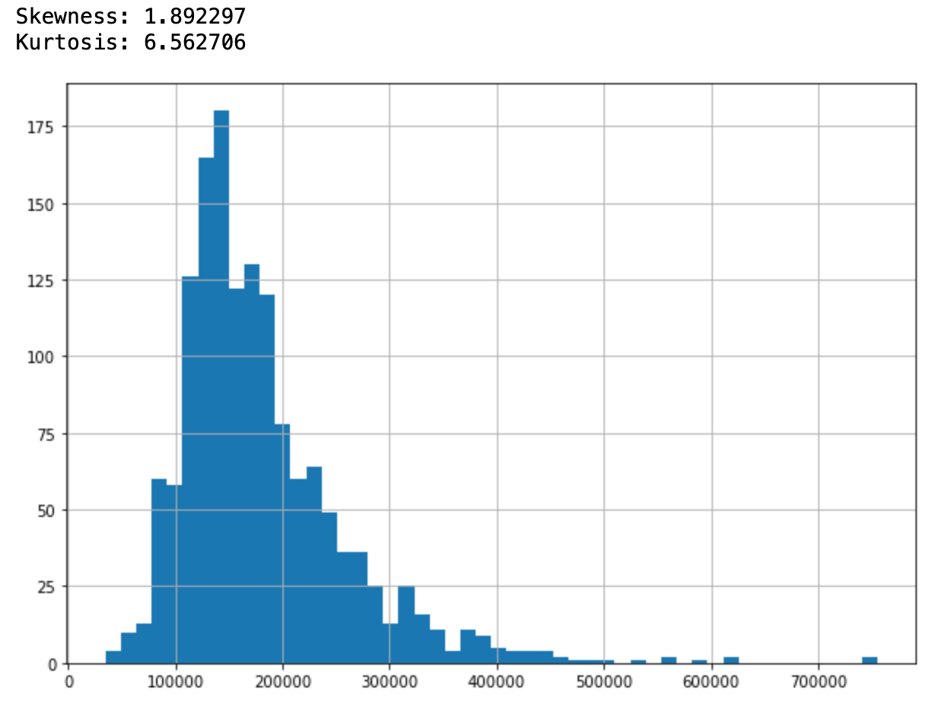
Target Feature - SALE PRICE
The target variable we have to predict is the SalePrice of the houses.
We can see this is skewed.
Running this model led to a high RMSE value.
So, we need to make changes to make our target feature less skewed.

Slide 13
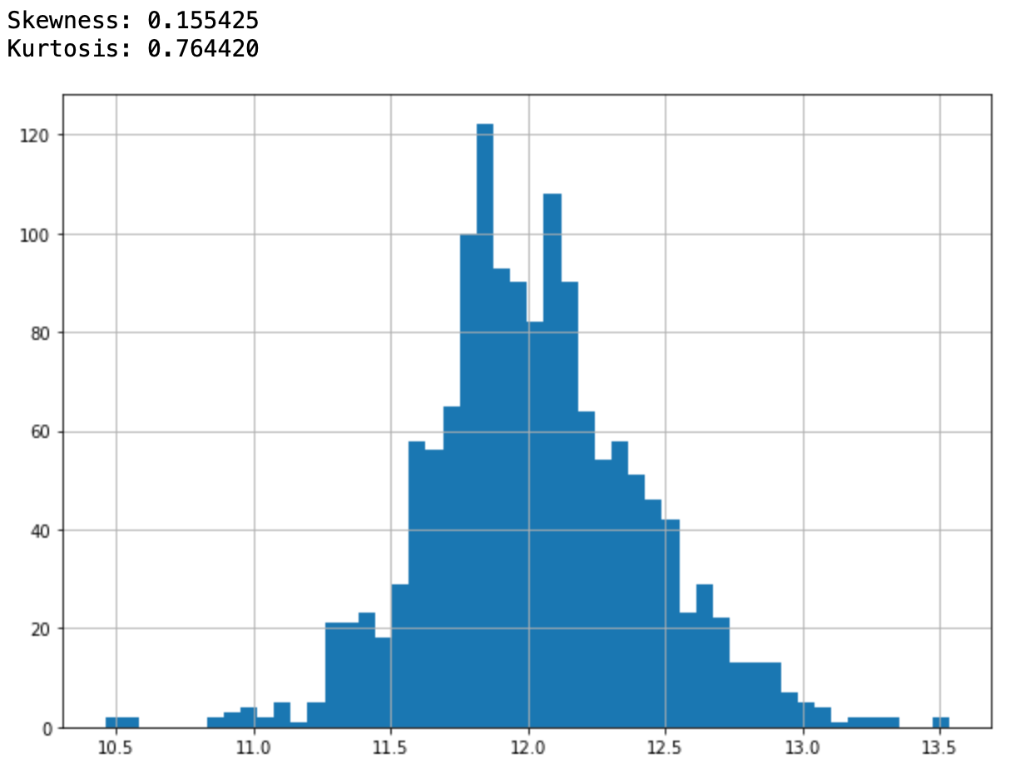
Skewness
Sale Price
After Log1P
There are many ways to handle skewness.
Either use Box Cox Transform, Log1P etc.
For our target feature, we used Log1P.
Now SalePrice is skewness is reduced and follows a somewhat normal distribution.

Slide 14
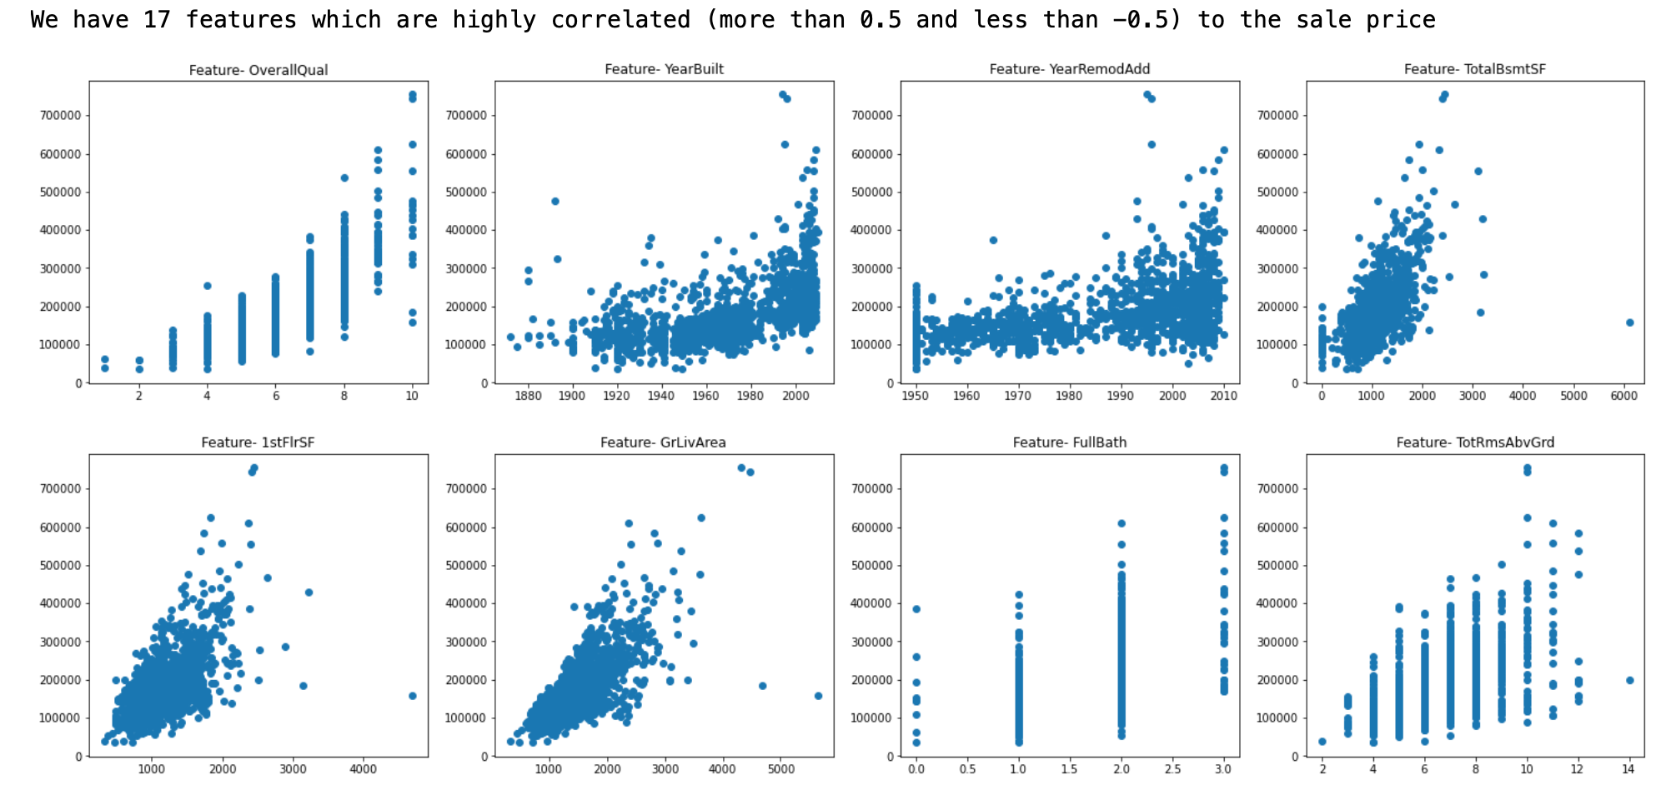
Correlation
In our training data we found that more than 17 features were highly correlated with the sale price.
Some of the figures are shown here.
They have correlation of more than 0.5 or less than -0.5

Slide 15
Dropping Features
Analyzed the Correlation and Variance of the Features.
Features with very high variance were dropped.
High variance indicates that the feature has high skewness and that will not be helpful in our machine learning models.
Also features with correlation close to zero were also dropped.

Slide 16
Modeling
The training data split in a 70:30 ratio as asked.
The regression models we will be using for our data our are-
Linear Regression (used as base performance)
RidgeCV (Another form of Linear Regressor with Regularization)
KNearestNeighbourRegressor,
RandomForestRegressor,
ElasticNetCV,
LassoCV,

Slide 17
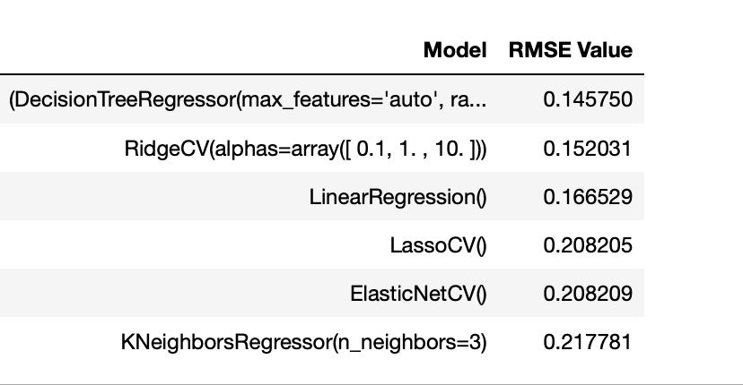
Cross Validation
Running the models directly on data can lead to overfitting.
One way to avoid overfitting is to use cross-validation
It splits our training set in subsets and applies model to each of the subsets.
Calculating mean scores of error and therefore avoiding overfitting.
Our models performance after initial run is shown

Slide 18
Hyperparameter tuning: Grid Search
Our top performing models were, RandomForest and RidgeCV.
Grid search was used to find the best possible parameters.
It is computationally heavy but gives us the best parameters.
Hyperparameter tuning led to an increase of 6% in RandomForest.
RidgeCV remained as is, because it was at optimal parameters value.

Slide 19
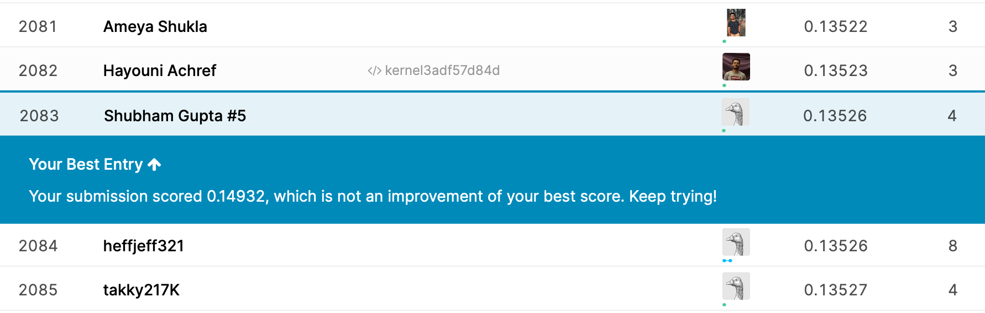
Results
Finally applied tuned models to the test set and submitted solution on Kaggle.
Received a score of 0.13526 and a rank of 2083.

Slide 20
Thank You

