Slide 1
Image Analysis: Plant seedling classification
Big Data Analysis and Project
Assignment-2
Shubham Gupta
A1787223

Slide 2

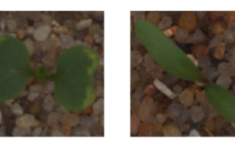
Problem Definition
The dataset comprises 12 plant species
The goal of the competition is to create a classifier capable of determining a plant's species from a photo.
The Aarhus University Signal Processing group, in collaboration with University of Southern Denmark, has recently released a dataset

Slide 3

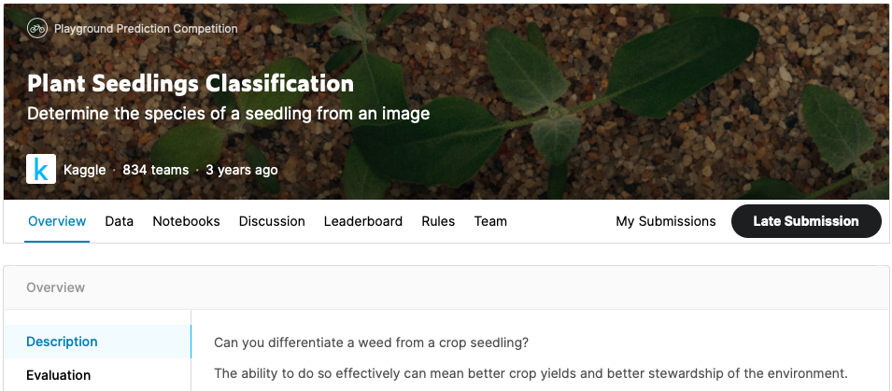
Database
It is a popular dataset on Kaggle.
Evaluate the performance of my model based on score received by submission.
Around 1000 submissions
Aim is to achieve highest accuracy and the best possible rank in the competition.

Slide 4
Environment
Anaconda - Jupyter Notebook , Python3 Kernel
Pytorch
Pretrained Models used are ResNet and VGG
Because there was no dedicated GPU available, model was not run for many epochs which might indicate the low accuracy received.
Slide – Powerpoint
Presenatation - Zoom

Slide 5
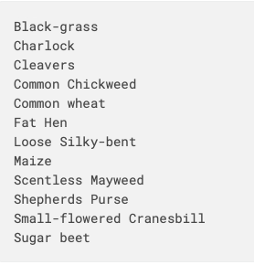
Features
Provided with train and test set
The dataset comprises 12 plant species.
The goal of the competition is to create a classifier capable of determining a plant's species from a photo
We can see the different species in Figure 1.
Figure 1

Slide 6
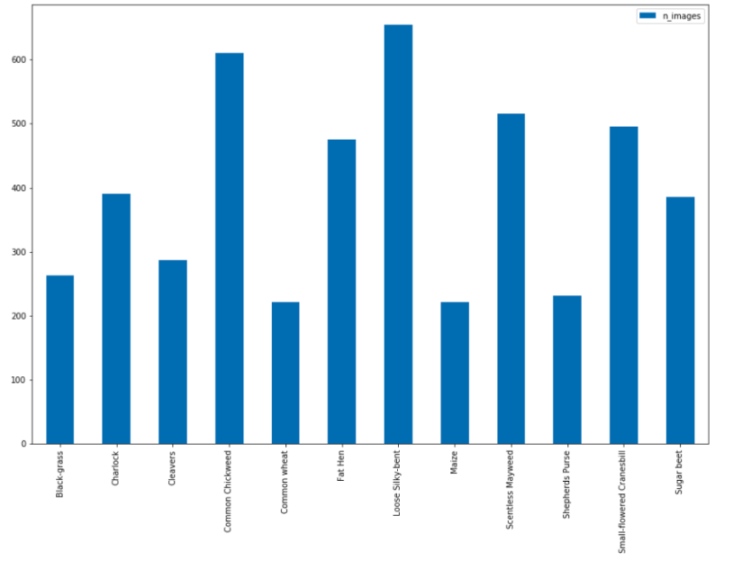
Distribution of the Original dataset

Slide 7
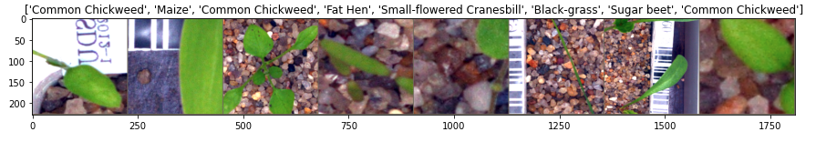
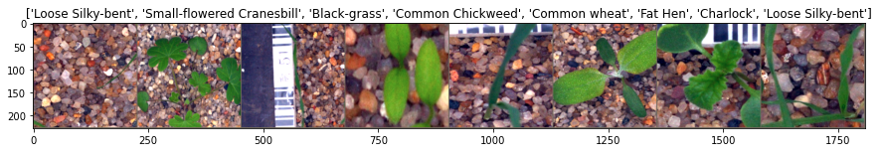
Training Data
Figure 1
Figure 2

Slide 8
Problems With Training Data
We can see the in the last slide that the images are not clean.
Some are blurry, some are not in center.
So we must apply necessary transformation to offset the errors.
Also there is no Validation data provided. So we must split the training data in order to make validation set.

Slide 9
Pytorch vS KERAs
Pytorch doesn’t know how to work with Images directly.
Pytorch needs something that is called “Tensors”.
A PyTorch Tensor is basically the same as a numpy array.
Pytorch is used because of its popularity in the scientific community over its ease of use and flexibility.

Slide 10
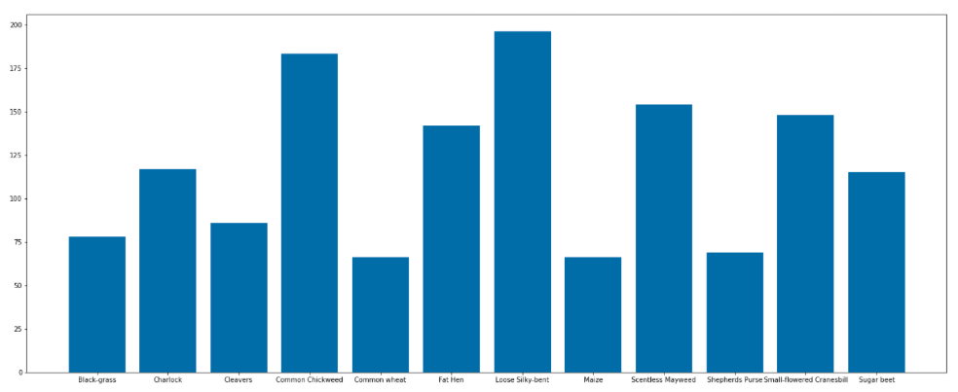
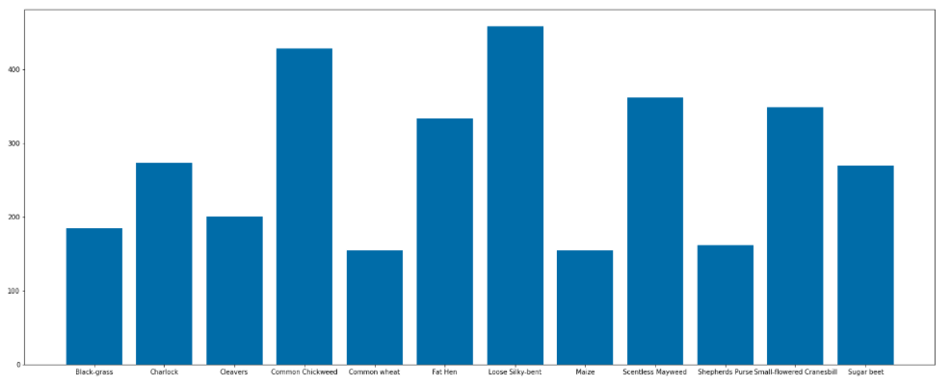
Splitting the dataset in train and validation set
The first thing that we did was to split our dataset into train and validation set.
Validation set helps us understand how well our model is doing and if it overfitting or not.
Validation Set
Training Set

Slide 11
Pytorch Transforms
As told earlier that pytorch doesn’t know how to work with images.
It need tensors.
Pytorch provides us with inbuilt functions which helps us achieve just that.

Slide 12
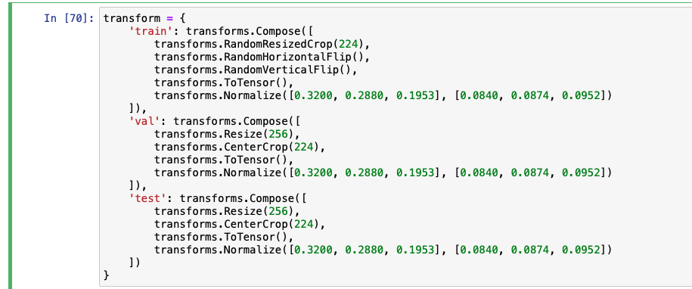
Pytorch Transforms
Here we can see in Figure 1 the transforms we are applying to the dataset.
We are resizing images so that that all the images are of same size and our network doesn’t fail.
We are also applying center crop, VerticalFlip. This is done so that our Model doesn’t learn the training set too well and therefore fail in the real work scenarios.
Lastly ToTensor converts all the images to numpy array that pytorch understands.
Also we normalize images so that each parameter (RGB) has a similar data distribution.
Figure 1

Slide 13
Pytorch Image Folder and Data Loader
The Pytorch ImageFolder and DataLoader functions helps us directly load any datasets.
We just have to provide the root directory to the imagefolder function.
In this function we can apply the necessary transformation needed simultaneously.
After this, we can use the dataloader function and specify the batch size and shuffle. Batch size is needed because we can’t load the entire dataset in one go usually. Therefore we have to divide it into batches.
Shuffle is also made True so there is no specific order of images being loaded and our model doesn’t overfit.

Slide 14
Making our CUSTOM CNN model
I built my own CNN model for classification purposes.
As pytorch was learnt from scratch for this project, A lot of references have been taken from the online community.
Specially would like to acknowledge StackOverflow and also the Pytorch Documentation on its website which is very detailed in explanation.
All the reference are provided in the report.

Slide 15
Parts of a Neural Network
nn.Module
torch.nn.Sequential
Batch Normalization
Dropout
Max Pooling

Slide 16
Loss Function
For this project we will be using Cross-Entropy loss.
Cross-entropy loss, or log loss, measures the performance of a classification model whose output is a probability value between 0 and 1.
The advantages of Cross-entropy loss is that it increases as the predicted probability diverges from the actual label.

Slide 17
Optimizer
For this project we will be using ADAM optimizer instead of SGD.
Stochastic gradient descent maintains a single learning rate for all weight updates and the learning rate does not change during training.
Adam is a popular algorithm in the field of deep learning because it achieves good results fast.

Slide 18
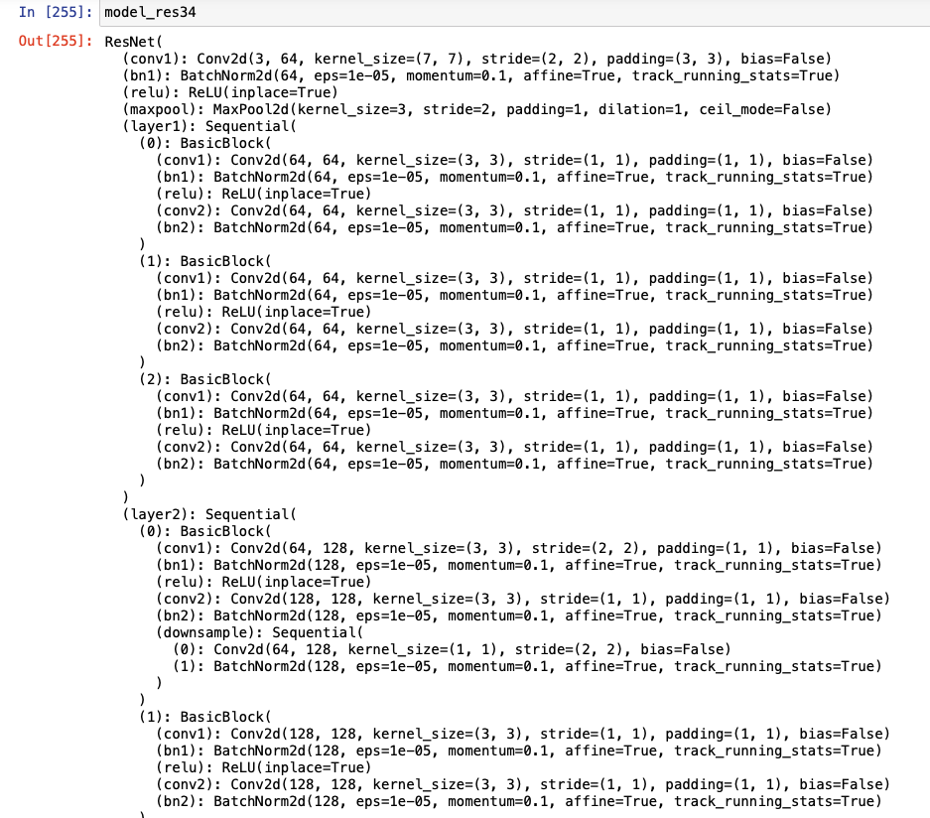
Pretrained models Used
ResNet (can see the architecture of ResNet34 in figure )
VGG
Architecture of ResNet34

Slide 19
Training
First we iterate over the dataloader and we get images and its labels in batches of 100.
We then make all our optimizer gradients to zero (Every time we want to calculate frest gradient to see how well it is doing ).
We then send the images to the network and store the output.
Now we calculate the cross entropy loss between output received from Model and actual label.
We calculate the gradients and take the optimization step. This process keeps on happening till the epochs we have specified.

Slide 20
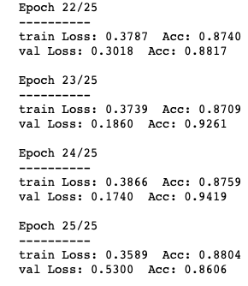
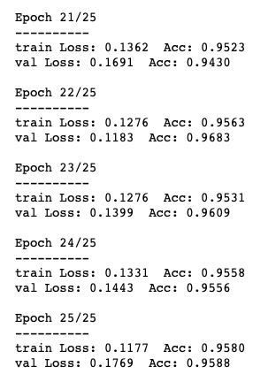
Results
Finally applied the models to the train and validation set.
Received a highest score of around 96% on the validation set ( Figure 2 )
Resnet34
ResNet50 plus Fully Connected Layer
Figure 1
Figure 2

Slide 21
Thank You

