Slide 1
Can AI outsmart a hacker?
DETECT
Agentic Lateral Movement
Detection
Using an AI agent + knowledge graph to find attackers hiding inside a network
Shane · CIS 6930 SP26

Slide 2
The Attacker Is Already Inside
Most attacks aren't a smash-and-grab. They're a slow crawl.
207
61%
1000s
Average days attackers lurk
before detection
Of breaches use
legitimate credentials
Traditional alerts
generated per day in enterprise
Security teams are flooded. Finding one attacker in a sea of alerts is like finding a needle in a haystack — except the needle is wearing a disguise.

Slide 3
What Is Lateral Movement?
🔓
🔑
💻
🏆
Attacker
Gets In
Steals
Credentials
Hops Machine
to Machine
Reaches
Target Data
Using only STOLEN credentials — they look just like normal employees.
This project uses REAL network logs from Los Alamos National Laboratory (LANL) — a U.S. national security research facility — to detect exactly this behavior.

Slide 4
The Approach: Think Like a Detective
Two systems working together — a knowledge graph + an AI agent
🗺 Knowledge Graph (Neo4j)
🤖 AI Agent (GPT-4o)
Stores the whole network as a web of connections:
• Users linked to computers they logged into
• Every login: time, success or fail, method used
• Every program they ran
Ask it: "Has this user EVER logged into this machine before?"
Investigates like a detective — on its own:
Phase 1: Scans the whole time window for suspicious patterns. No one told it who to look at.
Phase 2: Picks the top suspects, digs deep, asks the graph questions, and writes its conclusion.
⟺

Slide 5
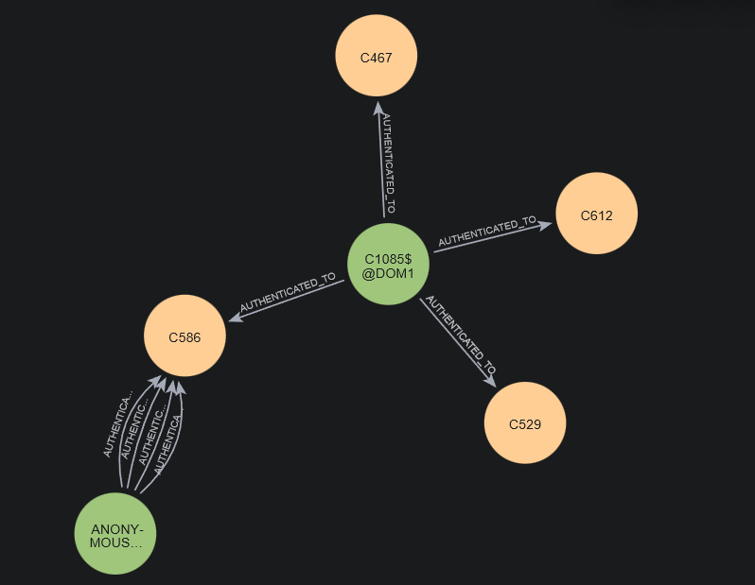
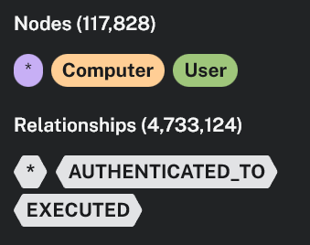
Why Not Just Use SQL Tables?
To find "U456 hopped C5 → C8 → C12", SQL needs 3 joined tables. A graph just follows the edges.
SQL Tables (3 JOINs required)
Knowledge Graph — just follow the edges
users
computers
C17
user_id
name
host_id
name
U100
Alice
C5
Server-5
Hop 1
Hop 2
U456
Bob
C8
DB-8
U456
C8
JOIN #1
JOIN #2
U789
Carol
C12
Admin-12
VS
auth_log (54 million rows)
Hop 3
C22
user_id
host_id
time
status
U456
C5
763210
Success
C12
U456
C8
763450
Success
U456
C12
763900
Success
+ self-JOIN #3 to chain hops
User
Computer
Target
Slower with every extra hop
Stays fast even across 10 hops

Slide 6
The AI's Toolkit: 9 Specialist Tools
Three categories — the agent picks which ones to use, when to use them
🔍 Behavioral Detection
🗺 Network Topology
🔬 Deep Investigation
• Unusual login failures?
• Is this a hub machine everyone uses?
• Full timeline of user activity
• First time on this machine?
• Reconstruct the attacker's travel path
• Who else was on this machine?
• Running unknown programs?
• Who connects through here?
• Active at the same time?
Spots the suspicious fingerprints that humans miss in 10M+ events.
Sees the big picture — which machines are pivot points.
Builds the case — evidence an analyst can read and trust.

Slide 7
Live Demo

Slide 8
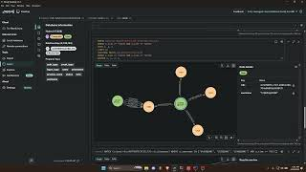
Live Demo
▶
Demo recording
Watch the agent discover an attacker it was never told about — using only raw logs.

Slide 9
Results: Did It Work?
0.978
0.747
0.605
Recall
Agent F1
Precision
Caught 97.8% of real attacks
vs. baseline F1 of 0.732
vs. baseline precision 0.577
Surprising Takeaways
🎯 The miss: an attacker who only touched ONE machine — by definition, not lateral movement.
⚠️ False alarms came from busy hub machines (everyone uses them) — the agent over-flagged shared servers.
🤖 The agent wrote better explanations than expected. It reasoned like an analyst, not just a detector.

Slide 10
The Takeaway
An AI that reads a network
like a detective can find attackers
that static rules simply miss.
Mean F1: 0.747 · Mean Recall: 0.978 · Mean Precision: 0.605
Baseline F1: 0.732 · 338 red-team events · LANL dataset · 30 balanced cases × 3 runs

