Slide 1

KLE’S JAGADGURU TONTADARYA COLLEGE , GADAG DEPARTMENT OF BACHELORS OF COMPUTER APPLICATIONS MINI PROJECT
Under the Guidance of
Prof. Chandrashekhar K

Slide 2
STUDENT PERFORMANCE ANALYSIS SYSTEM
Team:
Shivakumar M Patil
Kiran R Ambore

Slide 3
CONTENTS
1. Abstract
2. Introduction
3. Objectives
4. Aim Of The Project
5. Architecture Diagram
6. Requirements
7. Screenshots
8. Advantages
9. Conclusion
10. References

Slide 4
Abstract
As the name specifies “STUDENT PERFORMANCE ANALYSIS SYSTEM” is the software developed for analyzing the student performances in the academic.
Machine learning regression algorithm is used to predict marks for upcoming test.
The student performance analysis system provides an easy way for the teachers and students in searching the details of the academic attendance report and marks / percentage details the with graph.

Slide 5
introduction
This system aims to develop models which can predict the student’s performance and grades while keeping in mind other equally essential personality factors like interests, attributes which affects their lifestyle.
It uses various machine learning and deep learning techniques to predict the performance of the students.
It helps us to identify the success factors and success blockers.
The project contains an algorithm which analyses attributes like: existing grades, absences, number of hours studied, etc.

Slide 6
objectives
It helps in maintaining students’ records.
Easy for student to view his academic records.
It provides information about Test Performances, detailed analysis of each subject, anytime.
Easy to handle.
Graphical user interface is user friendly.

Slide 7
Aim of the project
The aim of the project is to providing the online interface for students, faculty etc. Student information analysis system aims to improve the efficiency of college information management, and the main function is to predict the upcoming exam’s results with high accuracy and understand where the student is lacking and also providing insights on various aspects of student’s academic performance.

Slide 8
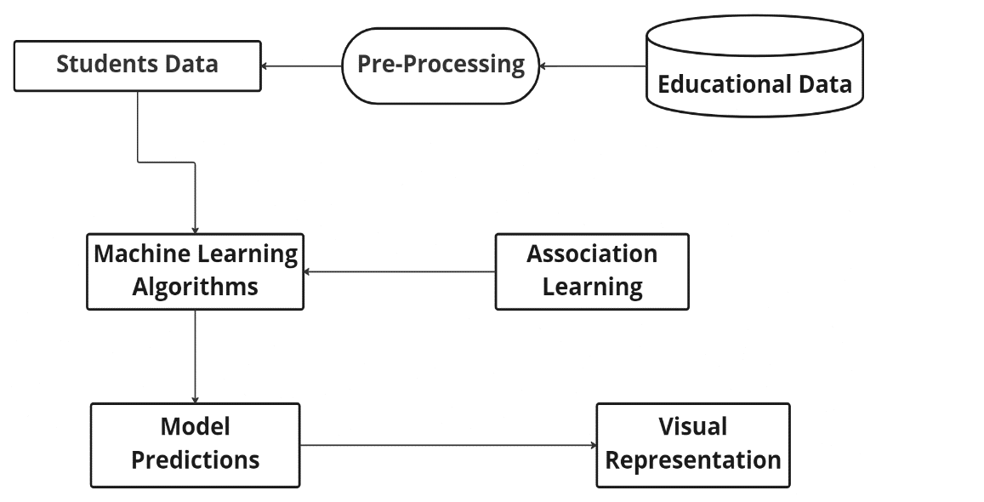
Architecture Diagram

Slide 9
requirements
HARDWARE REQUIREMENTS
Hard-Disk : PC with 30 GB
RAM : 4 GB
SOFTWARE REQUIREMENTS
OS: Windows 7 or above, Linux, Mac
Datasets: excel or csv files
Required python modules
Web Browser
Streamlit (Local host)

Slide 10
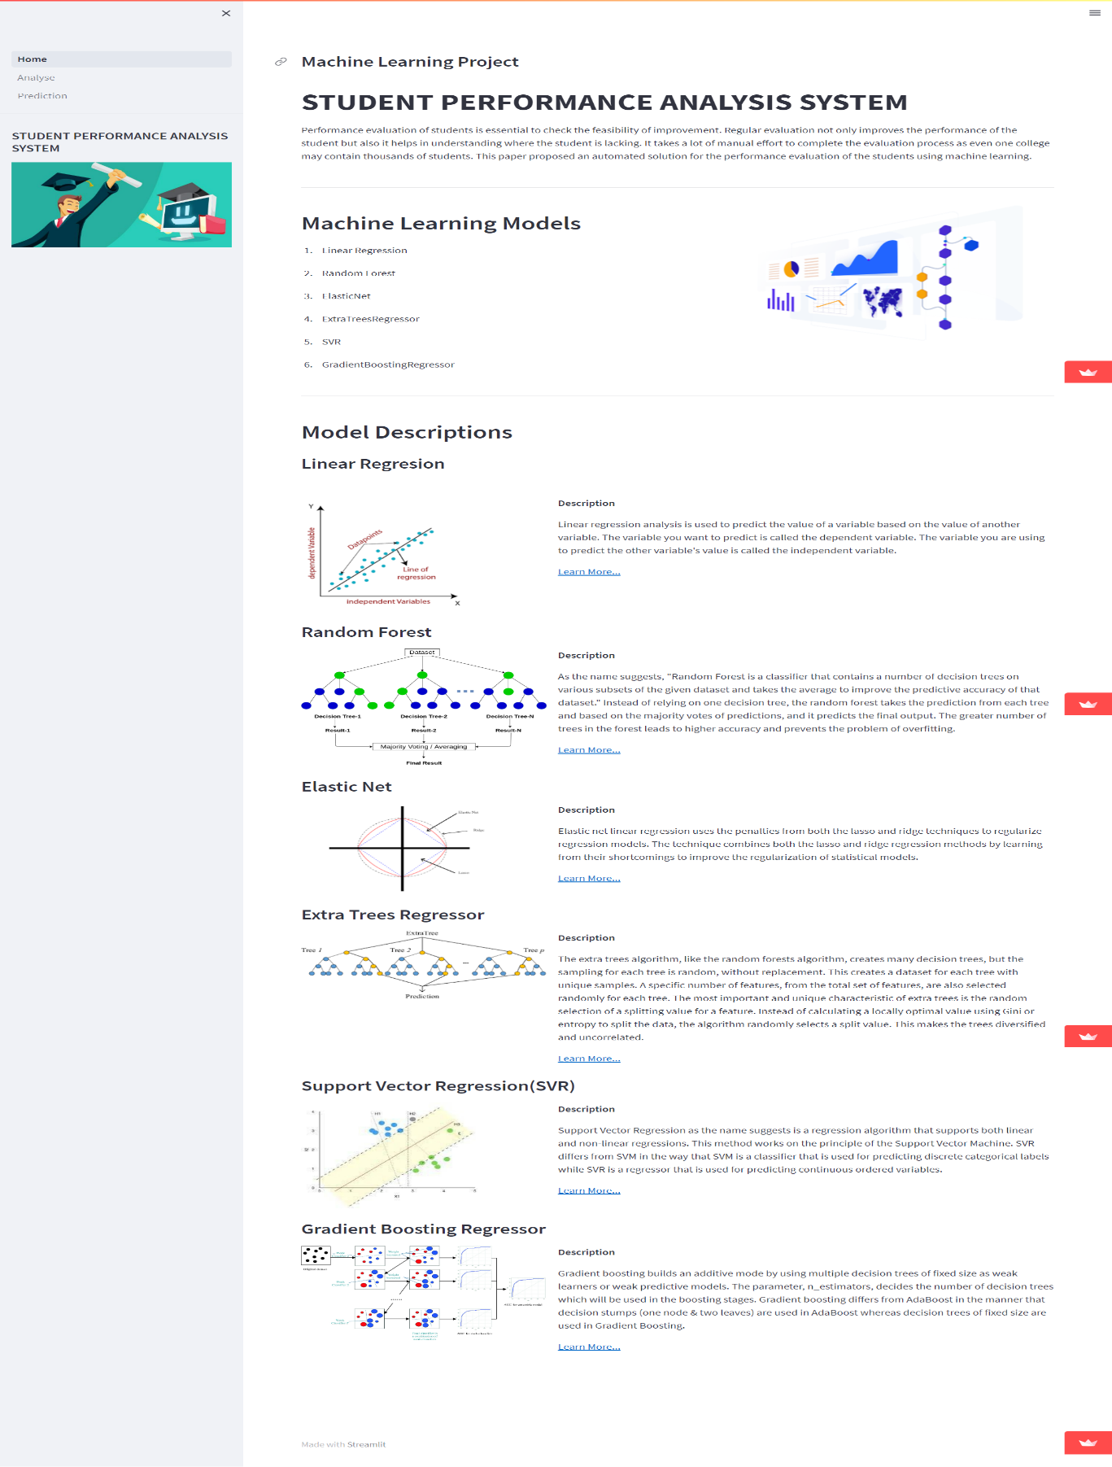

Slide 11
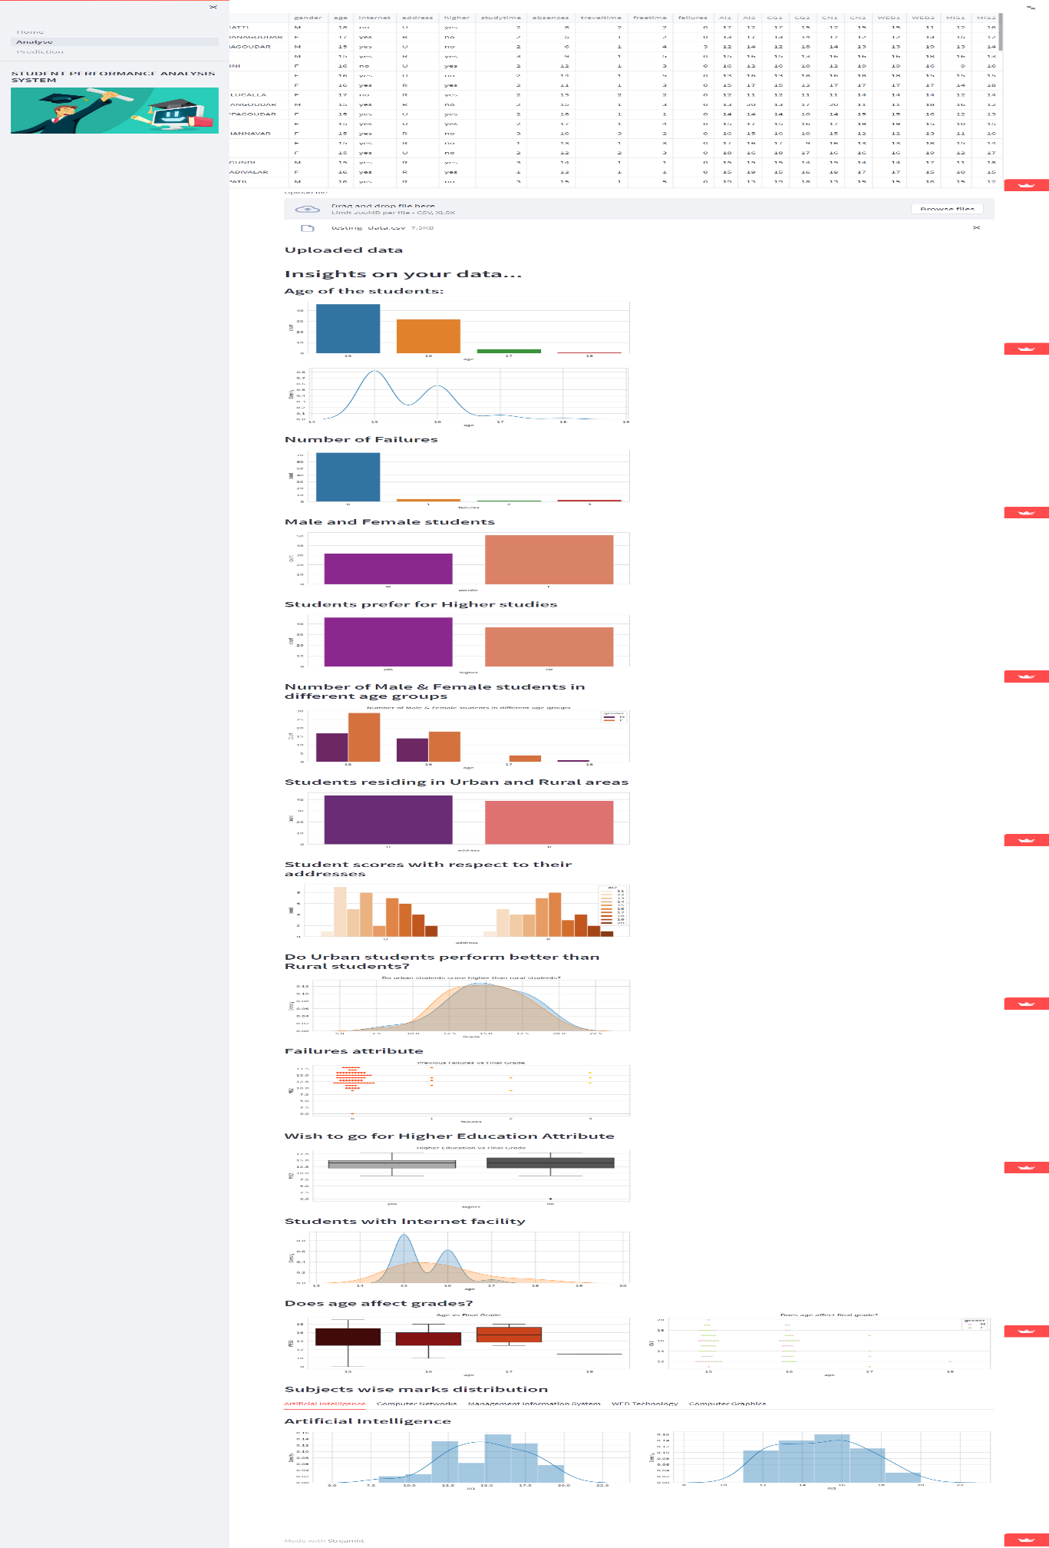

Slide 12
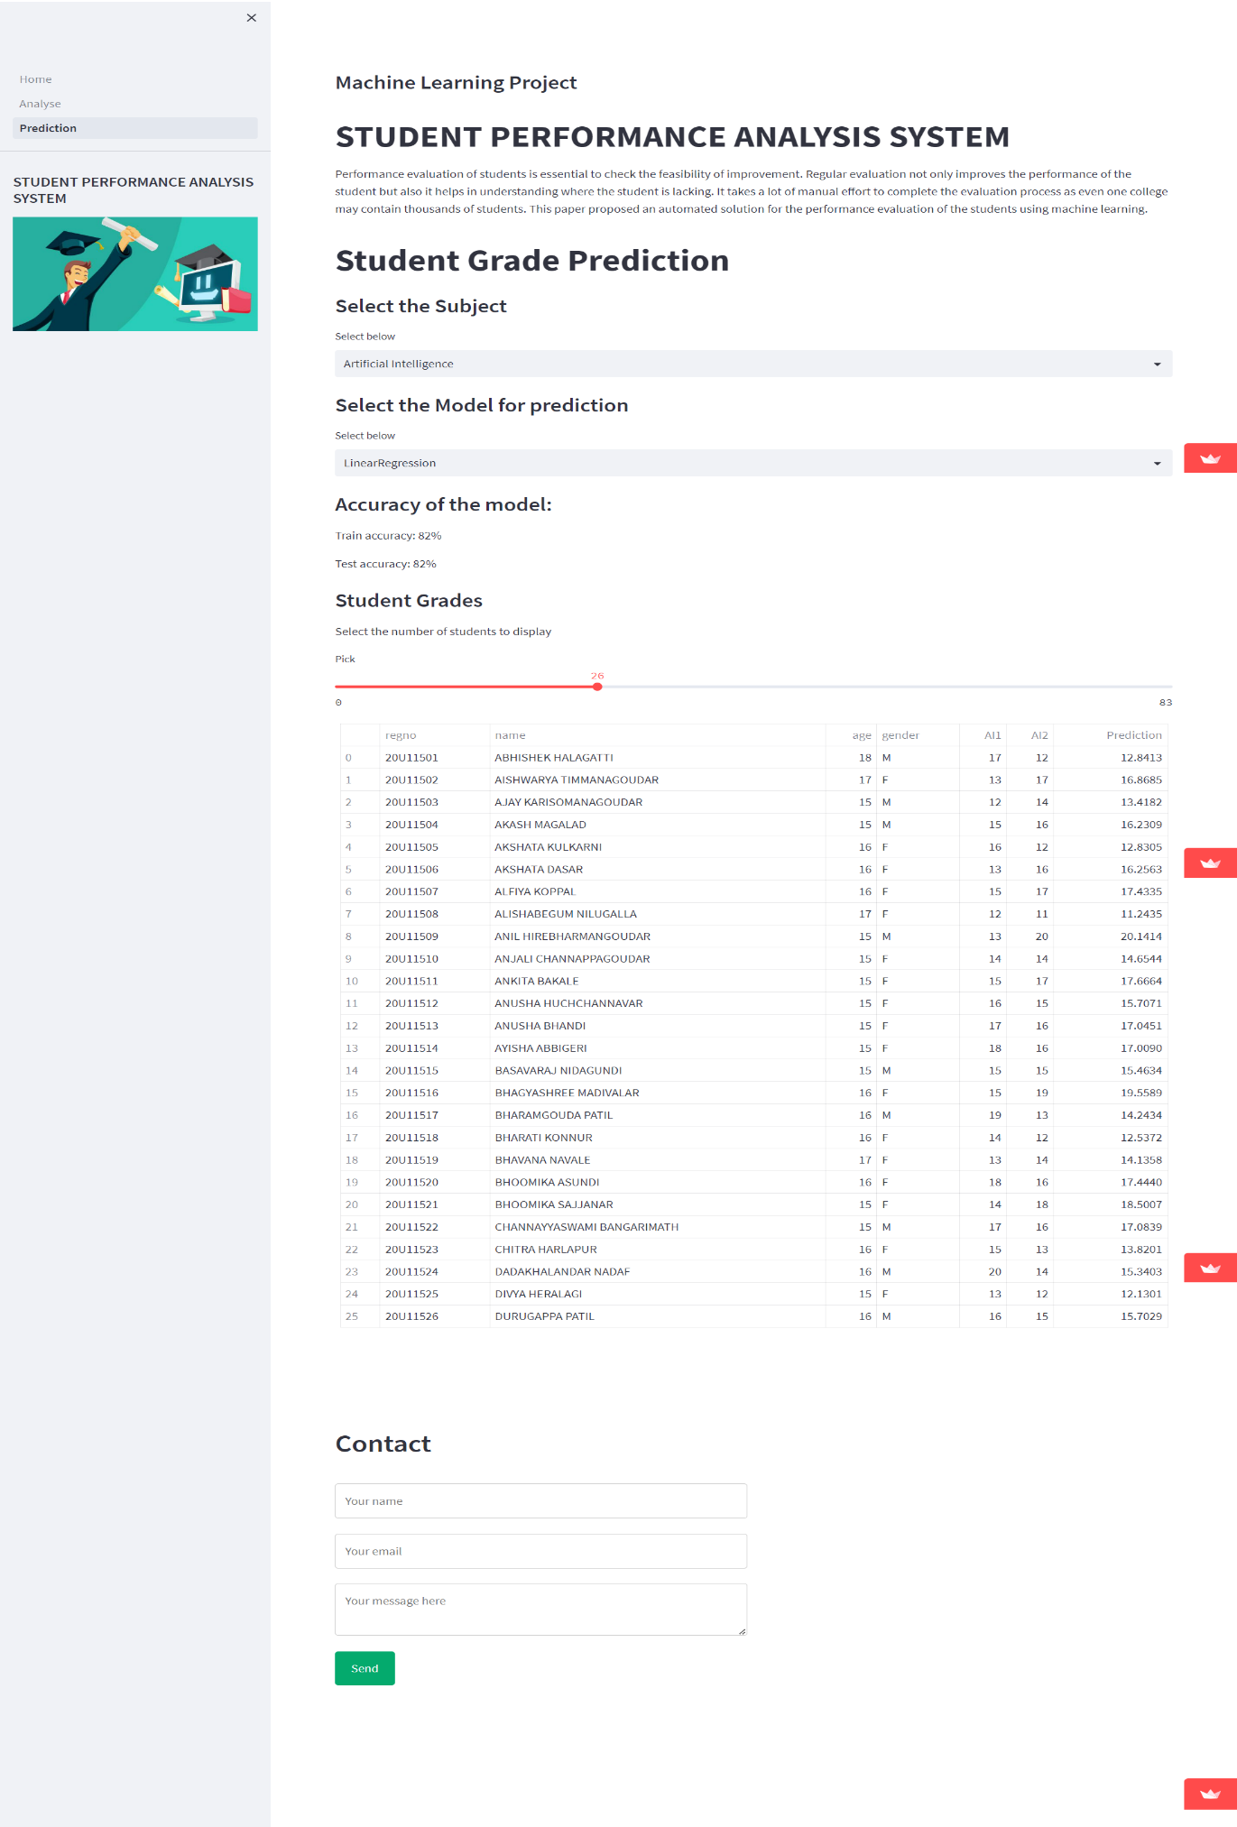

Slide 13
Advantages
1. Easy to handle.
2. It provides information about Test Performances, detailed analysis of each subject, anytime.
3. Graphical user interface is user friendly.

Slide 14
c0nclusion
In conclusion, the project concentrates on the development of a system for student performance analysis. A data mining technique, classification algorithm is applied in this project to ensure the prediction of the student’s performance in course “System Analysis and Design” is possible. The main contribution of the SPAS is that it assists the lecturers in conducting student performance analysis. The system assists lecturers in identifying the student’s that are predicted to fail in the course “System Analysis and Design”.

Slide 15
references
https://docs.python.org/3/
https://pandas.pydata.org/docs/
https://numpy.org/doc/
https://scikit-learn.org/stable/
https://docs.streamlit.io/
https://seaborn.pydata.org/
https://matplotlib.org/stable/index.html
Stack Overflow

Slide 16
Thank you

