Slide 1
The War of Neighborhoods
Using ML Algorithms to Predict Similar Neighborhoods in Delhi

Slide 2
A. Introduction
A.1 Description & Discussion of the Background
Apart from being the capital city of India, Delhi is also one of the most populated metropolitan city in the world where 16.8 million people live. It covers an area of 1,484 square kilometers. This makes its population density reach an astonishing figure of 11 thousands people per square k.m. The fact that so many people are living in so less space makes the neighborhoods rich in amenities like movie theatres, shopping centers, schools and so on.

Slide 3
Our subject of this study has his house located in Dabri Village, Dwarka, he loves his locality mainly because of all the amenities and facilities such as parks, pharmacies, schools, malls, shopping centers, hospitals he gets in his neighborhood.
He receives a very good job offer from a reputed company located on the opposite side of the city i.e. Connaught place, New Delhi. However, given the far distance from his current place if he decides to take up the job offer, he must relocate to the New Delhi. He is willing to take up the job offer but wants to move to a neighborhood in New Delhi which is like his current neighborhood in Dwarka.
In this project we will help our subject find a similar neighborhood in New Delhi.

Slide 4
A.2 Data Description
We will be dealing with the following data in our project:-
Dataset containing Borough and Neighborhood of Delhi, the dataset contains the names of Borough and Neighborhood in Delhi. Here is a link to dataset dataset .
I used python library geopy to extract coordinates of neighborhoods and saved them into a csv file on my computer. Data required some scraping for geopy to correctly give the coordinates of boroughs of Dwarka and New Delhi, since they are our points of concern. Here is a link to dataset coordinates_dataset .
I used Foursquare API to explore the most common places of a neighborhood in form of a json file.

Slide 5
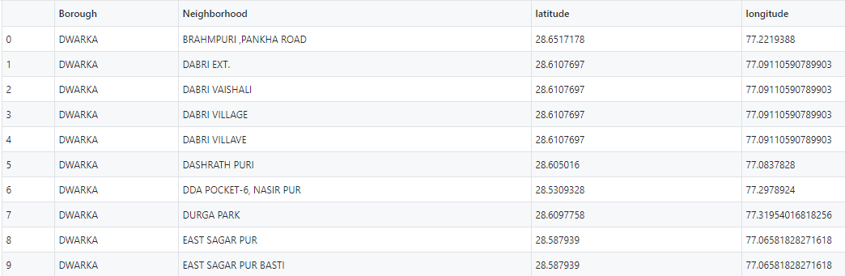
B. Methodology
As dataset I used coordinates_dataset , which i prepared using Election commission dataset. This dataset contains Borough, Neighborhood, Latitude and Longitude of the location.

Slide 6
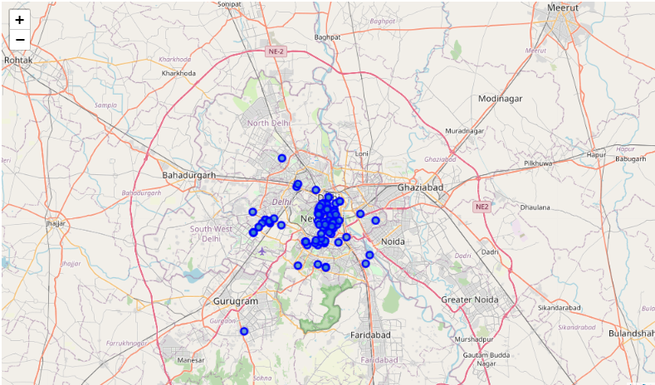
I used python library folium to visualize Delhi, its boroughs and neighborhoods.
Here is a map of Delhi with all the boroughs and neighborhoods of Dwarka and New Delhi represented by a blue circular marker.

Slide 7
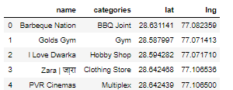
I used Foursquare API to explore the neighborhoods and used json file returned by Foursquare API to extract names and categories of venues nearby our neighborhoods in Dwarka and New Delhi. Here is a snapshot of head of data returned.

Slide 8
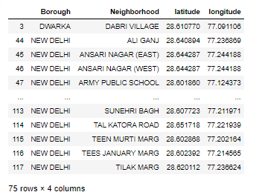
The data also showed that there were 125 unique venue categories in all neighborhoods of New Delhi and Neighborhood of Dabri Village.
Since, our subject needs to find a neighborhood like Dabri village, Dwarka in New Delhi area, i dropped all the other irrelevant neighborhoods of Dwarka. Now our dataset only contains the parameters of Dabri village and neighborhoods of New Delhi.

Slide 9
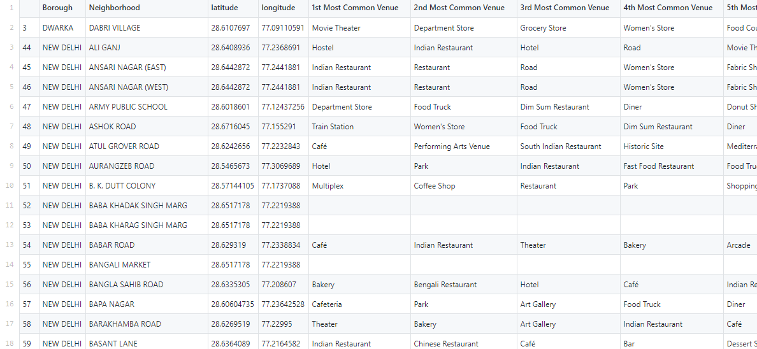
I used Foursquare API to return top 10 most common venues in a neighborhood.

Slide 10
click here to go to the database in my Github repository.
I then used machine learning algorithm KNN to cluster the neighborhoods of New Delhi and Dabri village, Dwarka.

Slide 11
K Means is a nonparametric clustering algorithm used for clustering data. K-means clustering is an unsupervised clustering algorithm that gathers and groups data into k number of clusters. K-means divides the data into non-overlapping subsets (clusters) without any cluster-internal structure. The data within a cluster is very similar, data across different clusters is very different. The variable k is a parameter that will be established by the machine learning engineer. I chose k=5 after running accuracy tests on the data.
Finally I used python library geopy to compute distances between coordinates considering the elliptical curvature of Earth.

Slide 12
C. Result
After doing the fit on data, the model returned 5 clusters, namely cluster 0, cluster 1, cluster 2, cluster 3, cluster 4. each cluster comprises of many neighborhood which are similar to each other. This means neighborhoods or localities which are in cluster 0 are similar to all other neighborhoods or localities in cluster 0. same goes with other clusters. The algorithm computes the similarity between neighborhood by computing the Euclidian distance, the lesser the Euclidian distance, more the similarity.

Slide 13
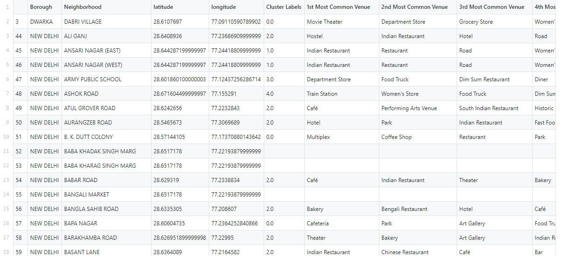
Following is a snapshot of dataset containing, neighborhood's name , coordinates, top 10 venues and cluster number. Click here to go to dataset.

Slide 14
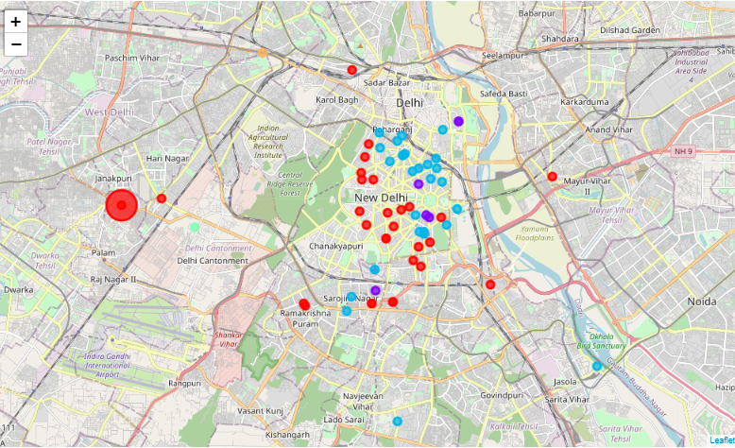
This is a map of Delhi with clusters. Notice the big red circle marker on map which is bigger than all other circle markers, that is our Dabri village.
All the red markers are our cluster 0, that means these all neighborhoods are similar to our subject's neighborhood in Dabri village, Dwarka.

Slide 15
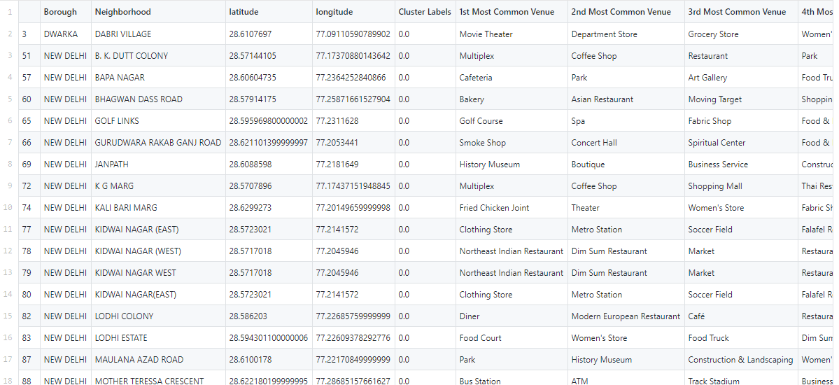
Here is a snap from database containing all the neighborhoods which lie in cluster 0.
click here to go to the above database.

Slide 16
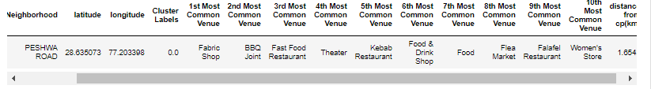
There were total 29 neighborhoods in cluster 0 excluding Dabri village.
Since, there are 29 neighborhoods, where should our subject should relocate to. His first criterion of similarity is fulfilled. I think he will now focus on the distance between these neighborhoods and Connaught place, remember he got a job offer from a reputed company located in Connaught place.
I calculated the distance between these neighborhoods and Connaught place and found that Peshwa Road locality in New Delhi is nearest to Connaught place and this locality is very similar to Dabri village.

Slide 17
D. Discussion
Delhi is a big city with diverse boroughs and neighborhoods. Different clustering algorithms can yield different clustering.
I used K Means technique, since I have good past experience with it. I tested the algorithm for different values of k ranging from 1 to 9 and checked the accuracy scores with each value of k. I found k=5 to be the optimum value of k. The coordinates of all the neighborhoods of New Delhi and Dabri village were used. Some neighborhoods didn't return popular venues, hence, their cluster couldn't be determined by K means algorithm, although their number is very small and hence they do not deviate our accuracy.

Slide 18
Python library folium has been used to create map visualizations of cluster data.
I ended study by finding the nearest neighborhood from Connaught place in New Delhi. In future studies some other criteria can be carried out.

Slide 19
F. Conclusion
Relocation due to better economic opportunities is very common now a days. Studies like this can help people better adjust to their new neighborhood.
Real Estate companies can help their customers by providing better and smooth relocation by using similar data analysis.
Thank you
Shivam Goswami

Slide 20
G. References
Delhi localities
Foursquare API

Slide 21
Feel free to check my code by clicking here , this will redirect you to my github repository containing code. You can check all the important databases generated in this project by clicking here .

