Slide 1

Sales, Expense and Revenue Computation Interactive Dashboard
END TERM EXAMINATION
INT217: INTRODUCTION TO DATA MANAGEMENT

Slide 2

What is financial analysis?
Financial analysis is the process of evaluating businesses, projects, budgets, and other finance-related transactions to determine their performance and suitability. Typically, financial analysis is used to analyze whether an entity is stable, solvent (Solvency is the ability of a company to meet its long-term debts and financial obligations. ), liquid,(Liquidity refers to the ease with which an asset, or security, can be converted into ready cash without affecting its market price.) or profitable enough to warrant a monetary investment.

Slide 3
What is dashboard and business Intelligence benefit?
A dashboard is a type of graphical user interface which often provides at-a-glance views of key performance indicators relevant to a particular objective or business process.
BI dashboards provide greater visibility with information available whenever it is required to ensure businesses are better placed to respond to changing market conditions.
With BI dashboards, you are no longer wasting valuable time generating reports from multiple systems. Instead, data is drawn from a centralized source and displayed as an easy to interpret visual overview.
With real-time, accurate insight on current customers purchasing behaviours, you have a better chance of achieving higher retention rates and increased revenue. Real-time insight allows sales teams to concentrate on the right customers at the right time, ensuring marketing efforts and activities are focused toward the right clients.

Slide 4
Dataset I chose to study
I have selected my dataset from Kaggle. Kaggle provides cutting-edge data science, faster and better than most people ever thought possible.
This dataset contains sales, revenue, expense, operational details of an organisation according to different region, year.
I have performed statistical operation to create analytical dashboard on financial conditions of an organisation.
Analytical dashboard is one of the types of dashboards (Operational Dashboards, Strategic / Executive Dashboards, Strategic / Executive Dashboards)
Analytical dashboards focus on accumulating insights for data over time – often the past month or quarter. These insights are then used to understand what happened, why it happened, and what changes can and should be made to positively affect these in the future.

Slide 5
If conducted internally, financial analysis can help managers make future business decisions or review historical trends for past successes.
If conducted externally, financial analysis can help investors choose the best possible investment opportunities.
There are two main types of financial analysis: fundamental analysis and technical analysis.
Fundamental analysis uses ratios and financial statement data to determine the intrinsic value of a security.
Technical analysis assumes a security's value is already determined by its price, and it focuses instead on trends in value over time.
Benefits

Slide 6
Objectives
1. Finding the expense trend using the given dataset
Expense Trends Analysis (ETA) is designed specifically for individuals who want to look at summarized expense data over time.
To calculate the quarter wise expense I have added three-month revenue for each quarter to (Jul, Aug and Sep for quarter 1 and so on for other quarters of the year) and this, I have used the sum function whose input was taken from the pivot table created for this analysis with region and year as rows and each month as values. I have created the table for each quarter of each year. And chart was created from that table and pivot table.
And same was done for the revenue trend.

Slide 7
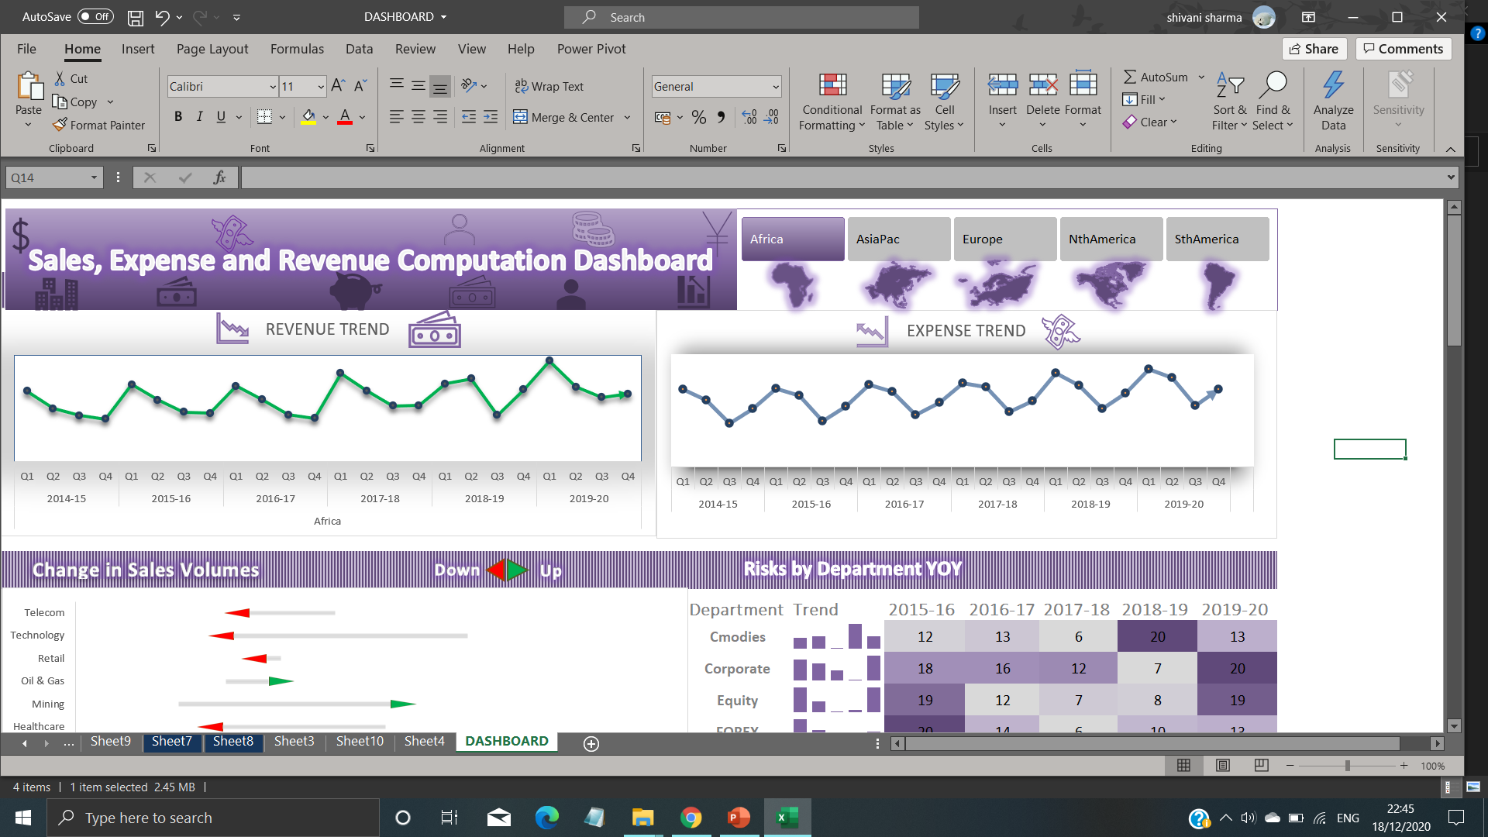

Slide 8
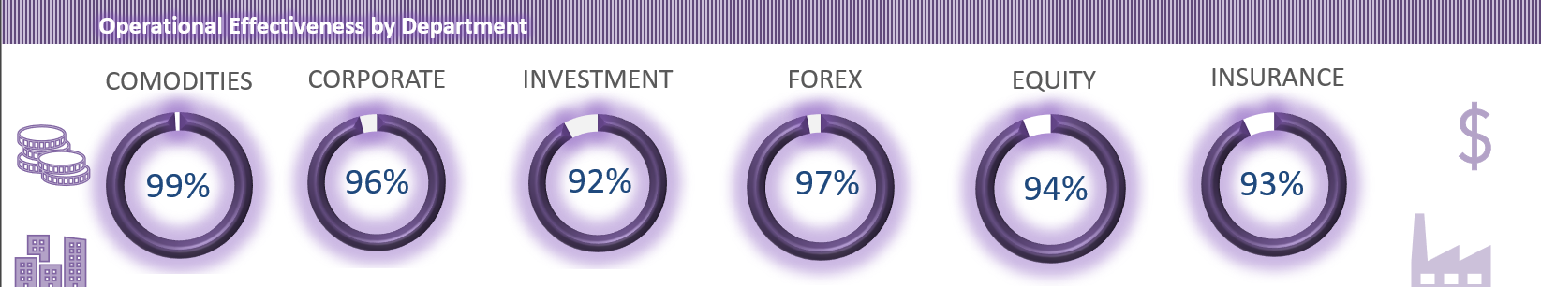
2. Finding Operational Effectiveness by Department
Operational effectiveness is a core objective of enterprise and IT governance where organizations seek to maximize the efficient use of resources in their business operations and to improve quality, productivity, or competitive positioning in markets in which they participate.

Slide 9
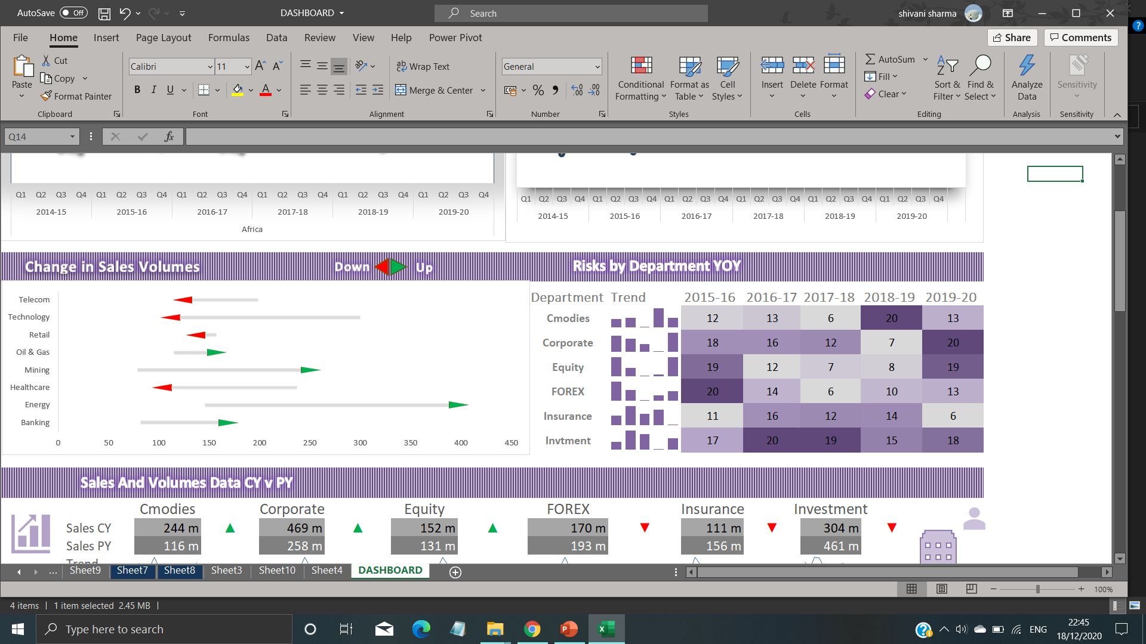
3. Finding change in Sales Volumes FY (Fiscal Year)
Sales volume is the number of units that are sold in a given period. Here comparing current year sales volume with previous year sales volume.

Slide 10
4. Finding Sales Volumes FY Data CY v PY
A company's fiscal year is its financial year; it is any 12-month period that the company uses for accounting purposes. The fiscal year is expressed by stating the year-end date. A fiscal year-end is usually the end of any quarter, such as March 31, June 30, September 30, or December 31.
Sales volume is the number of units that are sold in a given period. This is not to be confused with total sales, which are usually quantified as a monetary value.

Slide 11
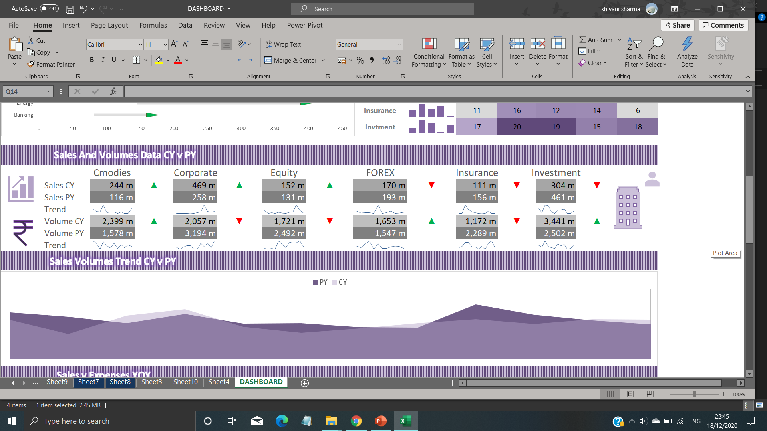

Slide 12
5. Finding the revenue trend using dataset
Revenue growth is the increase, or decrease, in a company's sales between two periods. Communicated as a percentage, revenue growth demonstrates the degree to which your company's revenue has grown (or shrunk) over time.

Slide 13
Dashboard
Slicer
Slicers give you the ability to add an attractive as well as interactive user interface to your dashboards and reports. Slicers allow you to filter your pivot table in a way that’s similar to the way Filter fields filter a pivot table. The difference is that slicers offer a user-friendly interface, enabling you to better manage the filter state of your pivot table reports.
Here from parent table, using region slicer is connected with other tables using power pivoting.

Slide 14
Other visualizations in dashboard
Conditional formatting is a feature in many spreadsheet applications that allows you to apply specific formatting to cells that meet certain criteria. It is most often used as color-based formatting to highlight, emphasize, or differentiate among data and information stored in a spreadsheet.
A sparkline is a very small line or bar chart, typically drawn without axes or coordinates. It presents the general shape of the variation in some measurement, such as temperature or stock market price, in a simple and highly condensed way

Slide 15
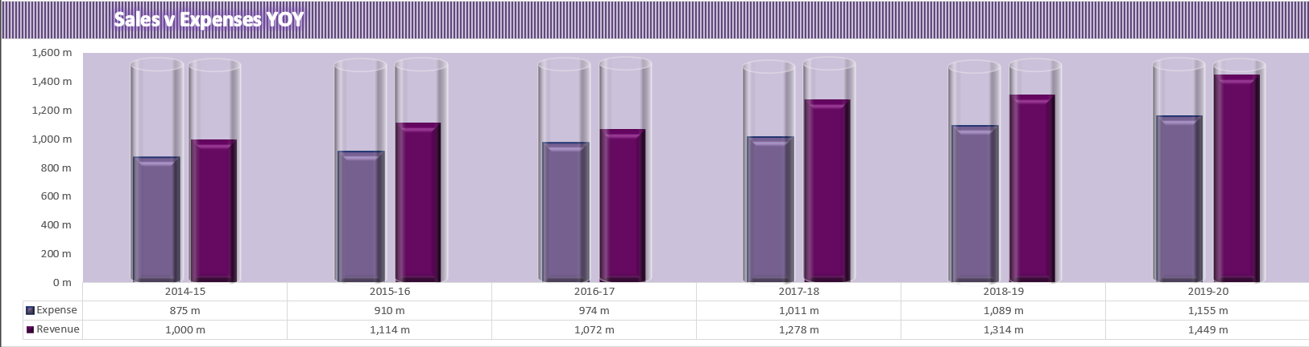
Pivot tables are one of Excel's most powerful features. A pivot table allows you to extract the significance from a large, detailed data set.
Power Pivot is an Excel add-in you can use to perform powerful data analysis and create sophisticated data models. With Power Pivot, you can mash up large volumes of data from various sources, perform information analysis rapidly, and share insights easily.

Slide 16
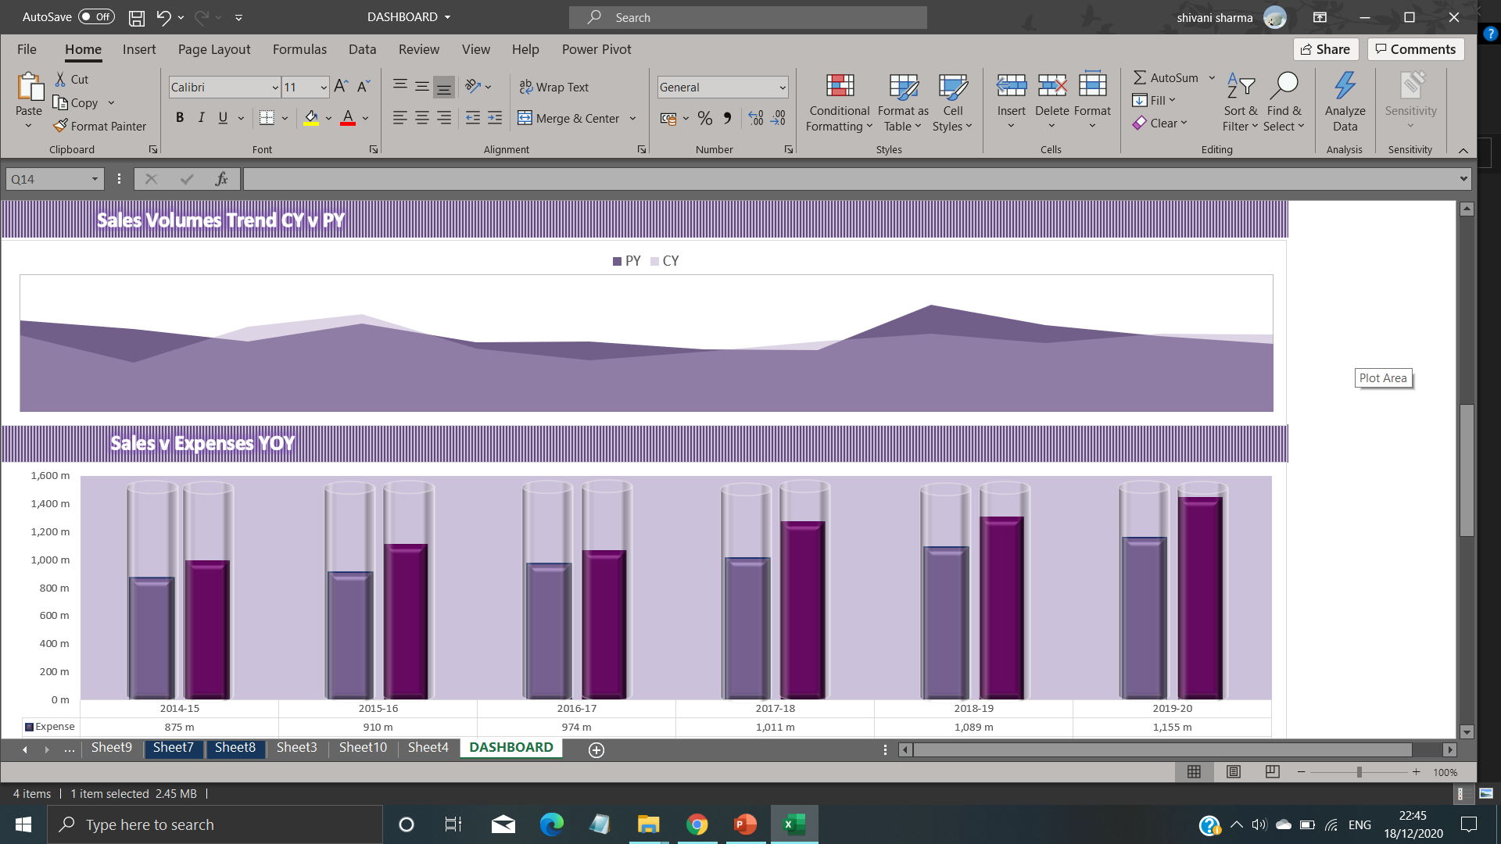
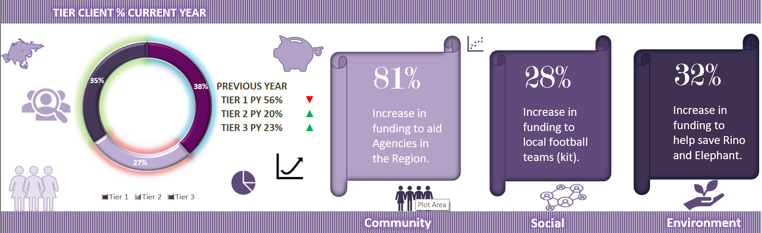

Slide 17
Thank you

