Slide 1

Healthcare Analytics for Doctor Visits
Shiwank Singh

Slide 2

PROBLEM STATEMENT
Healthcare services need evidence to understand patterns in demand. This project explores a dataset of 5,190 records to investigate how the number of reported illnesses, health indicators, age scale, income and healthcare support relate to doctor visits.
Problem question: Which recorded factors are associated with higher average doctor visits?
The analysis describes patterns in the available data; it does not diagnose patients or prove cause and effect.

Slide 3
PROJECT DESCRIPTION
• Load and inspect the provided healthcare dataset.
• Check data types, missing values and duplicate records.
• Summarize the distribution of doctor visits.
• Compare average visits across illness counts, chronic-condition indicator, gender and age groups.
• Examine correlations between visits and selected numeric variables.
• Present findings through clear charts and concise observations.
Scope: descriptive analysis of the supplied records; no prediction model or clinical recommendations are claimed.

Slide 4

WHO ARE THE END USERS?
• Healthcare administrators: understand patterns in service use.
• Public-health students and researchers: explore associations in health-related data.
• Data analytics learners: practice data cleaning, grouping, visualization and interpretation.
• Healthcare planners: use descriptive evidence as a starting point for further investigation.
Note: the dataset is for educational analysis and should not be used to make decisions about an individual patient.

Slide 5

Technology Used
PYTHON
Data processing and analysis
PANDAS + NUMPY
Data loading, cleaning and summaries
MATPLOTLIB
Charts and visual exploration
JUPYTER NOTEBOOK
Reproducible analysis workflow
CSV DATASET
5,190 records • 13 columns
METHODS
Descriptive statistics, group averages and correlation checks

Slide 6
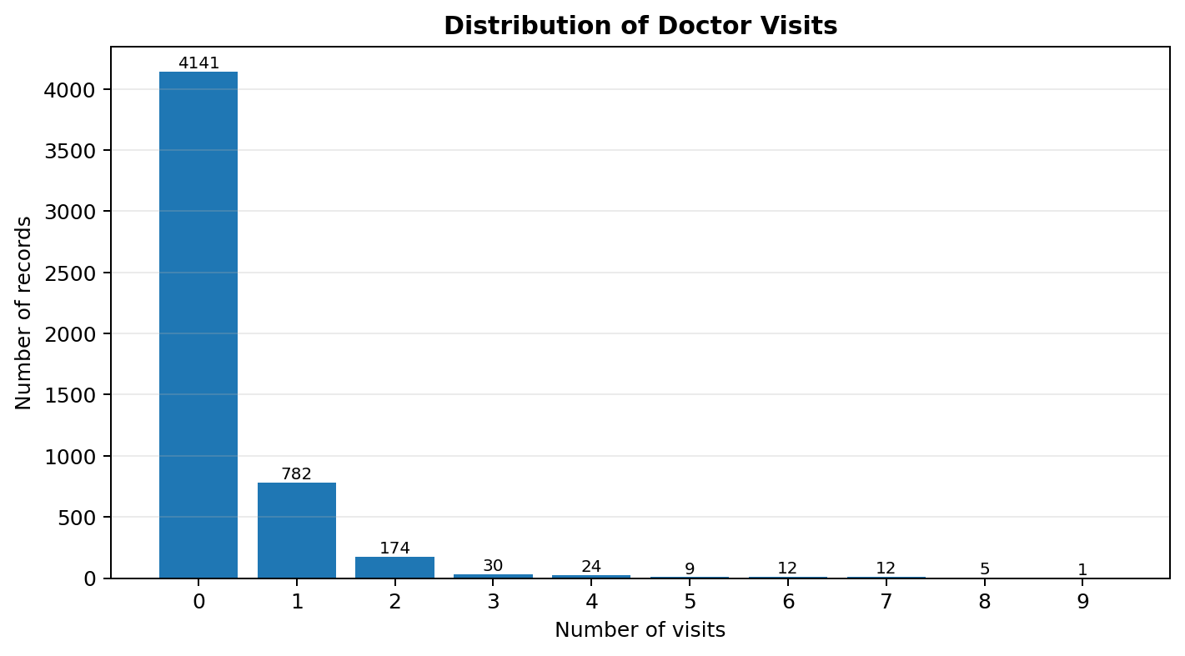
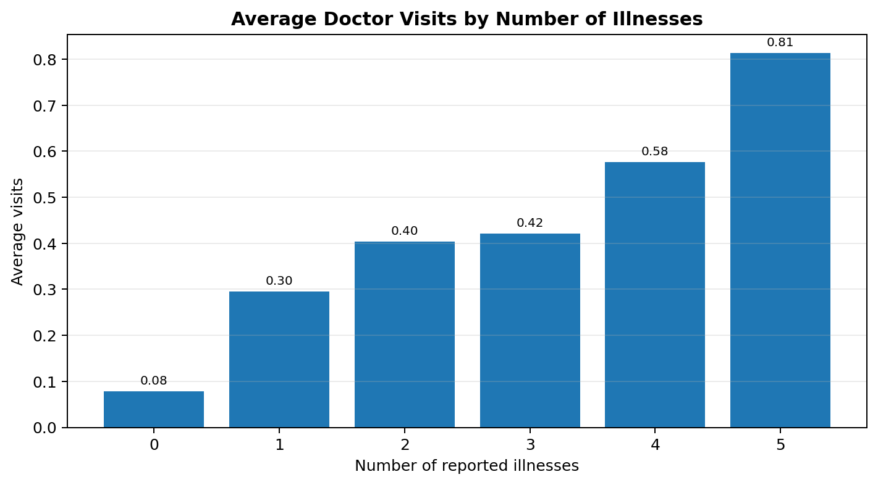
RESULTS & FINDINGS
Records analysed: 5,190
Average visits: 0.302
Median visits: 0
Zero visits: 79.8%
Key analysis charts
Project files: notebook, dataset and charts are included in the project folder.

Slide 7
Thank You
.
.

