Slide 1


Institute for Advanced Computing & Software Development Pune
PG-DBDA SEPT 2023
Project
Topic - Build a model to predict stock market performance using LSTM
Submitted By:
Group No: 5
Roll No: Name:
239548 Viraj Kawade
239540 Shreyas Dande

Slide 2
Introduction
The stock market is a dynamic environment influenced by various factors such as economic conditions, political events, and investor sentiment. Predicting stock market performance is crucial for investors, traders, and financial analysts to make informed decisions. In this project, we aim to develop a predictive model using Long Short-Term Memory (LSTM) networks, a type of recurrent neural network (RNN), to forecast stock prices.

Slide 3
Objective
Develop a predictive model for stock market performance using LSTM networks.
Leverage historical stock price data and deep learning techniques to forecast future stock prices accurately.

Slide 4
Overview
Data Preparation: Preprocess historical stock price data for model training.
LSTM Model Training: Design and train an LSTM neural network using preprocessed data.
Model Evaluation: Evaluate the trained LSTM model's performance using test data.
Visualization: Visualize actual vs. predicted stock prices to assess model accuracy.

Slide 5
Data Preparation
Import historical stock price data (Google_Stock_Price_Train.csv).
Clean and preprocess data, including normalization and feature engineering.

Slide 6
LSTM Model Training
Define LSTM model architecture with multiple LSTM layers and dropout regularization.
Compile the model using appropriate loss function and optimizer.
Train the model using training data with 200 epochs.

Slide 7
Model Evaluation
Load test data (Google_Stock_Price_Test.csv) for evaluation.
Prepare test dataset and generate predictions using the trained LSTM model.
Assess model performance using metrics such as mean squared error and coefficient of determination (R-squared).

Slide 8
Visualization
Plot actual vs. predicted Google stock prices for January 2017 using Matplotlib.
Analyze the visual representation to understand the accuracy and effectiveness of the LSTM model.

Slide 9
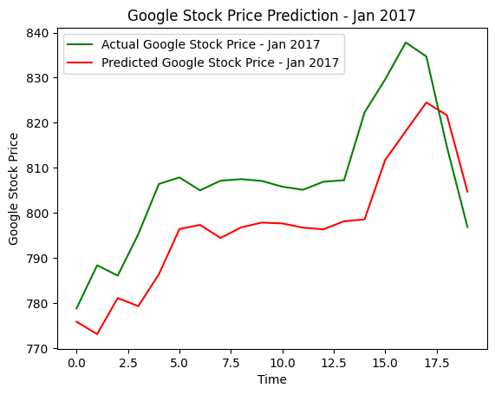

Slide 10
Conclusion
The project demonstrates the application of LSTM networks in predicting stock market performance.
By leveraging deep learning techniques and historical stock price data, we developed a predictive model capable of forecasting future stock prices.
Further research and refinement of the model could lead to improved performance and broader applications in financial markets.

Slide 11
References
TensorFlow Documentation
Keras Documentation
Scikit-learn Documentation
Pandas Documentation
Matplotlib Documentation

Slide 12
Thank You

