Slide 1

Basic Details of the Team and Problem Statement
Ministry/Organization Name/Student Innovation:
White Hour Solutions
PS Code: SJ572
Problem Statement Title: Hosting a blockchain code on to a cloud network in order to create a prototype app in the Healthcare sector
Team Name: SimpleSenary
Team Leader Name: Shubham Bhola
Institute Code (AISHE): U-1056
Institute Name: Netaji Subhash University of Technology

Slide 2
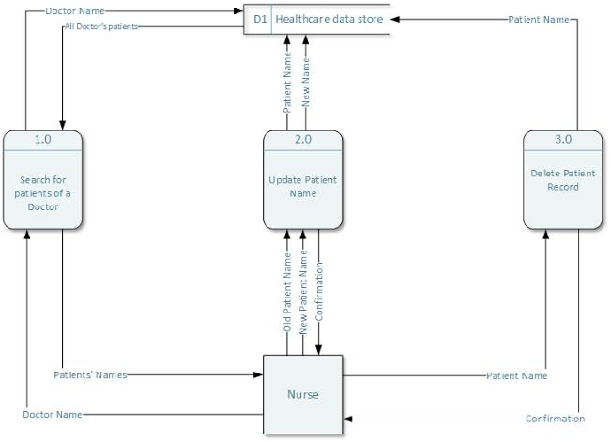
Idea/Approach Details
Describe your idea/Solution/Prototype here:
The idea is to store the data of patients, doctors and other staff on a blockchain so that a large amount of data can be stored very efficiently and securely. Through this we can also establish a proper chain of custody in drug shipments also.
We can even implement a patient-centric electronic health record for better user experience.
Describe your Technology stack here:
React
Solidity
Ethereum
Metamask

Slide 3
Idea/Approach Details
Describe your Use Cases here
Describe your Dependencies / Show stopper here
Blockchain and Healthcare to Enhance the Security and Control of Healthcare Transactions.
Blockchain to Establish Proper Chain of Custody in Drug Shipments.
Patient-centric electronic health records.
Medical Staff credential verification.
Regulations have always struggled to keep up with advances in technology.
Decentralised networks can be much less resilient to shocks, which can impact participants directly, unless careful thought is given to their design.
It places trust and authority in a decentralized network rather than in a powerful central institution. And for most, this loss of control can be deeply unsettling.

Slide 4
Team Member Details
Team Leader Name: Shubham Bhola
Branch : Btech Stream (ECE, CSE etc): IT Year (I,II,III,IV): II
Team Member 1 Name: Kartikey Mishra
Branch : Btech Stream (ECE, CSE etc): IT Year (I,II,III,IV): II
Team Member 2 Name: Rohit Sharma
Branch : Btech Stream (ECE, CSE etc): CSE Year (I,II,III,IV): II
Team Member 3 Name: Krati Jain
Branch : Btech Stream (ECE, CSE etc): ICE Year (I,II,III,IV): II
Team Member 4 Name: Pushkin Sharma
Branch : Btech Stream (ECE, CSE etc): ICE Year (I,II,III,IV): II
Team Member 5 Name: Devansh Khandelwal
Branch : Btech Stream (ECE, CSE etc): EE Year (I,II,III,IV): II
Team Mentor 1 Name: Dr. Mohinder Pal Singh Bhatia
Category: Academic Expertise: Software Engineering, Operating Systems for software submissions
Domain Experience (in years): 30+
Team Mentor 2 Name: Dr. Pinaki
Category: Academic Expertise: UI/UX, Backend Engineering
Domain Experience (in years): 20+

