Slide 1

Global Finance Services
Brand Identity and Style Guide

Slide 2

Out with the old, in with the new
GFS brand refresh for 2026
We are excited to announce that GFS has a refreshed brand for 2026! Our previous imagery, color palettes, and templates have helped define who we are for the last seven years, but our commitment to innovation makes it a perfect time for an update!
New branding guidelines take effect 30 January 2026.

Slide 3
Please refer to this updated Style Guide as your single source for brand materials, templates, and guidance.
The use of circular imagery and icons are approved and aligned with Deloitte Global Brand guidelines. The imagery and icons that follow have been selected specifically to represent GFS concepts and services.
Audience: GFS professionals and member firms.

Slide 4

GFS Style Guide | Table of contents
Imagery
GFS hero image and expanded hero image
5
Icons
GFS strategic goals, pillars, and shared services catalog
11
Color palettes
15
Global brand guidance
17
Fonts, language, and Global tagline
Email signature and templates
22
Frequently asked questions
27
Appendix
Key tips for staying on brand
30
Key tips for confirming font
32

Slide 5

Imagery

Slide 6






GFS Style Guide | Brand identity
Standard imagery and wordmark
HERO IMAGE (‘SYMBOL OF GFS’)
EXPANDED HERO IMAGE
WORDMARK (TEXT LOGO FOR SWIFT)
This image (or circular motif) establishes brand identity for GFS. It should be the primary image used for client-facing and/or internal GFS communications.
This image is an expansion of the GFS primary image. It incorporates the four strategic goals that highlight our core principles and brand identity. It can be used as an alternative option for GFS email communications.
The wordmark is used to establish brand identity for the SWIFT platform and can be utilized with the GFS imagery or as a standalone for SWIFT collateral and deliverables.
REPLACES PREVIOUS FIREBALL IMAGE
REPLACES PREVIOUS LIGHTBULB ICON
NO CHANGES, STAYS AS IS

Slide 7
GFS Style Guide | Hero image
What it symbolizes
Purpose and usage
Our new brand imagery signals a fresh, renewed outlook for GFS as we continue to transform, innovate, and expand our global presence.
The globe takes center stage, symbolizing interconnectedness to global collaboration. The five-point star represents our ongoing pursuit of exceptional, world-class services for our clients. The infinity shape emphasizes our limitless opportunity and influence.
Together, these elements capture the GFS drive for growth and progress, evoking a strong sense of purpose and our commitment to creating lasting, positive impact.
When to use it
Cover slide for GFS PowerPoint and Word documents
GFS email communications
GFS general marketing collateral
GFS website, the intelliHUB
GFS banners
GFS posters
Hero image (the "symbol of GFS")
This image establishes a new brand identity for Global Finance Services. It should be the primary image used for client-facing and internal GFS communications.
It replaces the previously used fireball motif.
How to use it
Use templates in this deck
Copy/paste image 1 as needed into GFS documents

Slide 8
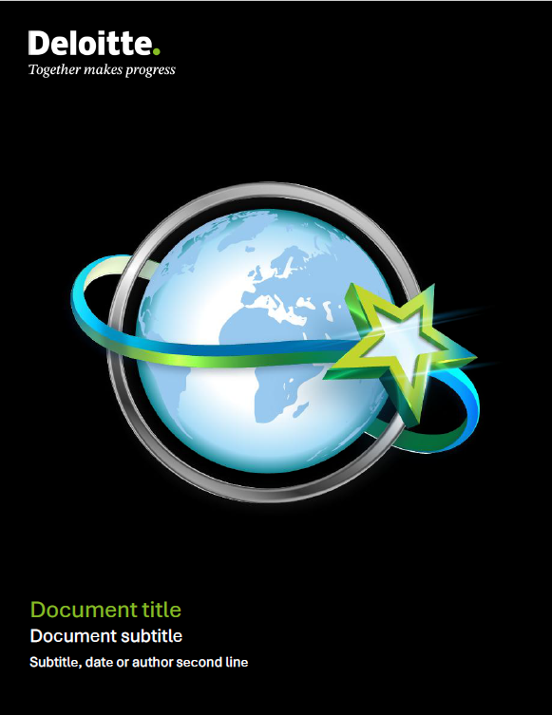


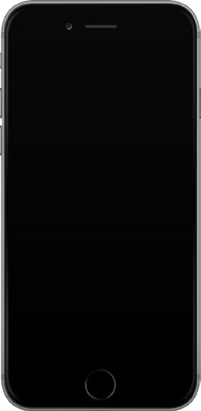

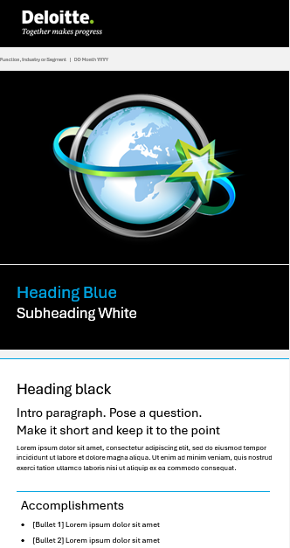
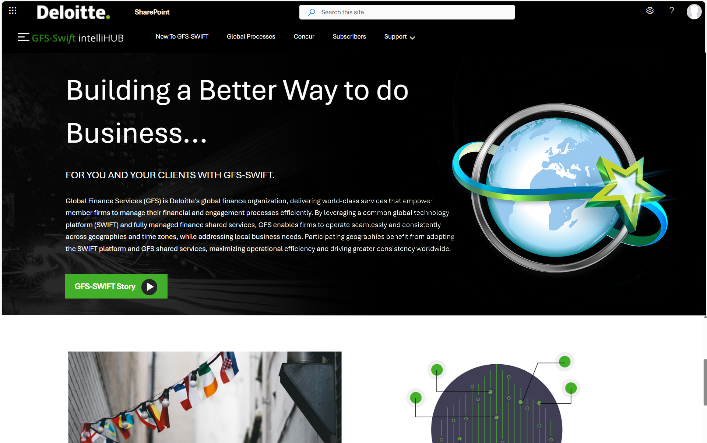

GFS Style Guide | Hero image applications
Document cover / poster
Presentation cover on tablet
Email template On mobile device
GFS website landing page on tablet
Web banner
Global Finance Services
www.deloitte.com

Slide 9
GFS Style Guide | Expanded hero image
Purpose and usage
What it symbolizes
This image is an expansion of the GFS primary or hero image. It incorporates the four GFS strategic objectives to highlight our core principles and broadly showcase the brand identity.
For more details on the GFS strategic goals, refer to slide 12.
When to use it
Alternative option for GFS email communications
GFS general marketing collateral or presentations - as approved by GFS Leadership team
Expanded hero image
How to use it
This image replaces the previous lightbulb icon.
Use email templates in this deck
Copy/paste image 2 as needed into GFS documents

Slide 10
GFS Style Guide | SWIFT wordmark
Purpose and usage
What it symbolizes
This wordmark identifies the SWIFT brand, which is the GFS global finance platform, powered by SAP S4 HANA.
When to use it
On SWIFT-specific communications and deliverables
As a background option during SWIFT-specific meetings with geography stakeholders
Wordmark (Text logo for Swift)
How to use it
The wordmark is used to establish brand identity for the SWIFT platform. It can be used with the GFS imagery or as a standalone image for SWIFT collateral and deliverables.
Copy/paste wordmark as needed into GFS documents

Slide 11
Icons

Slide 12




GFS Style Guide | Icons
Our shared strategic goals
The icons represent the four GFS strategic objectives (critical success factors) and can be used in the following instances:
In Word documents and PowerPoint decks as secondary images
Within tables and charts
Client service
Operational excellence
Innovation
People-centricity

Slide 13





GFS Style Guide | Icons
Our team pillars
The icons represent the core teams that comprise GFS and can be used in the following instances:
In Word documents and PowerPoint decks as secondary images
Within tables and charts
Engagement Financial Advisors
Shared
Operations
Global Process
Owner
Strategic
Projects
Global
Controls

Slide 14








GFS Style Guide | Icons
Our shared services
These icons represent the services in the GFS shared services catalog and can be used in the following instances:
In Word documents and PowerPoint decks, the GFS website, within tables and charts
Engagement
Financial Advisors (EFA)
Accounting & Controllership
(A&C)
Accounts Receivable Management (ARM)
Client to Cash
(CTC)
Reporting & Analysis
(R&A)
Expense Compliance
(EC)
Global Data Management
(GDM)
Procure to Pay
(PTP)

Slide 15
Color palette

Slide 16
GFS Style Guide | Color palette
The colors below are approved for use in GFS. Additional information on Deloitte color palettes can be found on Deloitte Brand Space.
Primary
Deloitte Green | Deloitte Mid Green | Blue 2 | Blue 3 | Blue 4
#86BC25 R134 G188 B37 C55 M0 Y100 K0 Pantone 368 | #26890D R38 G137 B13 C76 M0 Y100 K19 Pantone 368 | #62B5E5 R98 G181 B229 C60 M9 Y0 K0 Pantone 2915 | #00A3E0 R0 G163 B224 C86 M8 Y0 K0 Pantone 299 | #0076A8 R0 G118 B168 C95 M41 Y10 K0 Pantone 7690
Secondary
Green 2 | Deloitte Deep Green | Deloitte Dark Green | Blue 1 | Blue 5 | Cool gray 2 | Cool gray 6 | Cool gray 10 | Deloitte Dark Gray
#C4D600 R196 G214 B0 C28 M0 Y100 K0 Pantone 382 | #046A38 R5 G107 B56 C86 M0 Y84 K47 Pantone 349 | #1C3D26 R28 G61 B38 C63 M0 Y65 K77 Pantone 2411 | #A0DCFF R160 G220 B255 C39 M0 Y0 K0 Pantone 291 | #005587 R0 G85 B135 C100 M45 Y0 K45 Pantone 7692 | #D0D0CE R208 G208 B206 C5 M3 Y5 K11 | #A7A8AA R167 G168 B170 C16 M11 Y11 K27 | #63666A R99 G102 B106 C40 M30 Y20 K66 | #222222 R33 G33 B33 C0 M0 Y0 K100
Gradients
Green 2 - Deloitte Green - Blue 3 | Mid Green- Dark Green | Green 2 - Deep Green | Deloitte Green - Deep Green
Quick Tip: To quickly identify correct color, use the eyedropper the Hex Code using the #number above.

Slide 17
Global brand guidance

Slide 18

GFS Style Guide | Typography
Standard font and usage
Aptos is the Global default font, following Microsoft's decision to adopt Aptos as the default Microsoft Office font in early 2026. To ensure the GFS brand remains aligned and consistent with this direction, our GFS Style Guide, and Word and PowerPoint templates reflect this font. For more details, visit Global Brand Typography on Brand space.
  Font standards
Use Aptos as standard font
Should be installed as the default font on the majority of Deloitte systems
Font size is 11 for email
Font size is 14 for Word documents and PowerPoint decks
  Usage
Emails
PowerPoint presentations
Word documents
Website
Marketing collateral

Slide 19
GFS Style Guide | Language and style
Language in a legal context
Deloitte Brand maintains a comprehensive DTTL Language & Style Guide on Brand space. We’re including the following excerpts to cover common instances you may encounter, but we encourage you to defer to the Language & Style Guide and check for updates on a regular basis.
Deloitte is a global organization composed of independent firms throughout the world that provide audit and assurance, consulting, financial advisory, risk advisory, tax and related services to select clients. These firms are members of Deloitte Touche Tohmatsu Limited, a UK private company limited by guarantee (“DTTL”). Each Deloitte firm provides services in particular geographic areas and is subject to the laws and professional regulations of the particular jurisdiction or jurisdiction in which it operates. DTTL(also referred to as “Deloitte Global”) does not provide services to clients.
Some of the biggest RED FLAGS for any type of communication:
Misrepresenting DTTL and Deloitte firms as one unified commercial enterprise. Never refer to Deloitte as a company or firm. Instead, use network, Deloitte network, organization, Deloitte organization or Deloitte alone
Also acceptable is professional services network or professional services organization. If speaking about a Deloitte firm in a specific geography, you can also use firm (e.g., the French firm),but never use that term in the singular version if referring to the global network.
The following terms can be used to refer to Deloitte firms generally, with or without Deloitte Global:
Deloitte
Deloitte network
Network
Deloitte organization
Organization
Misusing the words partner or partnering.
The word partner has specific legal meaning and could imply a legal partnership between two or more entities or persons. Do not use partner, partnering or partnership to describe relationships between Deloitte firms or between people associated with different Deloitte firms.
  Exception: The terms lead client service partner and global lead client service partner are acceptable.
  Do not say the US and Canadian Deloitte firms are partners in a new initiative.
  Always lower-case partner unless it’s beginning a sentence.
  Use Deloitte [country] partners, Deloitte leaders, or Deloitte member firm partners. The latter is an exception where it’s recommended to use member firm instead of Deloitte or Deloitte firm.
  Do not say Deloitte partners, Deloitte firm partners or Deloitte Global partners. These terms may incorrectly imply that Deloitte Global or the Deloitte network are partnerships.
  Do not use the phrase global partnership in reference to Deloitte or any entity within the Deloitte network.
  Avoid using partner, partnering, or partnership when referring to clients and alliances.
  Do not say Deloitte Japan is partnering with the company.
Misrepresenting DTTL as providing services or having clients (never say DTTL clients or DTTL practitioners). Never say or imply that DTTL or DTTL people provide client services.
Creating an interpretation of giving an “assurance.” Do not say, for example, “The company will avoid risk by using this approach.” The approach cannot guarantee against risk—it can help reduce the chances of risk, or mitigate risk, etc. Replace words like will and must with may and should, or are designed to help
Only use absolute statements that can be substantiated. For example, writing, Deloitte is the largest professional services network by global aggregate revenue is a statement we can substantiate.
Member firms
Member firm refers to an entity that signed membership documentation with Deloitte Global. All member firms are considered Deloitte firms, but not all Deloitte firms are member firms.
Try to limit the use of member firm to references that specifically include only those firms that have membership agreements with DTTL.
Exception: When referring to member firm partners generally, you should say Deloitte member firm partners.
(continued on next slide)

Slide 20
GFS Style Guide | Language and style
Style and usage
Deloitte Brand maintains a comprehensive DTTL Language & Style Guide on Brand space. We’re including the following excerpts to cover common instances you may encounter, but we encourage you to defer to the Language & Style Guide and check for updates on a regular basis.
When referring to Deloitte revenue, use the term Deloitte aggregate member firm revenue or aggregate Deloitte firm revenue on first reference. In subsequent references, the phrase Deloitte revenue may be used.
The preferred way to reference a specific member firm is Deloitte+[territory]:
Deloitte North and South Europe
Deloitte Canada
Deloitte Asia Pacific
Always lowercase member firm(s) unless it begins a sentence, then capitalize member only.
Businesses
Businesses is preferred over functions when referring to Deloitte’s primary businesses of Audit & Assurance, Consulting, Financial Advisory, Risk Advisory and Tax (for legal and regulatory reasons, not all Deloitte firms provide legal services).
Capitalize if used as a proper name,but lowercase if the reference is generic.
Deloitte Consulting LLP provides consulting services in the US.
Centers of excellence (COEs)
Centers of excellence (COEs) are generally virtual pools of specialists with roles in pursuits, delivery support or educational support, which are available to assist Deloitte firms. Some COEs do not provide services to clients, while other COEs may do so. If a specialist from a COE provides client service on behalf of a Deloitte firm, such specialist will be assigned to that Deloitte firm.
COEs may be temporary, helping Deloitte firms build capabilities overtime and disbanding when necessary scale is achieved. Or, they may be permanent, ongoing sources of support for Deloitte firms.
Lowercase, unless it is part of a proper name. It can be abbreviated COE/COEs after being spelled out in the first instance.
Enabling areas (EAs)
Areas that support the Deloitte network and its businesses are considered enabling areas. Only capitalize enabling if it’s the first word of a sentence. It can be abbreviated EAs after being spelled out in the first instance.
Examples include, but are not limited to: Clients & Industries, Innovation, Talent, Technology, Finance, Communications, Brand, and Analyst Relations.
Financial Advisory
The group formerly called Financial Advisory Services, or FAS, is now known as Financial Advisory (FA). Do not use FAS.
People/professionals/practitioners
When referring to Deloitte people, the preferred terms are professional and practitioner. For client facing individuals, the preferred term is practitioner. For nonclient facing individuals, the preferred term is professional. Both terms are subject to local market, legal or regulatory requirements. Collectively, Deloitte people is acceptable when referring to groups that include both professionals and practitioners.

Slide 21

GFS Style Guide | Global tagline
Purpose and usage
Deloitte has a refreshed brand platform and its first-ever global tagline, Together makes progress. This platform and tagline represent our collective identity—one that each of us has played a part in building and one that inspires trust and loyalty from our clients by highlighting our multidisciplinary model.
  Overview:
Together makes progress is not a new concept to Deloitte—it is a long-lived mindset that guides what we do and shines a light on who we’ve always been. The tagline highlights the following:
  Together—it’s about trusted, professional relationships. But most importantly, together is how we're showing up—coming together across the breadth of our organization and disciplines via our multi-disciplinary model.
  Makes communicates our intention and deep industry knowledge.
  And progress is about delivering measurable results and making a meaningful difference through uncertainty and disruption.
  Usage:
  The global tagline should always be displayed locked with the Deloitte logo, as noted below:

Slide 22
Email signature and templates

Slide 23
GFS Style Guide | Email signature
  Email signature guidelines
Use the standard format provided
Include the employing firm entity after your title
Use the correct legal entity
Use Aptos font; font size 11 is preferred
Professionals assigned to GFS from USI, TW, KR, JP, NZ, SEA or IL
Name Surname
Title | Position
Supporting GFS
[Your Employing entity]
Address, Street, City, State, Post code, Country (Optional)
D: +00 (0)00 0000 0000 | M: +00 (0)00 0000 0000
name@deloitte.com | www.deloitte.com
Professionals assigned to GFS from US, DTTS, UK, CA or NL
Name Surname
Title | Global Finance Services
[Your employing entity], assigned to Deloitte GFS Limited
Address, Street, City, State, Post code, Country (Optional)
D: +00 (0)00 0000 0000 | M: +00 (0)00 0000 0000
name@deloitte.com | www.deloitte.com
Note: If you are in a geography, region, or territory that is not referenced above, your signature style is up to your individual discretion or preference. It is recommended that it aligns as closely as possible with the examples above.

Slide 24

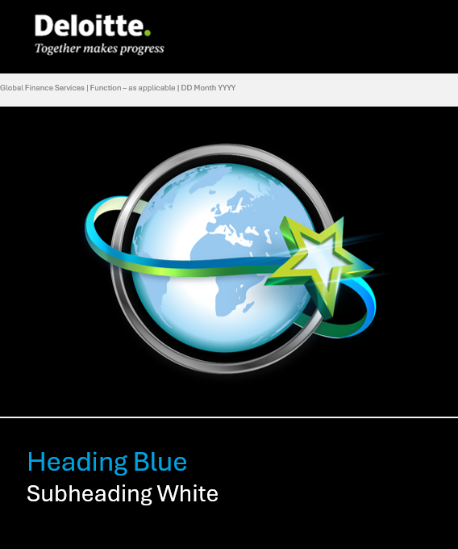
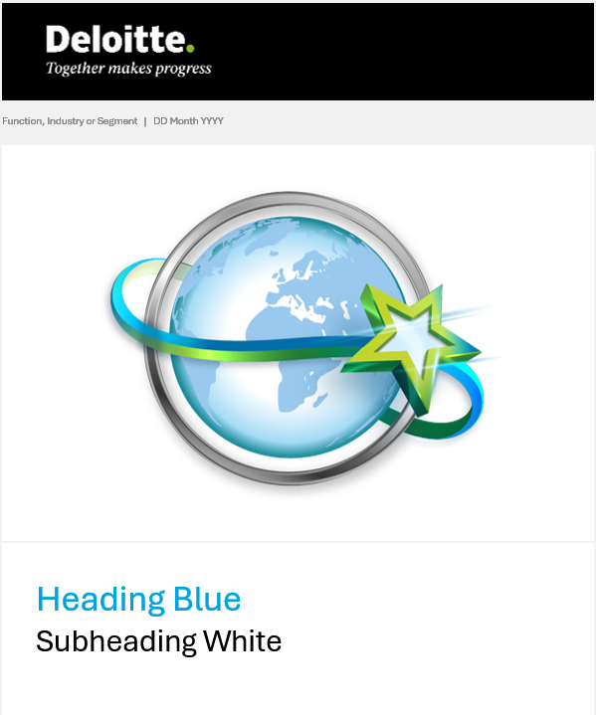

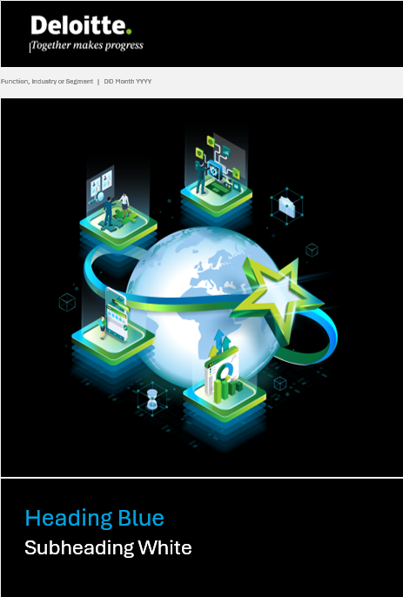
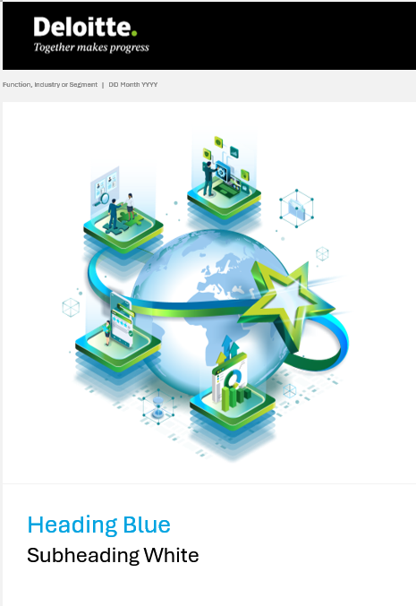


GFS Style Guide | Email announcement and PowerPoint templates
Email Announcement
Note: Please use for GFS wide and MF communications
PowerPoint
Email Announcement templates:
Email template (image 1) - white background
Email template (image 1) - black background
Email template (image 2) - white background
Email template (image 2) - black background
PowerPoint templates:
PPT template - white background
PPT template - black background
PPT timesaver - white background
PPT timesaver - black background
Email and PowerPoint samples:
Email sample (new format) - white background
PPT sample (new format) - white background

Slide 25
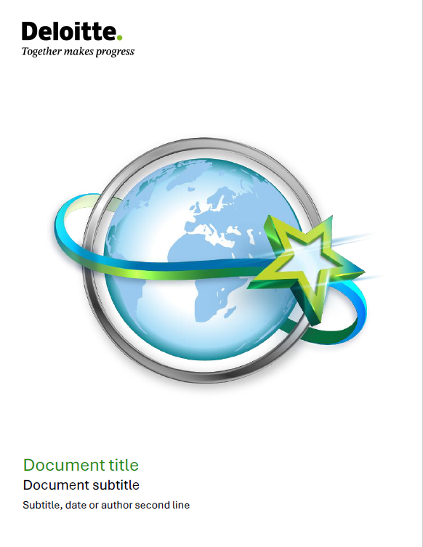
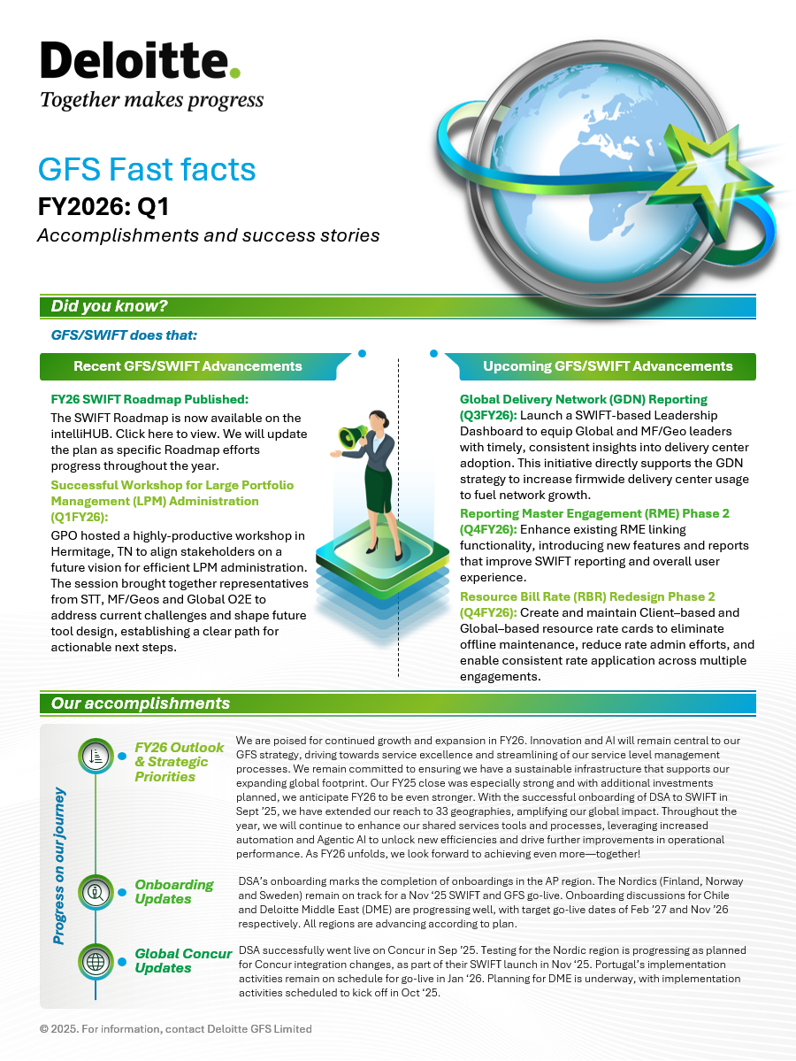
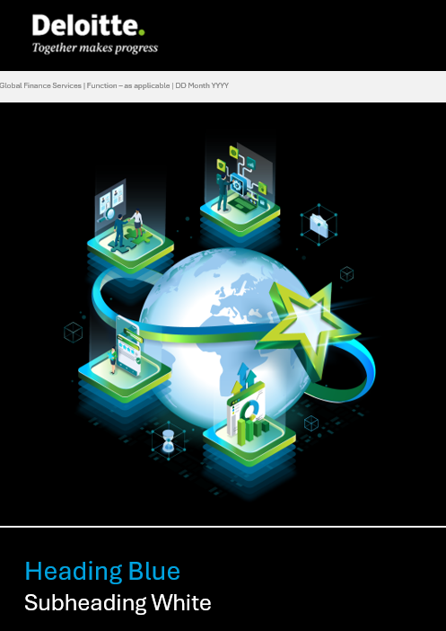

GFS Style Guide | Word templates
Word templates:
Word template – white background
Word template – black background
Word template – mix format
Newsletter templates:
Newsletter template - white background
Newsletter template - black background
GFS Fact Sheet template:
Fact Sheet template - white background
GFS Fast Facts templates:
Fast Facts template - white background
Fast Facts template - black background
Word
Newsletter
Fast Facts

Slide 26
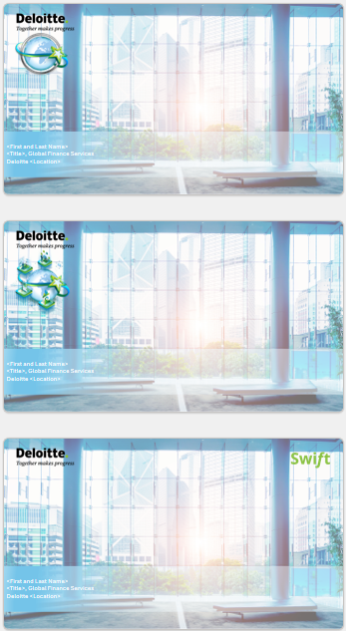
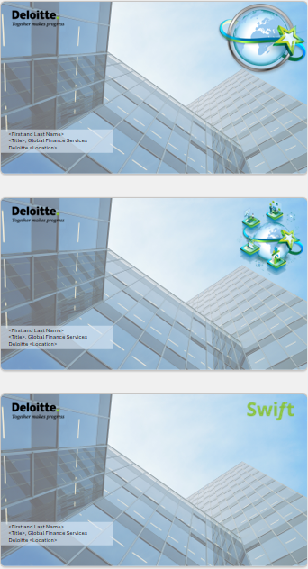
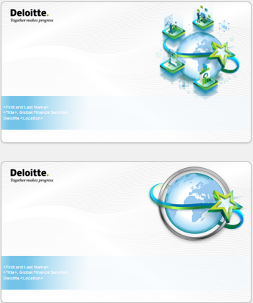
GFS Style Guide | Virtual background templates
Virtual backgrounds templates

Slide 27
Frequently asked questions

Slide 28
GFS Style Guide | Frequently asked questions
What types of images are acceptable for our brand and what imagery should I avoid?
The GFS hero image should be used on the cover slide of all PowerPoint decks. You can additionally use the expanded hero image and GFS icons as outlined in this guide. Please refrain from using non-Deloitte stock photos, clip art, or busy visuals. If you need additional images and icons, please refer to the comprehensive Deloitte image and icon library available on Brand space.
Which fonts are approved for use and when should I use each one?
Deloitte’s standard font is Aptos. Aptos should be used for all GFS materials, both internal and external, including headers, titles, and body text. Refrain from using variations such as Aptos Lite. For specifics on font sizes and text hierarchy, consult the approved templates in this guide.
Where can I find the correct templates for presentations, emails, and documents?
For convenience, all approved GFS templates are all available centrally within this guide. The guide is also available on the intelliHUB.
Can I modify images, icons, templates, or brand elements to fit my needs?
No. To maintain a consistent brand identity, GFS images and icons should not be stretched, recolored, rearranged, or otherwise altered. However, our templates may be adjusted as needed to suit your content needs along as they adhere to overall color schemas and branding guidelines. Later this year, we will be introducing GFS themes to make it easier to leverage new GFS colors and templates in Microsoft applications, so stay tuned!
When should I start using the refreshed GFS brand materials?
Starting 30 January 2026, please use the refreshed imagery, colors and templates for any newly-developed GFS content. The previous branding will be phased out to ensure a smooth transition. All existing materials must be fully aligned with the new brand guidelines by 30 May 2026.
Who should I contact if I have questions about GFS branding guidelines, colors and/or templates?
We are happy to help answer your branding-related questions. For assistance, please contact Jackie Easey or Kanav Kenth

Slide 29
Deloitte refers to one or more of Deloitte Touche Tohmatsu Limited (“DTTL”), its global network of member firms, and their related entities (collectively, the “Deloitte organization”). DTTL (also referred to as “Deloitte Global”) and each of its member firms and related entities are legally separate and independent entities, which cannot obligate or bind each other in respect of third parties. DTTL and each DTTL member firm and related entity is liable only for its own acts and omissions, and not those of each other. DTTL, Deloitte GFS Limited and Deloitte GFS Holdings Limited do not provide services to clients. Please see www.deloitte.com/about to learn more.
This communication is for internal distribution among personnel of Deloitte Touche Tohmatsu Limited, its global network of member firms and their related entities. It may contain confidential information and is intended solely for the use of the individual or entity to whom it is addressed. If you are not the intended recipient, please notify us immediately and then delete this communication and all copies of it on your system. Please do not use this communication in any way.
None of DTTL, its member firms, related entities, employees or agents shall be responsible for any loss or damage whatsoever arising directly or indirectly in connection with any person relying on this communication.
© 2026. For information, contact Deloitte GFS Limited

Slide 30
Appendix

Slide 31
GFS Style Guide | Messaging tips
Imagery & icons
Use only approved GFS brand images, icons, and templates.
Avoid off-brand stock photos, clip art, or unapproved styles.
Color usage
Follow the primary and secondary brand color palette.
Use primary brand colors for key elements (titles, headers, buttons, shapes) and avoid letting non-brand colors dominate.
Ensure colors meet contrast and accessibility standards.
Fonts & typography
Use only approved fonts, sizes, and weights as specified in the guide.
Apply correct hierarchy for headings, subheadings, and body text.
Avoid unapproved fonts in all content, including in charts and diagrams.
Templates & layout
Choose the correct template for your message and audience.
Keep layout clean, balanced, and consistent with GFS standards.
Follow guide examples for margins, spacing, and alignment.
Ensure enough white space; avoid clutter.

Slide 32
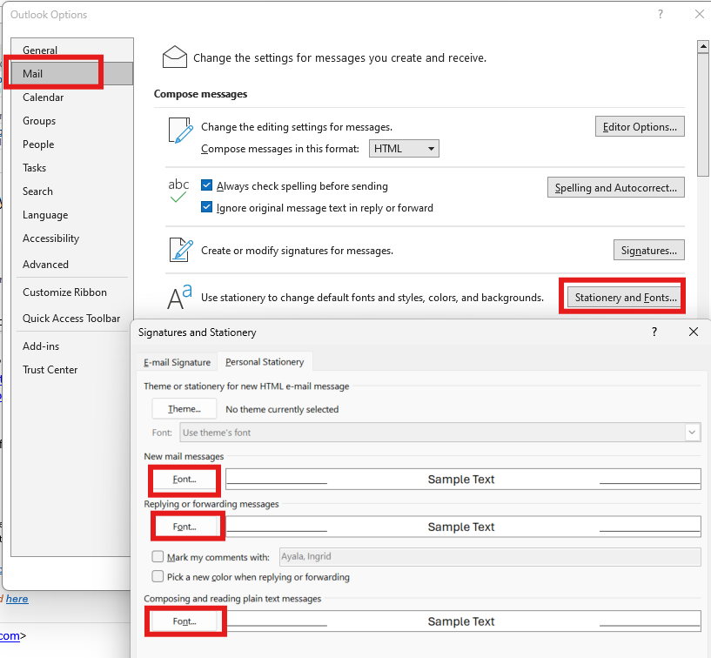
GFS Style Guide | Tips for confirming fonts (Outlook)
If the standard Aptos font does not show in your Microsoft applications, please follow the instructions below to manually make updates to your default settings.
OUTLOOK
Go to File > Options > Mail > Stationary and Fonts > select each font option and manually update to Aptos, size 11.

Slide 33
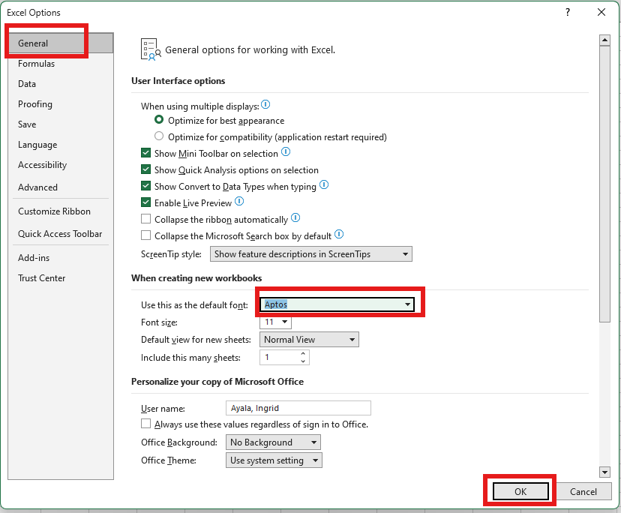
GFS Style Guide | Tips for confirming fonts (Excel)
If the standard Aptos font does not show in your Microsoft applications, please follow the instructions below to manually make updates to your default settings.
EXCEL
Open new workbook
Go to File > Options > General
Under “When creating new workbooks”, update the “Use this font” dropdown to Aptos
Click OK to save changes
Restart Excel

Slide 34
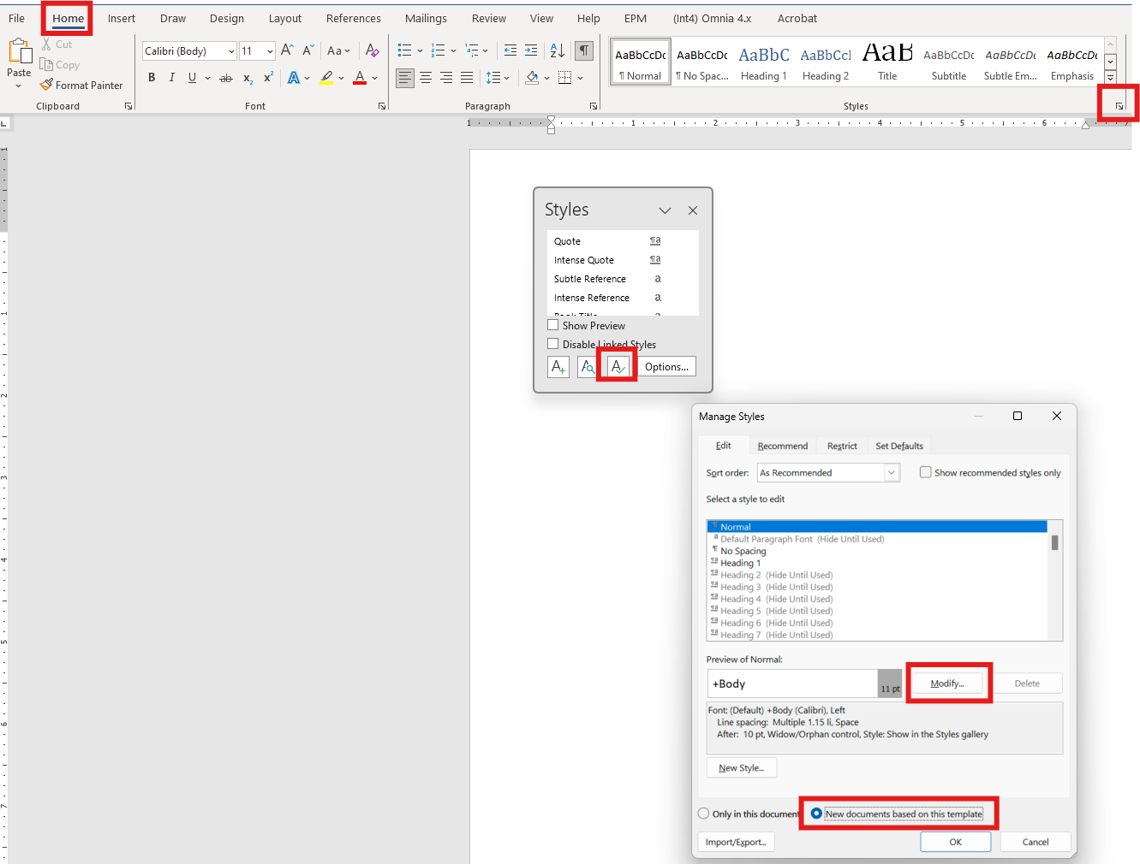
GFS Style Guide | Tips for confirming fonts (Word)
If the standard Aptos font does not show in your Microsoft applications, please follow the instructions below to manually make updates to your default settings.
WORD
Open new document
Go to Home > Change Styles by selecting Styles Dialog
Select Manage Styles (A with checkmark)
Select New documents based on this template
Select Modify
Update font to Aptos
Select New documents based on this template
Select OK and select OK (as you work backwards through the screens)
No need to save the document;
Opening a new document should default to Aptos

Slide 35
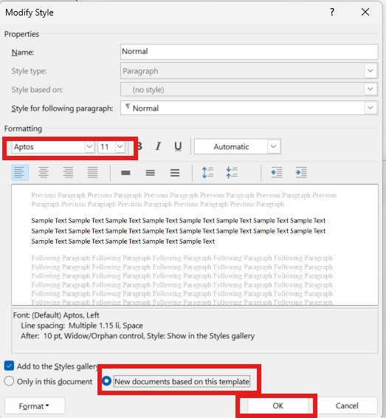
GFS Style Guide | Tips for confirming fonts (Word, cont’d)
If the standard Aptos font does not show in your Microsoft applications, please follow the instructions below to manually make updates to your default settings.
WORD
Open new document
Go to Home > Change Styles by selecting Styles Dialog
Select Manage Styles (A with checkmark)
Select New documents based on this template
Select Modify
Update font to Aptos
Select New documents based on this template
Select OK and select OK (as you work backwards through the screens)
No need to save the document;
Opening a new document should default to Aptos

