Slide 1



BIRLA INSTITUTE OF TECHNOLOGY & SCIENCE PILANI (RAJASTHAN)
April 2023
SEZG518–Database Design and Application
Design an online shopping system
By SHUBHAM PAL SINGH
2022mt93056@wilp.bits-pilani.ac.in
LOGO

Slide 2
Presentation Agenda
Purpose of system
Objective of the Work
Requirement Specification
Problem statement and requirement of project
Conceptual Design
ER diagram concept
Logical Design
Defining relationship between entities and attributies
Physical design
Code depicting the relations between entities.
Final Design and code
Key Learnings
References
BITS SEZG518 - BITS Project – 2022MT93056 – SHUBHAM PAL SINGH

Slide 3
Introduction About the Project
Overview of the Work
This work is to get familiar with the data base management and systems
This document gives brief about the purpose (goal) of the system & its key requirements.
Study the relationship between the entities and attributes
BITS SEZG518 - BITS Project – 2022MT93056 – SHUBHAM PAL SINGH

Slide 4
Problem statement Key Requirements
Problem statement
We decided to create a database that can help maintain up-to-date inventory of items for online shopping application. Database should maintain details regarding available products from various categories, user details, seller information, order details, promotion and discount details, shipping details.
Currently business is performing their sales offline which is very tedious process and often miss to deliver the product on time to customers due to no single point of view of available inventory, order details to serve the customer and customers are also not able to place orders as offline orders are sometimes not picked up business and might lead to missing the order confirmation and delivery.
With an online process, application will provide users with registration and login features. Authenticated users can login and browse for various categories of products of interest, add them to cart to buy them later. Application also provides users with options to track order fulfilment and history of all previous orders.

Slide 5
Problem statement Key Requirements
Problem statement
With an online process, application will provide users with registration and login features. Authenticated users can login and browse for various categories of products of interest, add them to cart to buy them later. Application also provides users with options to track order fulfilment and history of all previous orders.
Application will provide an option for login as a retail user or as seller. Seller can login and view his inventory and analyse how his business is performing and based on available inventory can stock up the products to better serve the customers.
With the proposed online application, users would be provided with an option to view all details of orders which includes order id, order value, status, ordered item, quantity being ordered, delivery date and address.

Slide 6
Problem statement Key Requirements
Problem statement
Application will provide a single view to track all shipment related details which includes shipment identifier and order for which shipment request is initiated, status, priority, mode of shipment, mode of shipment. Shipment details will also include shipping partners providing details of delivery partners.
Our proposed application should provide the user with a feature to browse various product catalogs which includes product identifier, name, category, description, price and quantity available in stock to place order. Application also provides users with an option to view the previous orders and cancel existing orders.
Business owners/sellers will have a clear insight on which all products are in demand and what all products are being returned. This way our application will help business owners to understand the requirements of users and help in serving them better.

Slide 7
Key Requirements
Feature ID | Feature name | Description
T01 | Browse | Browse for various products and place orders
T02 | Tracking | Track status of order
T03 | Place cancel | Place the orders
T04 | Cancel Order | Cancel the ongoing orders
T05 | View orders | View history of previous orders
Platform | Window
Frontend/Console/Client side | Java
Backend/Server side
Database | Oracle
Programming language:Frontend | Java
Backend:Programming/server

Slide 8
Conceptual Design
In this design methodology, the process of constructing a model of the data is used in an enterprise, independent of all physical considerations.
The conceptual database design phase starts with the formation of a conceptual data model of the enterprise that is entirely independent of implementation details such as the target DBMS, use of application programs, programming languages used, hardware platform, performance issues, or any other physical deliberations.
So, here we will draw ER diagram for showing relationship between entities and attributies.

Slide 9
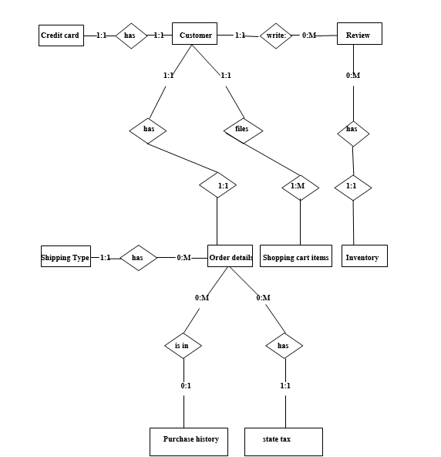
Conceptual Design

Slide 10
Conceptual Design
- Conceptual design can be divided into two parts: The data model and the process model.
- A data model is a conceptual representation of the data structures that are required by a database. The first step in designing a database is to develop an Entity- Relation Diagram (ERD). The ERD serves as a blue print from which a relational database maybe deduced.
The cardinality is the frequency of a relationship between two entities. The types of cardinality are one to one (1:1), one to many (1:M), zero to many (0:M) and many to many (M:M).
One to one means that every record in entity A matches exactly one record in entity B and every record in B matches exactly one record in A.
One to many means that every record in A matches zero or more records in B and every record in B matches exactly one record in A.
If there is a one to many relationships between two entities, then these entities are represented as Associative Entities.
BITS SEZG544 - BITS Project – 2022MT93056 – SHUBHAM PAL SINGH

Slide 11
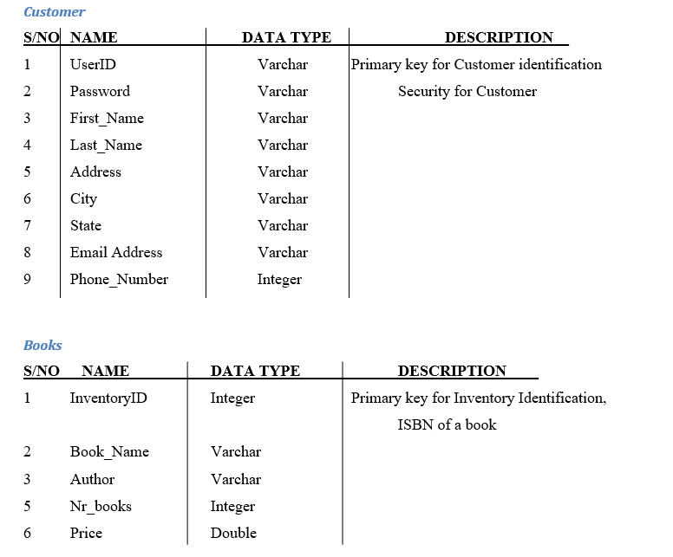
DATABASE DESIGN
BITS SEZG544 - BITS Project – 2022MT93056 – SHUBHAM PAL SINGH

Slide 12
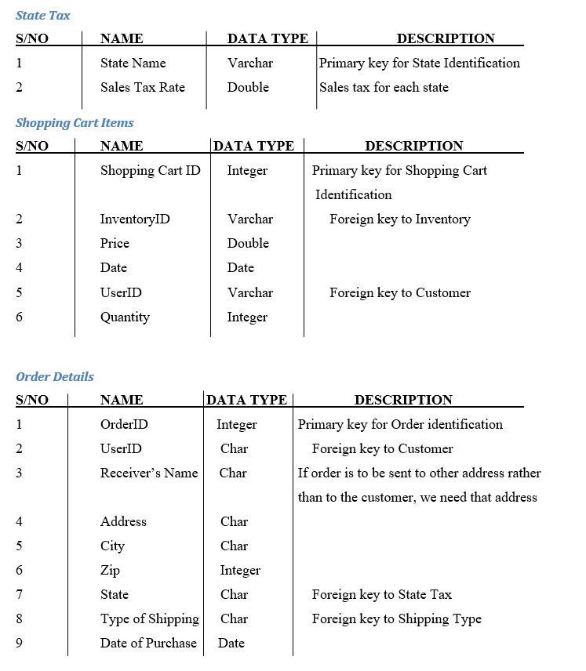
DATABASE DESIGN
BITS SEZG544 - BITS Project – 2022MT93056 – SHUBHAM PAL SINGH

Slide 13
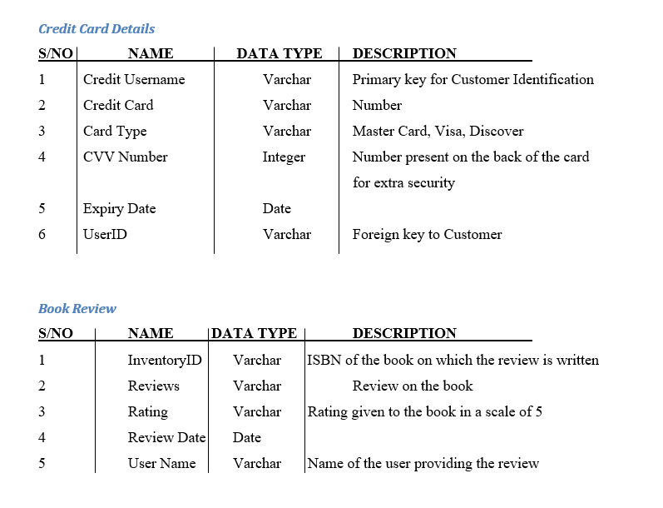
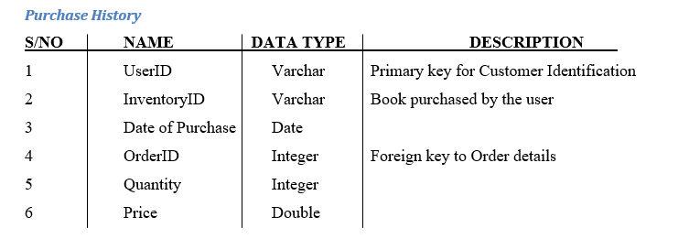
DATABASE DESIGN
BITS SEZG544 - BITS Project – 2022MT93056 – SHUBHAM PAL SINGH

Slide 14
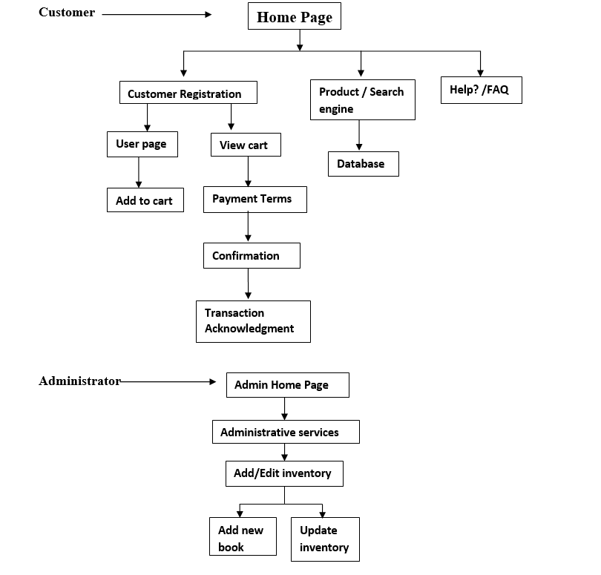
Logical Diagram(Process Model)
.
BITS SEZG544 - BITS Project – 2022MT93056 – SHUBHAM PAL SINGH

Slide 15
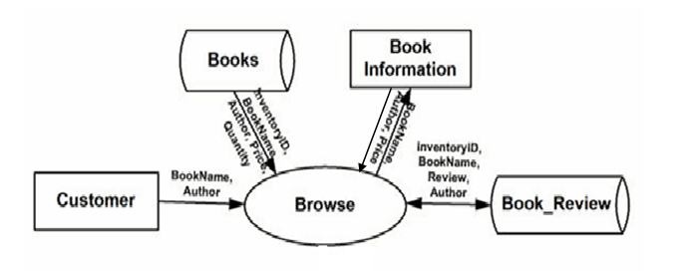
Logical design
Rectangles representing external entities, which are sources or destinations of data.
Ellipses representing processes, which take data as input, validate and process it and output it.
Arrows representing the data flows, which can either, be electronic data or physical items.
Open-ended rectangles or a Disk symbol representing data stores, including electronic stores such as databases or XML files and physical stores such as filing cabinets or stacks of paper.
BITS SEZG544 - BITS Project – 2022MT93056 – SHUBHAM PAL SINGH

Slide 16
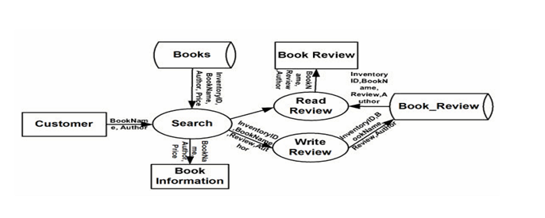
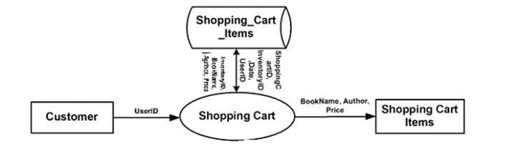
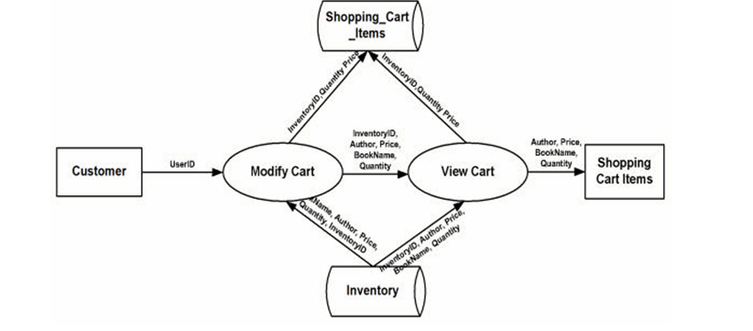
Logical Design

Slide 17
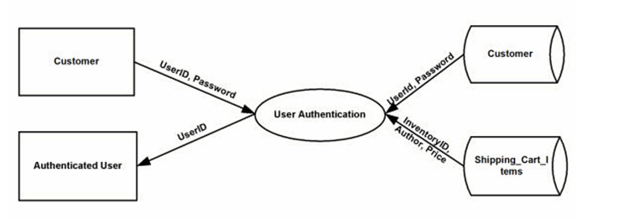
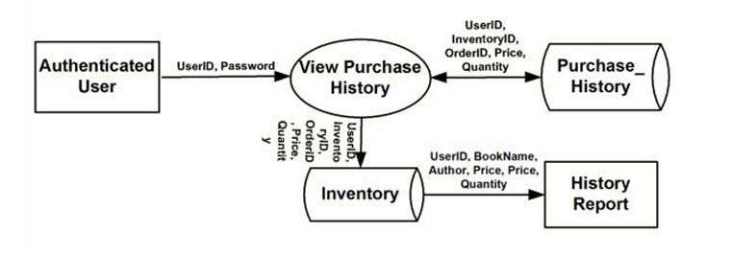
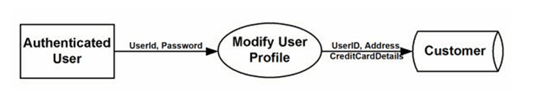
Logical Design

Slide 18
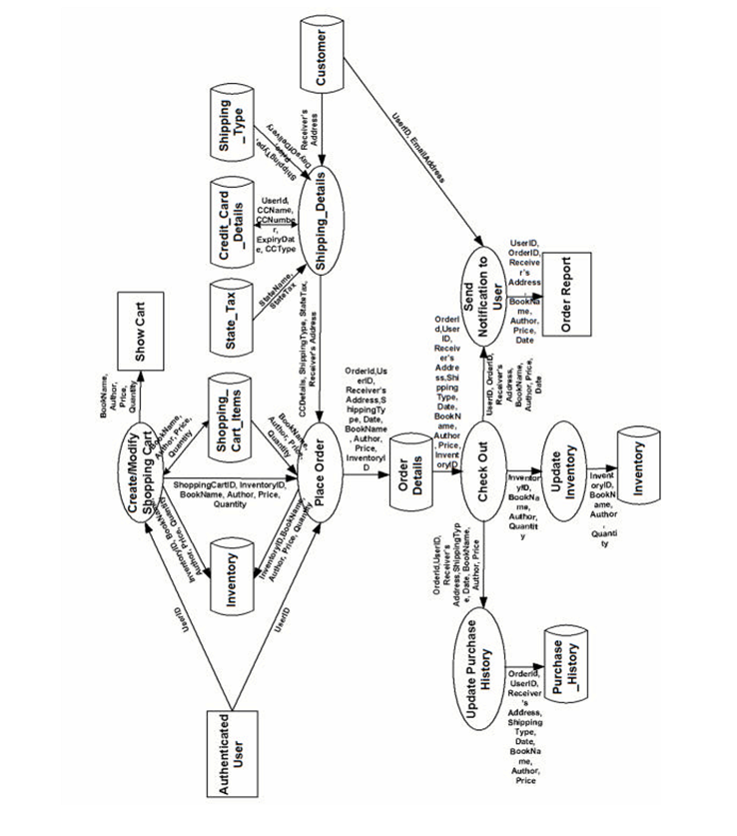
Logical Design

Slide 19
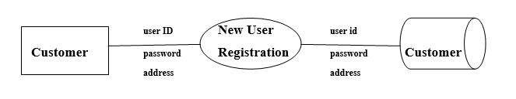
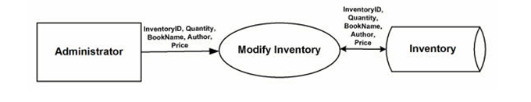
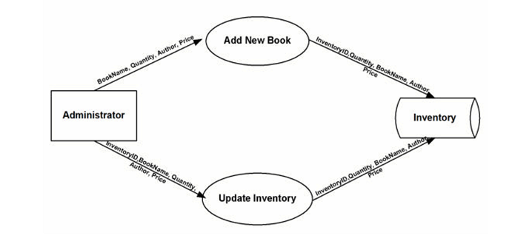
Logical Design

Slide 20
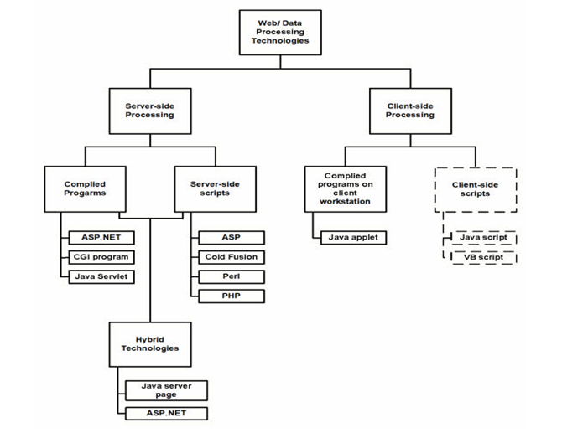
Physical Design

Slide 21
Physical Design
The application will be using a technology known as Open Data Base Connectivity (ODBC) to access the database.
<%@ Import Namespace="System" %>
<%@ Import Namespace="System.Data" %>
<%@ Import Namespace="System.Data.Odbc" %>
After all the necessary namespaces are imported, a connection to the database is made.
OdbcConnetion odbcCon = new OdbcConnection ("DRIVER = {MySQL ODBC 5.6.20Driver}; SERVER=localhost; DATABASE=project; UID=root; PASSWORD=pwd"); odbcCon.Open();

Slide 22
Physical Design
Since the data is stored in the same computer as the application, the SERVER is given as local host. Next we open the connection object. Listed below are the common connection object methods we could work with:
Open- Opens the connection to our database
Close- Closes the database connection
Dispose- Releases the resources on the connection object. Used to force garbage collecting, ensuring no resources are being held after our connection is used.
State- Tells you what type of connection state your object is in, often used to check whether the connection is still using any resources
Once the connection is made, in order to access the data in a database, ADO.NET relies on two components: DataSet and Data Provider

Slide 23
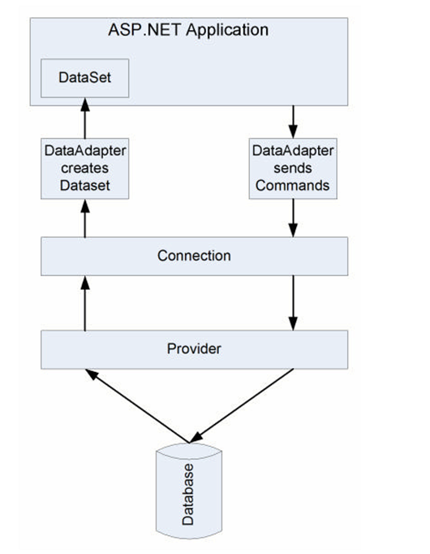
Physical Design

Slide 24
Physical Design
When an ASP.NET application needs to access the database, it submits an appropriate request to ADO.NET through a DataAdapter object, which in turn sends a command to the Connection object.
The Connection object establishes a connection to the database and submits the request sent by DataAdapter.
The Connection object connects to the database through a Provider such as ODBC.NET. The Provider acts as a translator between the Connection object and the database. It translates the request for data to database’s language and brings back the data, if needed.
The Provider sends the data back to the DataAdapter through the Connection object and DataAdapter places the data in a DataSet object residing in application’s memory

Slide 25
Physical Design
The steps required to connect our ASP.NET application to the MySQL database and access the data are given below:
Import the required namespaces.
using System;
using System.Data;
using System.Data.Odbc;
Create a connection object.
string myConnectionString;
myConnectionString = “DRIVER = {MySQL ODBC 3.51 Driver}; SERVER =
localhost; DATABASE = project; UID = root; PASSWORD = ‘’”
OdbcConnection odbcCon = new odbcConnection(myConnectionString)

Slide 26
Physical Design
3. Create a SQL query
string str;
str="Select * from Customer where UserID='admin’;
4. Create a Command object to run the SQL query
odbcCmd = new OdbcCommand(str,odbcCon);
5. DataReader to read the result
OdbcDataReader odbcReader;
String text, text2;

Slide 27
Physical Design
while (odbcReader.Read( ) )
{
text = odbcReader["UserID"].ToString( );
text2 = odbcReader[“FirstName”].ToString( );
}
6. Close odbcReader and odbcConnection
odbcReader.Close ( );
odbcCon.Close ( );
The data can now be used as desired by the application.

Slide 28
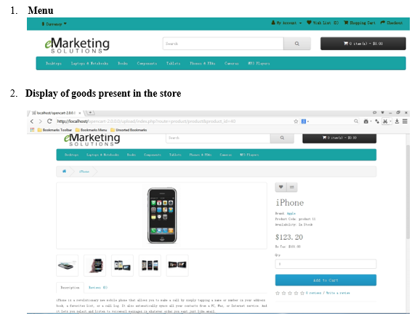
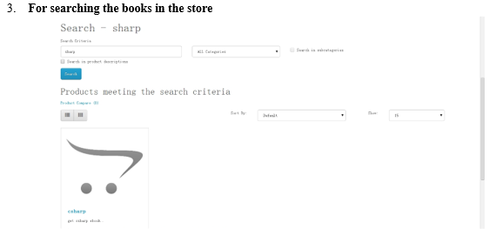
View of the application

Slide 29
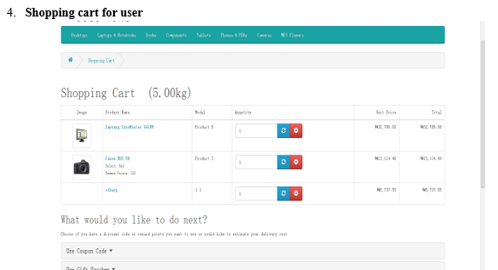
View of the application

Slide 30
View of application

Slide 31
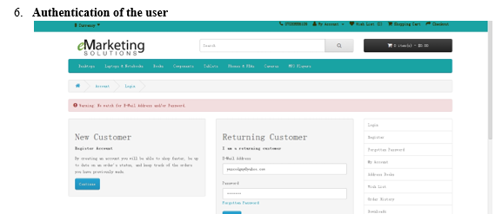
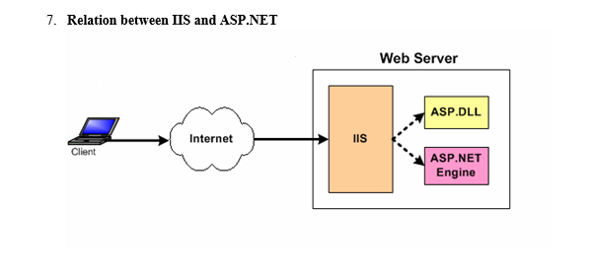
View of application

Slide 32
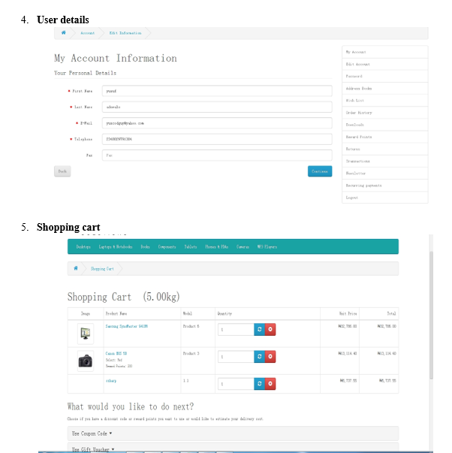
View of application

Slide 33
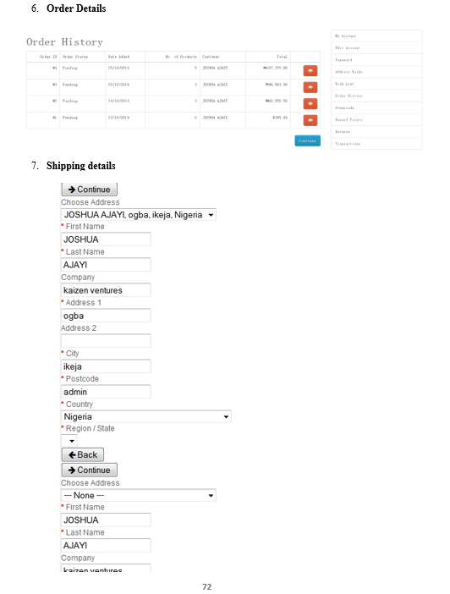
View of application

Slide 34
View of application

Slide 35
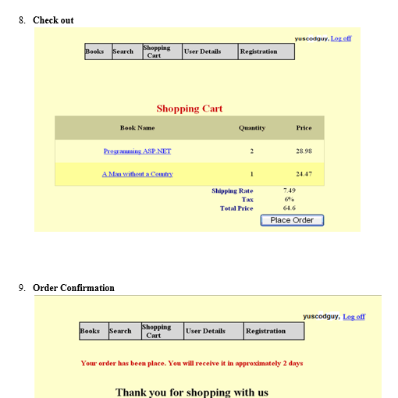
View of application

Slide 36
Code for online shopping of items
The code for the project in java is saved in github.Please find the link below:
https://github.com/iamshubhampalsingh/onlineshoppingofitems/blob/main/DBMS

Slide 37
Thank You
BITS SEZG544 - BITS Project – 2022MT93056 – SHUBHAM PAL SINGH
BITS PROJECT
SOFTWARE ARCHITECTURE

