Slide 1

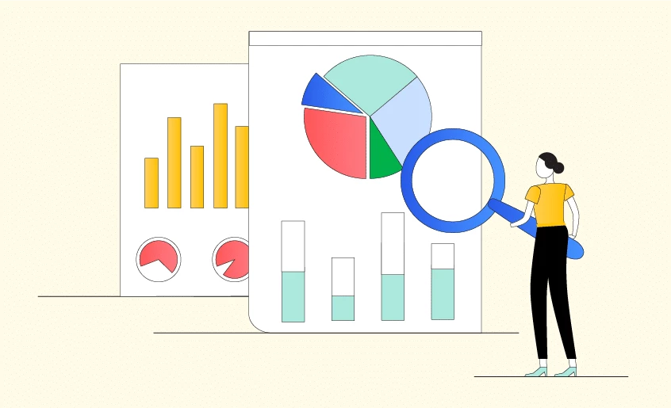
Research Methodology
Faculty : Dr. Md. Abdullah-Al-Jubair
Department of FST
Presentation
TITLE
Smart Agricultural manufacturing (Cultivation and preservation) by weather analysis using IoT Software with integrated AI.
Notes:
NOTE: To change images on this slide, select a picture and delete it. Then click the Insert Picture icon
in the placeholder to insert your own image.

Slide 2
GROUP MEMBERS
NAME | ID
Aishi Mandal | 21-45111-2
Fiaz Al Fardin | 21-45413-3
Nowrin Binte Rashid | 21-45957-3
Shuvo Chandra Mali | 21-45971-3
Shahadat Hossain Sakib | 21-45983-3
Notes:
NOTE: To change images on this slide, select a picture and delete it. Then click the Insert Picture icon
in the placeholder to insert your own image.

Slide 3

Objectives
To explore how IoT validated Weather analysis can optimize cultivation practices by giving real time, AI data driven recommendations to environmental conditions.
To analyze the advantages of AI driven models in predicting market price trends and delivering preservation guidelines to reduce food wastage.
Notes:
NOTE: To change images on this slide, select a picture and delete it. Then click the Insert Picture icon
in the placeholder to insert your own image.

Slide 4
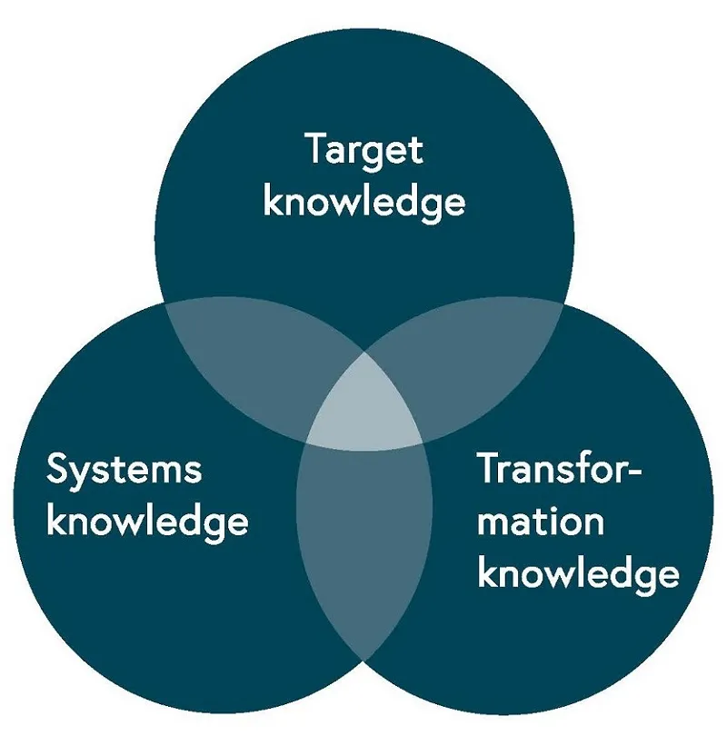
STATE OF KNOWLEDGE
Bangladesh is developing an innovative smart agriculture software platform to enhance cultivation, preservation, and market analysis processes for farmers. The system, integrated with artificial intelligence (AI), provides guidance for beginners and agro doctors, reducing time wastage and improving agricultural practices. It analyzes market prices, provides AI-driven instructions for best cultivation practices, and allows Agro experts to register for disease treatment. The system also alerts farmers when to sell their produce for maximum profit, offers online services for queries, and provides preservation techniques to reduce wastage and maintain quality. This project aims to address the growing unemployment problem in developing countries.

Slide 5

Problem statement
Agriculture is crucial to Bangladesh's economy and livelihood but faces challenges in efficiency, productivity, and sustainability due to limited modern tools and technology. Farmers struggle with weather prediction, preservation, cultivation practices, and market pricing, leading to crop loss, resource waste, economic instability, unemployment, and food crises. Additionally, inadequate farming guidance, weak connections between farmers and agro-experts, and insufficient knowledge about diseases or untreated land further reduce yields
This research paper proposes a smart agricultural manufacturing system integrating IoT and AI to address agricultural challenges in Bangladesh. The system offers weather-based cultivation, preservation guidance, and market price prediction to reduce food waste and enhance decision-making. Key features include AI-driven decision-making and expert guidance to empower farmers, boost economic profits, and create job opportunities. The system aims to ensure food availability, promote sustainable practices, and improve agricultural efficiency, particularly benefiting rural communities in developing countries.

Slide 6

Research Question
How will smart agricultural manufacturing system improve cultivation efficiency, preservation practices and market analysis to improve productivity and economic stability for farmers by using IoT software with AI integrated in developing countries like Bangladesh?

Slide 7
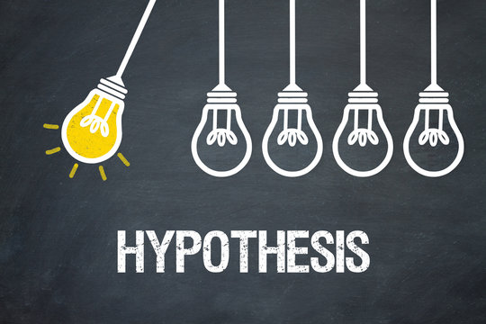
Hypothesis
Using IoT software for weather analysis and AI driven decision making into an agricultural manufacturing system will improve cultivation efficiency, reduce food wastage, optimize preservation techniques and improve economic profitable for farmers by providing market price predictions. The farmers will get the agro experts’ consultation for any kind of inconvenience. The unemployment problem will reduce and encourage the next generation in agriculture.

Slide 8
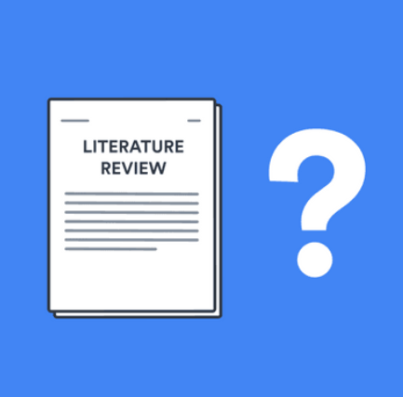
Literature Review:
Smart Agriculture is smart farming which uses technology IoT (Internet of Things) and AI (Artificial Intelligence) to improve efficiency, productivity and sustainability. As global food demand increases and climate change becomes unpredictable, make stability in economic. This literature review surveys recent research and studies that mention the potential of IoT, applications and challenges of using IoT and AI in agricultural systems.

Slide 9
Literature Review:
IoT in Agriculture:
AI in Cultivation and Preservation:
An automated agriculture system is developed to monitor and maintain the important aspects of farming like temperature, humidity, soil moisture content and sunlight using IoT technology. IoT uses sensors, smart devices, cloud storage, and the internet to exchange real-time data.
IoT sensors linked with cloud-based systems might automate irrigation schedules, decreasing manual involvement while assuring appropriate water distribution. In developing countries, a very concerning factor, where water management is critical for high yield agricultural.
AI can process many datasets and provide in an easiest way to get the actionable component of modern agriculture. AI models trained on historical weather and crop yield data can forecast optimal planting and harvesting times. The AI will be the solution to reducing post-harvest losses. The AI will maintain food quality and address wastage, especially in developing countries.

Slide 10
Literature Review:
Market Price Predictions:
Challenges in implementation :
Market analysis is critical for farmers to get the maximum profits. For market price predictions, the AI model is used for the trends. The AI model predicted the crop prices based on historical data, weather analysis and market trends. The AI model could help to analyzing the weather demands.
To implement the IoT technology and AI, there are some challenges to adapt and identify the issues. The challenges: high costs of technology, lack of technical expertise among farmers, and inadequate infrastructure in rural areas. The authors called for government subsidies, training programs, and the development of affordable, user-friendly technologies to bridge these gaps.

Slide 11
Selection of Design
Quantitative Design:
This method includes some collection of structural data based on variables such as weather analysis, yields outcome, market trends and user feedback on the system’s efficiency. It provides evidence of systems’ impact on agriculture, validating the hypothesis with statistical analysis.
Qualitative Design:
This method focuses on gathering perception from farmers and agro-doctors about their experiences, needs and expectations. It explores unstructural data such as user challenges to adapting smart technologies or the socio-economic complications of the system.
Mixed-methods Design:
The combination of methods will analyze the gap between numerical data and subjective user experiences. It improves the problem finding and understanding of both technical and human aspects of smart agriculture.

Slide 12
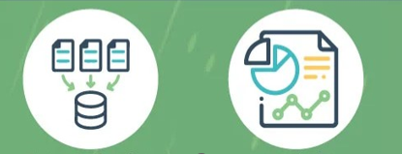
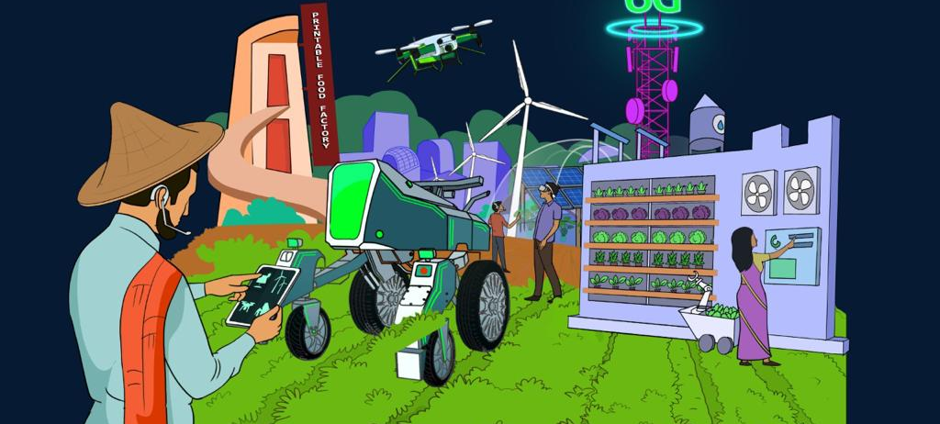
RESEARCH VARIABLES
Independent Variable:
Weather Analysis Using IoT Software with Integrated AI: This variable represents the technology and method used to analyze weather patterns and provides guidelines for agricultural practices.
2. Dependent Variable:
Enhancement in Cultivation, Preservation, and Market Analysis Processes for Farmers: These variable measures the outcomes and improvements in agricultural processes resulting from the implementation of the IoT and AI-based weather analysis system.

Slide 13
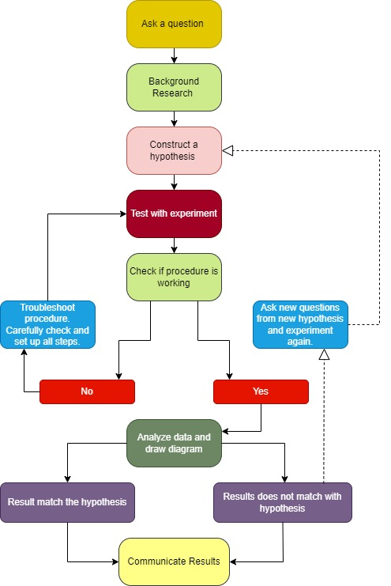
SCIENTIFIC DESIGN

Slide 14

CONCLUSION
The literature highlights IoT and AI as transformative tools for addressing agricultural challenges by enabling real-time environmental data collection and improving cultivation, preservation, and market research. However, barriers like cost, accessibility, and infrastructure remain. Targeted interventions and policy support could drive broader adoption, especially in developing countries like Bangladesh. This analysis provides a foundation for future research into creating a smart agricultural system tailored to the needs of small-scale farmers in resource-limited areas.

Slide 15
REFERENCES
Deepa, B., Anusha, C., Chaya Devi, P. (2021). Smart Agriculture Using IOT. In: Satapathy, S., Bhateja, V., Janakiramaiah, B., Chen, YW. (eds) Intelligent System Design. Advances in Intelligent Systems and Computing, vol 1171. Springer, Singapore.
Alam, M., Hossain, F., & Rahman, S. (2023). Smart irrigation systems using IoT: A sustainable approach. International Journal of Agricultural Research, 19(4), 45-56.
Sharma, R., & Gupta, N. (2023). AI applications in modern farming: A case study on crop yield optimization. Journal of Agricultural Informatics, 12(2), 90-103.
Patel, R., Kumar, S., & Singh, P. (2022). Overcoming barriers to smart farming adoption. Sustainable Agricultural Practices, 15(1), 98-110.

Slide 16
Thank You

