Slide 1
Machine DOCTOR : Machine Fault Diagnosis Agent
IBM HACKATHON PROJECT
Presented By:
Faculty name : Dr.M.Prasannakumr
College Name : Vel Tech Rangarajan Dr.Sagunthala R&D
Institute of Science and Technology
Department : CSE

Slide 2
OUTLINE
Problem Statement
Technology used
Wow factor
End users
Result
Conclusion
Git-hub Link
Future scope
IBM Certifications

Slide 3
Problem Statement : Industrial machines such as CNCs, lathes, and pumps face unexpected failures due to excessive vibration, overheating, tool wear, or power issues. These failures cause costly downtime, unplanned maintenance, and safety risks. Traditional maintenance approaches are either reactive (fixing after breakdown) or preventive (fixed schedules), both of which fail to predict failures in advance using real-time sensor data.
Proposed Solution: AI Agent (IBM Granite + RAG) with Predictive Maintenance ML Model (IBM Cloud Lite): An integrated system that answers operator queries, retrieves maintenance knowledge, and predicts machine failures in advance by classifying fault types and recommending proactive actions.

Slide 4
Technology used
IBM cloud lite services
Natural Language Processing (NLP)
Retrieval Augmented Generation (RAG)
IBM Granite model

Slide 5
IBM cloud services used
IBM Cloud Watsonx AI Studio
IBM Cloud Watsonx AI runtime
IBM Cloud Agent Lab
IBM Granite foundation model

Slide 6
Wow factors
AI-powered predictive maintenance reduces costly downtime and unplanned breakdowns.
IBM Granite + RAG with Cloud Lite makes the system intelligent, scalable, and industry-ready.
Provides explainable insights and actionable recommendations, not just predictions.
UNIQUE FEATURES
Real-time monitoring of machine health using sensor data.
Knowledge-driven fault diagnosis with retrieval from manuals and past cases.
Safety-first approach with automatic alerts and precautionary guidance.
Cloud-native solution accessible anytime, ensuring easy integration across industries.

Slide 7
End users
Manufacturing Industries – CNC machines, lathes, and milling units.
Automobile & Aerospace Companies – assembly lines and precision machinery.
Power Plants & Utilities – pumps, turbines, and heavy equipment monitoring.
Oil & Gas / Chemical Industries – hydraulic pumps, compressors, and rotating machines.
Maintenance Engineers & Operators – who directly use the agent for diagnosis and safety guidance.

Slide 8
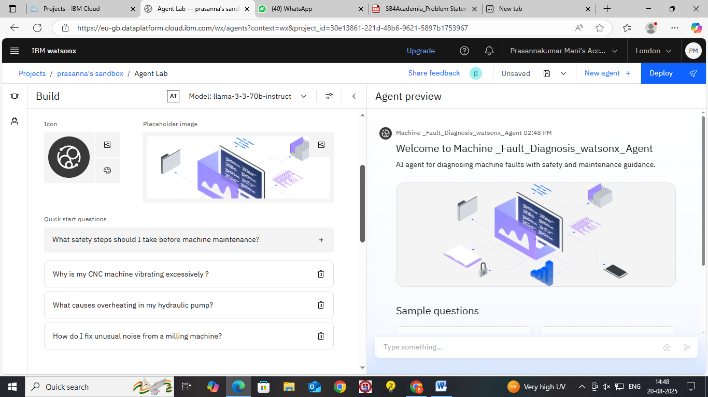
Results

Slide 9
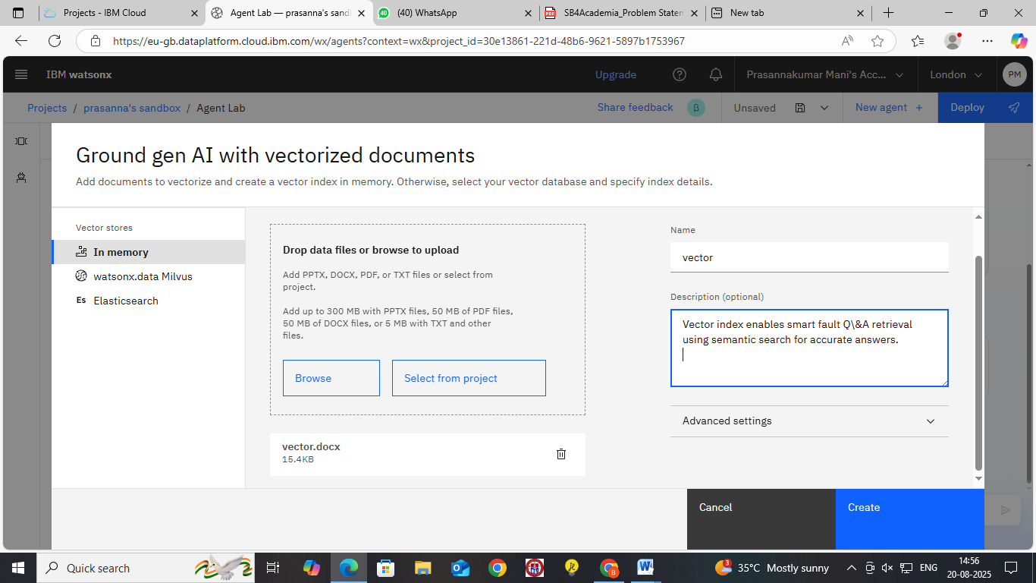
Results

Slide 10
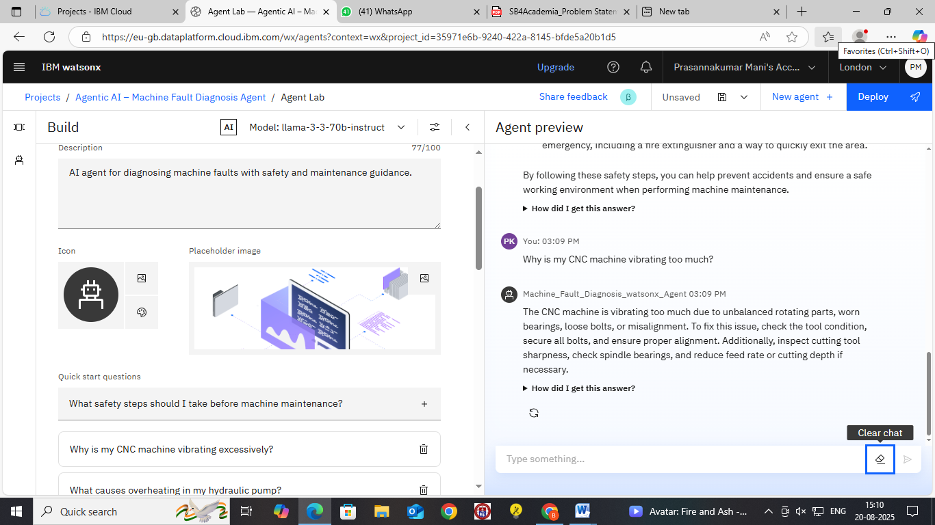
Results

Slide 11
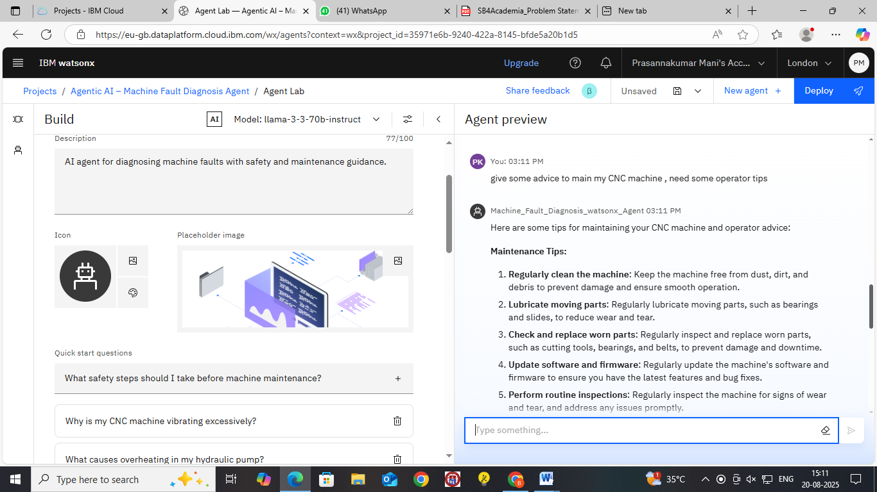
Results

Slide 12
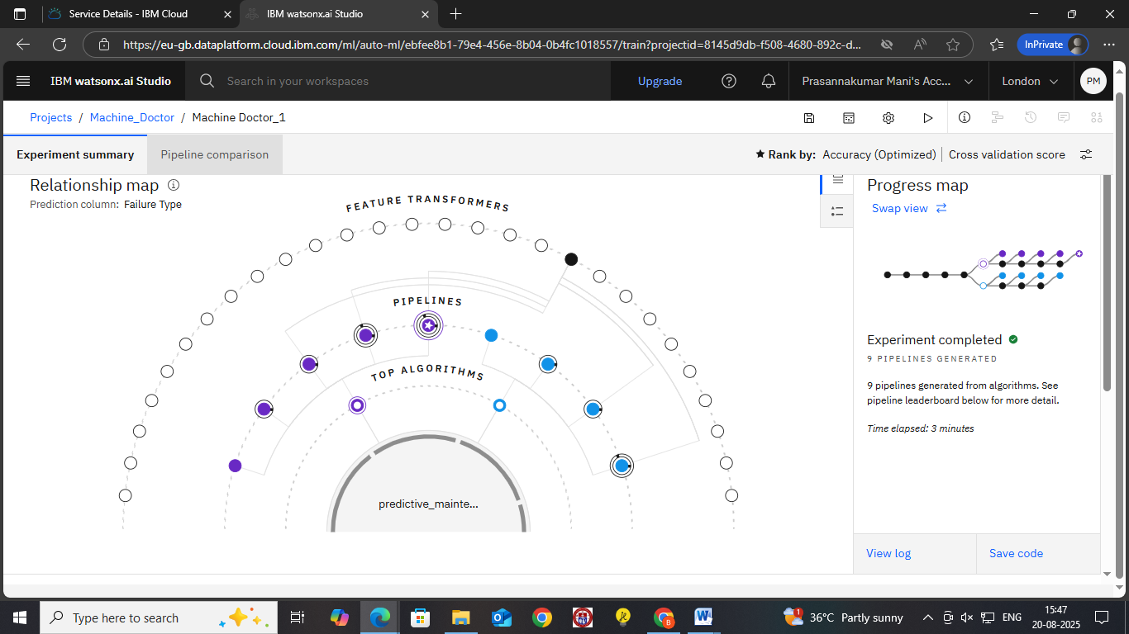
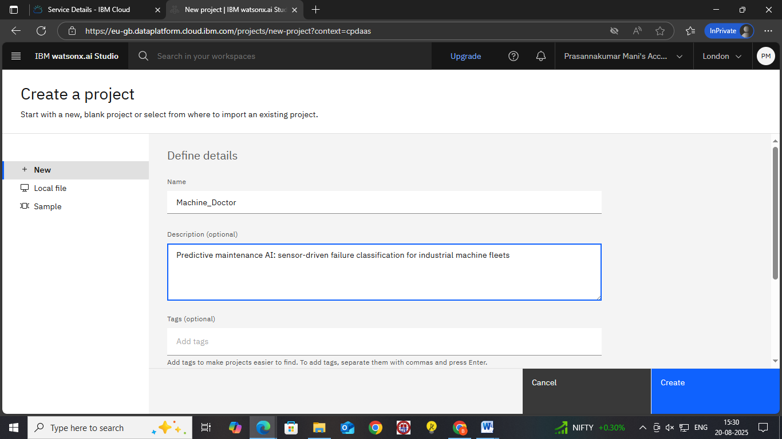
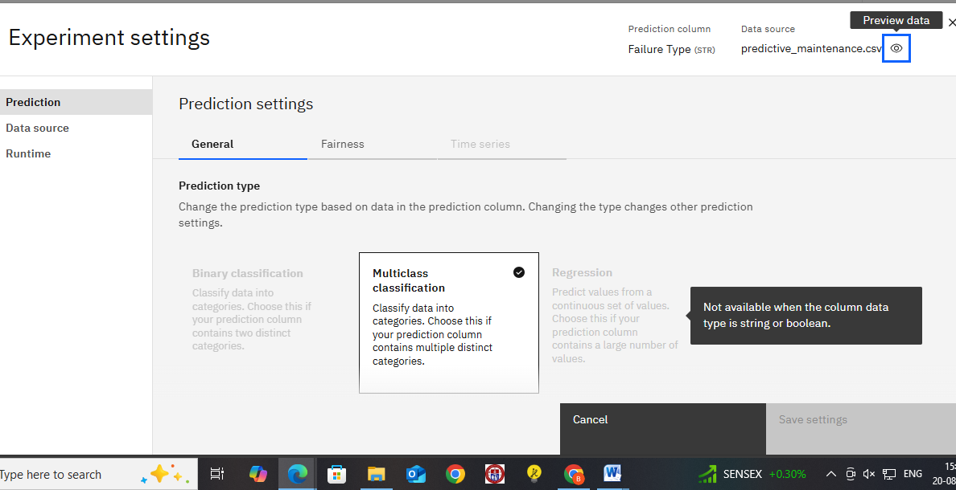
Results

Slide 13
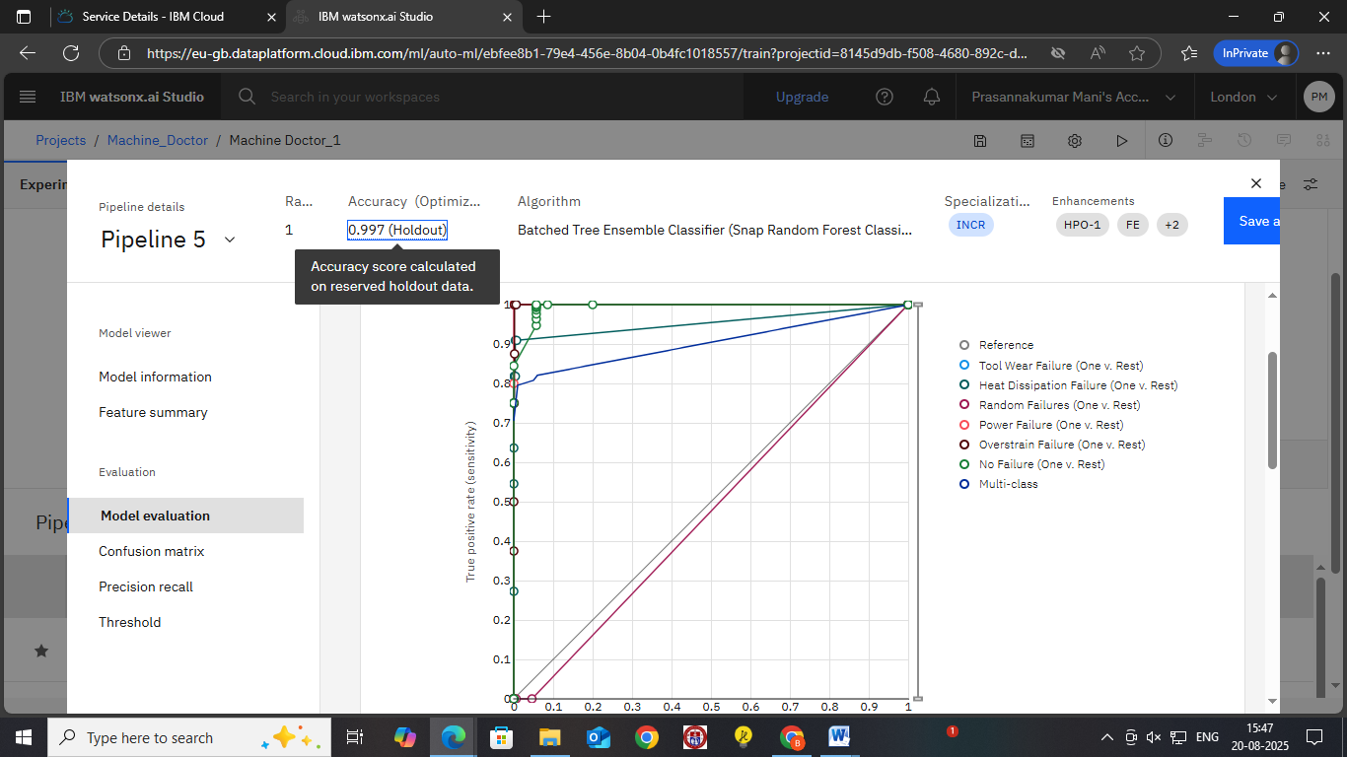
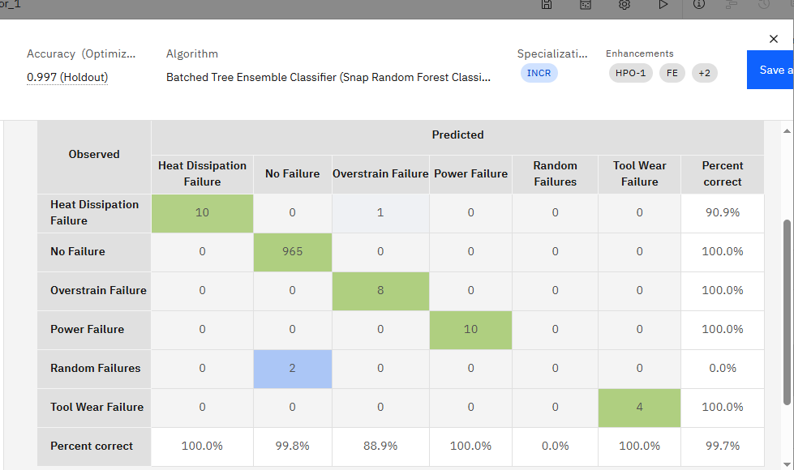
Results

Slide 14
Conclusion
The agent can predict faults, generate reports, and recommend maintenance actions for machines.
It saves time by automating diagnosis, knowledge retrieval, and safety guidance.
The system enhances efficiency, reliability, and cost savings in industrial operations.

Slide 15
GitHub Link
Make sure that there should be readme file

Slide 16
Future scope
Advanced Deep Learning Models → improves fault prediction accuracy and supports detection of complex failure patterns.
Industry-Wide Deployment → scalable solution for manufacturing, power plants, aerospace, and oil & gas with centralized cloud monitoring.
Smart Dashboard & Mobile Access → gives operators intuitive visualizations, alerts, and remote decision-making support.
Self-Learning System → continuously adapts using new sensor data and past fault cases to become more intelligent over time.

Slide 17
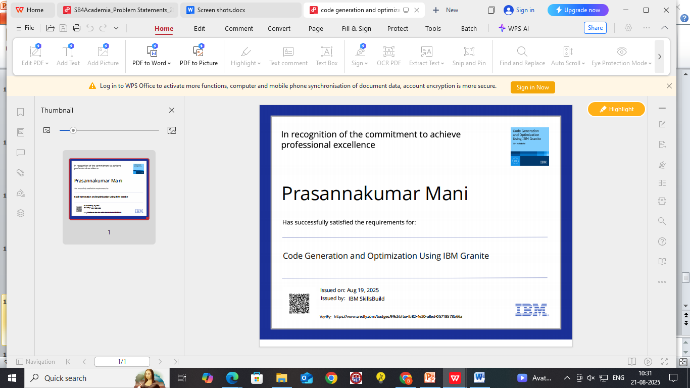
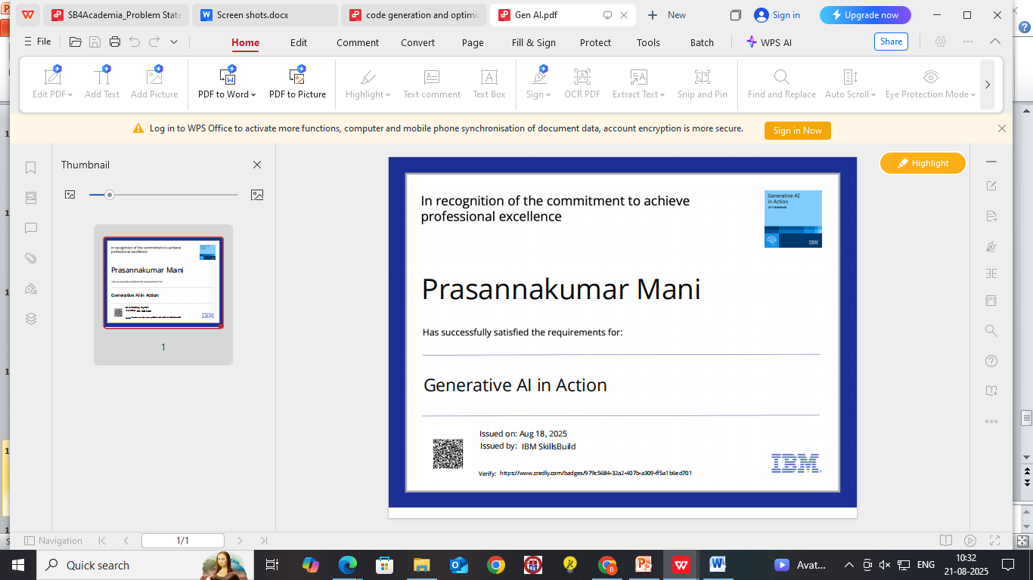
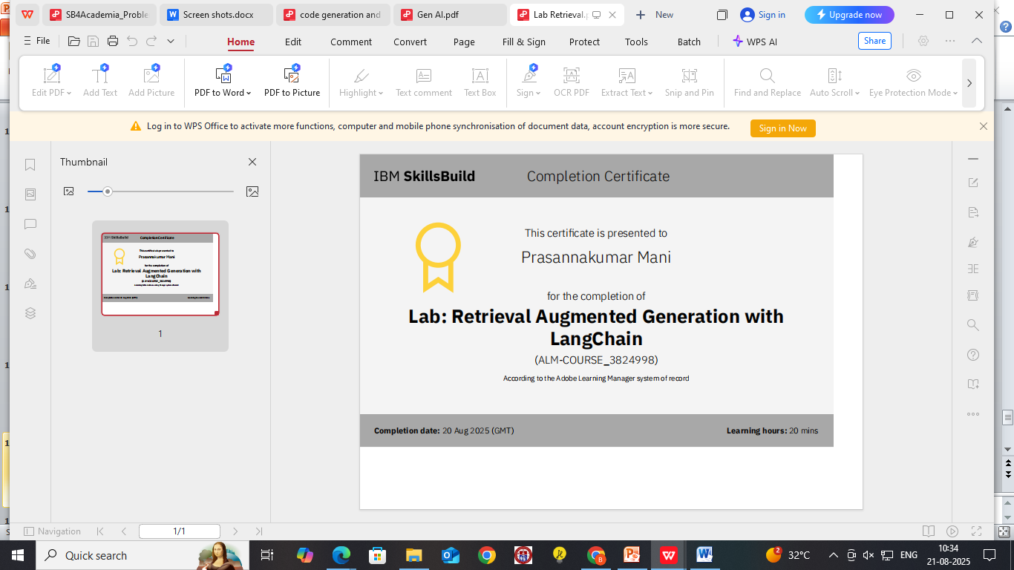
IBM Certifications

Slide 18
THANK YOU

