Slide 1
Chapter VII
Shader Models

Slide 2
Shader Models
The GPU evolution can be described by the shader models of Direct3D.
A shader model corresponds to a particular GPU architecture with distinct capabilities.
  Shader Model 1: Direct3D 8 (assembly level and C-like instructions)
  Shader Model 2: Direct3D 9 (in 2002)
  Shader Model 3: Direct3D 9.0c (in 2004)
  Shader Model 4: Direct3D 10 (in 2006)
  Shader Model 5: Direct3D 11 (in 2008)
The rendering pipeline presented so far is based on Shader Model 3, the programmable parts of which are only the vertex and fragment shaders.
As GPUs evolve, the programmable parts are getting expanded and becoming larger than the fixed-function parts.
7-<number>

Slide 3
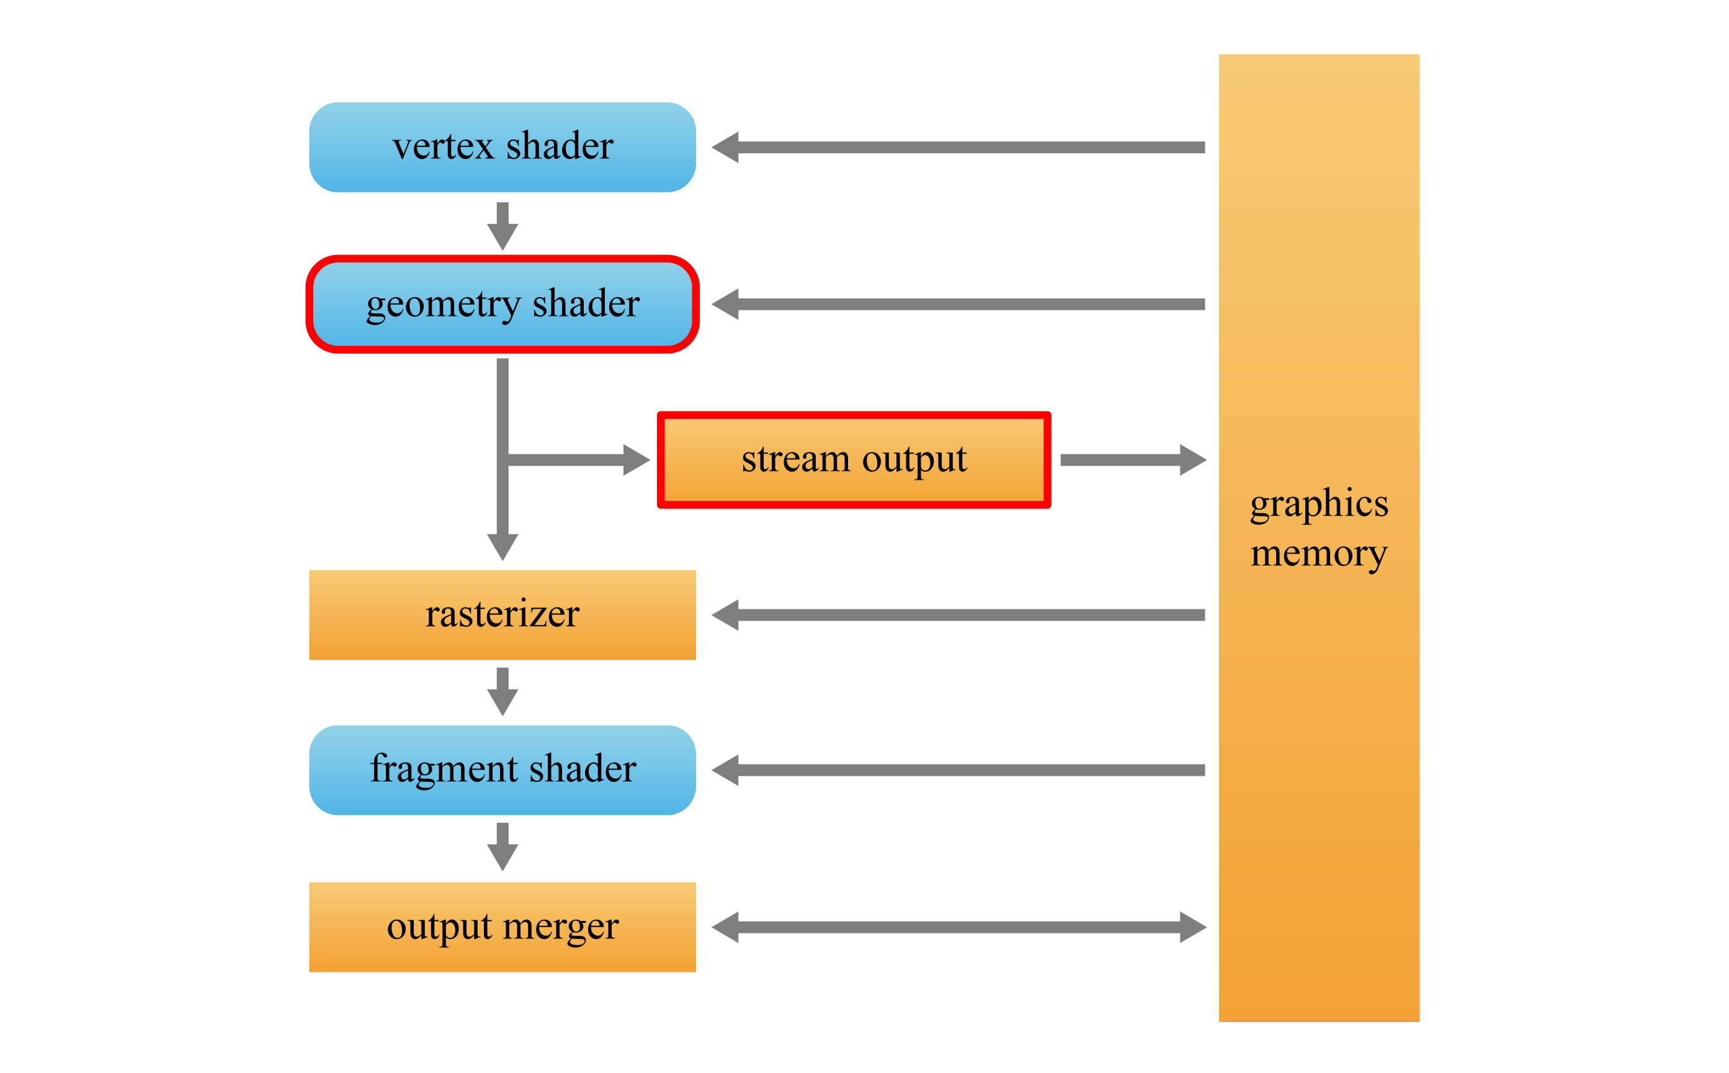
Shader Model 4 – Geometry Shader
The output of the vertex shader goes to either the geometry shader if present or the rasterizer otherwise.
The geometry shader performs per-primitive operations. Its input is the vertices of a single primitive, e.g., three vertices of a triangle.
It can discard the input primitive, or emit one or more new primitives.
Prior to Shader Model 4, the CPU must be invoked to fill the vertex/index buffer when new primitives are dynamically created.
7-<number>

Slide 4
Shader Model 4 – Stream Output
The hard-wired stage, stream output, enables the vertex or geometry shaders to output their results directly to the graphics memory.
Prior to Shader Model 4, the results of the vertex shader must pass through to the rest of the pipeline, and then can exit the pipeline. The stream output stage enables the geometry data to bypass the rasterizer and later stages of the pipeline, and to be iteratively processed by the vertex shader.
7-<number>

Slide 5
Dynamic Particle System
A particle system refers to a collection of small objects named particles, and is popularly used for presenting water, fire, rain, snow, smoke, dust, etc.
In a dynamic particle system, a particle is created and destroyed at run time within the GPU using the geometry shader and stream output.
A particle system consists of two stages.
  The simulation stage determines the positions and velocities of the particles using physics laws.
  The rendering stage renders the system using application-specific methods.
The simulation stage
  Newton’s second law of motion: A force f acting on an object produces an acceleration a related to f by f=ma, where m is the mass of the object.
  The forces acting on an object of mass m are all combined to determine f, and the acceleration a is defined to be f/m.
  The acceleration is integrated over a time step to produce the change in velocity.
  The velocity is used for another integration to produce the change in position.
  The integration operations for updating the velocity and position play the key role in physics-based simulation.
7-<number>

Slide 6
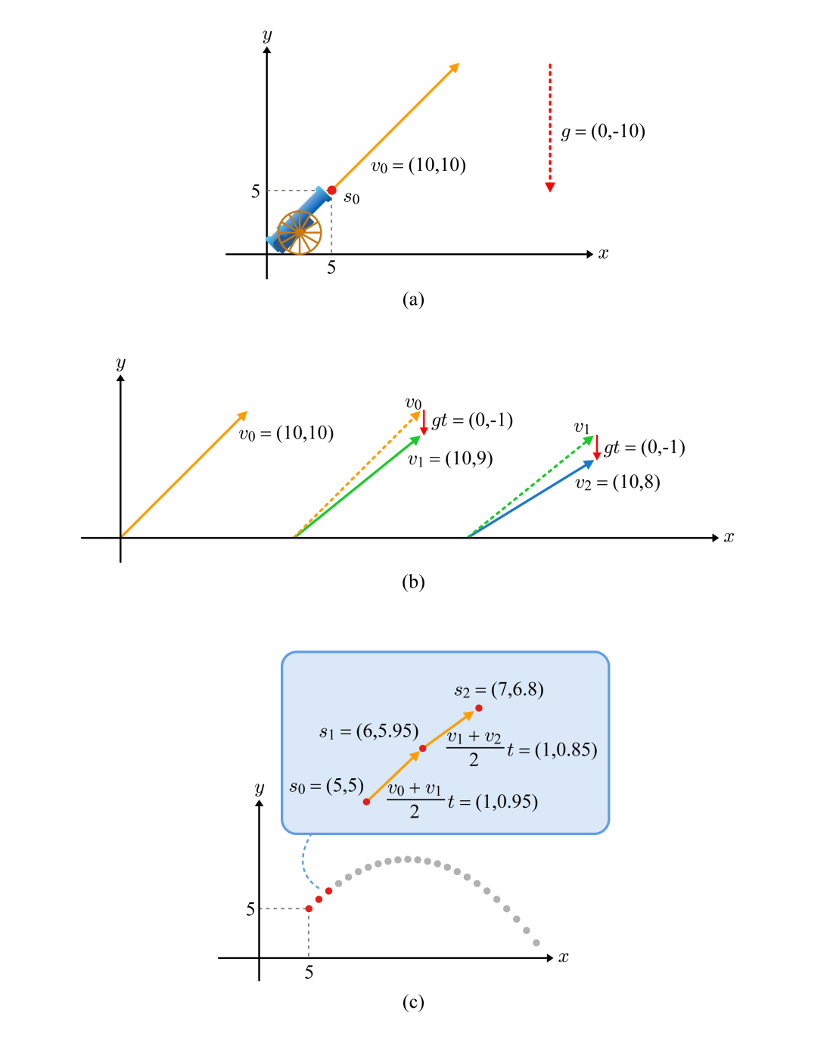





Dynamic Particle System (cont’d)
Tools of the trade
For simplicity, the time step is set to 1/10 second, and the acceleration of gravity g is approximated as 10m/s².
7-<number>

Slide 7
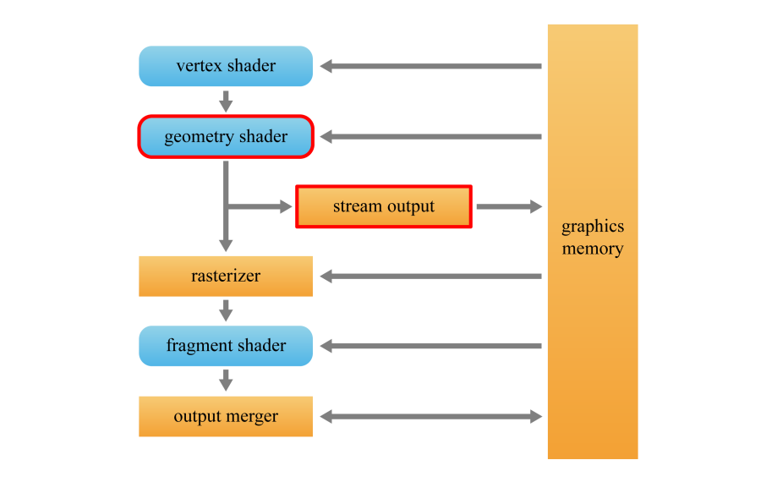
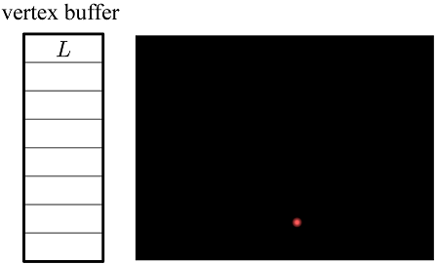
Fireworks
Three types of particles: launcher, shell, and ember.
The launcher particle does not move, and intermittently emits a shell particle along a randomized direction. For this purpose, it repeats counting down, emitting a shell when the timer reaches zero, and resetting the timer.
Two-pass algorithm: simulation and rendering
Simulation
  The vertex shader simply passes the launcher L to the geometry shader (GS).
  The GS decrements its timer, and writes L to the memory through the stream output (SO) stage.
Rendering
  The vertex buffer is rendered, which now contains L only.
7-<number>

Slide 8
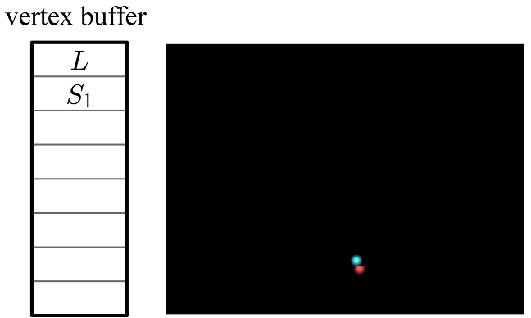
Fireworks (cont’d)
Suppose that L's timer reaches zero.
Simulation
  L's timer is reset.
  A new shell S₁ is created and is associated with its own timer representing its life span. (The GS creates a new primitive!!!)
  Its initial velocity and position are determined.
  The GS outputs L and S₁ to the memory.
Rendering
  The vertex buffer is rendered, which now contains L and S₁.
7-<number>

Slide 9
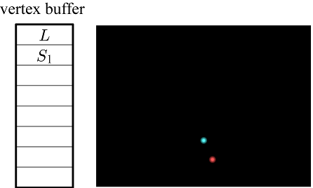
Fireworks (cont’d)
For a certain sequence of frames, the following is repeated.
Simulation
  The timers of L and S₁ are decremented.
  S₁'s velocity and position are updated.
  The GS outputs L and S₁ to the memory.
Rendering
  The vertex buffer containing L and S₁ is rendered
7-<number>

Slide 10
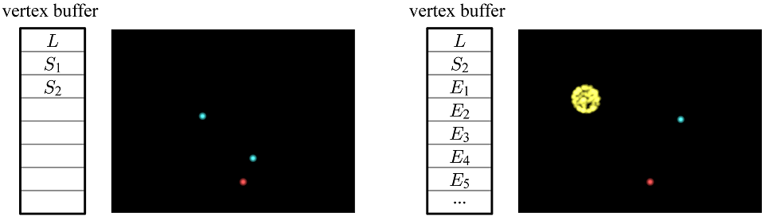
Fireworks (cont’d)
If L's timer reaches zero whereas S₁'s does not, another shell (S₂) is emitted. See the left-hand figure.
When S₁ reaches the end of its life span, it is supposed to explode and emit many embers.
Simulation
  The embers are created and assigned a timer.
  Their initial positions and velocities are determined in a radial fashion.
  The GS outputs L, S₂, and the embers. S₁ is not output, i.e., it is discarded.
Rendering
  The vertex buffer is rendered, which now contains L, S₂, and the embers.
7-<number>

Slide 11
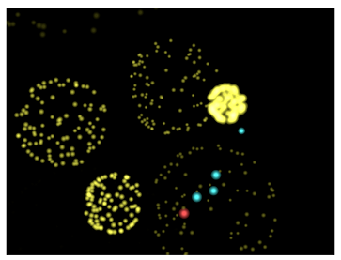

Fireworks (cont’d)
For a certain sequence of frames, the following is repeated.
Simulation
  The timers of all particles are decremented
  The velocities and positions of the shell and embers are updated.
  The GS outputs all particles.
Rendering
  The vertex buffer is rendered.
Embers fade out as their timer is decremented. When their timer reaches zero, the GS does not output the embers, i.e., they are discarded.
Shown below is a frame, where multiple shells have exploded.
7-<number>

Slide 12
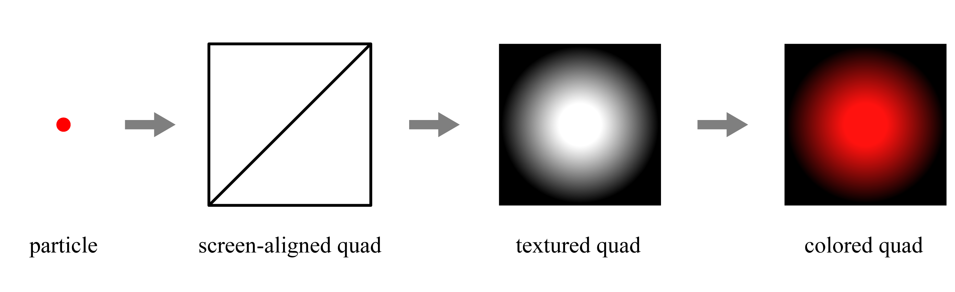
Fireworks (cont’d)
For rendering a particle, use a billboard, which is a quad with an image texture applied on it.
  A particle is replaced by a quad, whose size is pre-defined.
  It is textured to make it look like a sphere-shaped volume.
  Then, the specific color of each particle is combined.
In general, the black texels are made transparent so as to make the background show through. In the fireworks example, however, they are taken opaque and work fine because the background is the dark sky.
7-<number>

Slide 13
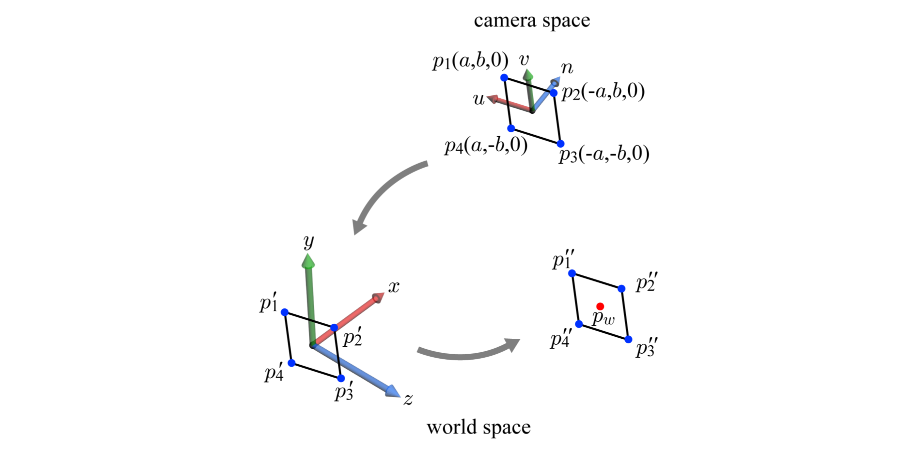
Fireworks (cont’d)
Screen-aligned billboard
  A camera-space quad is pre-defined by four vectors {p₁, p₂, p₃, p₄}.
  The rotation part of the inverse of the view transform M_{view} transforms a camera-space vector into a world-space vector.
  Then, a particle’s world-space position p_{w} is added.
The GS computes the world-space quad, and further transforms it to the clip space.
7-<number>

Slide 14
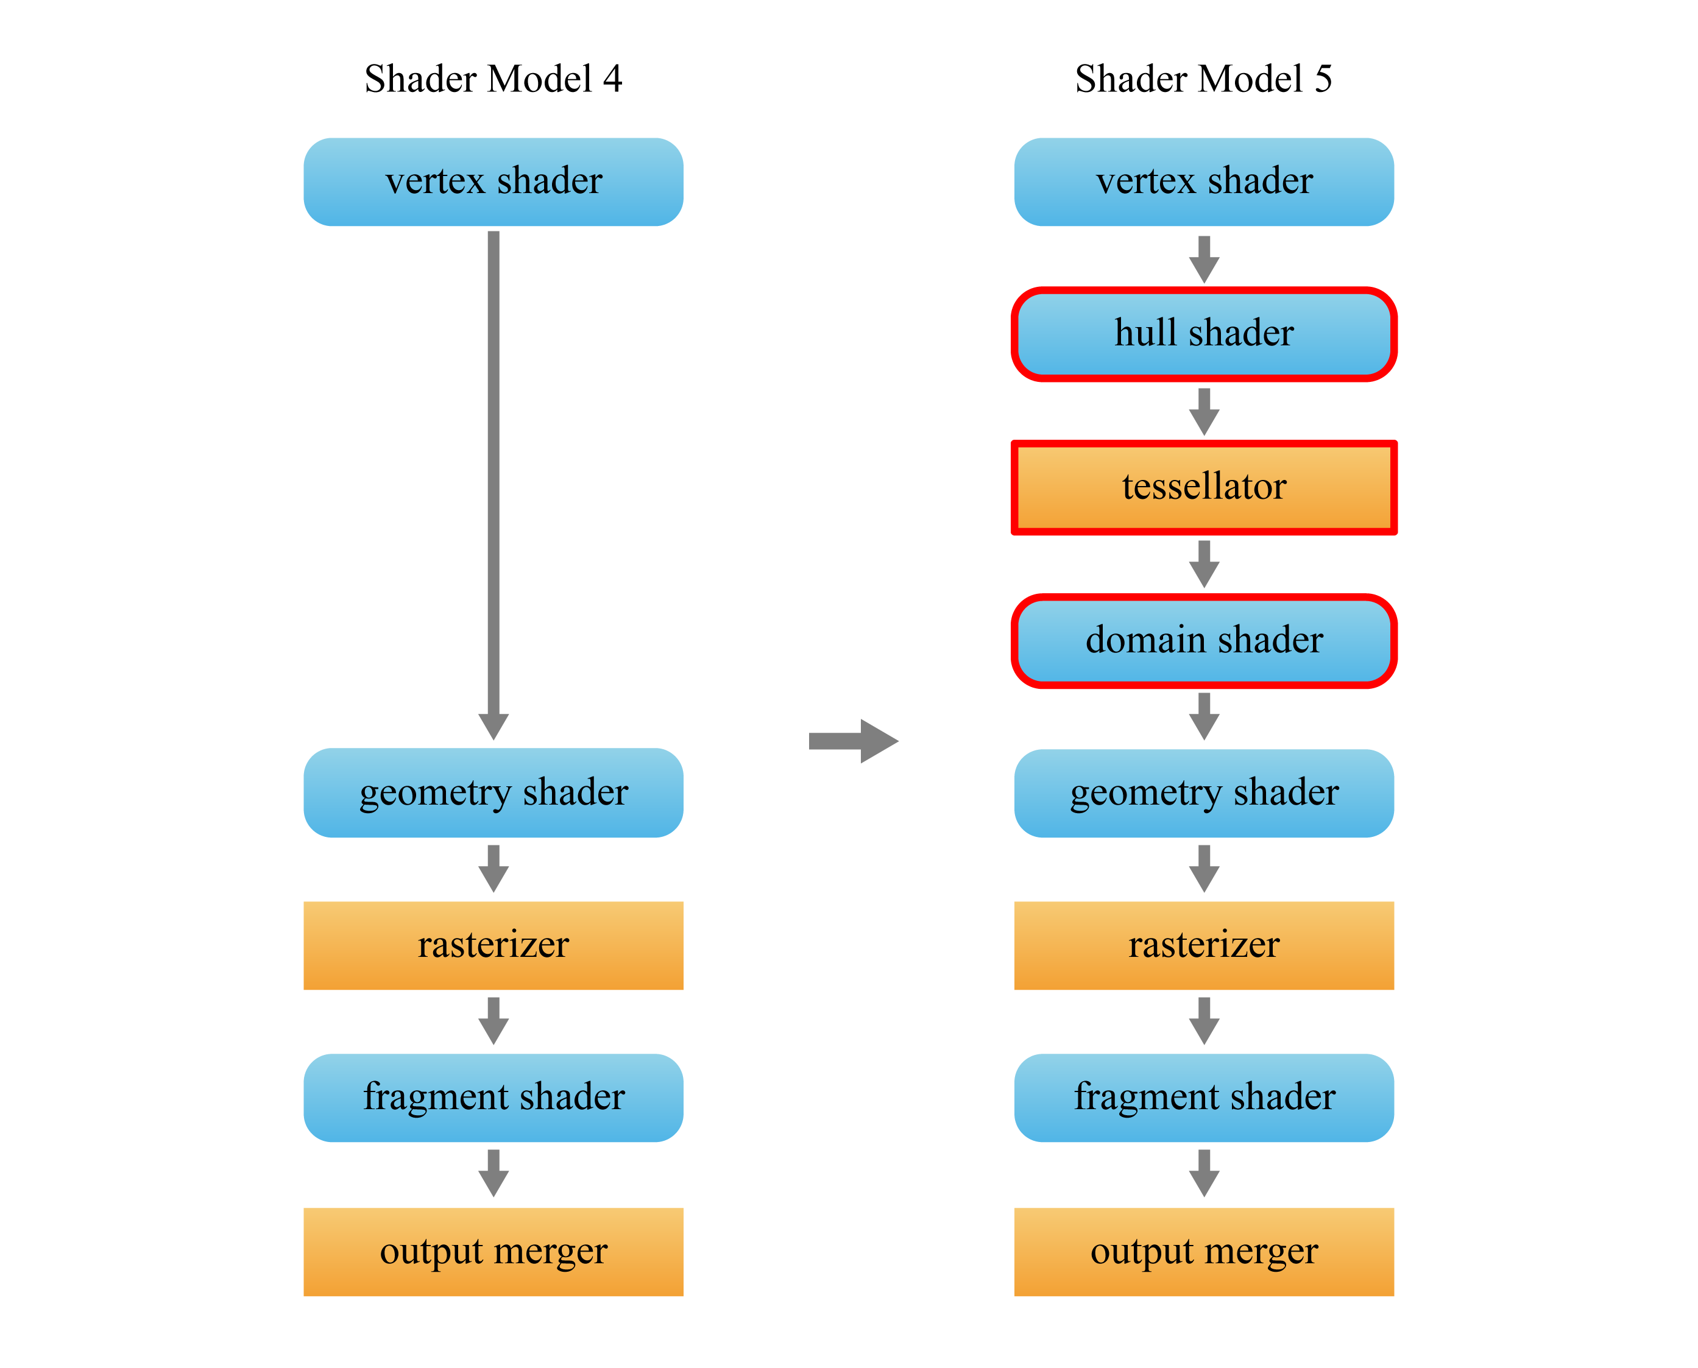
Shader Model 5
The most notable feature of Shader Model 5 is the support of hardware tessellation.
The goal of these new stages is to enable efficient processing of smooth surfaces.
7-<number>

Slide 15
PN-Triangle
A PN-triangle (standing for point-normal triangle) refers to a Bézier triangle that is derived from a triangle of a polygon mesh.
A PN-triangle can be tessellated into an arbitrary number of small triangles, and they replace the triangle from which the PN-triangle is derived.
7-<number>

Slide 16
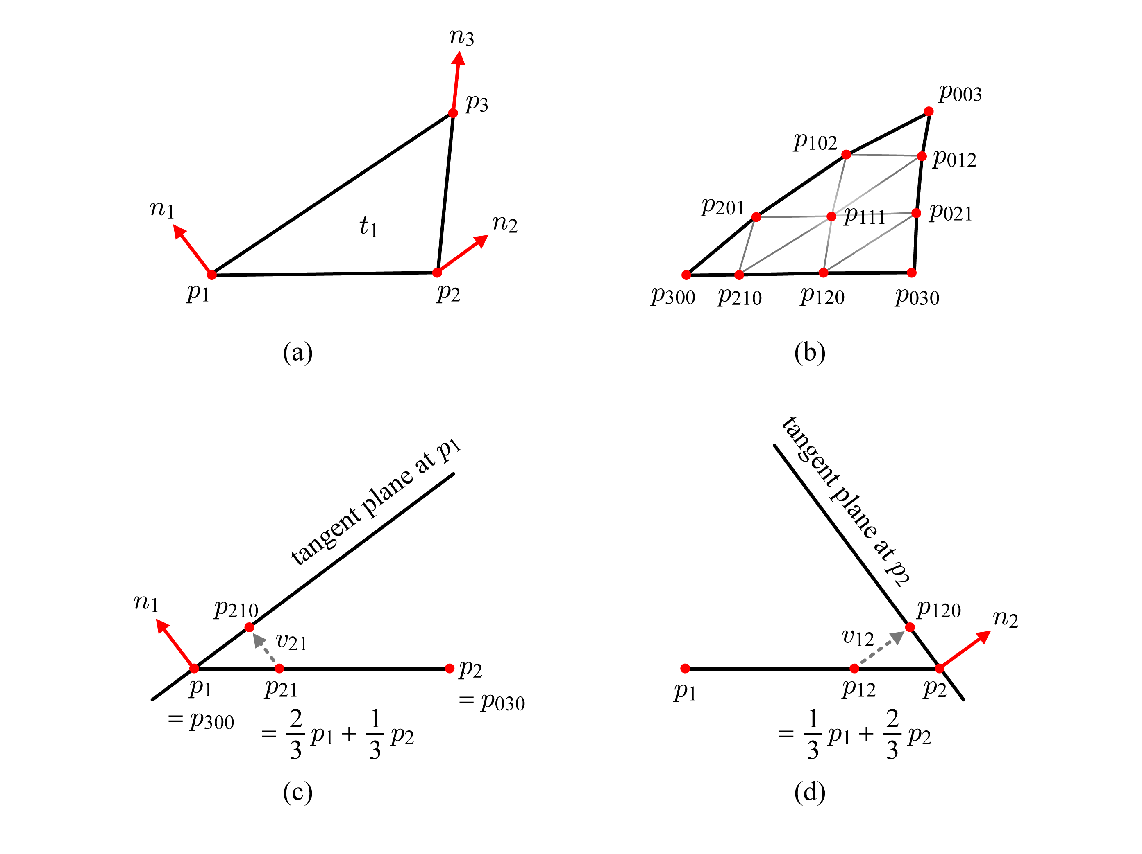

PN-Triangle – Control Points
Our goal is to convert the triangle t₁ in (a) into the Bézier triangle in (b).
First of all, the control points on the edge!
7-<number>

Slide 17

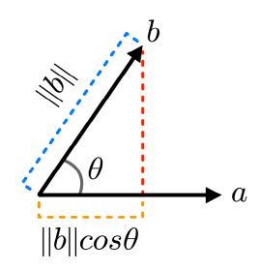
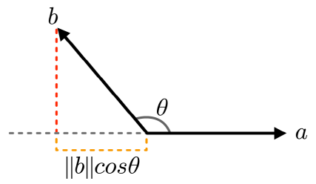
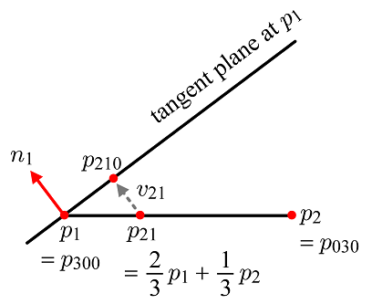
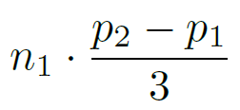
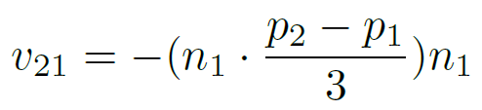

PN-Triangle – Control Points (cont’d)
Recall the definition of dot product:
When a is a unit vector, it is reduced to ||b||cosθ and represents the length of b projected onto a.
Note that the dot product is positive if θ is an acute angle and is negative if θ is an obtuse angle. ||b||cosθ is often called a signed length.
Now we can compute p₂₁₀.
7-<number>

Slide 18
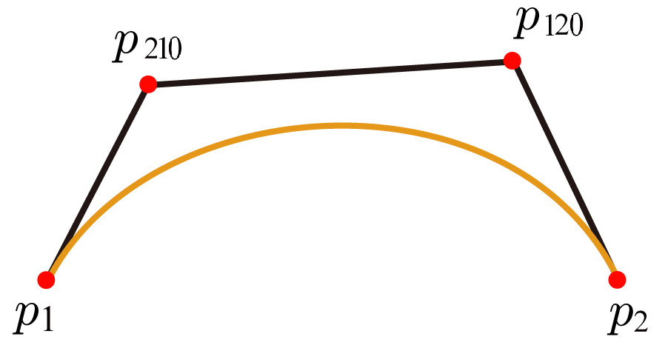
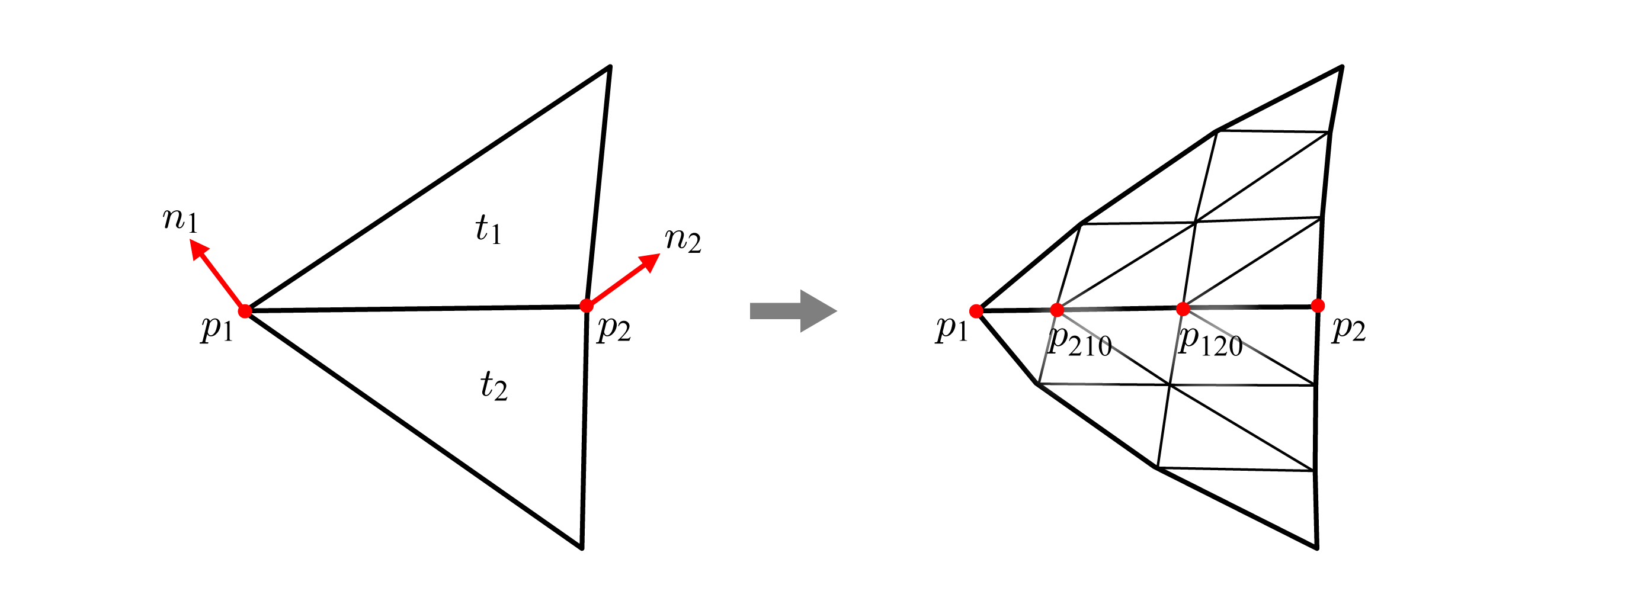
PN-Triangle – Control Points (cont’d)
Understand that p₁(p₃₀₀), p₂₁₀, p₁₂₀, and p₂(p₀₃₀) define a cubic Bézier curve.
Adjacent triangles of a polygon mesh are converted into two PN-triangles that share the control points.
Consequently, the high-resolution mesh produced by the two PN-triangles does not have a gap if both PN-triangles are tessellated with a uniform sampling rate. If a watertight mesh is converted into a higher resolution mesh using PN-triangles, the resulting mesh can be also watertight.
7-<number>

Slide 19



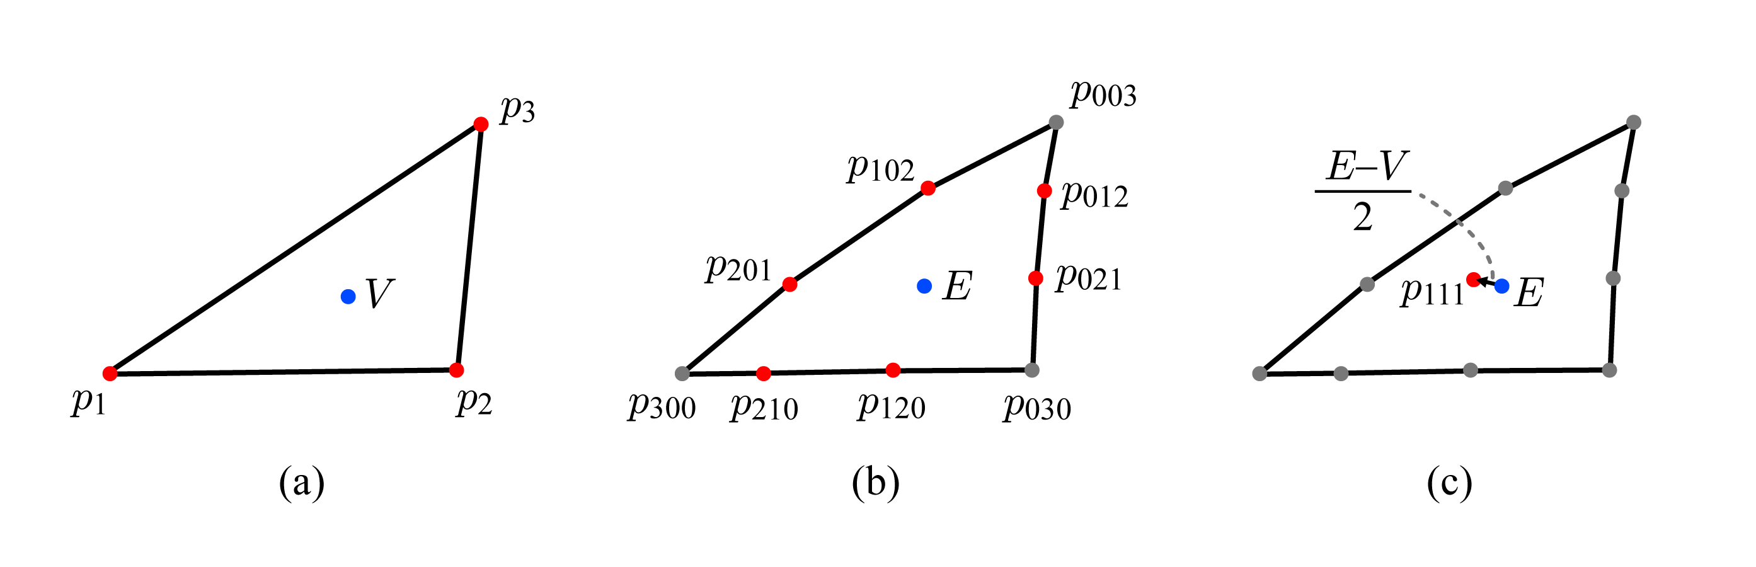
PN-Triangle – Control Points (cont’d)
Computing the interior control points
7-<number>

Slide 20
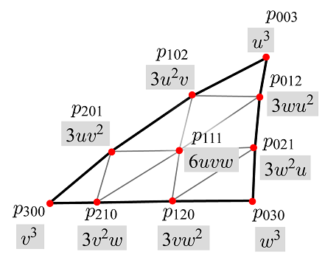
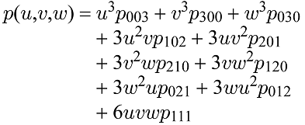
PN-Triangle – Control Normals
  Recall that the degree-3 control point net leads to the Bézier triangle equation p(u,v,w), which maps (u,v,w) to a vertex (x,y,z).
  However, the vertex positions are not sufficient for rendering the polygon mesh. We need vertex normals.
7-<number>

Slide 21
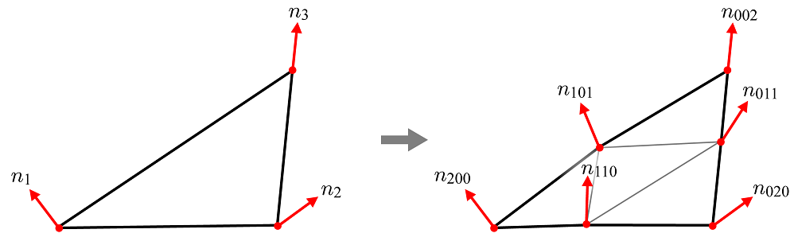
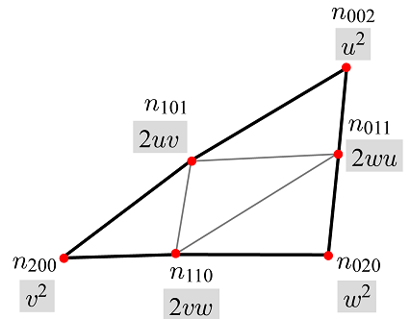

PN-Triangle – Control Normals (cont’d)
  A method for providing the vertex normals is to construct a triangular net of control normals. For example, see the following degree-2 control normal net.
Control point net vs. control normal net
  The degree-3 control point net leads to the Bézier triangle equation p(u,v,w), which maps (u,v,w) to a vertex position (x,y,z).
  The degree-2 control normal net leads to Bézier triangle equation n(u,v,w), which maps (u,v,w) to a vertex normal at (x,y,z).
Even though the control point net and the control normal net serve for a surface, they may have different degrees.
7-<number>

Slide 22
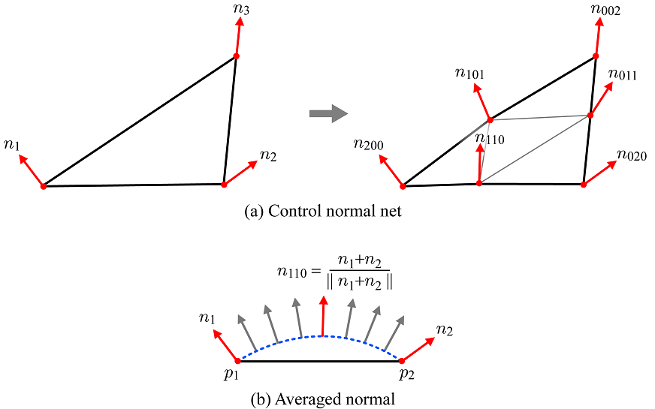
PN-Triangle – Control Normals (cont’d)
7-<number>

Slide 23
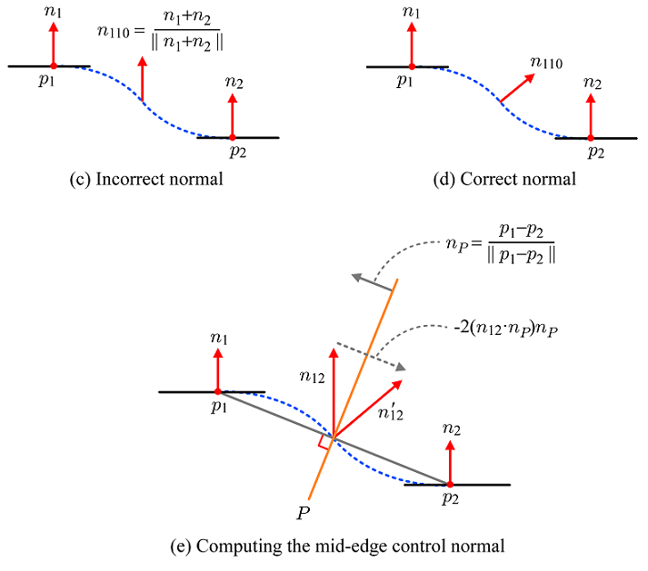

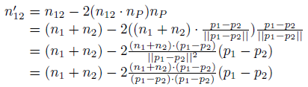
PN-Triangle – Control Normals (cont’d)
7-<number>

Slide 24
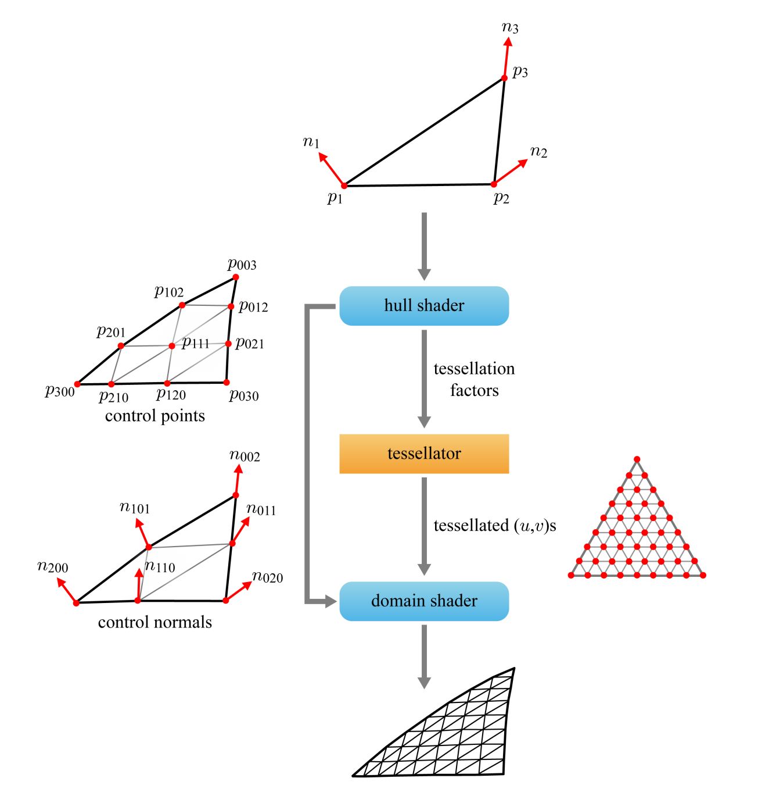
PN-Triangle Tessellation
  The hull shader produces the triangular nets of control points and control normals, which are sent to the domain shader, bypassing the tessellator.
  The hull shader also determines the tessellation factors. These are sent to the tessellator, which generates a regular pattern of (u,v) coordinates,
  The domain shader uses the coordinates to evaluate the control point/normal nets.
7-<number>

Slide 25
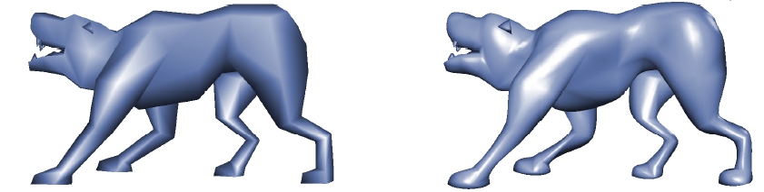
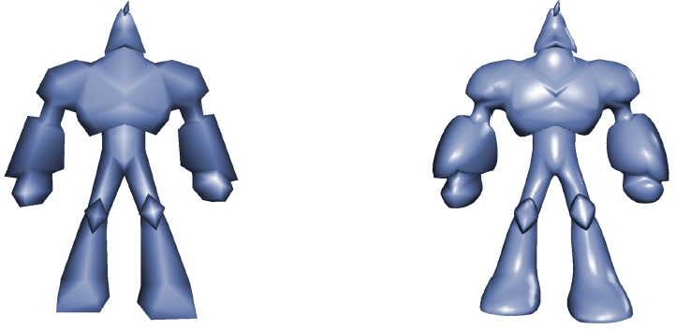
PN-Triangle Examples
7-<number>

