Slide 1
Chapter XII
Physics-based Simulation

Slide 2
Physics-based Simulation
Physics-based simulation
  Collision detection, which concerns the problems of determining whether, when, and where two or more objects come into contact
  Collision resolution, which describes how the objects move after collision
This chapter presents two methods for collision resolution
  Penalty method
  Impulse method
12-<number>

Slide 3
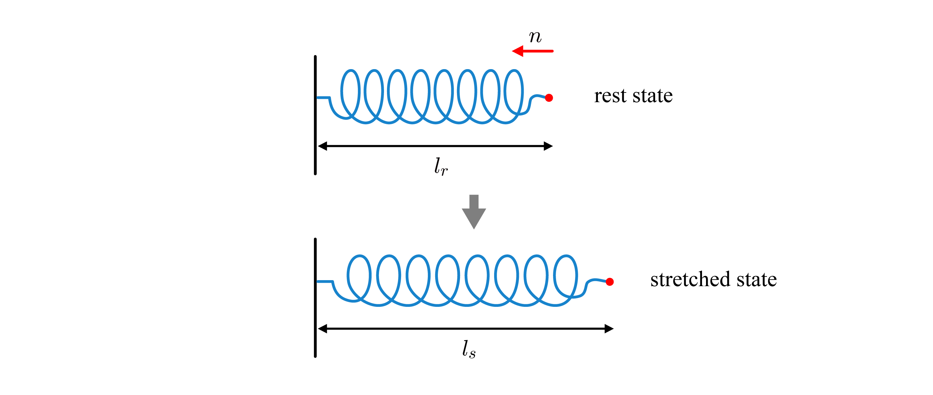

Penalty Method
Consider a particle falling into the ground. Assume that the y-axis of the world space is upward and the zx-plane corresponds to the ground. Then, collision is detected when the y-coordinate of the particle's position becomes zero or negative. This is the simplest example of collision detection!
A spring has the rest length l_{r} and the stiffness constant k_{s}. It is stretched along the opposite direction of n. If the stretched length is l_{s}, the spring force is defined to be k_{s}(l_{s}- l_{r})n.
12-<number>

Slide 4
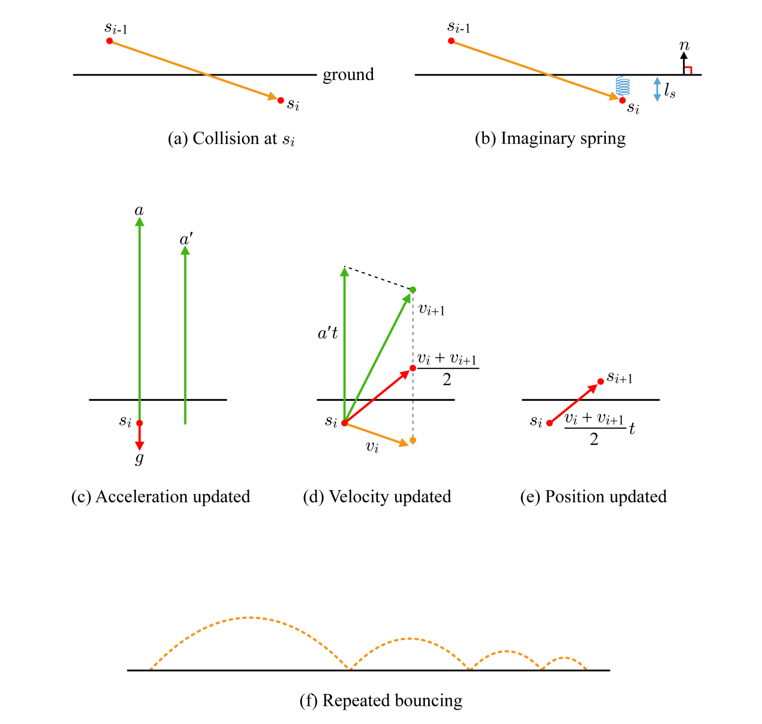
Penalty Method (cont’d)
12-<number>

Slide 5
Penalty Method (cont’d)
The penalty method is easy to implement, and the spring force adopted in the method is neatly integrated with other forces such as gravity.
However, the penalty method often reveals a serious problem.
  Suppose that k_{s} is underestimated, i.e., is set to a smaller value than desired. Then, the spring force becomes small, leading to small vectors for acceleration and velocity. As a result, the new position might be still under the ground.
  In contrast, overestimated k_{s} may lead to an overly large velocity, and the particle might overshoot in an unrealistic manner.
12-<number>

Slide 6










Impulse Method
Momentum (p) is defined to be mass (m) times velocity (v), i.e., p = mv.
The principle of conservation of momentum
12-<number>

Slide 7
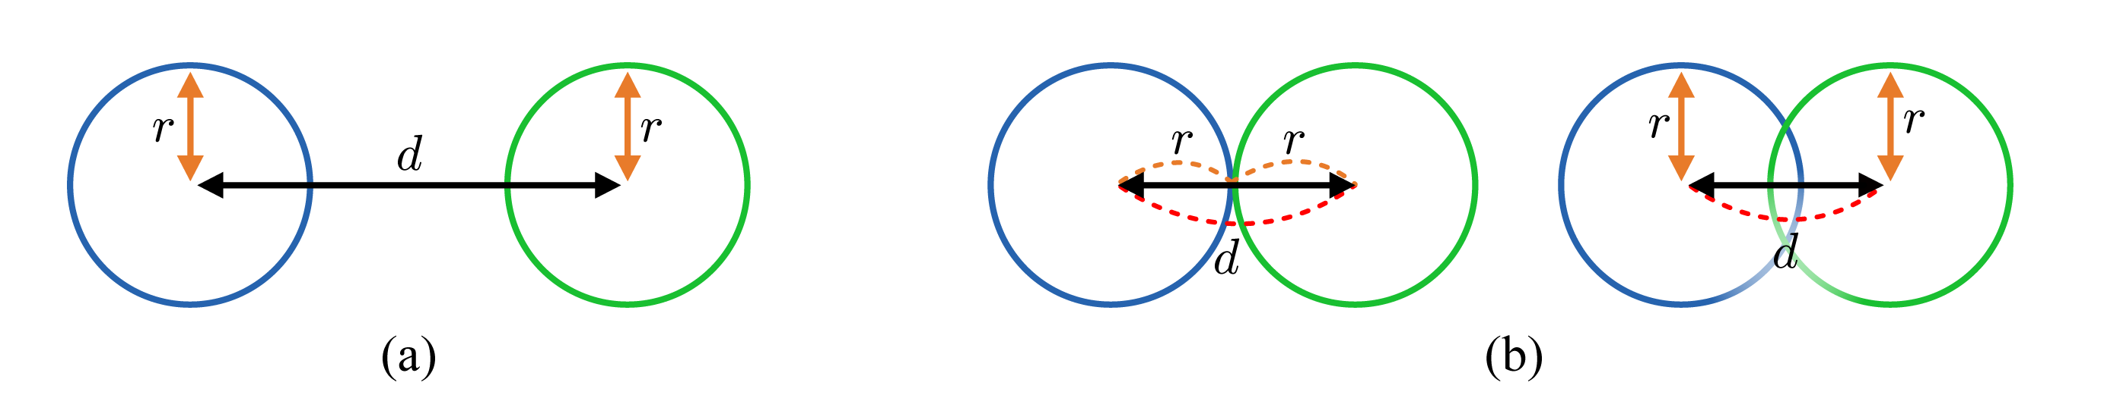
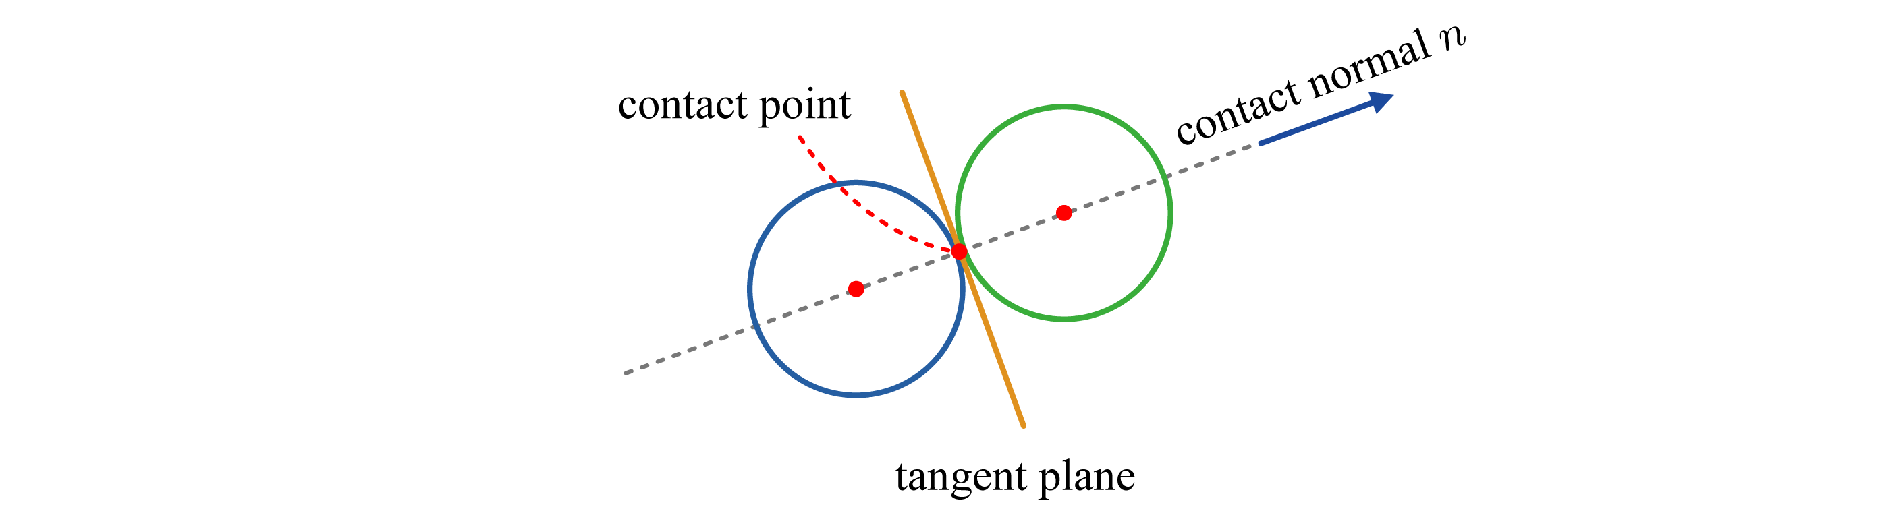
Impulse Method (cont’d)
The best example for demonstrating the impulse method is the billiard game.
Collision detection between two billiard balls is straightforward.
Contact point and contact normal
12-<number>

Slide 8
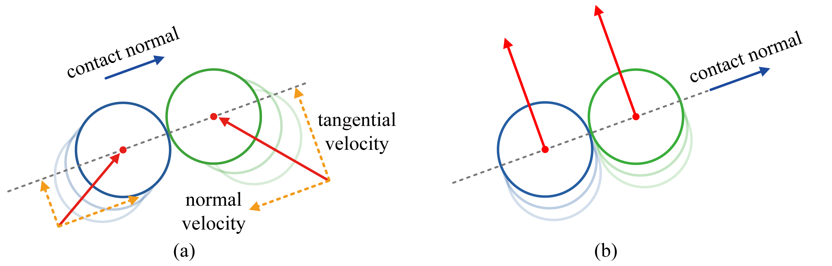
Impulse Method (cont’d)
The approaching velocity is decomposed into the normal velocity and the tangential velocity, as shown in (a).
After collision, the normal velocities are changed, but the tangential velocities remain constant. Therefore, only the normal velocities will be considered for collision resolution.
In (b), the normal velocity of each ball is zero, and consequently no collision resolution is needed.
The momentum in the tangential direction is conserved for each ball because the tangential velocity remains constant. In contrast, the normal velocity changes, and so does the momentum in the normal direction.
The impulse (change in momentum) occurs along the normal direction only.
12-<number>

Slide 9


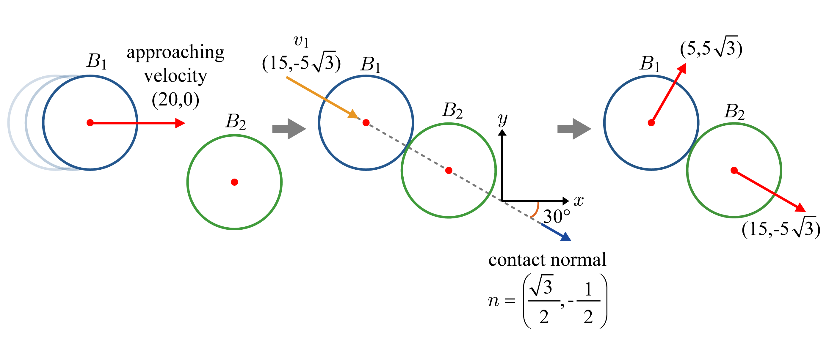


Impulse Method (cont’d)
Note that v_{r} of the equation in the box can be restricted to the normal component of the relative approaching velocity.
12-<number>

Slide 10
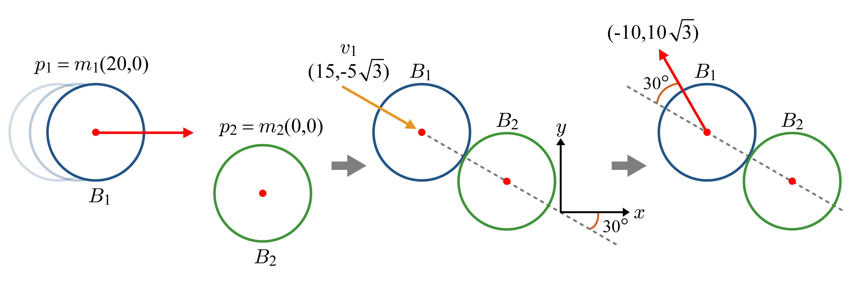
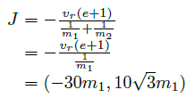

Impulse Method (cont’d)
Let’s see another example.
12-<number>

Slide 11
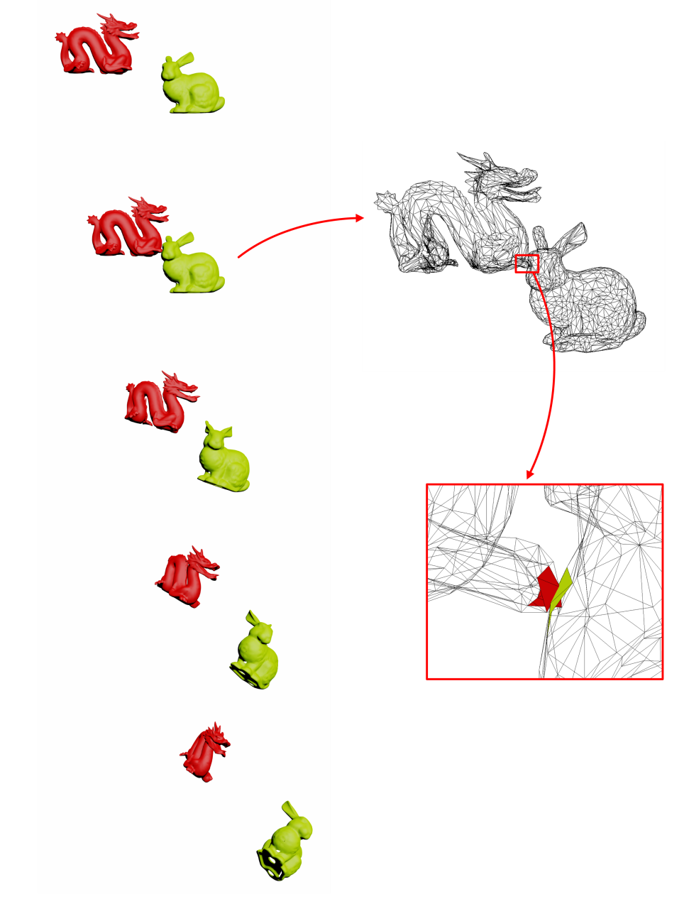
Collision Detection
In general, collision detection requires intersection tests among the triangles. If each object is composed of 1K triangles, for example, we would need 1M triangle-triangle intersection tests, which are obviously expensive.
To save the computing cost, collision detection algorithms are usually implemented in two phases.
  The broad phase excludes all parts of the objects that are out of the bounds of possibility of collision and identifies the remains as the potentially colliding set (PCS).
  The narrow phase performs the pairwise triangle tests within the PCS.
12-<number>

Slide 12
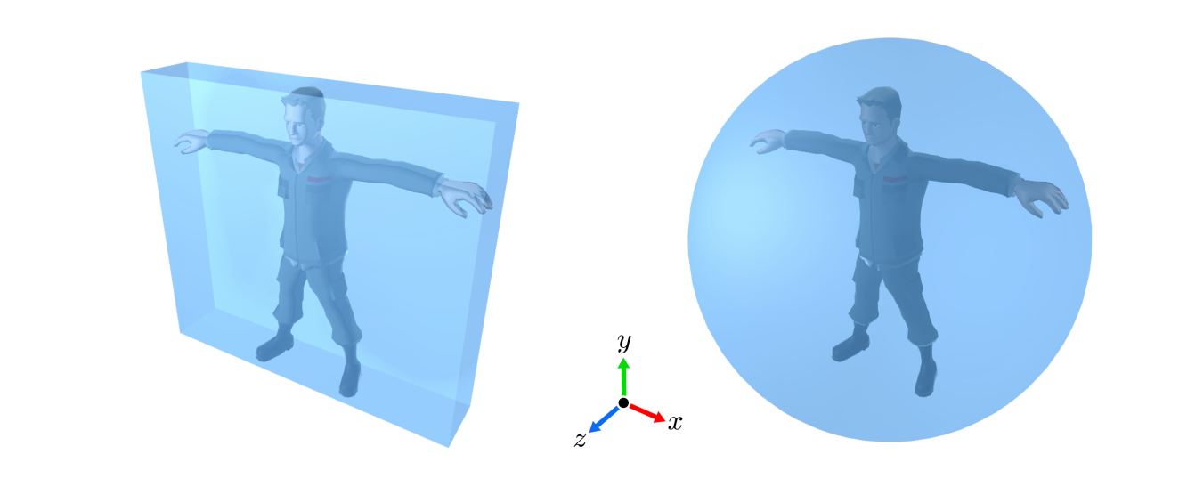
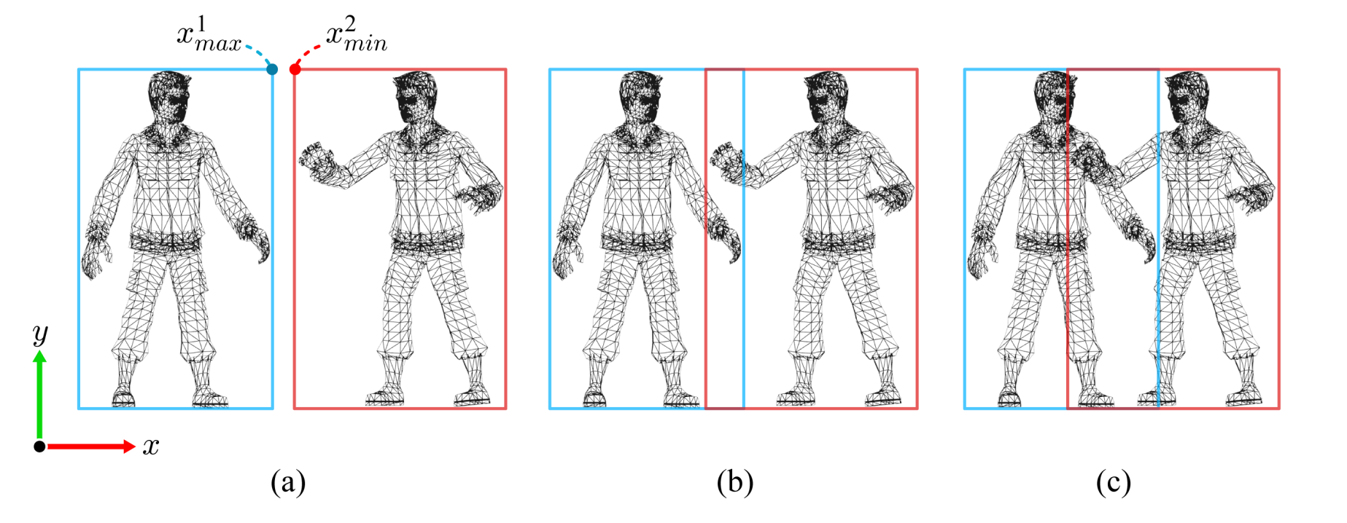
Collision Detection (cont’d)
The broad phase typically uses the bounding volumes.
12-<number>

Slide 13
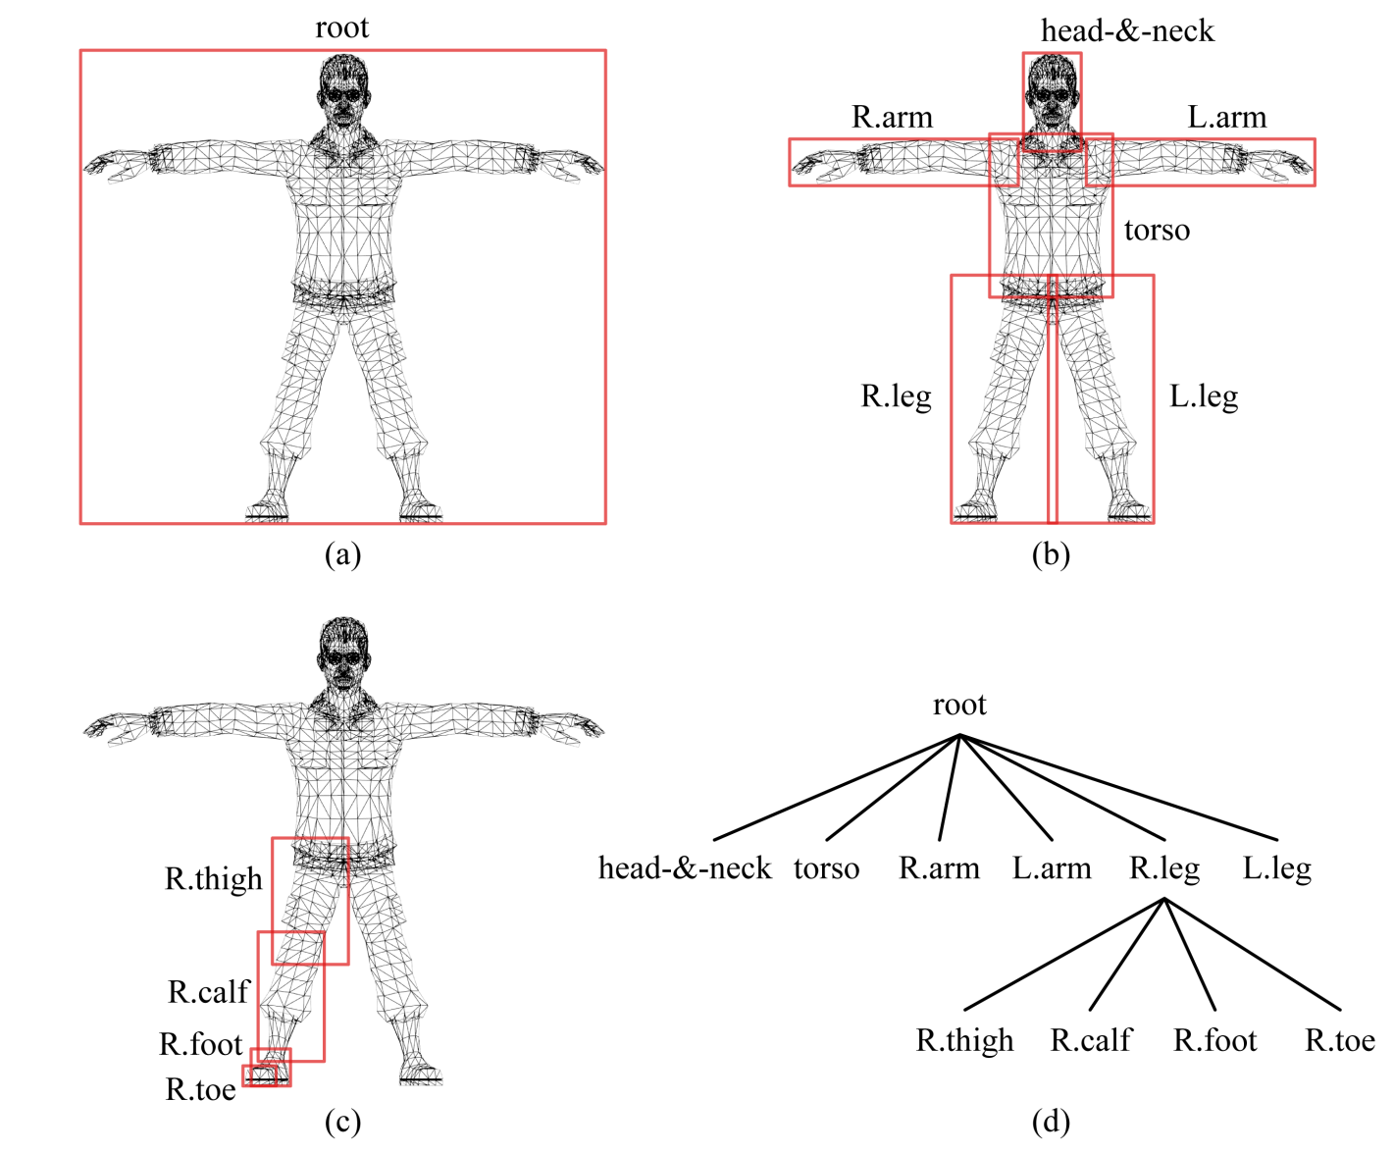
Collision Detection (cont’d)
The bounding volumes are typically organized in a hierarchy.
12-<number>

Slide 14
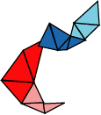

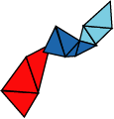



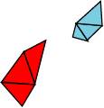





Collision Detection (cont’d)
Collision detection using the bounding volume hierarchies.
A
A and B
A₂ and B
A₁ and B
A₁
A₂
B
A₁ and B₁
A₁ and B₂
B₁
B₂
triangle-triangle test
12-<number>

Slide 15
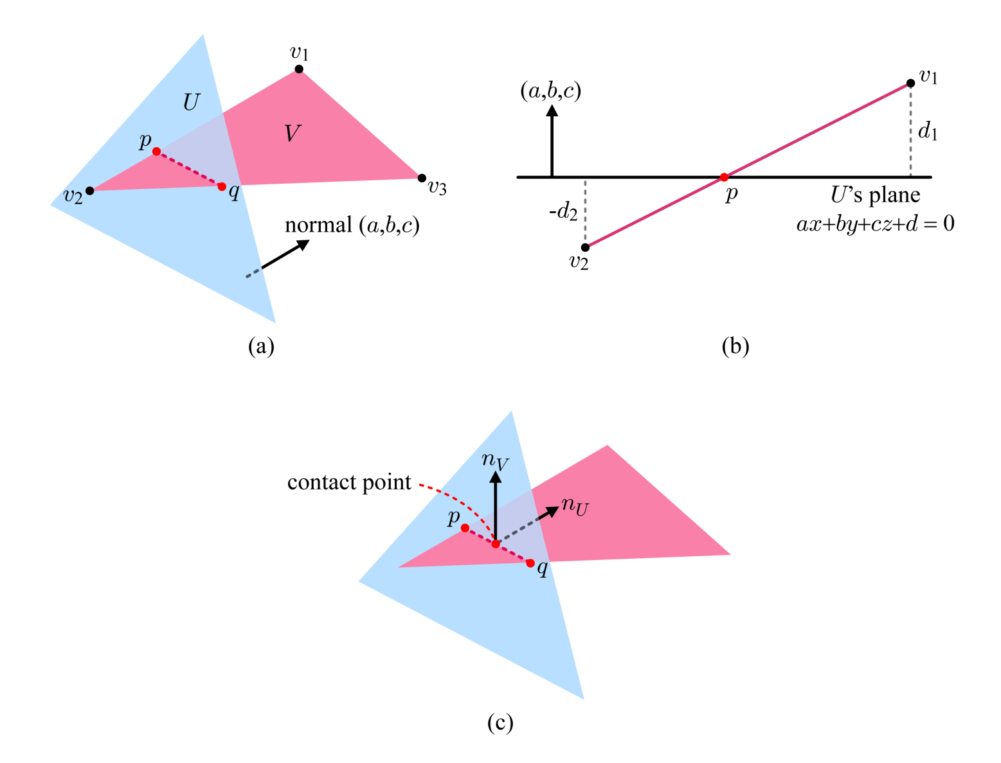



Collision Resolution
Triangle-triangle Intersection
12-<number>

Slide 16
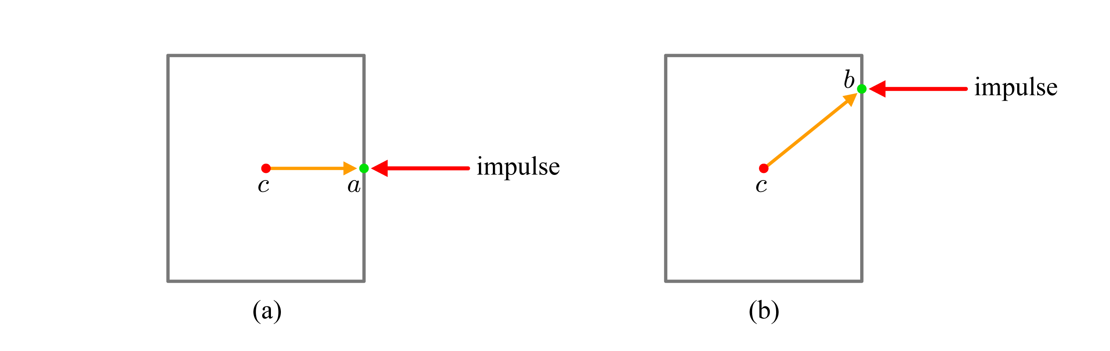
Collision Resolution (cont’d)
So far, we have considered only linear accelerations for physics-based simulation. When a force is applied to an object, however, the force may induce angular accelerations.
12-<number>

