Slide 1
Business Analyst Portfolio Project
BRD / SRS Document
Food Delivery App – Order Cancellation & Refund Feature
End-to-end requirements package: BRD, SRS, user stories, use cases, acceptance criteria, process flows, RTM and UAT scenarios.
GitHub + LinkedIn Ready

Slide 2
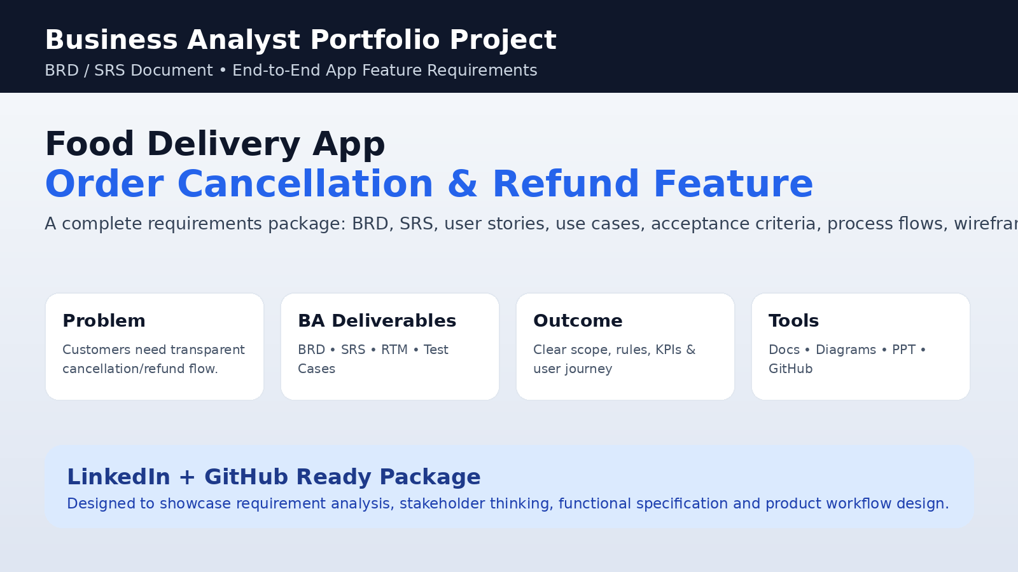
Business Problem
Why this feature is needed
• Customers do not know if cancellation is allowed.
• Refund amount and cancellation fee are unclear.
• Support teams manually verify order/refund status.
• Refund delays create repeat follow-ups and poor experience.

Slide 3
Project Objective & Scope
What the BRD/SRS covers
Objective Define a clear, testable cancellation and refund workflow that improves transparency and reduces support effort.
In Scope Cancel flow, refund calculation, reason capture, admin exceptions, notifications, audit trail, reporting.
Out of Scope: full payment gateway development, full delivery app development, coupon engine redesign, loyalty/referral refunds.

Slide 4
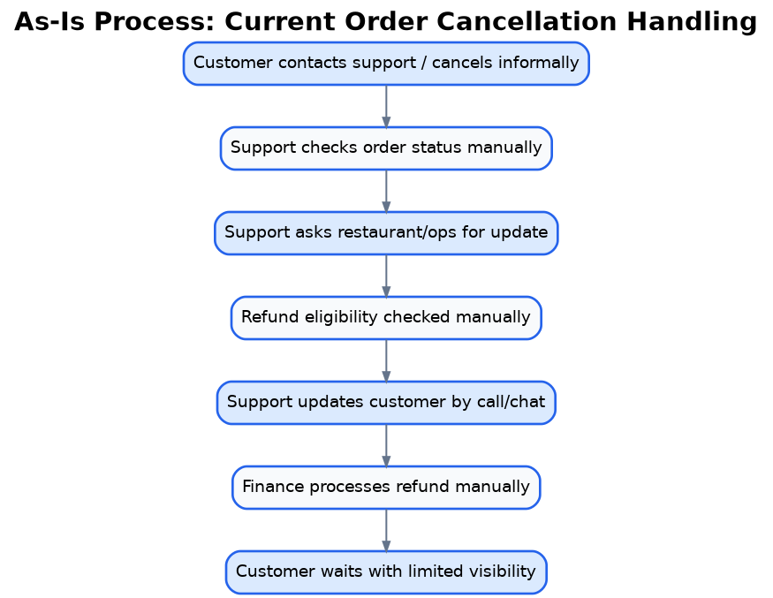
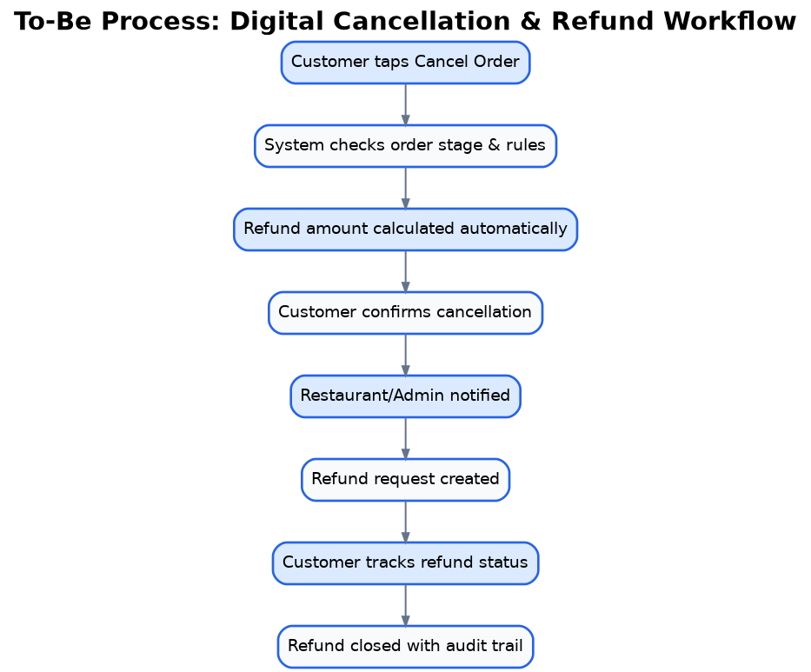
As-Is vs To-Be Process
Current manual process redesigned as a digital workflow

Slide 5
Stakeholders & Business Rules
Requirement context
• Customer
• Finance Team
BR-01: 100% refund before restaurant acceptance
• Restaurant Partner
• Product Manager
BR-02: Cancellation fee after preparation starts
• Support/Admin
• Operations Team
BR-03: Cancellation blocked after pickup
BR-04: Admin override requires reason & audit

Slide 6
Functional Requirements
High-level requirement summary
FR-01: Show Cancel Order button only when eligible
FR-05: Show cancellation fee and refund timeline
FR-02: Capture cancellation reason
FR-06: Initiate refund through payment workflow
FR-03: Validate current order stage
FR-07: Allow customer to track refund status
FR-04: Calculate refund amount automatically
FR-08: Admin can handle exception refunds

Slide 7
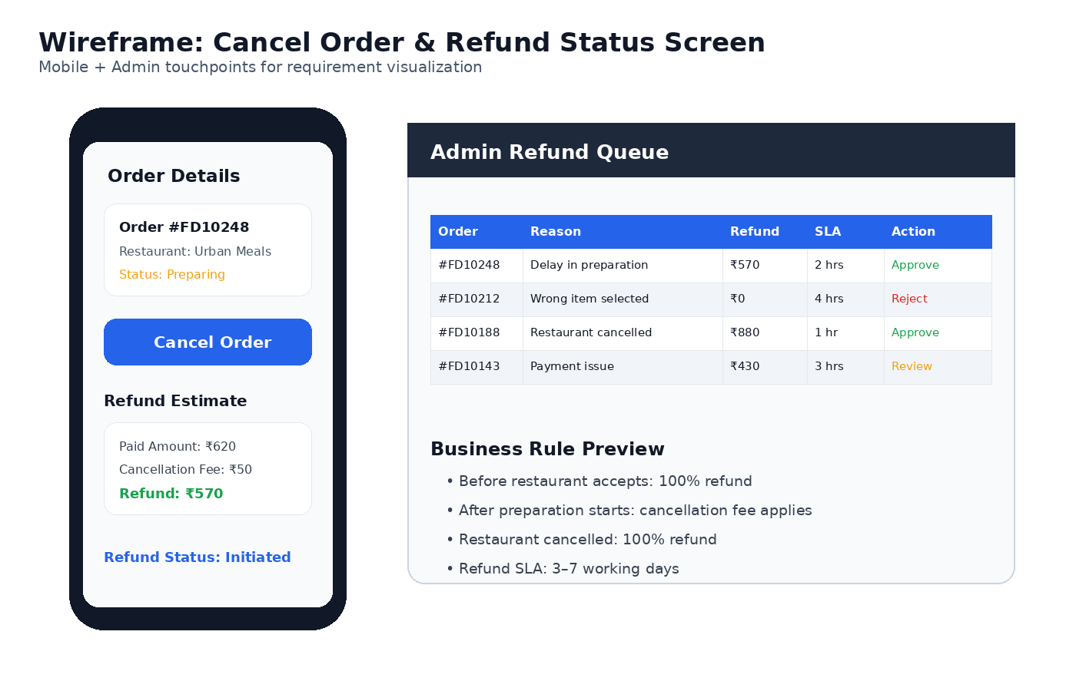
Feature Wireframe
Customer and admin touchpoints

Slide 8
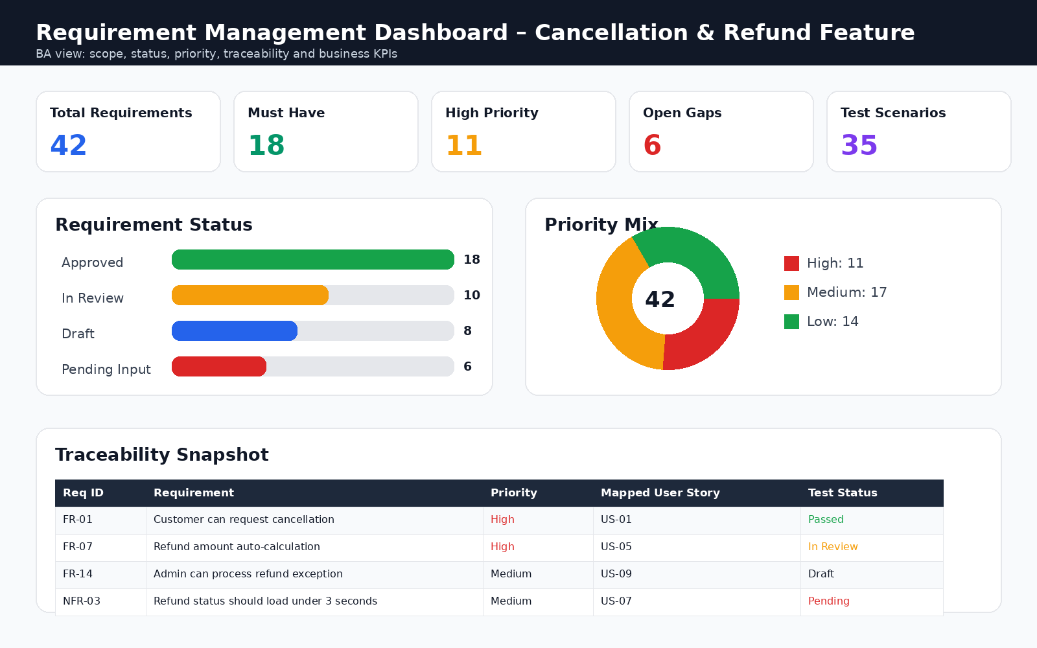
Requirement Dashboard
BA tracking and traceability view

Slide 9
Requirement Traceability & UAT
How requirements become testable
RTM links: • Requirement ID • User Story • Use Case • Test Scenario • Priority • Status
UAT Scenarios: • Eligible cancellation • Cancellation fee case • Refund API failure • Admin exception approval • Refund report export

Slide 10
Project Outcome
A complete BA requirements package for a real-world app feature.
Demonstrates BRD/SRS writing, stakeholder analysis, process design, functional requirements, user stories, business rules, acceptance criteria, RTM and UAT planning.
Ready for GitHub + LinkedIn

