Slide 1
Power BI HR Attrition Dashboard
Business Analyst Case Study | People Analytics | Attrition Insights

Slide 2
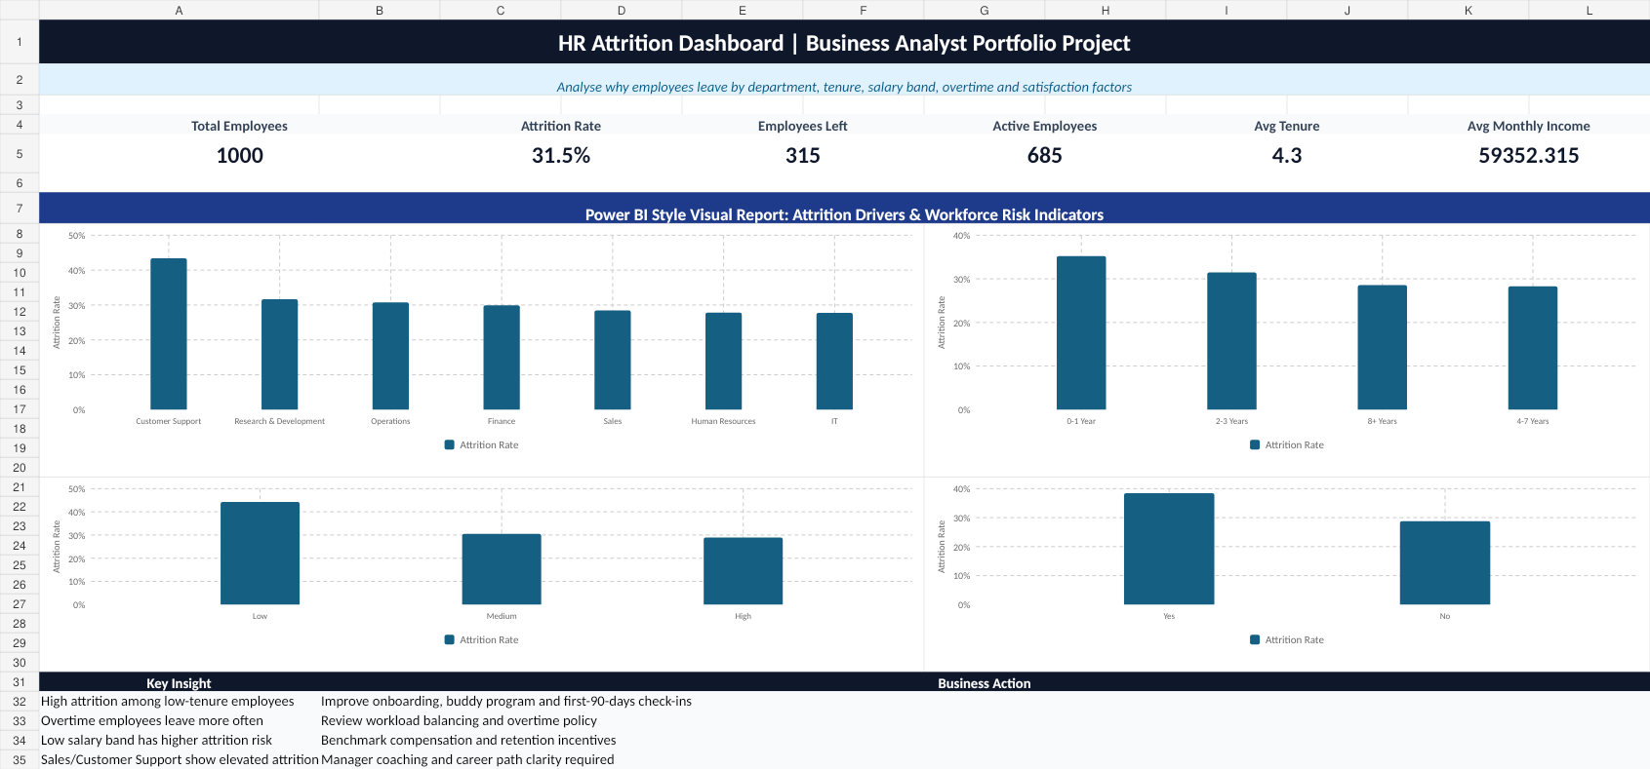
Business Problem
Employee attrition impacts hiring cost, productivity, team stability and employee morale.
HR leadership needs a visual dashboard to answer:
• Which departments have the highest attrition?
• Are new employees leaving faster?
• Does overtime increase attrition risk?
• Is salary band connected to employee exits?
• What actions should HR prioritize?
Power BI HR Attrition Dashboard | Business Analyst Portfolio Project

Slide 3
Key HR Attrition KPIs
Executive summary metrics for HR leadership
Total Employees
Employees Left
Attrition Rate
1000
315
31.5%
Active Employees
Avg Tenure
Avg Income
685
4.3 yrs
₹59,352
Power BI HR Attrition Dashboard | Business Analyst Portfolio Project

Slide 4
Dashboard Preview
Power BI style dashboard layout for HR attrition analysis
Power BI HR Attrition Dashboard | Business Analyst Portfolio Project

Slide 5
Segmentation Analysis
Attrition segmented by department, tenure, salary band and overtime
Dashboard segments attrition by:
• Department: Identify business units with high workforce risk
• Tenure Band: Detect early-tenure exits and onboarding gaps
• Salary Band: Understand compensation-related attrition exposure
• Overtime: Evaluate workload and burnout indicators
• Job Role: Highlight roles needing immediate intervention
Department | Employees | Left | Attr %
Customer Support | 129 | 56 | 43.4%
Research & Development | 259 | 82 | 31.7%
Operations | 117 | 36 | 30.8%
Finance | 97 | 29 | 29.9%
Sales | 218 | 62 | 28.4%
Power BI HR Attrition Dashboard | Business Analyst Portfolio Project

Slide 6
Key Business Insights
What the HR team should notice
1. Early-tenure employees show higher attrition risk.
2. Overtime is strongly connected with employee exits.
3. Low salary band employees have higher attrition exposure.
4. Attrition is concentrated in selected departments and job roles.
5. Retention actions should focus on onboarding, workload and compensation.
Power BI HR Attrition Dashboard | Business Analyst Portfolio Project

Slide 7
Business Recommendations
HR actions based on dashboard insights
✓ Create a 30-60-90 day onboarding and engagement check-in process.
✓ Monitor overtime by department and rebalance workload where required.
✓ Review salary bands for high-risk employee groups.
✓ Run stay interviews for employees with tenure below 2 years.
✓ Prepare department-level retention action plans and track progress monthly.
Power BI HR Attrition Dashboard | Business Analyst Portfolio Project

Slide 8
BA Deliverables & Portfolio Value
Artifacts included for GitHub and LinkedIn
• Dataset CSV
• SQL Analysis Queries
• Dashboard Workbook
• Dashboard Preview Image
• BRD Document
• SRS Document
• User Stories
• KPI Definitions
• Insights & Recommendations
• LinkedIn Caption
Power BI HR Attrition Dashboard | Business Analyst Portfolio Project

Slide 9
How to Share This Project
Recommended LinkedIn + GitHub presentation
LinkedIn Post:
• Upload dashboard image as the first visual
• Attach PPT/PDF as a carousel
• Add GitHub link in the first comment
GitHub Repository:
• README.md with project objective, KPIs and insights
• data/ folder for CSV
• sql/ folder for queries
• dashboard/ folder for workbook
• documentation/ folder for BA documents
• presentation/ folder for PPT/PDF
Power BI HR Attrition Dashboard | Business Analyst Portfolio Project

