Slide 1


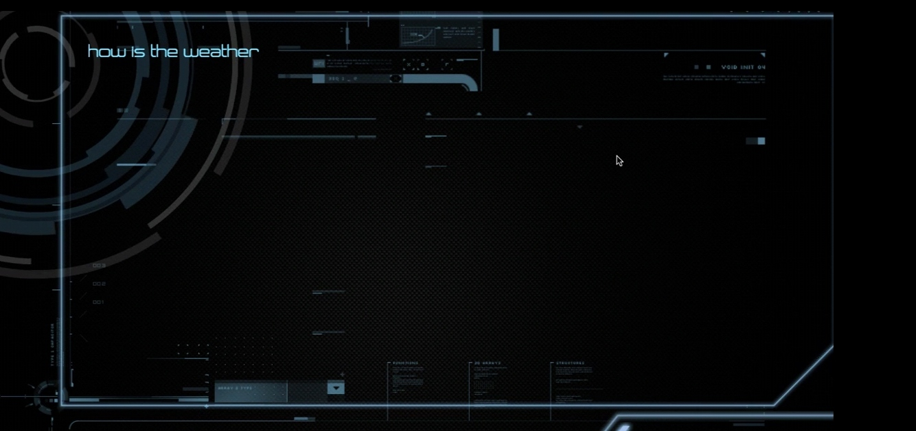
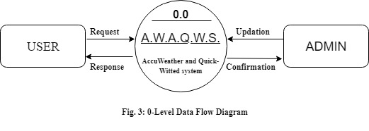
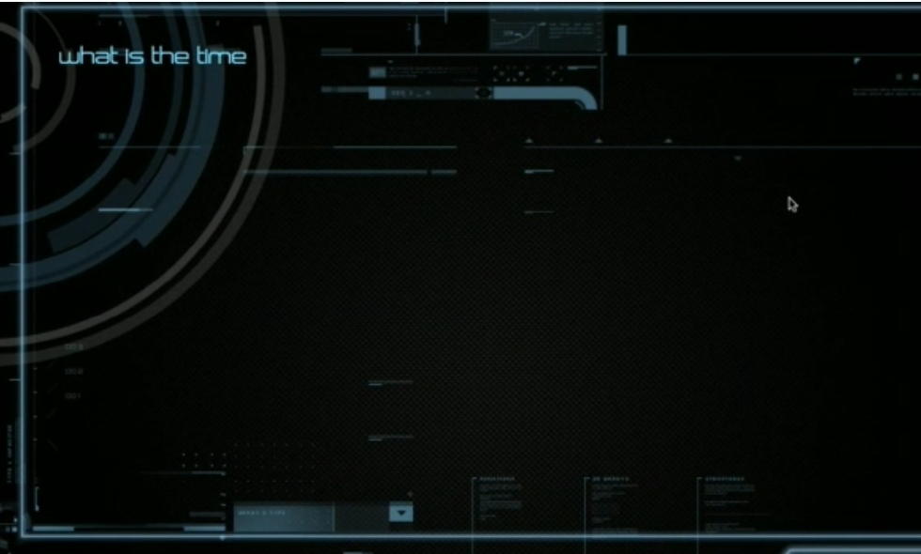
SHRI RAMSWAROOP MEMORIAL GROUP OF PROFESSIONAL COLLEGES
DEPARTMENT OF INFORMATION TECHNOLOGY
A.W.A.Q.W.S. (Virtual Assistant)
(AccuWeather and Quick-Witted System)
PROJECT MEMBER:
MOHD SUHEL (1612213066)
MANISHA KUMARI (1612213008)
UNDER THE GUIDANCE OF:
Mrs. Shilpi Khanna
INTRODUCTION
This Project aims at developing an (A.I.) artificial intelligence based virtual assistant which would assist user according to the weather.
It is being developed to brief user according to weather with greetings of the day, music and it will provide weather warning means the warned event is expected and people in the affected area should prepare for the expected weather such kinds of other weather related features. A weather forecast VPA application using the weather API.
OBJECTIVES
Our aim is to create a application to
Alarm for a sudden change in weather.
Help in Transportation Business.
Journey Plans According to the Weather.
National Weather Service warnings.
Schedule Events According to the Weather.
Helpful for farmers.
Find your Next Music Data According to the Weather.
ADVANTAGES
Smartly pulled out relevant information your journey plans, meetings.
Find information weather report and National Weather Service warnings.
Run timers, notifications and reminders
Control your music according to weather.
PROPOSED METHODOLOGY
The project uses iterative model that focuses on addition of requirements in design and implementation of the software at all successive increments with improvements at every iteration.
LIMITATIONS
MODULE DESCRIPTION
Weather is extremely difficult to forecast correctly.
It is expensive to monitor-so many variables from so many sources.
The weather forecasters get blamed if the weather is different from the forecast.
Without internet connection the app will not respond.
Conversation Module: This module is to make A.W.A.Q.W.S. understand what you are saying, with the help of a python program that speech-recognition techniques.
Logic Engine Design: The entry point to direct queries to its logic engine. It contain a ladder of if/else clauses to determine what the user wants to say. If there is a pattern match with one of the statements call the corresponding module.
Making A.W.A.Q.W.S. Responsive: The task of making responsive, so that she can respond to questions. This requires you to compare the speech text variable to a predefine string.
CONCLUSIONS
The virtual assistant is to gather data from the internet (weather data, data from Wikipedia, data mining); play music; and take notes
Virtual assistant is useful for helping the users of a computer system automate tasks and accomplish task with minimum human interaction with a machine.
0 LEVEL DFD
FUTURE SCOPE
We will initially want to decide when and where we synch our physiology, decision-making and emotions with our virtual assistant. Then real-time synchronisation will just be easier and more efficient.
A virtual assistant software can serve in the Internet of thing as well as run a voice-controlled vechicle, drones.
SCREENSHOTS
REFERENCES
https://www.researchgate.net/publication/264001644_Virtual_personal_Assistant
https://en.wikipedia.org/wiki/Representational_state_transfer
https://developers.google.com/assistant/sdk/guides/library/python/embed/install-sample
https://pypi.org/project/weather-api/

