Slide 1
Bluetooth

Slide 2
Process
Set up bluetooth
Enable bluetooth
Discover bluetooth devices and list them

Slide 3
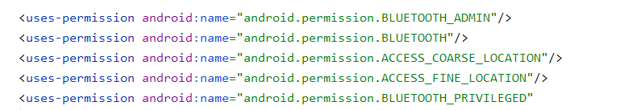
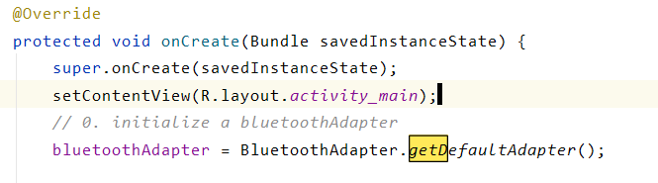
Set up bluetooth

Slide 4
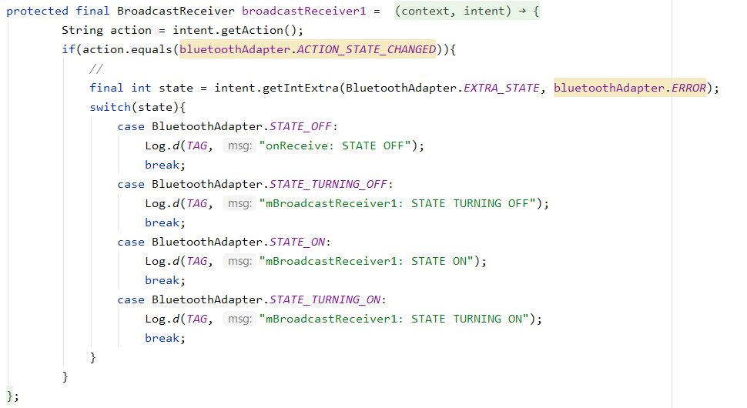
Enable bluetooth

Slide 5
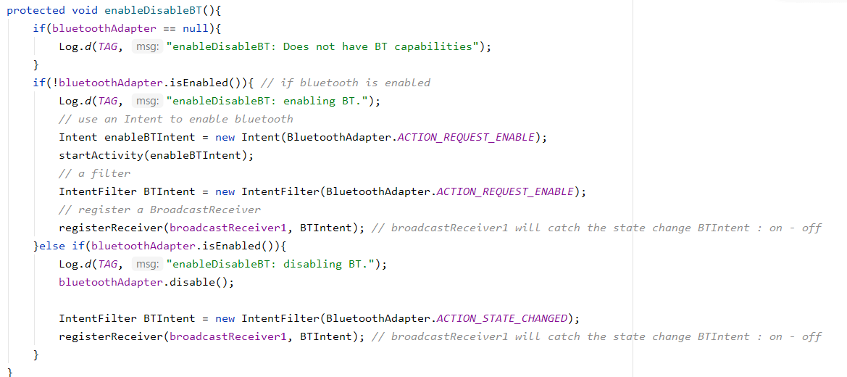
Enable bluetooth

Slide 6
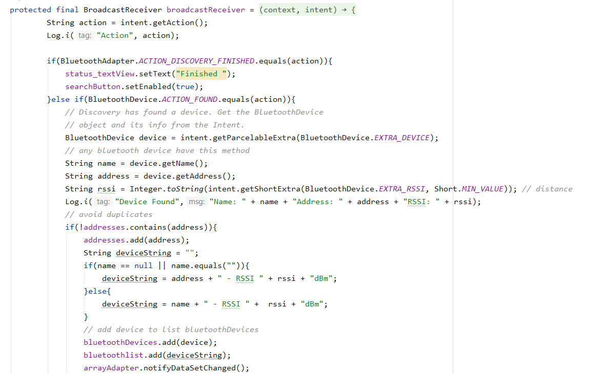
Discover bluetooth devices and list them

Slide 7
