Slide 1
A 3rd-party YouTube Application with OkHttp Nan Sun

Slide 2
Index
1. Application Design
2. OkHttp
3. Implementation

Slide 3
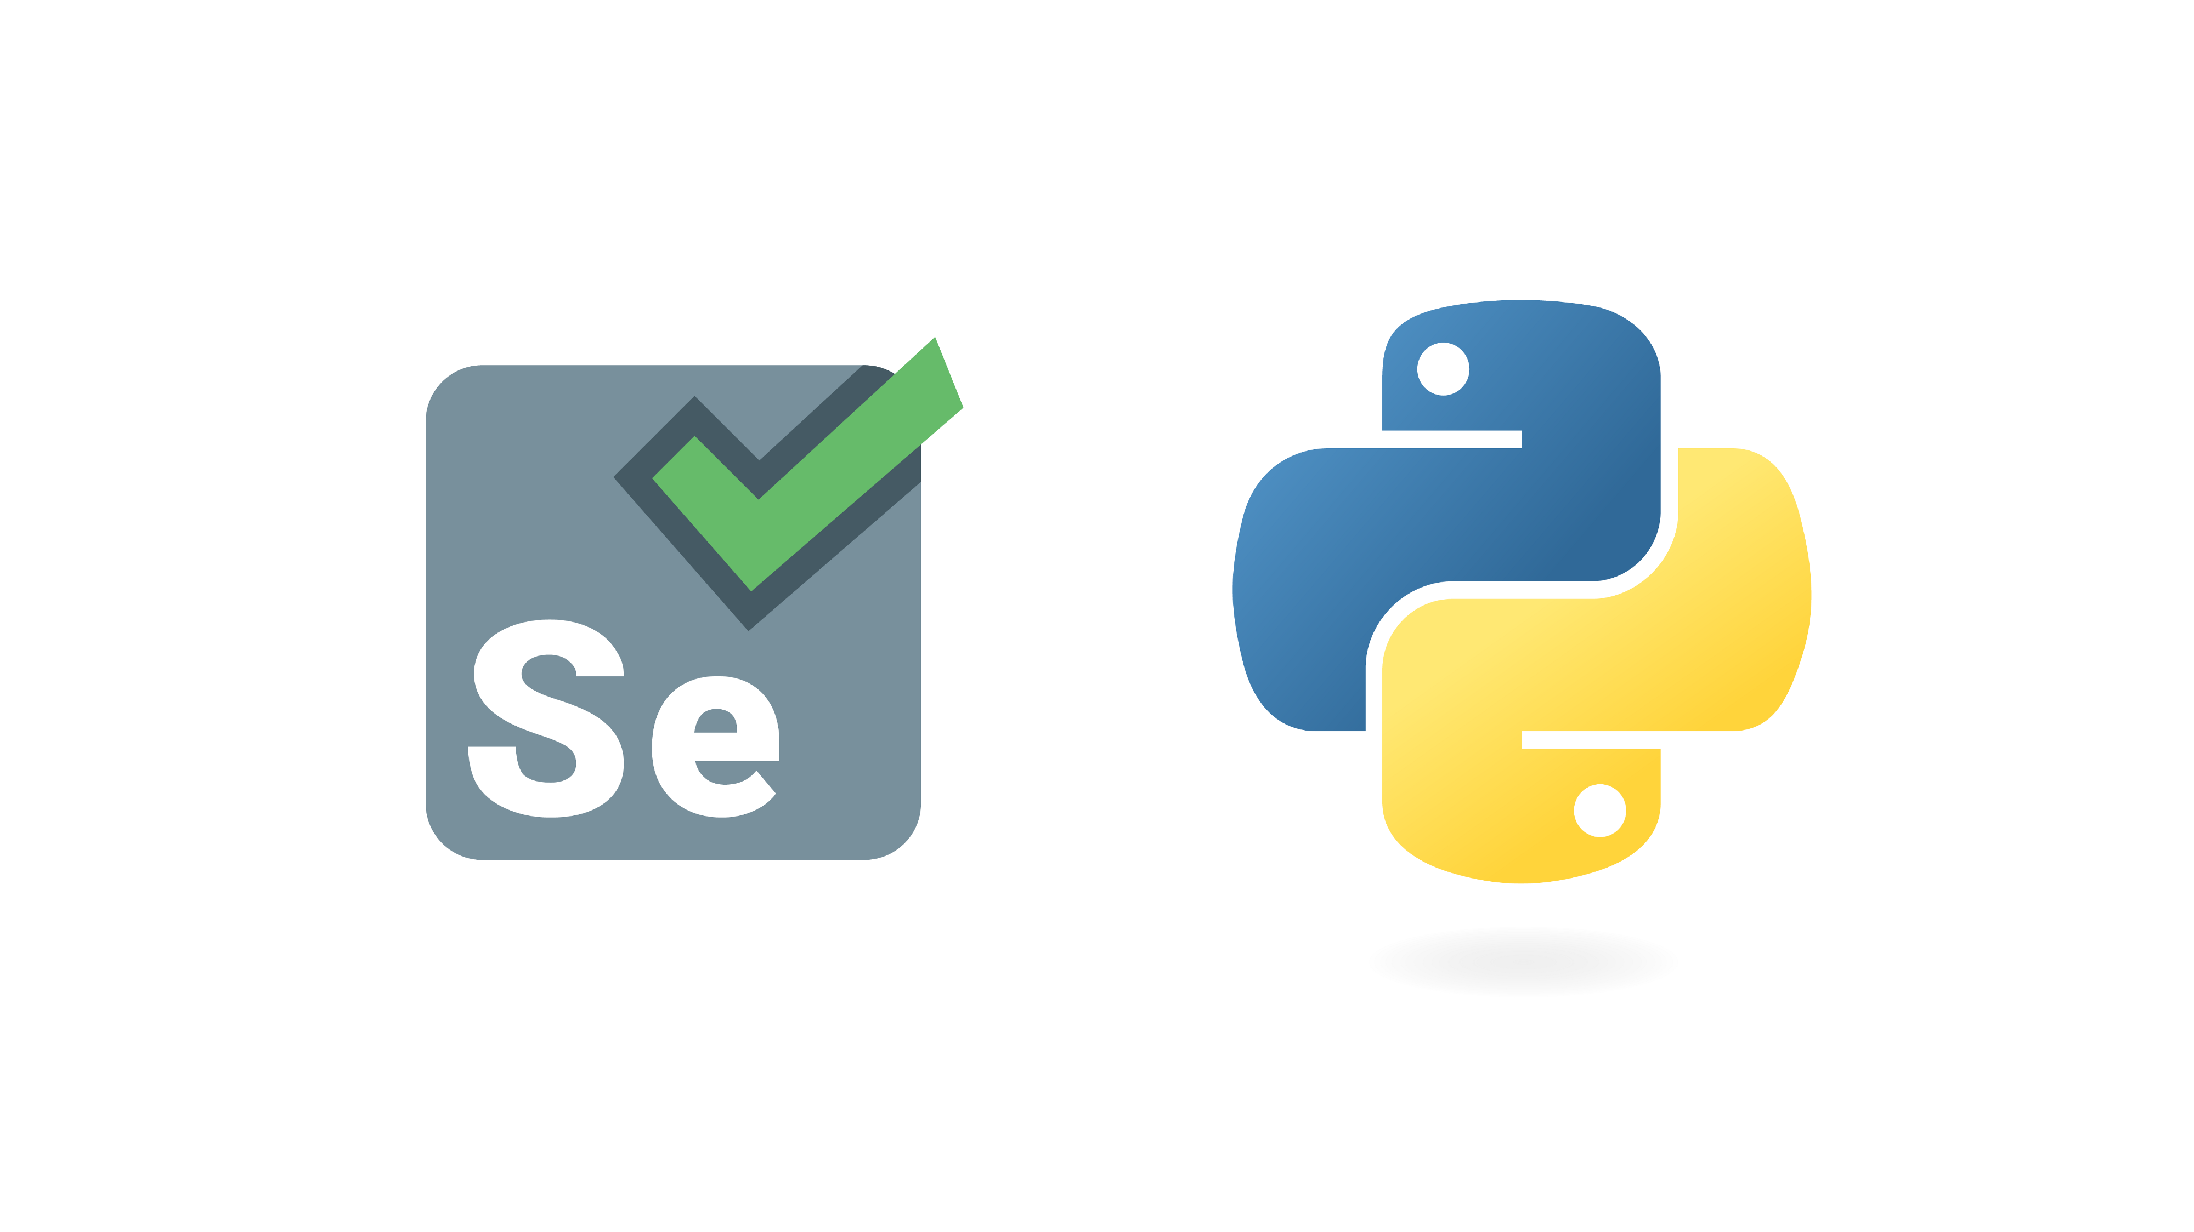

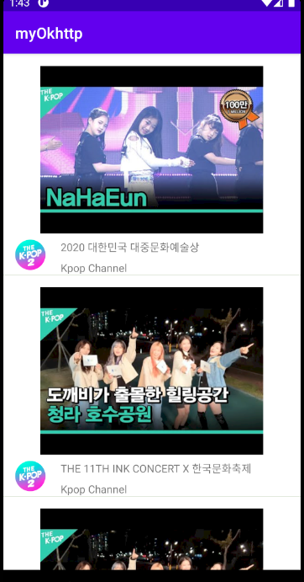

Application Design
Android App
Sever
OkHttp

Slide 4
OkHttp
What is OkHttp?
A HTTP client framework for Android and Java.
Why OkHttp?
(1) Super easy and fast.
(2) HTTP/2(multiplexing), connection pooling, shrinks download sizes with transparent GZIP...
How to use OkHttp?
(1)
(2) Decide your process: Read from a URL? Post something to a Server?

Slide 5
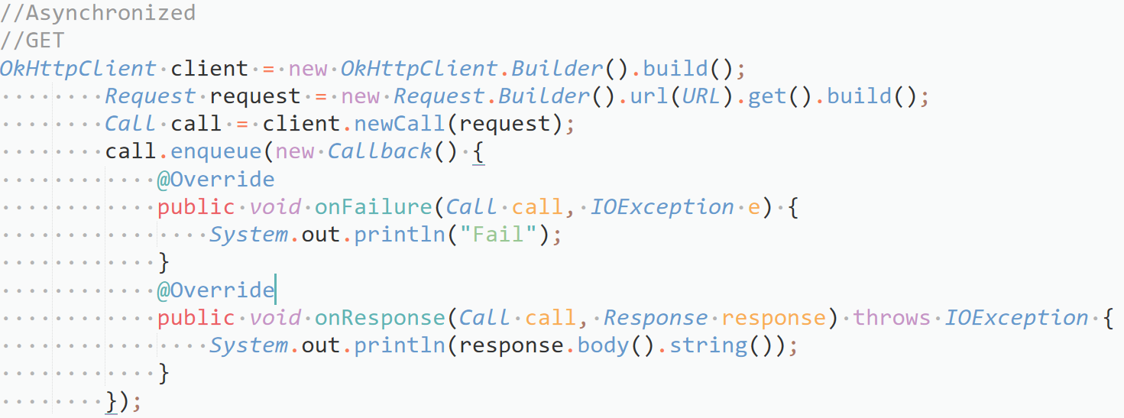

Slide 6
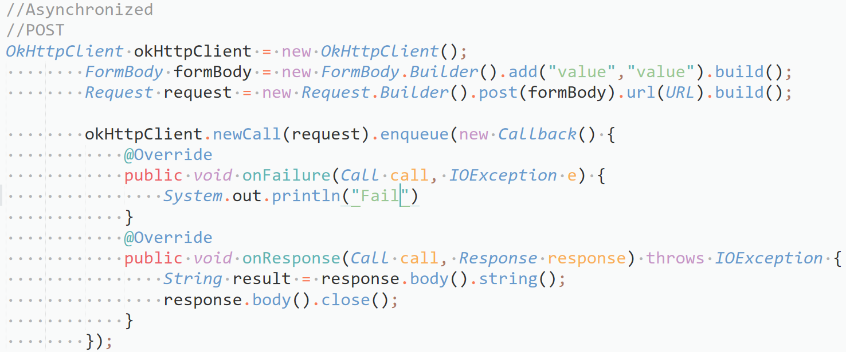

Slide 7
Implementation
Data (On server)
Display (On local)

Slide 8
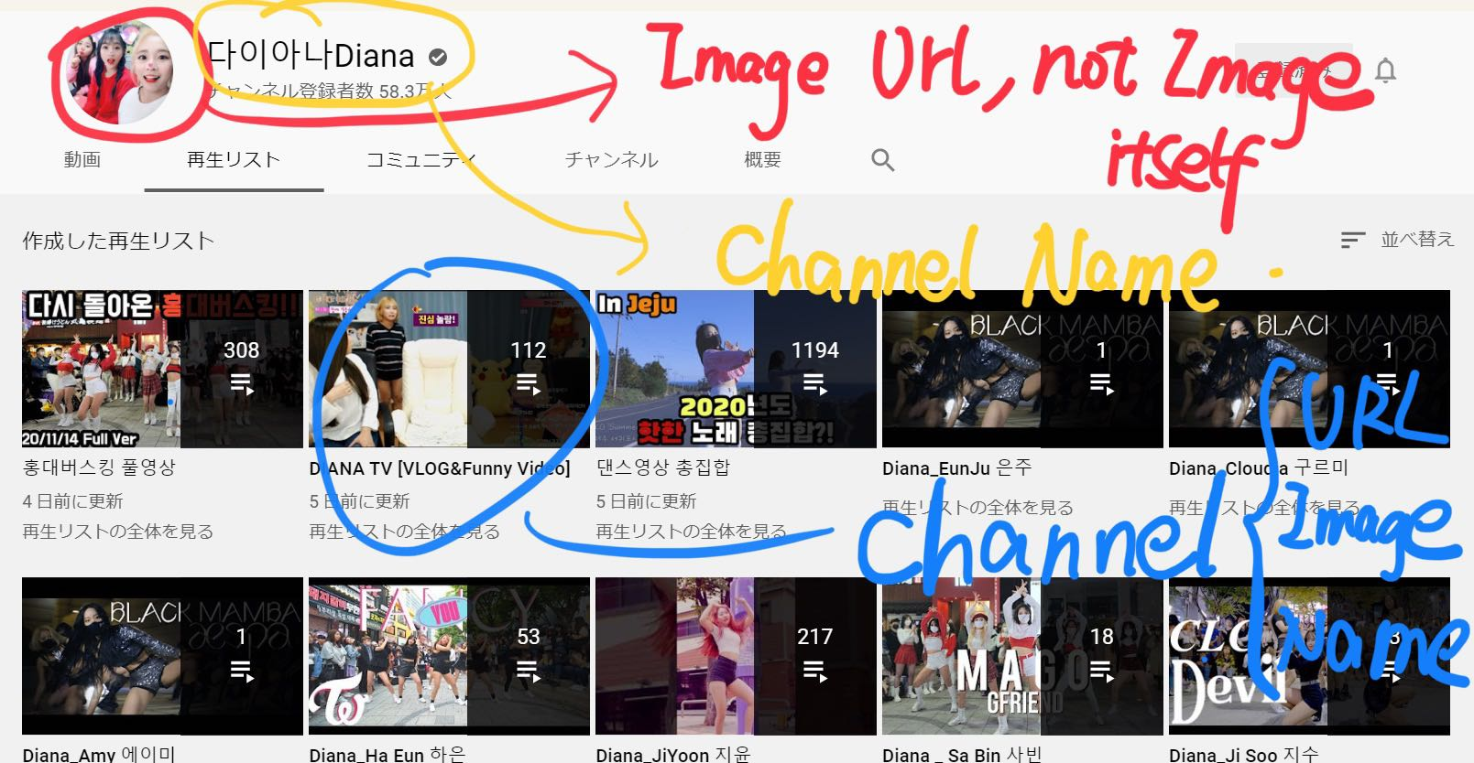

Slide 9
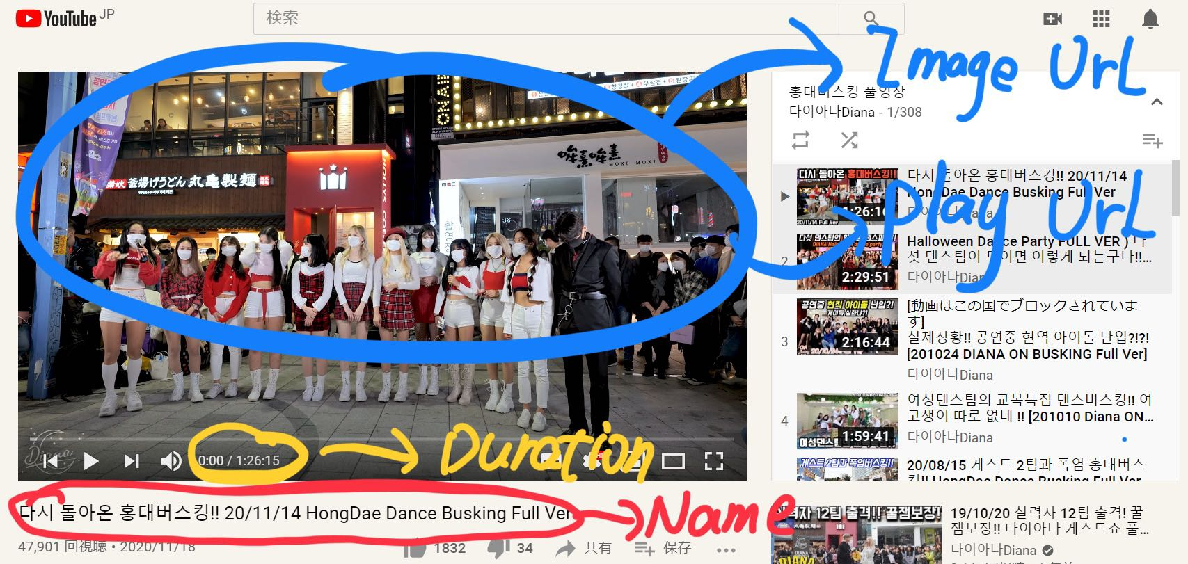

Slide 10
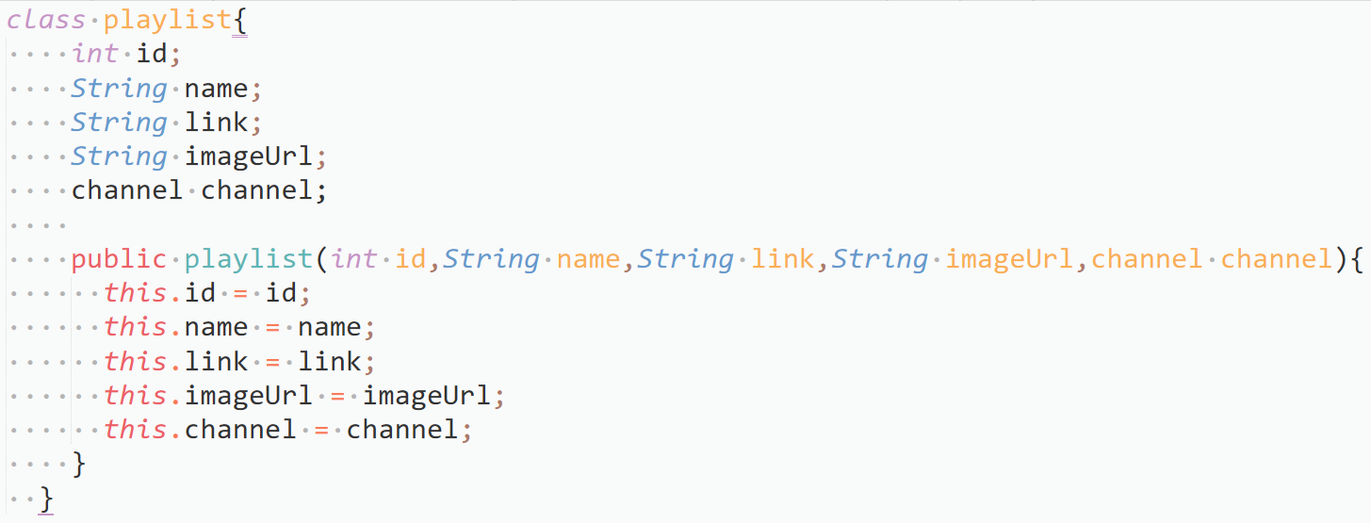
Data Structure

Slide 11
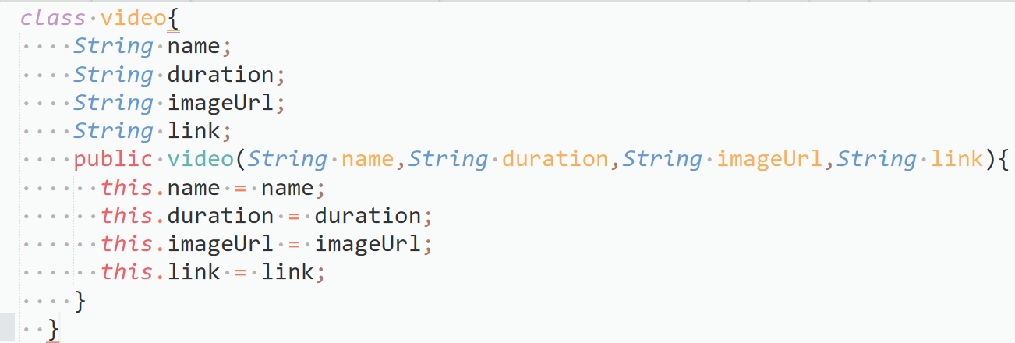
Data Structure

Slide 12
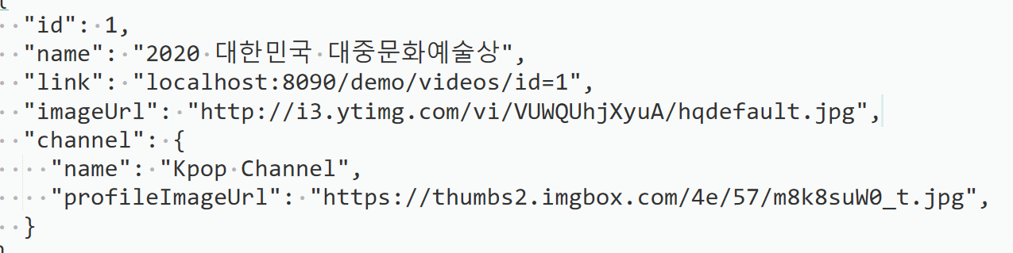
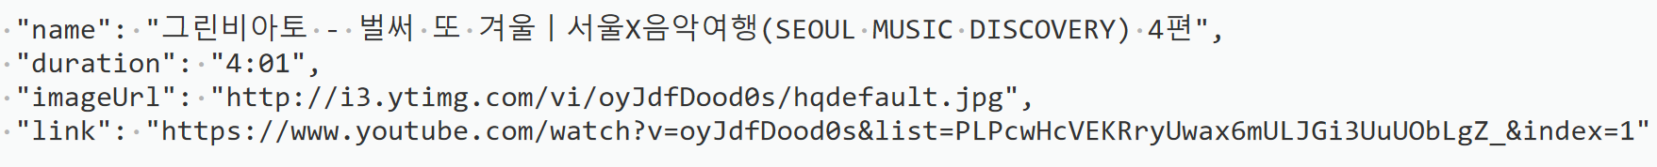
Fetched Data

Slide 13
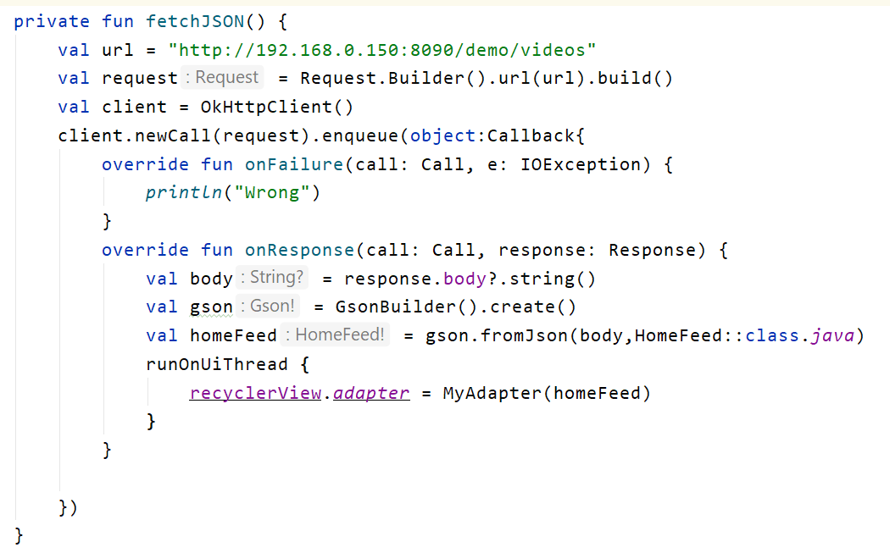
Code - playlist

Slide 14
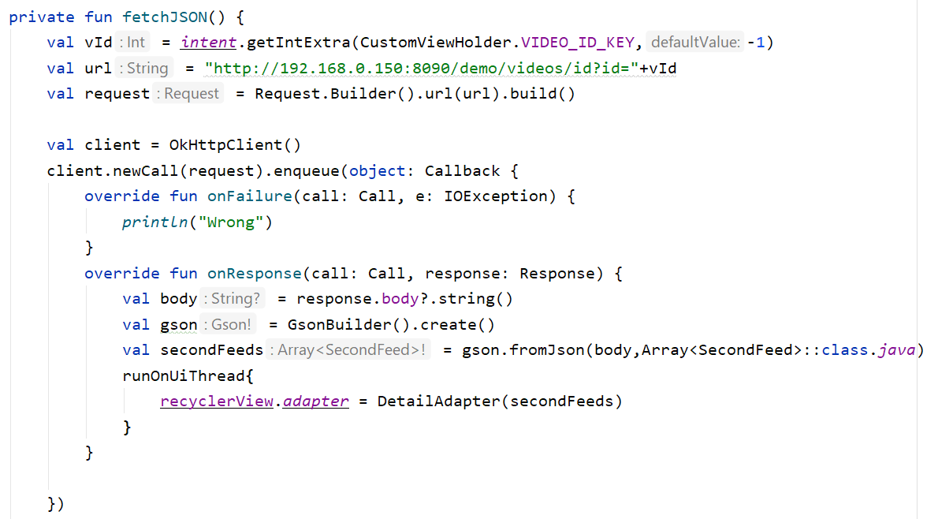
Code - video

Slide 15
Display
RecyclerView
Picasso

Slide 16
RecyclerView
Load list data.
Implement the RecyclerView.Adapter<ViewHolder>
Bind your data in onBindViewHolder function.
Implement your interactive functions in ViewHolder. It is optional.

Slide 17
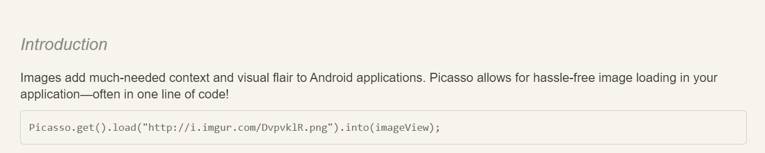
Picasso
Super easy to load image to the View interface.

