Slide 1
DATA EXPOSYS LABS
“DIABETES PREDICTION USING DATA SCIENCE”
Submitted by :- Sonal Sanjay Shitole

Slide 2
Problem Statement :-
Diabetes is a type of chronic disease which is more common among the people of all age groups. Predicting this disease at an early stage can help a person to take the necessary precautions and change his/her lifestyle accordingly to either prevent the occurrence of this disease or control the disease (For people who already have the disease).

Slide 3
Task :-
Task 1
Task 2
Prepare the data-set using several methods to train the model.
Build a model which can give high accuracy of predicting the disease.

Slide 4
Content :-
Slide 5
Slide 7
Slide 9
INTRODUCTION
METHODOLOGY
PROPOSED ARCHITECTURE
IMPLEMENTATION
CONCLUSION
Slide 6
Slide 8

Slide 5
Introduction :-
In this project, a support vector machine [SVM] is applied in diabetes prediction. The performance of the SVM algorithm is analyzed for different available kernels. The best kernel is selected and used for prediction. The proposed approach is implemented in python programming language and its performance is as good as other algorithms.
Diabetes is becoming a very common disease in India. The annual report of the World Health Association, added up to the number of individuals experiencing diabetes is 422 million the year .

Slide 6
Methodology :-
Methods
Existing
Proposed
Tests
Python language
FPG test
A1C test
RPG test
SVM
Fasting plasma glucose
Hemoglobin A1C
Random plasma glucose
Machine learning algorithm

Slide 7
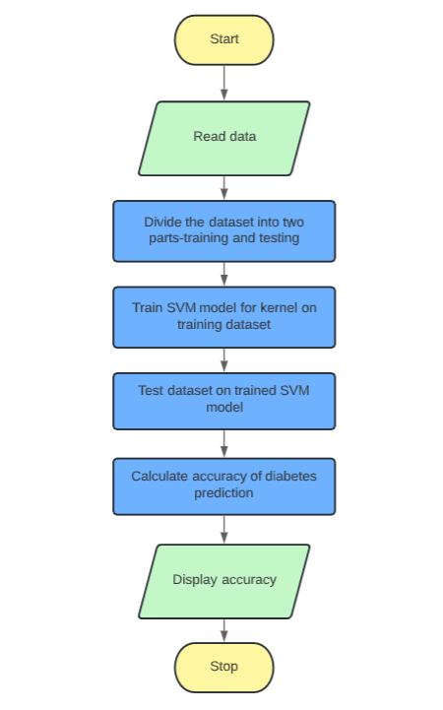
Proposed Architecture :-
The SVM model is created by using python programming language. The dataset is divided into training parts and testing parts. Then, the SVM model is trained accordingly. The SVM is tested on one kernels which are Linear. The best SVM kernel is selected and used for diabetes prediction.The proposed model is tested on a data set (source-kaggle) of 768 patients.

Slide 8
Implementation :-
Code link

Slide 9
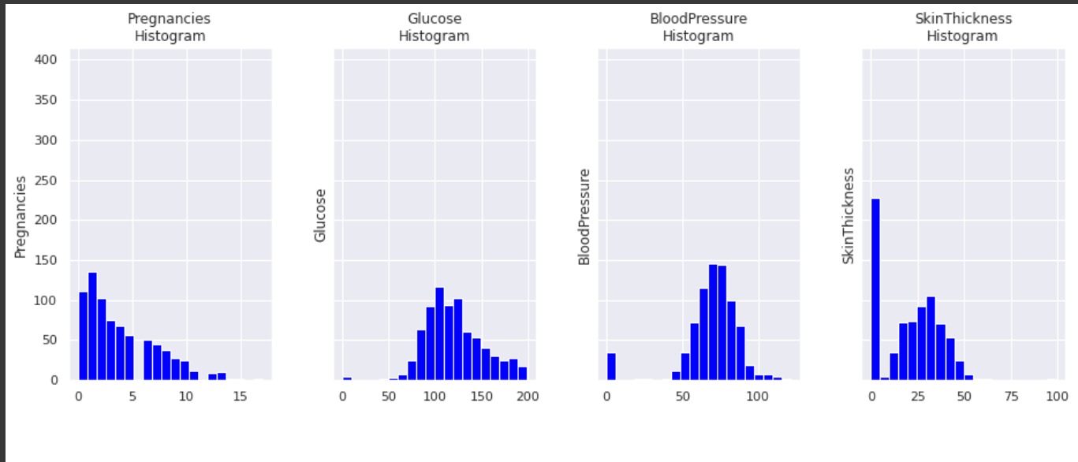
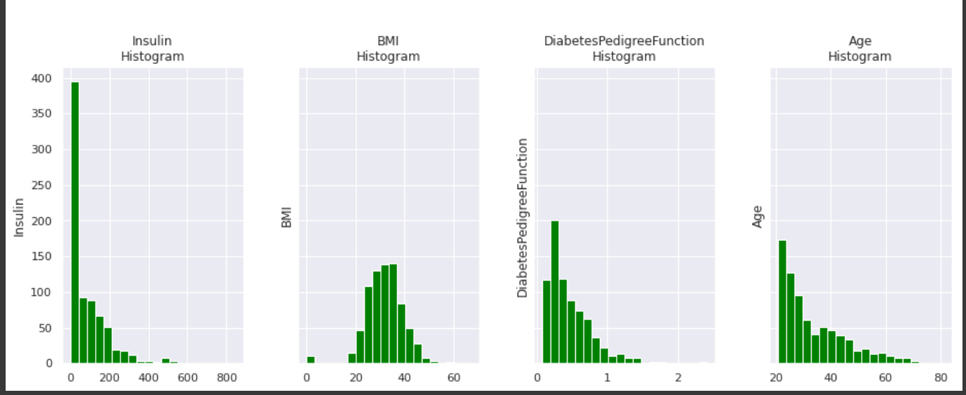
Conclusion :-
In this project,it is found that the kernel best performs for the diabetes prediction as its prediction accuracy is found. In future the SVM kernel can be tested in prediction of other diseases such as Cancer, Thyroid etc. Further the work can be extended to compare the performance of SVD on other performance metrics such as precision, recall and F-measure and can be compared with other existing techniques.

