Slide 1
Flipkart Review Analysis: Unveiling Customer Sentiments with Machine Learning
Faculty Coordinator – Subha Meenakshi S
Team Members :
Sonika R - 1BI20AI049
Yashas R - 1BI20AI058

Slide 2

Abstract
This project involves the application of sentiment analysis on Flipkart reviews using advanced natural language processing techniques. The goal is to extract meaningful insights from customer feedback to aid businesses in making informed decisions.

Slide 3
Introduction
In the dynamic landscape of e-commerce, customer feedback has emerged as a critical factor influencing business strategies and consumer decisions. Understanding and interpreting this vast amount of unstructured data embedded in customer reviews is a complex challenge, but one that holds the key to unlocking valuable insights. Our project, the "Flipkart Review Sentiment Analysis," delves into the realm of Natural Language Processing (NLP) to harness the power of machine learning in deciphering sentiments expressed by users in their Flipkart reviews.

Slide 4
Proposed System
Our proposed system employs state-of-the-art sentiment analysis techniques to evaluate Flipkart reviews. The system leverages machine learning algorithms to categorize reviews into positive, negative, or neutral sentiments, providing businesses with actionable intelligence.

Slide 5
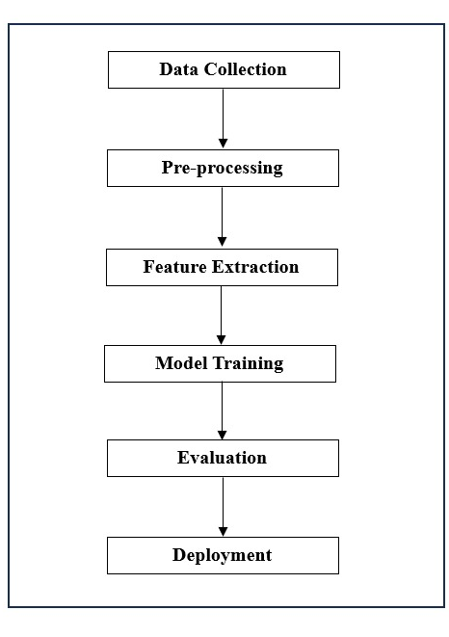
Block Diagram
Data Collection: Extract reviews from Flipkart using web scraping.
Preprocessing: Clean and preprocess the textual data.
Feature Extraction: Utilize NLP techniques to extract relevant features.
Model Training: Train a sentiment analysis model on labeled data.
Evaluation: Assess model performance using metrics like accuracy and precision.
Deployment: Implement the model for real-time sentiment analysis.
Block Diagram

Slide 6
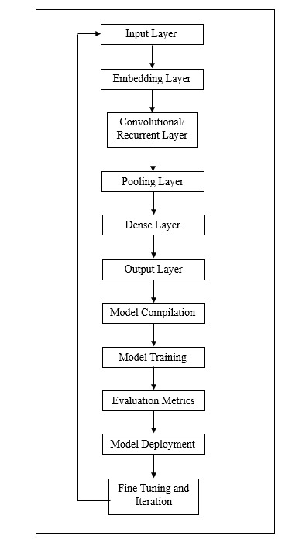
System Architecture
Data Collection Module: Web scraping tools to collect Flipkart reviews.
Preprocessing Module: Text cleaning and tokenization.
Feature Extraction Module: Extract features using NLP techniques.
Model Training Module: Train a machine learning model for sentiment analysis. Tokenizing: The process of breaking a stream of textual data into words, terms, sentences, symbols, or some other meaningful elements called tokens.
Wordcloud Formation: A word cloud is a visual representation of text data, where the size of each word indicates its frequency or importance in the given text. In the context of machine learning (ML), word clouds are often used for text analysis and visualization.

Slide 7
1.Input Layer: This is where the raw data is fed into the model. Raw text is tokenized, and the tokens may undergo additional preprocessing, such as removing stop words or stemming.
2.Embedding Layer: Converts the tokenized input into dense vectors, representing words in a continuous vector space. Pre-trained word embeddings may be used to enhance the model's understanding of context.
3.Recurrent or Convolutional Layers: For sequence data like text, recurrent neural networks (RNNs) or convolutional neural networks (CNNs) can be employed to capture sequential dependencies or local patterns.
4. Pooling Layer: In the case of CNNs, a pooling layer may be used to reduce the spatial dimensions of the input, capturing the most salient features.

Slide 8
6. Output Layer: Produces the final output, which is the sentiment prediction for the input text. A softmax activation function is often used for multi-class classification.
7. Model Compilation: This step configures the model for training by specifying the optimizer, loss function, and evaluation metric. Common choices include the Adam optimizer, categorical cross-entropy loss for multi-class classification, and accuracy as the evaluation metric.
8. Model Training: The model is trained on a labeled dataset using an iterative process, adjusting weights to minimize the chosen loss function. The training set is used to update the model parameters during each epoch. Validation sets help monitor overfitting.
9. Evaluation Metrics: Metrics such as accuracy, precision, recall, and F1 score are used to evaluate the model's performance on a separate validation or test set. These metrics provide insights into how well the model generalizes to new, unseen data.

Slide 9
System Requirements
Hardware Requirements:
Software Requirements:
- CPU : Processor i5 or more
- RAM : 8GB
- Operating System
- Jupyter Notebook
- Anaconda Navigator
- Python 3.8
Non-Functional Requirements
Reliability:
The software should be able to detect the URL type accurately irrespective of number of attempts.
It should be able to give the faster response as output.
Scalability:
The software should be able to differentiate the class of all the URLs ands should be user friendly for yielding better results.

Slide 10
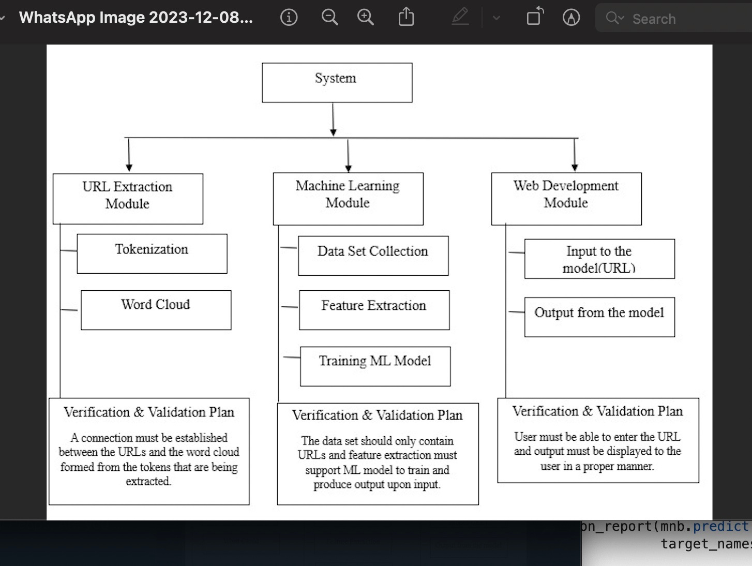
Module Design:

Slide 11
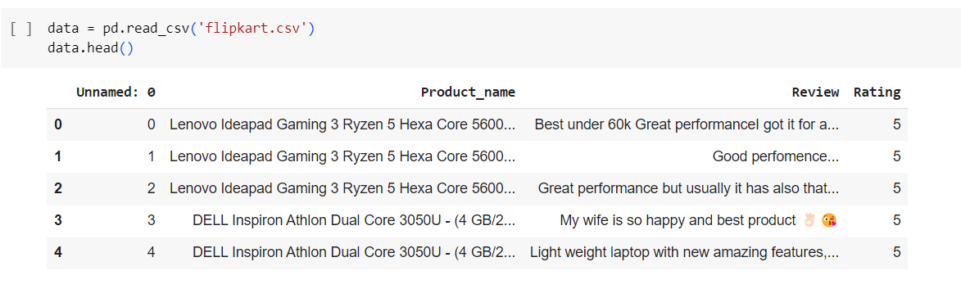
Output

Slide 12


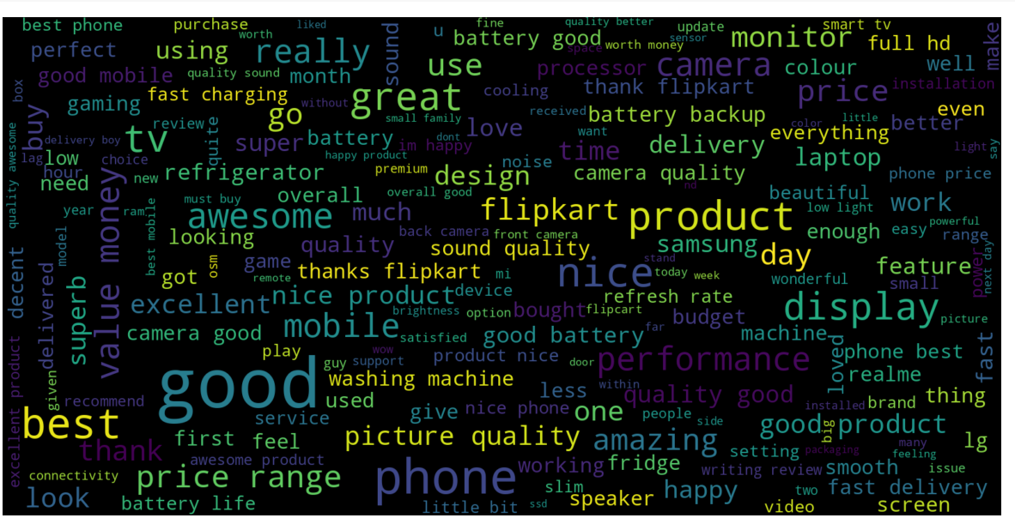

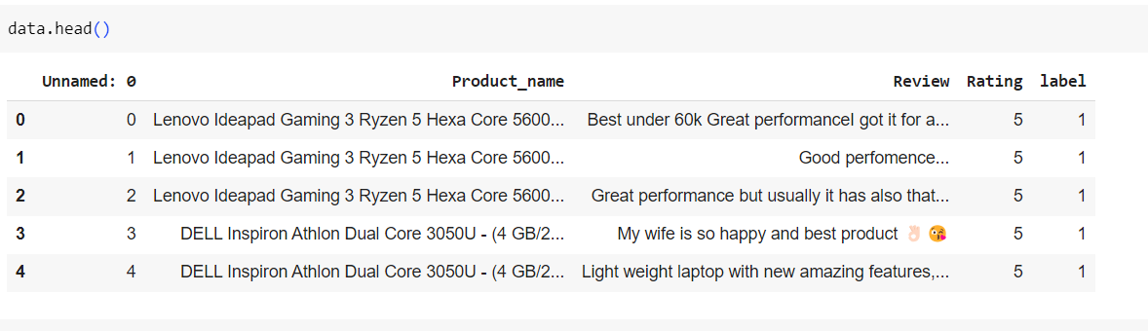

Slide 13
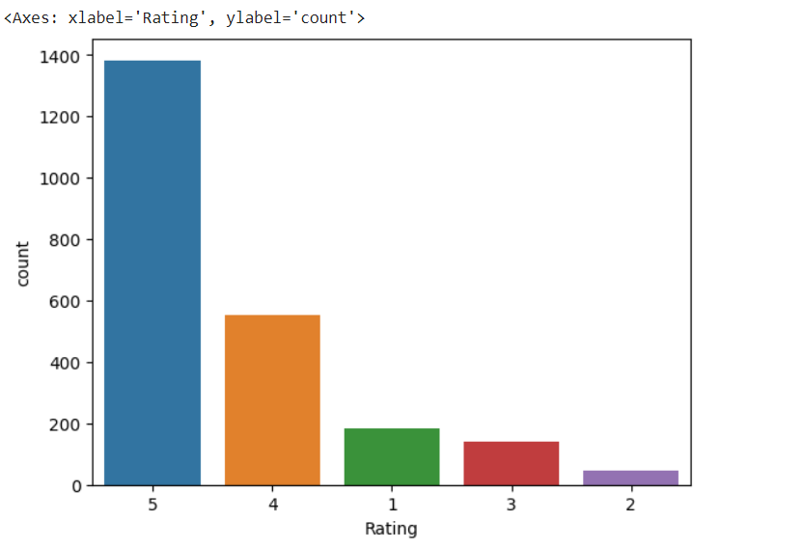

Slide 14
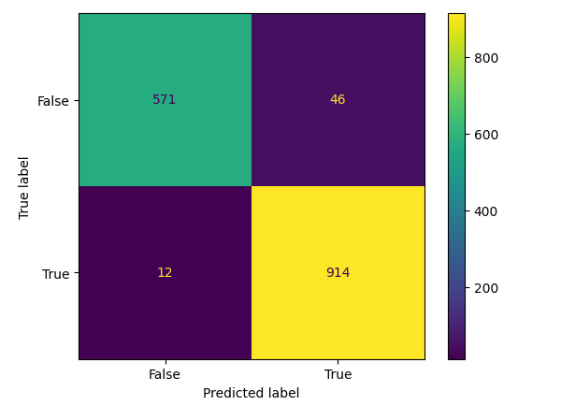

Slide 15
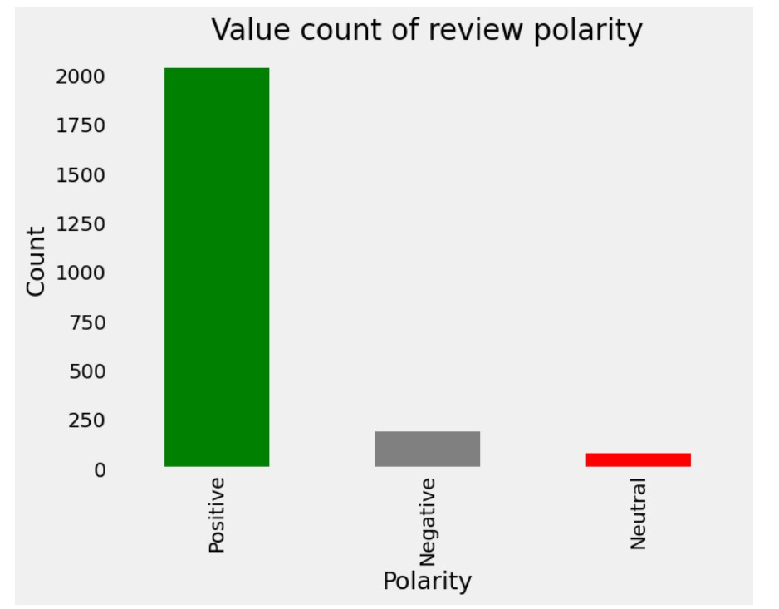

Slide 16
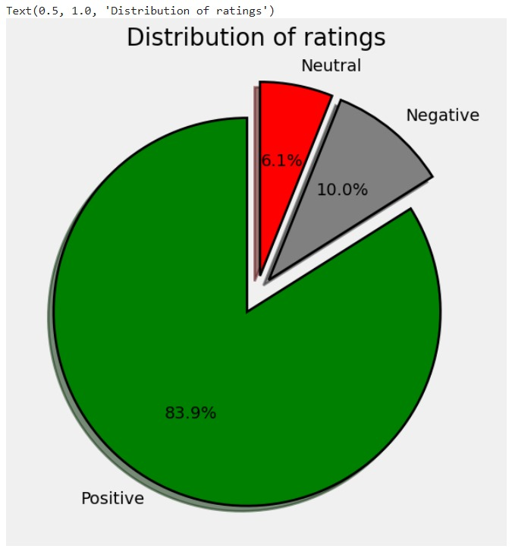

Slide 17
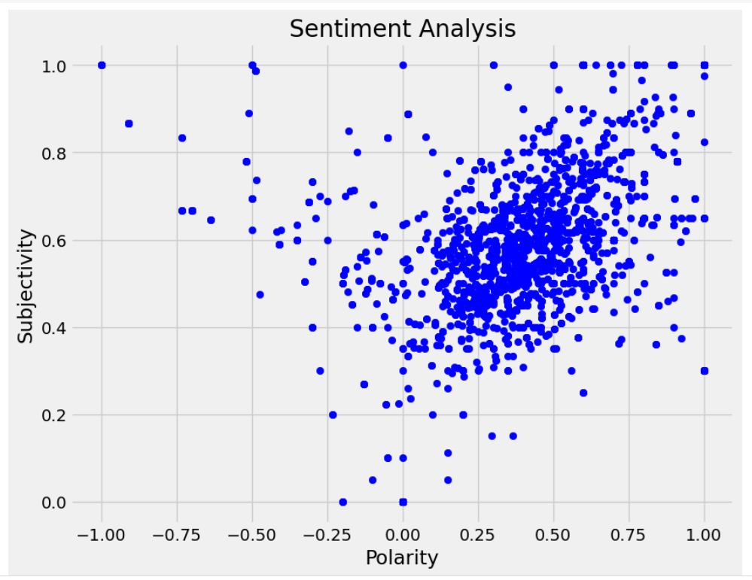

Slide 18
Thank You

