Slide 1

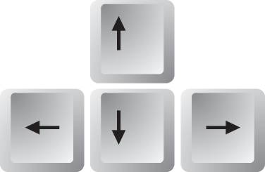
CONTROLS
UP
LEFT
RIGHT
DOWN

