Slide 1

BlockMarket A decentralised Customer Loyalty Reward System
UTKALHACKS 2.0
Team: PyAI/Oneers
Members:
Swaraj Priyadarshan Dash
Siddhant Panda
Navin Chandra
Lakhi Charan Mahato

Slide 2
What is Customer loyalty?
Customer loyalty is when a supplier receives the ultimate reward of his efforts in interacting with its customer.
Customer loyalty tends the customer to voluntarily choose a particular product against another for his need.
The loyalty may be product specific or it may be company specific. When a loyal customer has repetitive requirement of the same product, such customers may be described as being ‘brand loyal’.
But, why it is so much important for the brands to have loyal customers.

Slide 3
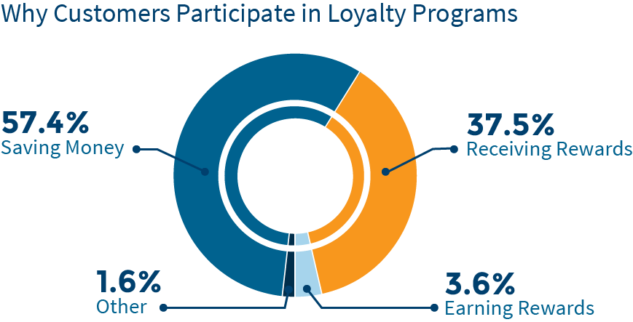

Slide 4

What is the present scenario?
Whether you were on the side of the customer or the business in charge of it, chances are you have worked with one or more loyalty programs.
Regardless of your experience, you have no doubt noticed areas where loyalty programs could be improved, inefficiencies and inconsistencies which blockchain implementation and tokenization could help eliminate.
According to Deloitte, only 50% of loyalty program members are actually active participants, and of that half, 20% have never redeemed any rewards at all

Slide 5
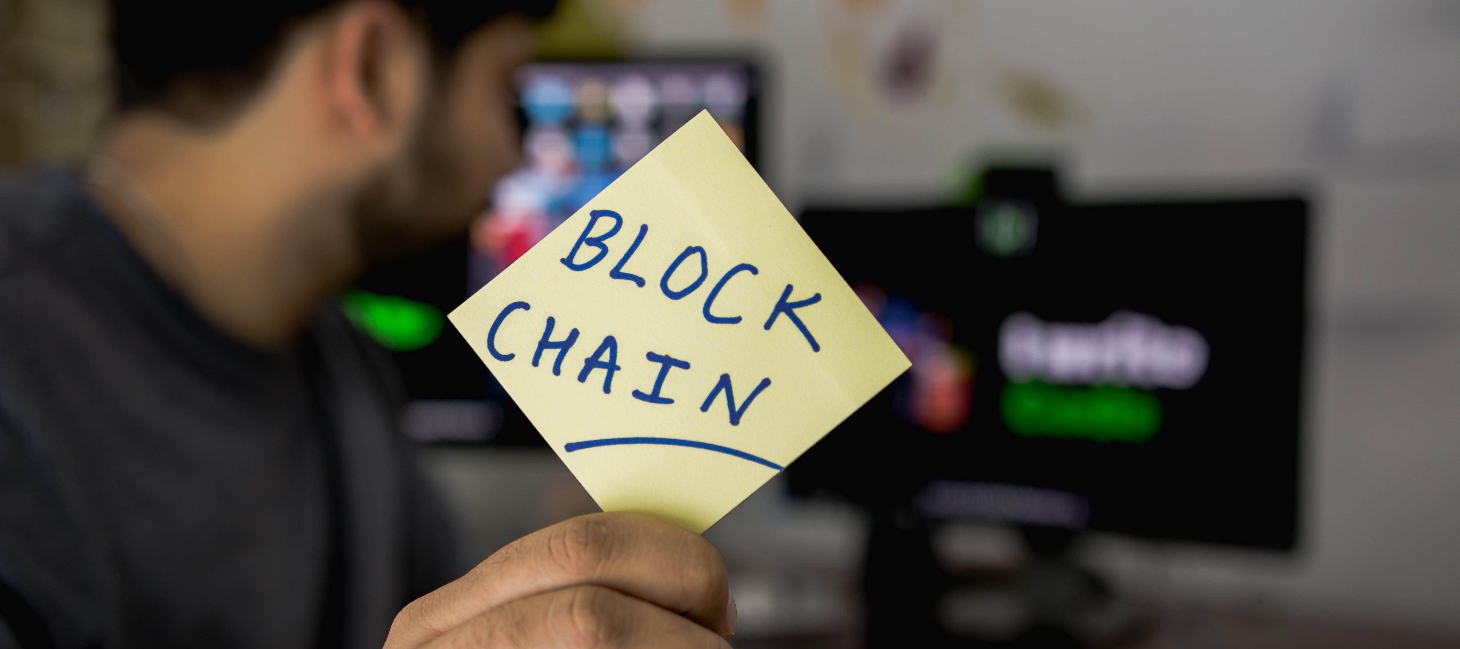
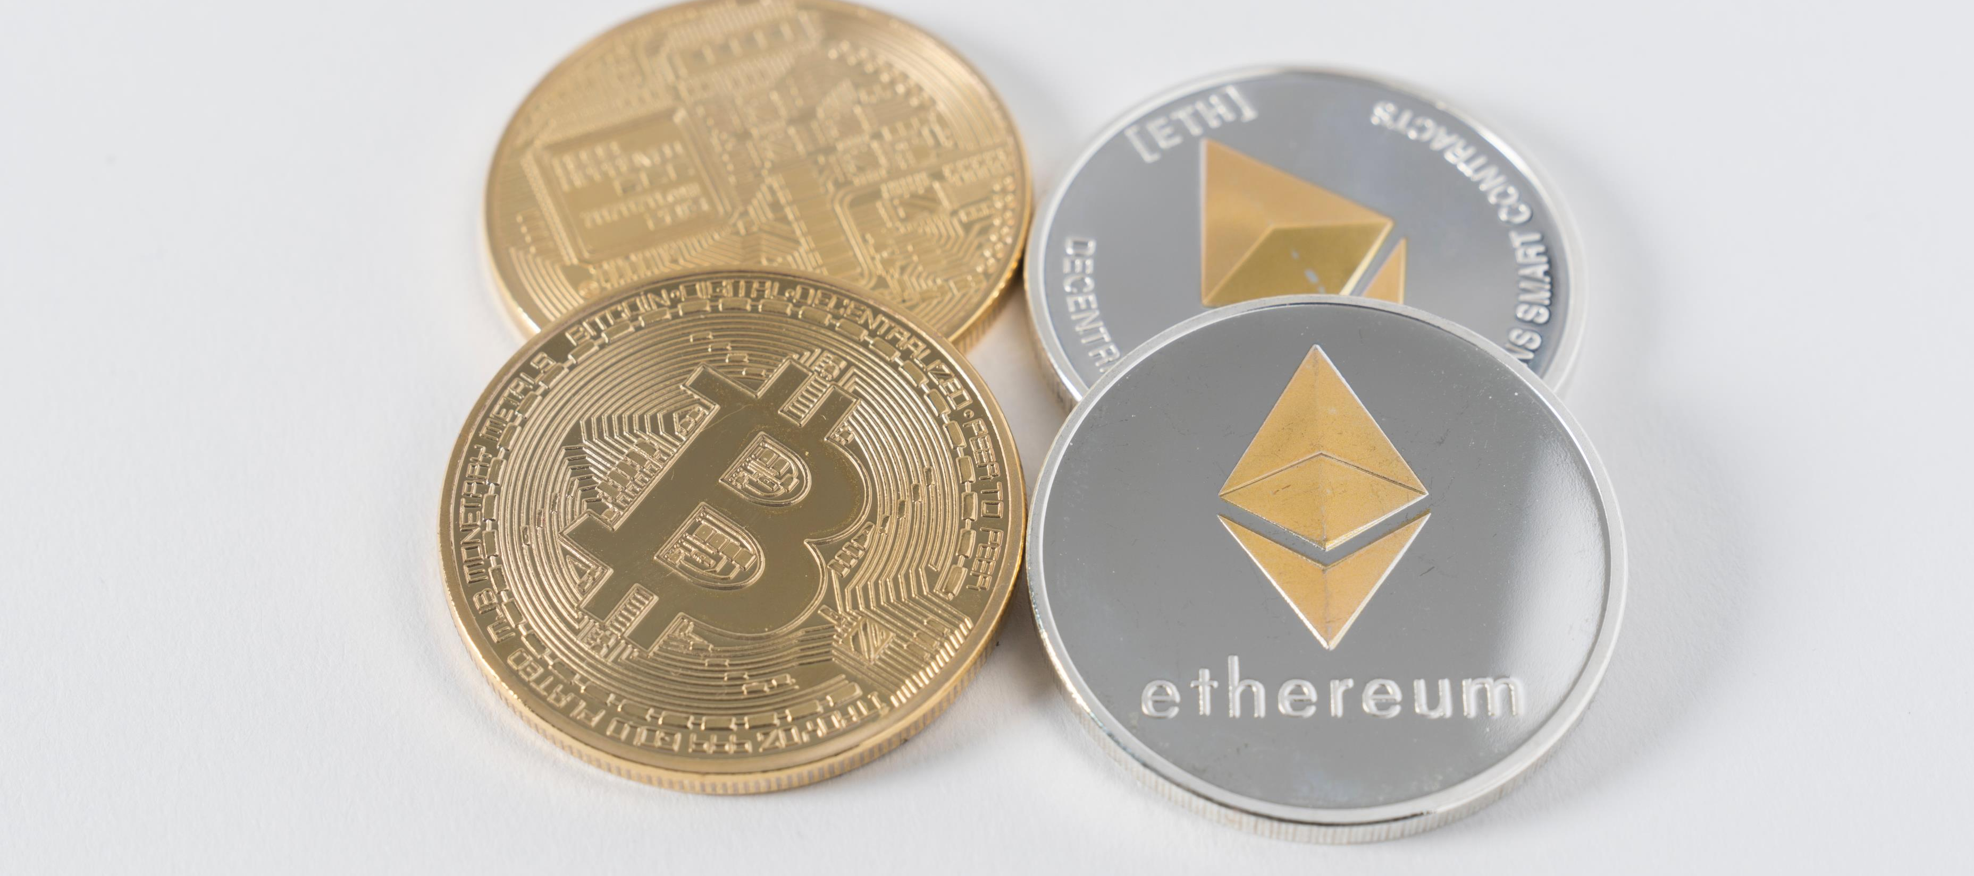
Enter the Blockchain…
A blockchain, originally block chain, is a growing list of records, called blocks, that are linked using cryptography. Each block contains:
a cryptographic hash of the previous block,
a timestamp,
and transaction data (generally represented as a Merkle tree).

Slide 6

Why Blockchain?
Blockchain's automated, decentralized ledger ensures that loyalty points are securely recorded, allowing anyone to view when loyalty points were issued, redeemed or exchanged.
This creates transparency and speed for producers and consumers involved, making the process verifiable.
Blockchain's automated, detailed system supports balance sheet liability of loyalty points by tracking points that are deferred until redemption.

Slide 7
How it solves the problem?
The present loyalty system is time & cost intensive.
Companies can decrease the overall administrative and personnel costs due to blockchain's ability to execute programs in near real-time with clarity.
Using blockchain also reduces the cost of security, development, integration and reconciliation.
Luckily, there are many startups getting into blockchain for loyalty programs.

Slide 8

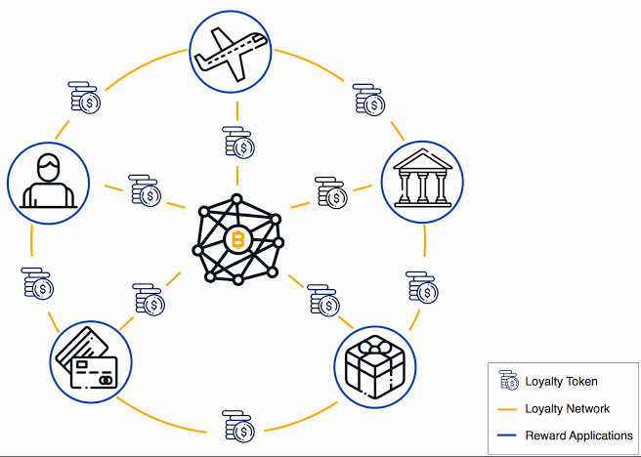
BlockMarket
A decentralised Customer Loyalty Reward system.
Customers are enrolled in different loyalty programs for ‘n’ brands.
We strive to narrow this down to a single transactional currency: $ilicoin
Customers will be able to use their reward points anywhere, anytime for transaction.
This will result in hassle-free transactions.

Slide 9
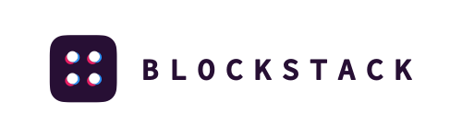
Behind the scenes…
How our system works?
We are using Blockstack to create a decentralised application.
A customer or a business can access BlockMarket only through a secure Blockstack ID.
The customer needs to redeem the points by logging in to the BlockMarket site & select the available brands to shop.
Then the customer uses $ilicoin to make transactions at the select retail brands.

Slide 10
What’s next?
Currently, BlockMarket is suitable for offline brands & stores who wants to retain their customers by providing them lucrative offers.
We have the potential to revive those businesses which are facing stiff competitions from bigger players in the market.
Expansion of BlockMarket in online retail market.
Conversion of redeemable loyalty points to national currencies.

Slide 11


