Slide 1

Project Title -Seasonal Agriculture Performance Analysis
Student Name – Amancha Sreeja
College Name- Kakatiya Institute Of Technology And Science Warangal
AICTE STU ID : STU68a008796f99e1755318393

Slide 2

PROBLEM STATEMENT
Agricultural performance is influenced by seasonal variations in environmental conditions, farming practices, resource availability and other factors.
The project analyzes agricultural data to identify seasonal differences, patterns, trends, relationships and variations in agricultural performance.
Key Problem:
Difficulty in understanding seasonal performance from raw agricultural data.
Need for data-driven insights for better agricultural planning.
This wording closely follows the problem statement in your project brief/template.

Slide 3
Project Description
Seasonal Agriculture Performance Analysis is a data analytics project that explores agricultural performance across different seasons, crops and regions.
The project uses data cleaning, statistical analysis and visualization to understand patterns in yield, production, profit, environmental conditions and resource usage.
Main Analysis
1.Seasonal performance comparison
2.Crop-wise performance analysis
3.Environmental factor analysis
4.Relationship and correlation analysis
5.Identification of patterns and variations

Slide 4

WHO ARE THE END USERS?
Who Are the End Users?
🌾 Farmers — To understand crop and seasonal performance.
🏢 Agricultural Organizations — To support agricultural planning and decision-making.
📊 Data Analysts — To analyze agricultural trends and relationships.
🏛️ Policy Makers — To support evidence-based agricultural planning.
🌱 Researchers — To study seasonal and environmental effects on agriculture.

Slide 5

Technology Used
  Programming Language – Python.
  Libraries – Pandas, NumPy, Matplotlib, Seaborn.
  Platform - Google Colab.
  Techniques - Data Cleaning, Descriptive Statistics, Group-by Analysis, Correlation Analysis, Data Visualization, Outlier Analysis.

Slide 6
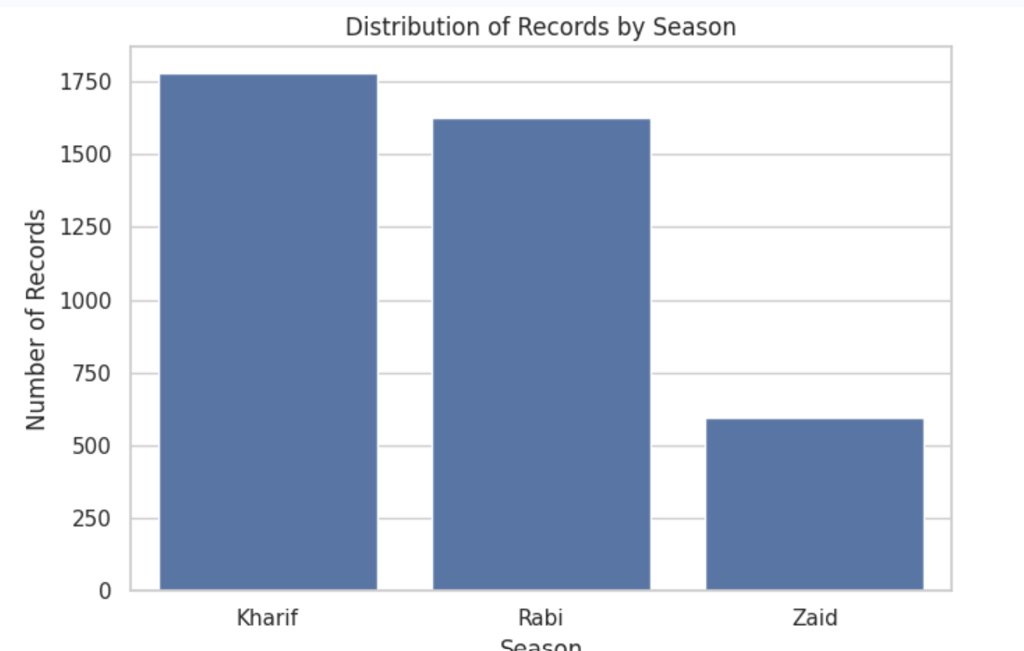
RESULTS
Distribution of Records by Season
This plot shows how the agricultural data is distributed across different seasons.
It helps understand the number of observations available for each season before
making comparisons.

Slide 7
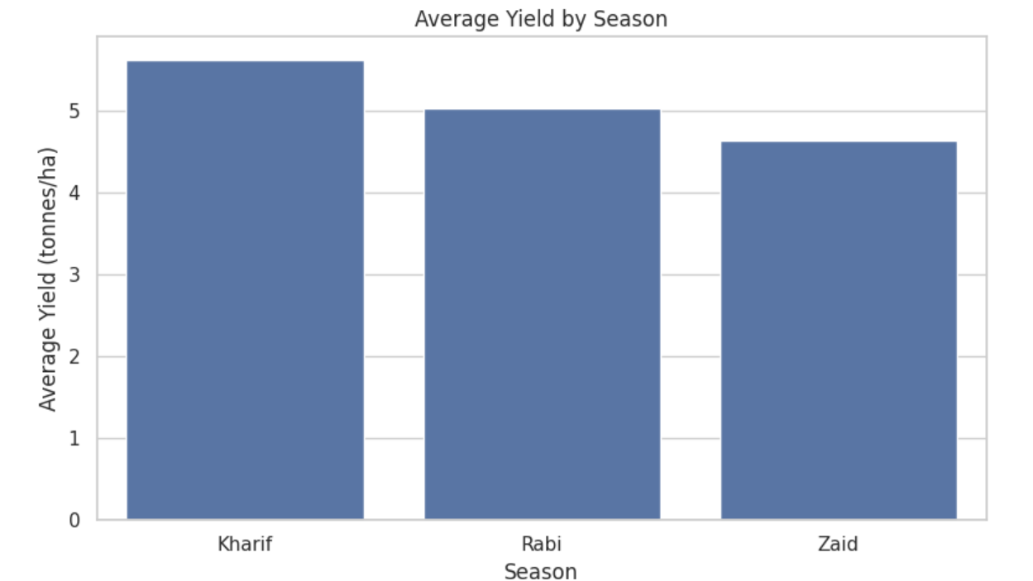
RESULTS
Average Yield by Season
This plot compares the average agricultural yield across different seasons.
It helps identify the best-performing season and understand seasonal variations in productivity.

Slide 8
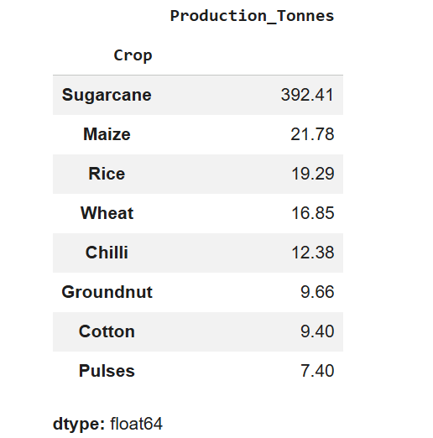
RESULTS
Average Production by Crop
This analysis presents the average production for each crop in the dataset.
It helps compare the overall production performance of different crops and
identify crops with higher average production.

Slide 9
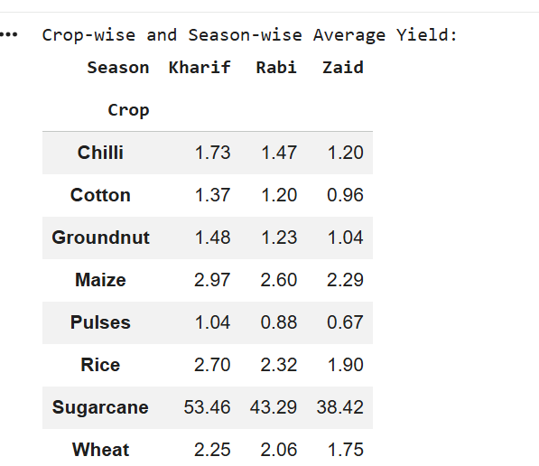
RESULTS
Crop-wise and Season-wise Average Yield
This analysis presents the average yield for each crop across different seasons.
It helps compare crop performance between seasons and identify crop-season
combinations with higher average yield.

Slide 10
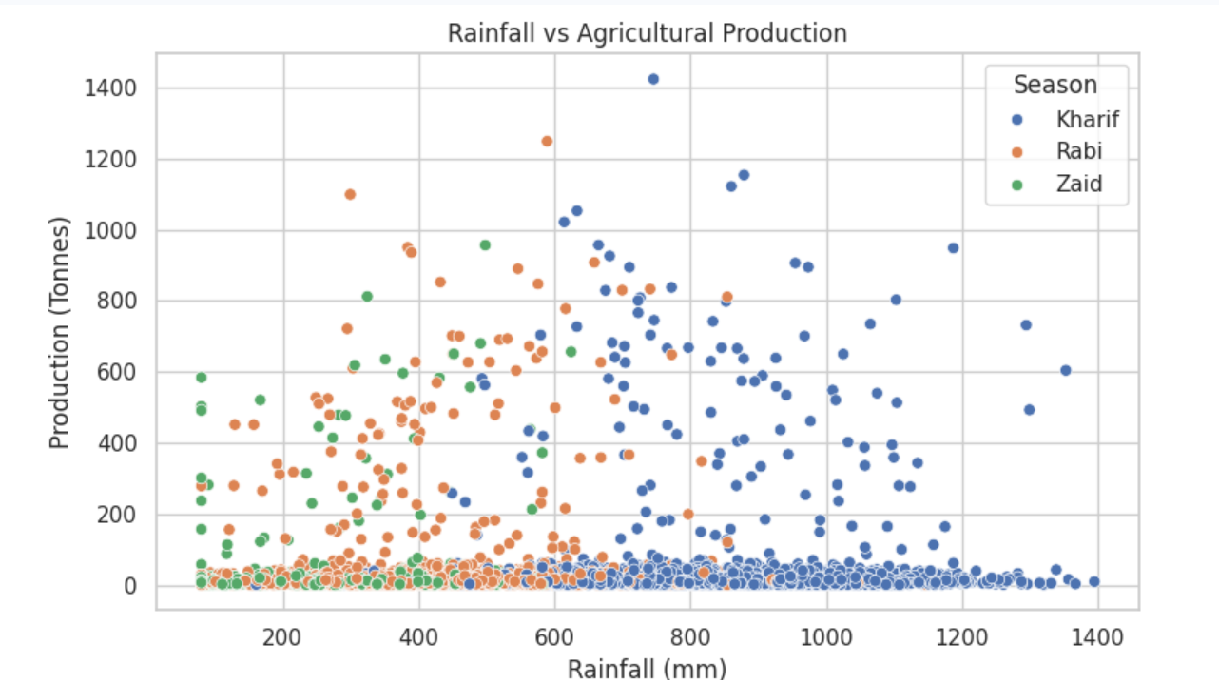
RESULTS
Rainfall vs Production
This scatter plot examines the relationship between rainfall and agricultural production.
It helps determine whether changes in rainfall are associated with changes in production
and identify possible patterns.

Slide 11
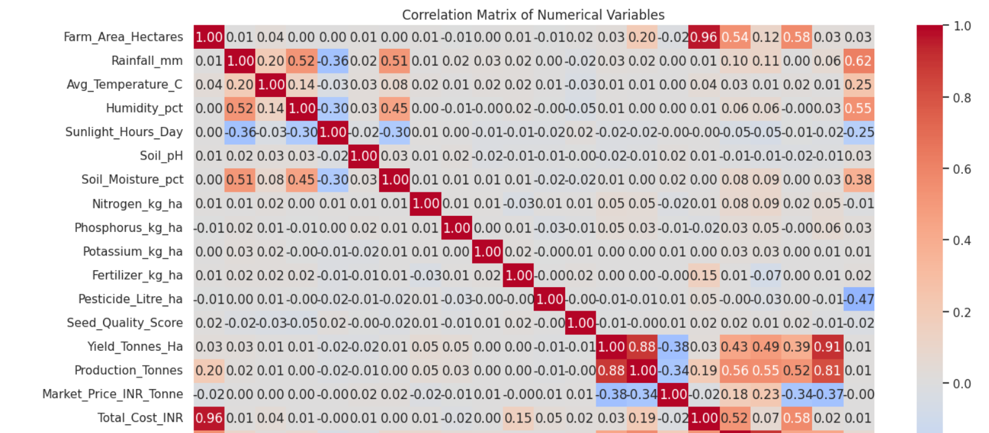
RESULTS
Correlation Matrix / Heatmap
This heatmap shows the strength and direction of relationships between numerical
agricultural variables.
It helps identify important relationships among factors such as yield,
production, rainfall, temperature and profit.

Slide 12
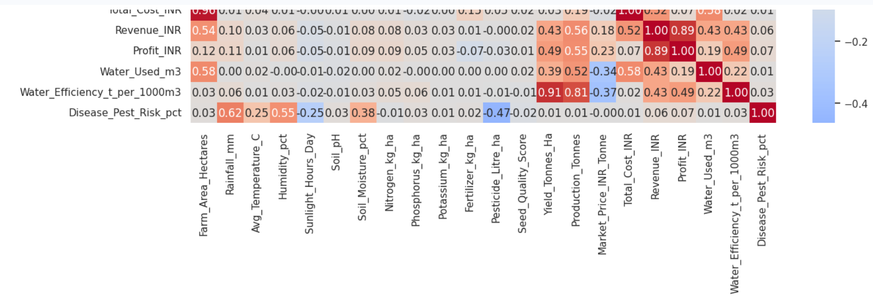
RESULTS

Slide 13
Future scope
Develop a predictive model for crop yield and production.
Use machine learning to predict seasonal agricultural performance.
Incorporate real-time weather and environmental data.
Develop an interactive agricultural dashboard.
Provide crop and season recommendations to farmers.
Extend the analysis to larger and more diverse datasets.
Conclusion
The project successfully analyzed the agricultural dataset to understand seasonal variations, crop performance and relationships between important agricultural variables.
Data visualization and statistical analysis provided meaningful insights that can support better agricultural planning, resource management and evidence-based decision-making.

Slide 14
GitHub Link
https://github.com/iamsreeja/SEASONAL-AGRICULTURE-PERFORMANCE-ANALYSIS

Slide 15
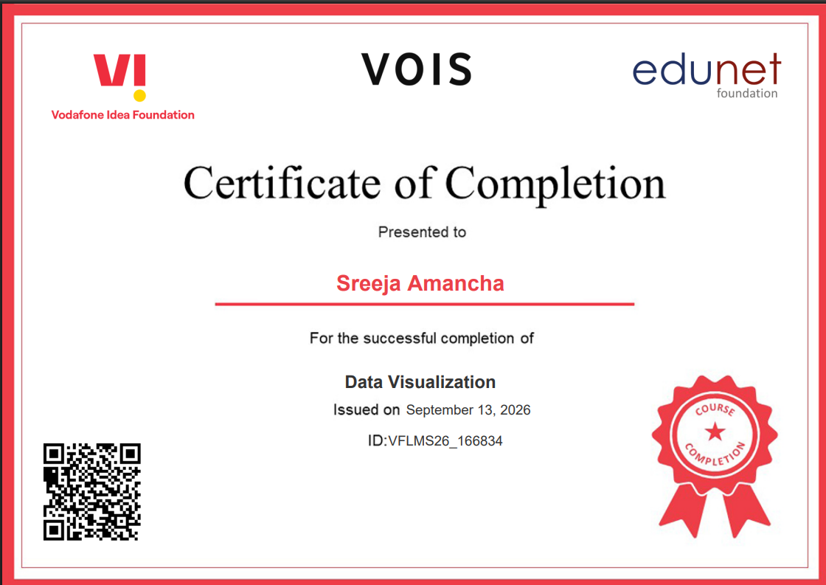
VOIS Course completion certificate -
Course name- Data Visualization

Slide 16
Thank you
.
.

