Slide 1

OIDC With Harness
Srinath
28/03/2025

Slide 2
Problem Statement
Deploy
Deploy non-Terraform products
Run
Run BDD test on Connected environments
Import
Import Data fusion Pipeline into RTL environment
Upload
Upload DAG to bucket for Cloud composer

Slide 3
General Problems with Service Account Keys
Traditional authentication methods involve long-lived keys.
Key issues: Risk of leakage, management difficulties, security vulnerabilities.

Slide 4
Introducing Workload Identity Federation (WIF)
Secure authentication for external workloads without static credentials.
Seamless integration with various identity providers (GCP,Harness GitHub, etc.).

Slide 5
What is OIDC?
OpenID Connect (OIDC) is an identity authentication protocol.
Built on OAuth 2.0, issues JWTs (identity tokens) for verification.

Slide 6
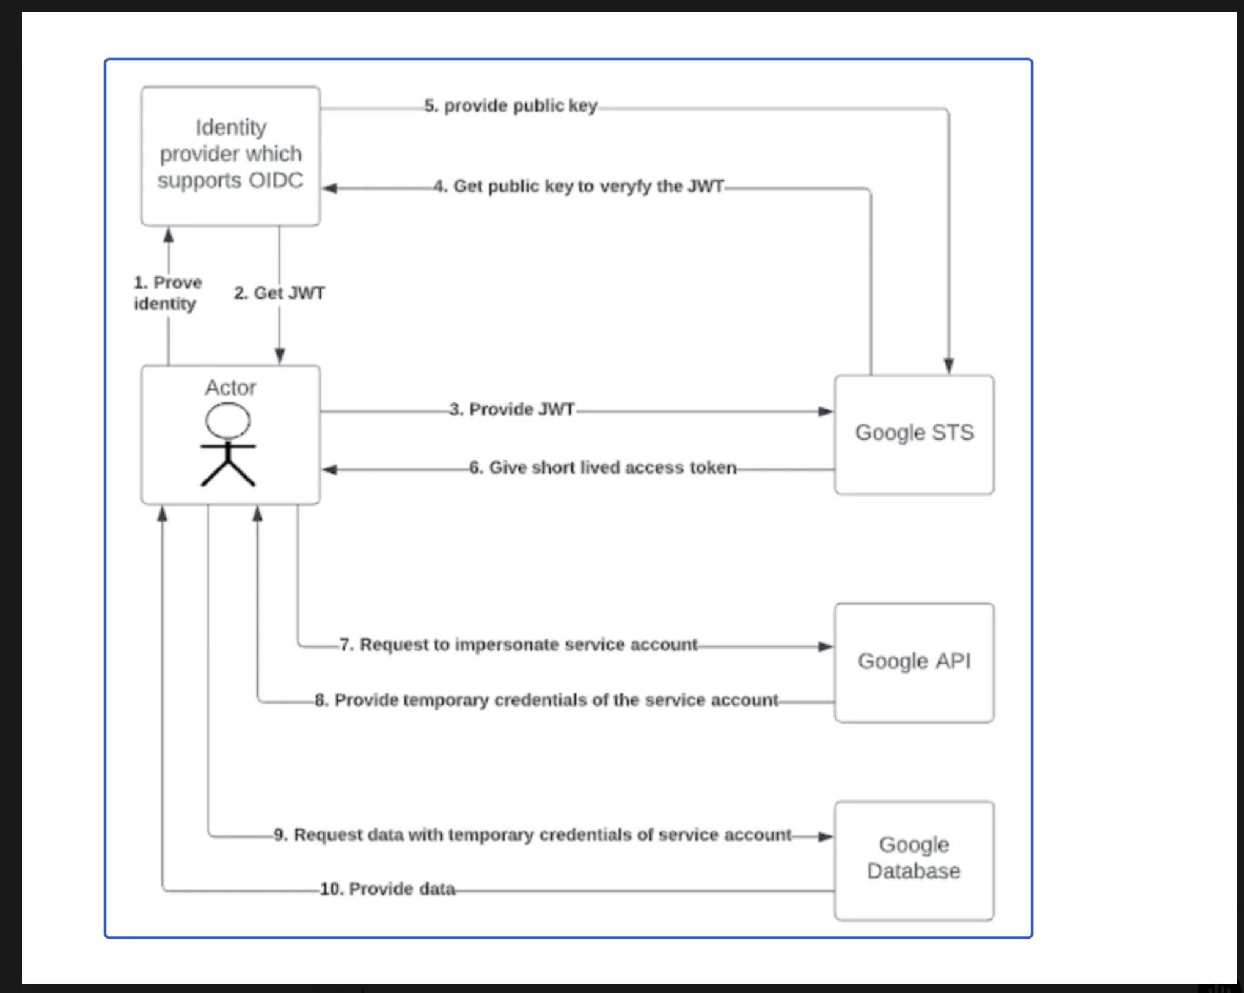
OIDC in Workload Identity Federation
External workloads request an OIDC token (JWT) from their Identity Provider (IdP).
JWT is sent to GCP’s Security Token Service (STS) for verification.

Slide 7
Key Components of Workload Identity Federation
Workload Identity Pool: Logical grouping of external identities (e.g., Dev, Staging, Production).
Workload Identity Pool Provider: Connects GCP with external IdPs, validates identity claims.

Slide 8
Issuing Access Tokens
GCP exchanges the verified JWT for a short-lived OAuth 2.0 access token.
Token is used to access GCP services securely.

Slide 9
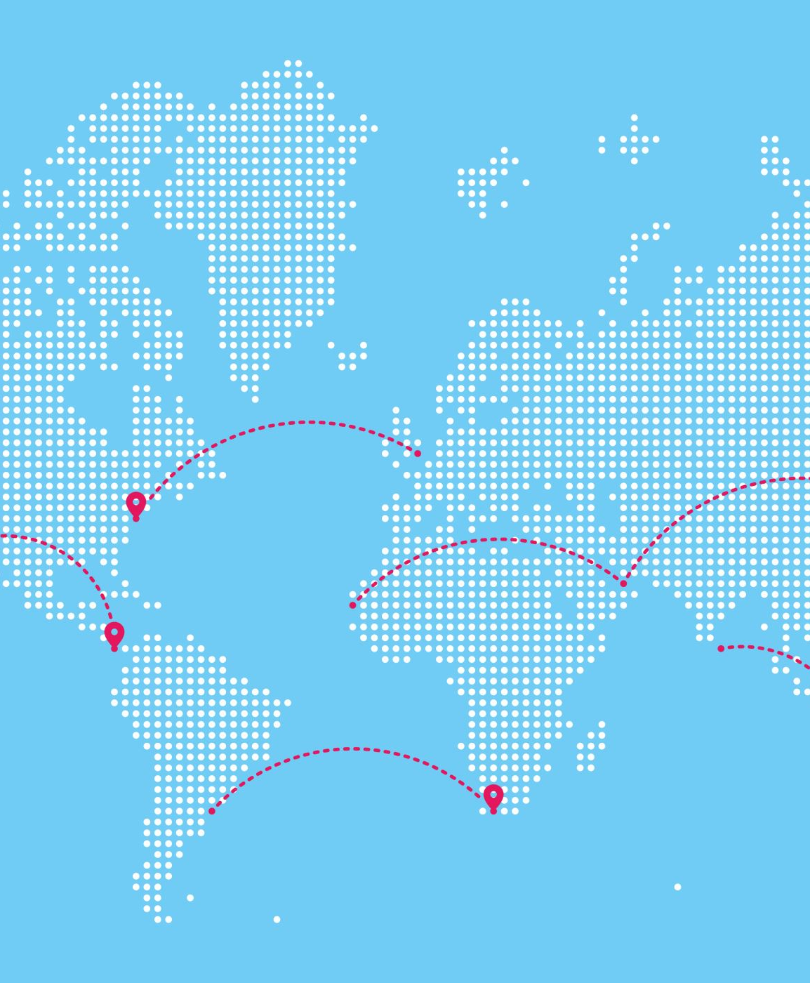
Importance of Attribute Mapping
Defines how external IdP attributes map to GCP IAM roles.
Example: google.subject=assertion.sub.

Slide 10
Benefits of Workload Identity Federation
Eliminates static credentials and leakage risks.
Automatic token rotation for enhanced security.
Seamless IAM integration across multiple IdPs.

Slide 11
Final Outcome & Automation
External workloads authenticate dynamically using OIDC.
Secure access to GCP services without service account keys.
Call to Action: Offer a Terraform automation script for setup.

Slide 12
Example: Pipeline in Harness
Harness generates an OIDC token (JWT).
JWT sent to GCP STS; validated against Workload Identity Pool Provider.
STS issues a short-lived OAuth 2.0 Access Token.
Access Token used to interact with GCP services like Vertex AI, GCS, DataFusion.

Slide 13

Questions and Discussion

