Slide 1









Git :

Slide 2




Overview
1. Install git and create a Github account
2. What is git?
3. How does git work?
4. What is GitHub?
5. Quick example using git and GitHub
Github icon

Slide 3




1
Install git and a create GitHub
account

Slide 4
Install git
•
Linux (
Debian
)
- Command: sudo apt-get install git
•
Linux (Fedora)
- Command: sudo yum install git
•
Mac
- http://git-scm.com/download/mac
•
Windows
- http://git-scm.com/download/win

Slide 5
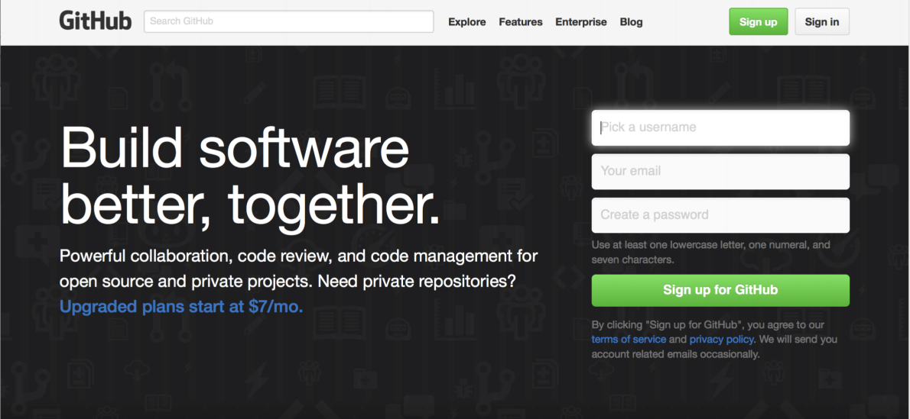
Create Github account
• www.github.com
• Free for public repositories

Slide 6
What is version control?
•
A system that keeps records of
your changes
Allows for collaborative
development
Allows you to know who made
what changes and when
Allows you to revert any changes
•
•
•
and go back to a previous state

Slide 7
2
What is git?

Slide 8
What is version control?
•
•
Distributed version control
Users keep entire code and
history on their location
machines
• Users can make any changes
without internet access
• (Except pushing and pulling
changes from a remote server)

Slide 9

What is git?
•
Started in 2005
Created by Linus Torvald to aid
in Linux kernel development
•
Git icon

Slide 10



What is git?
•
isn’t the only version control
system
Git
•
But (we think) it’s the best

Slide 11
3
How does git work?

Slide 12
How does git work?
•
Can be complicated at ﬁrst, but
there are a few key concepts
Important git terminology in
following slides are blue
•

Slide 13
Key Concepts: Snapshots
•
The way
git
keeps track of your code
history
Essentially records what all your ﬁles
•
look like at a given point in time
You decide when to take a snapshot,
•
and of what ﬁles
Have the ability to go back to visit any
•
snapshot
•
Your snapshots from later on will stay
around, too

Slide 14
Key Concepts: Commit
• The act of creating a snapshot
• Can be a noun or verb
•
“I
code”
“I just made a new commit”
commited
•
• Essentially, a project is made up
of a bunch of commits

Slide 15
Key Concepts: Commit
• Commits contain three pieces of
information:
Information about how the ﬁles
changed from previously
1.
2. A reference to the commit that
came before it
•
Called the
“
parent commit
”
3.
A hash code name
•
Will look something like:
f2d2ec5069fc6776c80b3ad6b7cbde3cade4e

Slide 16
Key Concepts: Repositories
•
’
A collection of all the ﬁles and
the history of those ﬁles
Often shortened to ‘
repo
•
• Consists of all your commits
• Place where all your hard work is
stored

Slide 17
Key Concepts: Repositories
•
Can live on a local machine or
on a remote server (GitHub!)
The act of copying a repository
from a remote server is called
cloning
Cloning from a remote server
allows teams to work together
•
•

Slide 18
Key Concepts: Repositories
•
The process of downloading
commits that don’t exist on your
machine from a remote repository
is called pulling changes
The process of adding your local
changes to the remote repository
is called pushing changes
•

Slide 19
Key Concepts: Branches
•
All commits in git live on some
branch
But there can be many, many
branches
The main branch in a project is
called the master branch
•
•

Slide 20
So, what does a typical project look like?
•
A bunch of commits linked
together that live on some branch,
contained in a repository
Following images taken and
modiﬁed from:
•
• http://
marklodato.github.io
/visual-
git
-
guide/index-en.html
• Also a good tutorial!

Slide 21
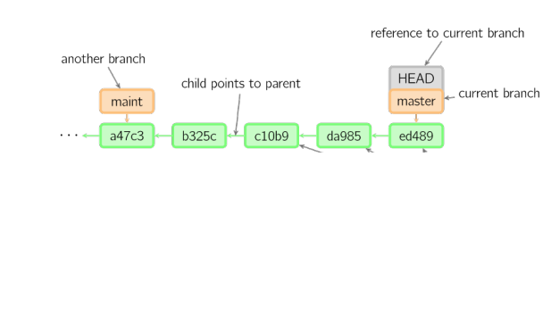

So, what does a typical project look like?
Time going forward

Slide 22
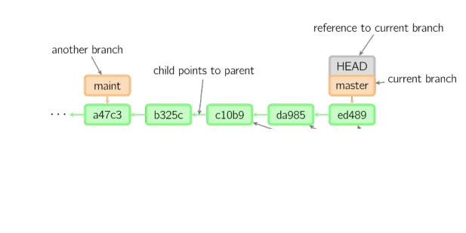
So, what is HEAD?
Time going forward

Slide 23
So, what is HEAD?
•
A reference to the most recent
commit
Time going forward

Slide 24
So, what is HEAD?
•
A reference to the most recent
commit
•
(in most cases – not always true!)
Time going forward

Slide 25
So, what is MASTER?
•
The main branch in your project
•
Doesn’t
have
to be called master, but almost
always is!
Time going forward

Slide 26
Key Concepts: Branching oﬀ of the master
branch
•
The start of a branch points to a
speciﬁc commit
When you want to make any
changes to your project you
make a new branch based on a
commit
•

Slide 27
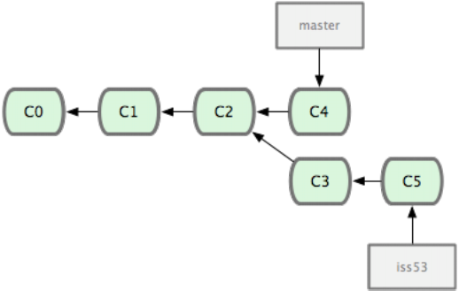
Key Concepts: Branching oﬀ of the master
branch
Images from:
http://codingdomain.com/
git/merging/
Time going forward

Slide 28
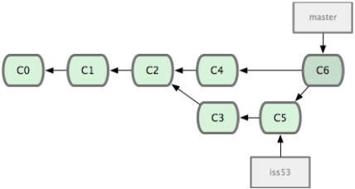
Key Concepts: Merging
•
Once you’re done with your
feature, you merge it back into
master
Time going forward

Slide 29
Key Concepts: How do you make a commit
anyway?
•
There are a lot of ‘states’ and ‘places’
a ﬁle can be
•
Local on your computer: the ‘
working
directory’
•
When a ﬁle is ready to be put in a
commit you add it onto the ‘index’ or
‘staging’
• Staging is the new preferred term – but
you can see both ‘index’ and ‘staging’
being used

Slide 30
Key Concepts: How do you make a commit
anyway?
•
The process:
• Make some changes to a ﬁle
• Use the ‘
command to put
the ﬁle onto the staging
environment
git
add
’
• Use the ‘
command to
create a new commit’
git
commit
’

Slide 31
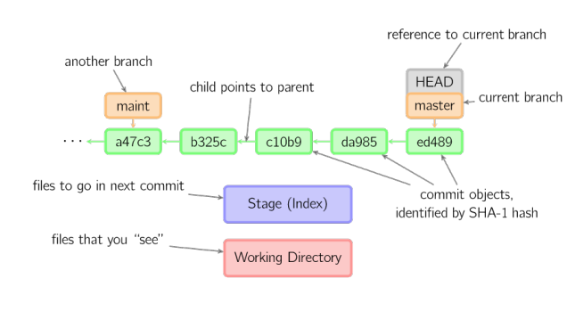
Key Concepts: How do you make a commit
anyway?
Time going forward

Slide 32
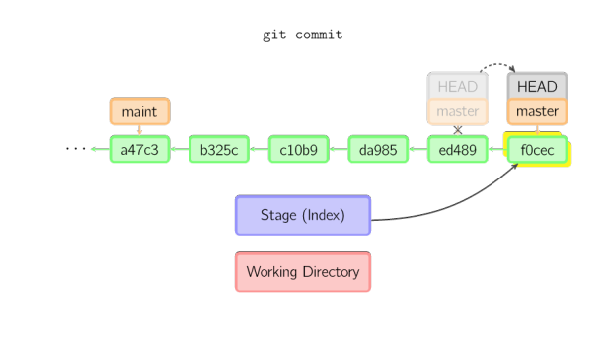


Key Concepts: How do you make a commit
anyway?
Time going forward

Slide 33
4
What is GitHub?

Slide 34


What is GitHub?
•
•
www.github.com
Largest web-based
git repository
hosting service
• Aka, hosts ‘
remote repositories
’
•
Allows for code collaboration with
anyone online
•
Adds extra functionality on top of
git
• UI, documentation, bug tracking, feature
requests, pull requests, and more!
Octocat!

Slide 35
What is GitHub?
•
Founded in 2008
Also has an Enterprise edition
for businesses
•
Octocat!

Slide 36




Additional Resources

Slide 37
Additional Resources
•
Oﬃcial
git
site and tutorial:
https://git-scm.com/
•
GitHub
guides:
https://guides.github.com/
•
Command
cheatsheet
:
https://training.github.com/kit/
downloads/github-git-cheat-sheet.pdf
•
Interactive
git
tutorial:
https://try.github.io/levels/1/challenges/1
•
Visual/interactive
cheatsheet
:
http://ndpsoftware.com/git-cheatsheet.html

