Slide 1
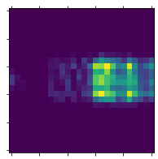
Encoder
Decoder
Autoencoder for feature compression
CNN for feature compression
Encoded data
16
Reconstruction Error
(MSE Loss)
Input: Nx69
FC 32
FC 32
FC 69
FC 69
FC 64
FC 64
Output
Classifiers
Classifier for each label
Input: N×26x26x1
Classification Error
(CrossEntropy Loss)
FC 120
Max Pooling
Max Pooling
FC 84
Conv, out=6
Flatten: (16x5x5)
Conv, out=16
FC 10
FC 128
FC 64
FC 16
Output: C
Concatenate
26
Convolution layer, 3x3, stride=1
Classifier for each label
Max-Pooling layer, kernel_size=2
……

Slide 2
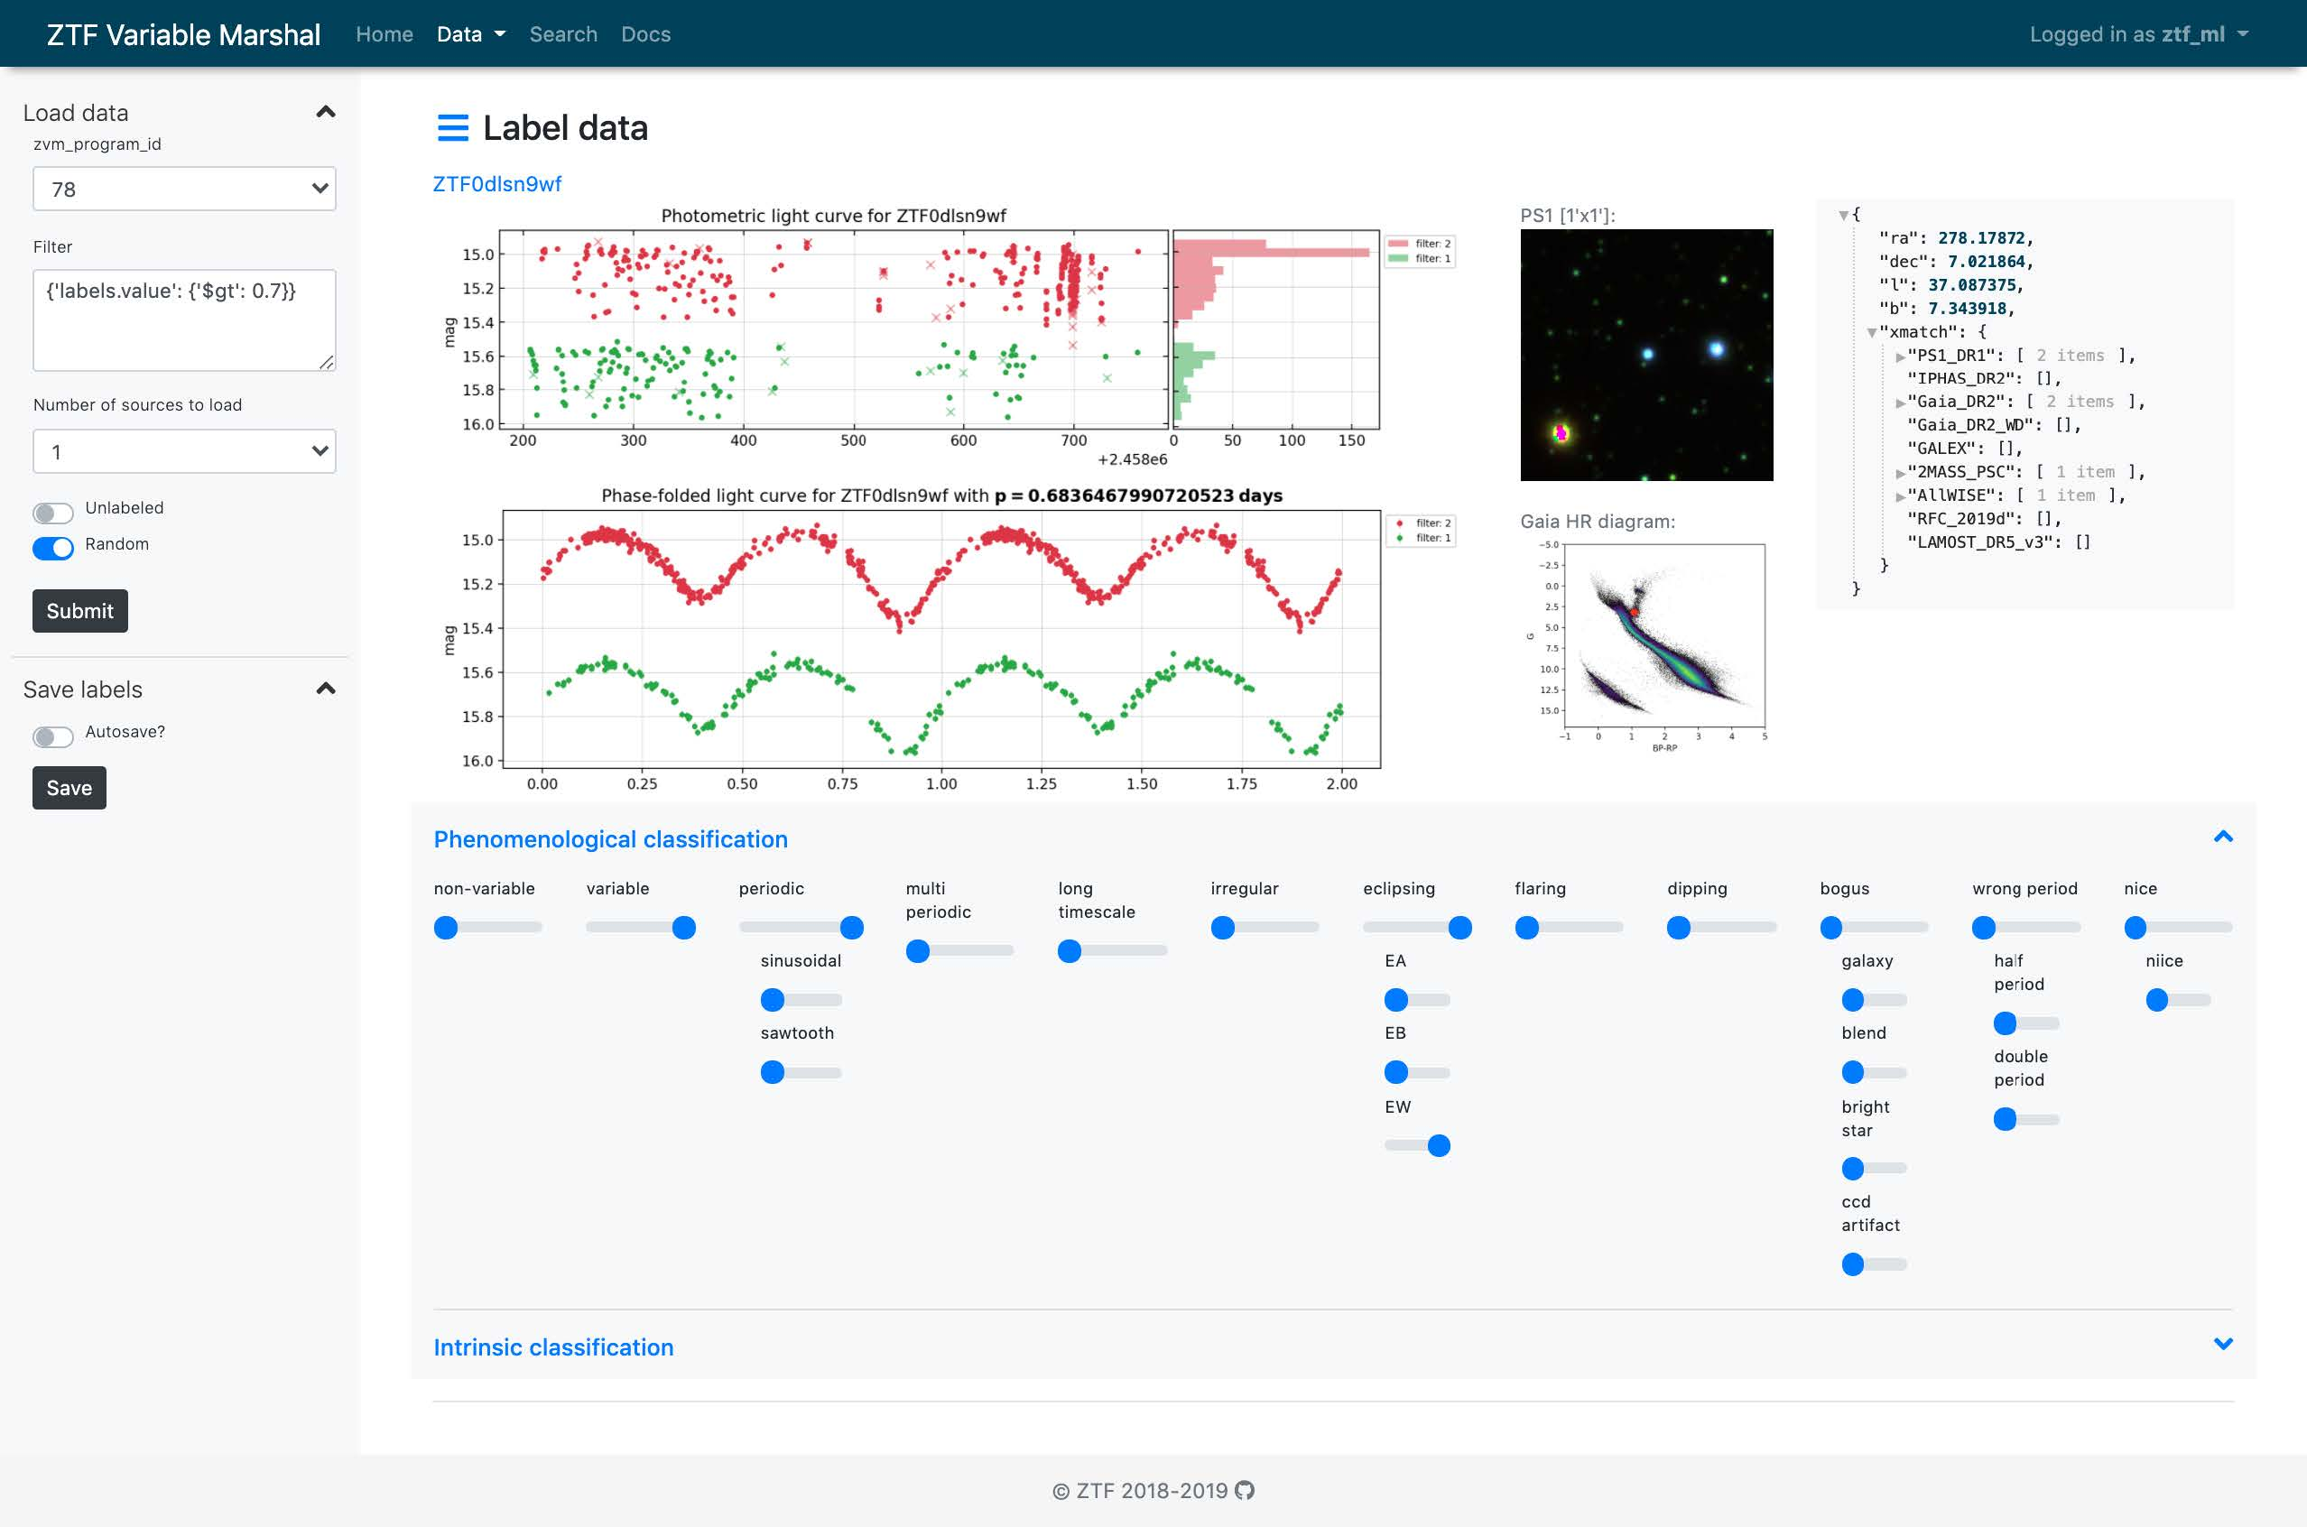
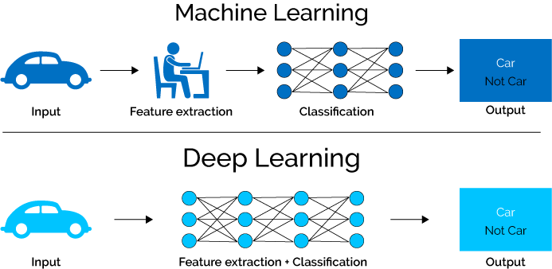

Slide 3
Label & Property
Label & Property

