Slide 1
Bcr-Abl Kinetics Suggest Self-Renewing Leukemic Cells are Reduced During Imatinib Treatment
A Stein, T Kalebic, D Bottino

Slide 2
Background: IRIS
The International Randomized Study of Interferon and STI571 (IRIS) is a phase 3, randomized, multicenter trial which demonstrated the superior safety and efficacy of imatinib over interferon-α plus cytarabine for patients with Philadelphia positive (Ph+) chronic myeloid leukemia in chronic phase (CML-CP)¹
Patients randomized to imatinib achieved the following response rates at 8 years follow-up:²
  Complete cytogenetic response, 83%
  Overall survival, 85%
  Event-free survival, 81%
  Freedom from progression to accelerated phase/blast crisis, 92%
Long-term follow-up from IRIS show high, durable rates of hematologic, cytogenetic and molecular response with a proven survival benefit supported by more than 8 years of clinical follow up
1. O’Brien et al. N Eng J Med. 2003; 348:994-1004.
2. Deininger et al. Blood. 2009; Volume 114, Abstract 1126.

Slide 3
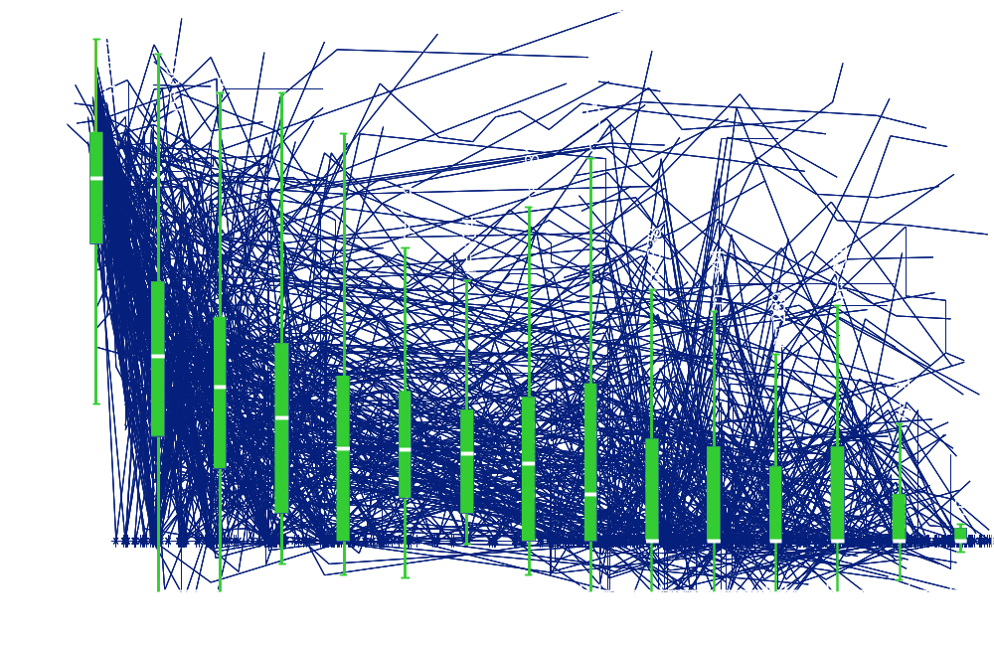
Introduction: BCR-ABL levels decrease over time on imatinib

Slide 4
Does imatinib impact leukemic self-renewing cells (LSCs)?
Leukemic ‘stem cells’ have been described as the basis of CML and may contribute to relapse¹
In preliminary studies of imatinib discontinuation in a small patient populations, the majority of patients relapsed after stopping imatinib¹⁻⁷
In vitro, quiescent stem cells (CD34⁺) are insensitive to imatinib and nilotinib over 3–12 day experiments⁸⁻⁹
1. Ross et al. ESH meeting, Bordeaux, Sept. 2009: CML – Biological basis of therapy.
2. Rousselot et al. Blood. 2007;109:58-60.
3. Mahon et al. J Clin Oncol. 2009; 15s:Abst.7084. 4. Koskenvesa et al. Blood. 2008;112:212. 5. Russo et al. Haematolgica. 2009;94(s2):194.
6. Goh et al. Leukemia & Lymphoma. 2009;50:944-951.
7. Janssen et al. Curr Stem Cell Res Ther. 2009 Sep;4:224-236.
8. Graham et al. Neoplasia. 2002;99:319-325.
9. Jorgensen et al. Neoplasia. 2007;109:4016-4020.

Slide 5
Goal: investigate if imatinib therapy can reduce the LSCs in patients
We have used:
  Molecular response data from IRIS patients (7 years)
  Information about early progenitor kinetics, and
  Mathematical modeling
  To characterize the BCR-ABL time-profiles
  To infer dynamics of LSCs
  in patients treated with imatinib

Slide 6
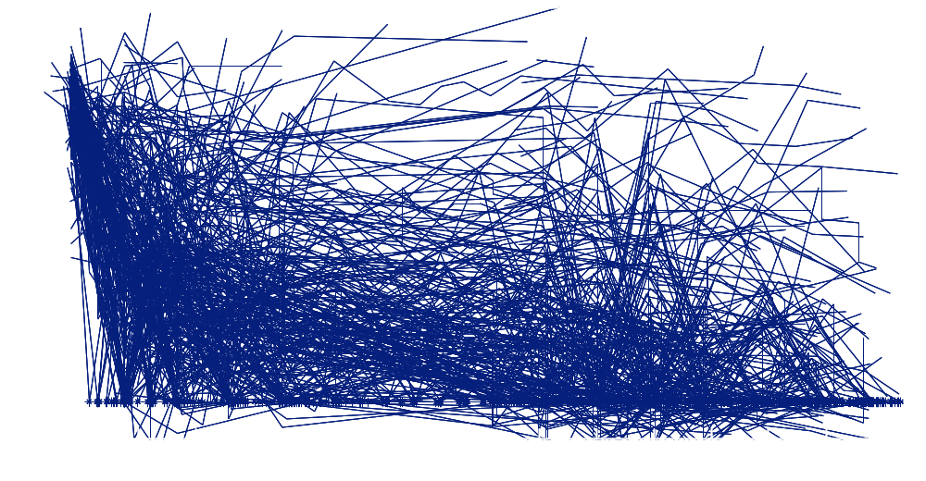
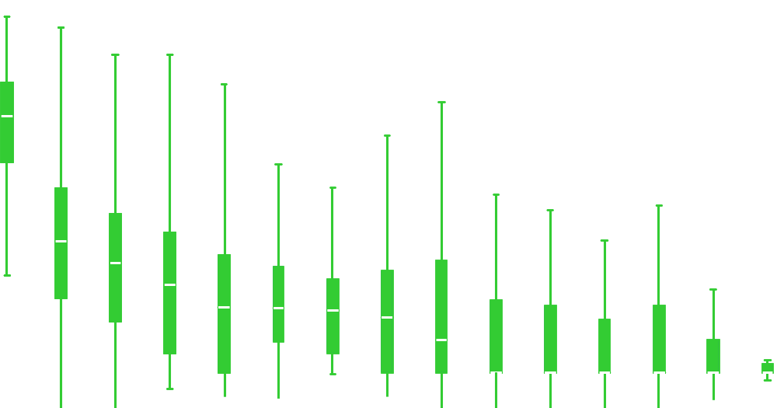
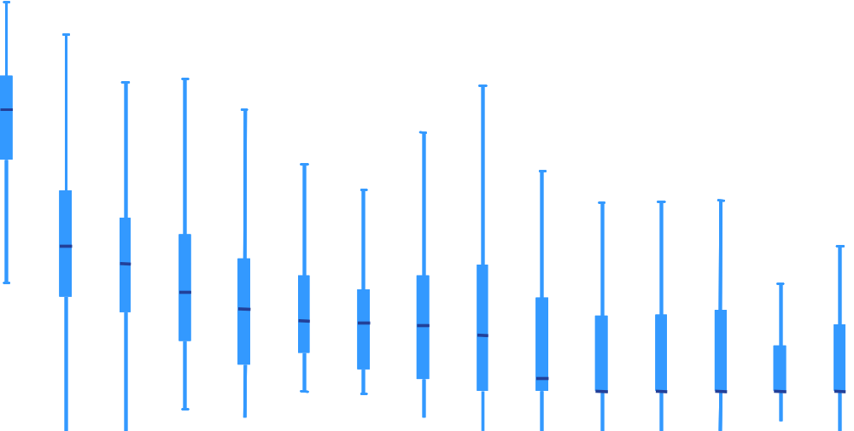
Methods
1106 patients in IRIS
(7-year follow up)
553 patients randomized to imatinib
327 patients with ≥ 4
BCR-ABL observations
Empirical model selection (AIC)¹
mono
bi
tri-exp
AIC, Akaike Information Criterion
1. Akaike, H. IEEE Transactions on Automatic Control. 1974;19(6):716-723.

Slide 7
Empirical characterization of patient PCR profiles: Multi-exponential regression & model selection
Monoexponential
Monoexponential
Bi-exponential
Tri-exponential
Tri-exponential
1000
100
β > 0
α
α
10
β = 0
1
α slope
β
0.1
β slope
β
β < 0
0.01
γ
γ
0.001
0.0001
0
1
2
3
4
5
6
7
Years on imatinib treatment
Standard statistical methods (Akaike Information Criterion [AIC]) used to find simplest multi-exponential function that explained the data
Tri-exponential was rejected for all but 4 patients via AIC, suggesting
β-decline continues to decline below detection threshold
Bi-exponential function: Ae^{αt} + Be^{βt}, α < β, t = time in years
  α < 0 represents the initial slope of BCR-ABL decline (up to ~6 months)
  β represents the longer slope (~ 6 months and beyond)
1. Akaike, H. IEEE Transactions on Automatic Control. 1974;19(6):716-723.

Slide 8
Patient parameter estimates for the bi-exponential model
Distribution of β slopes: 72% β < 0, 28% β > 0
100
80
40
30
60
β < 0
72%
(235/327)
β > 0
28%
(92/327)
Number of Patients
Number of Patients
α
20
40
10
20
0
-50
-25
0
0
-5
0
5
α (1/year)
β (1/year)

Slide 9
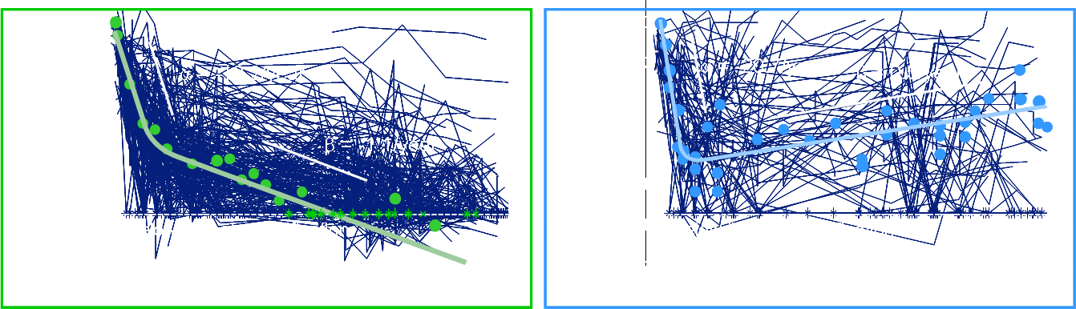
Typical individual profiles for β < 0 and β > 0
10
Patient Total (327) | β < 0 (235) | β > 0 (92)
Progression (43) | 6/235 (3%) | 37/92 (40%)
Discontinued w/o Prog. (52) | 32/235 (14%) | 20/92 (22%)
Maintained Treatment (232) | 197/235 (84%) | 35/92 (38%)
χ² two sample test: p < 0.00001
8
6
4
2
β estimate (1/year)
0
-2
-4
-6
-8
-10
0
50
100
150
200
250
300
Patient number

Slide 10

What drives the α and β slopes?
Two hypotheses with distinct implications for LSCs
Leukemic self-renewing cells (LSCs)
Early Progenitors
Late Progenitors
White Blood Cells
Monocyte
MDP
Granulocyte
GMP
LT-HSC
ST-HSC
MPP
CMP
Mast Cell
Basophil
MEP
Megakaryocyte
Erythrocyte
Self-renewal
Differentiation
β
α
1: EP-LSC Hypothesis
α ~ decline of EPs
β ~ decline of LSCs
LSC
EP
LP
WBC
2: LP-EP Hypothesis
α ~ decline of LPs
β ~ decline of EPs
LSCs untouched
β
α
LSC
EP
LP
WBC
1. Bottino et al. J Clin Oncol 2009; 27 (15S):7056. 2. Michor et al. Nature 2005; 435:1267-1270.

Slide 11
Model Simulations
1: EP-LSC hypothesis
2: LP-EP hypothesis
β
β
α
α
LSC
EP
LP
WBC
LSC
EP
LP
WBC
100
α
100
α
10
WBC
Both models can predict biphasic WBC response
10
WBC
1
β
1
β
WBC Bcr-Abl IS
WBC Bcr-Abl IS
0.1
0.1
0.01
0.01
0.001
-1
0
1
2
3
4
0.001
-1
0
1
2
3
4
100
α
100
10
EP
Models make different predictions of EP kinetics
10
β
1
β
1
EP Bcr-Abl IS
EP Bcr-Abl IS
0.1
0.1
0.01
0.01
EP
0.001
-1
0
1
2
3
4
0.001
-1
0
1
2
3
4
-1
0
1
2
3
4
100
Models make different predictions of
LSC kinetics
100
10
β
10
1
1
LSC/(LSC+HSC)
LSC/(LSC+HSC)
0.1
0.1
0.01
LSC
0.01
LSC
0.001
-1
0
1
2
3
4
0.001
-1
0
1
2
3
4
Time (years)
Time (years)

Slide 12
Experimental observations suggest EP decline is much faster than observed β slope
1: EP-LSC hypothesis
2: LP-EP hypothesis
β
β
α
α
LSC
EP
LP
WBC
LSC
EP
LP
WBC
100
EP
100
EP
10
10
1
1
EP Bcr-Abl IS
EP Bcr-Abl IS
0.1
0.1
0.01
0.01
0.001
-1
0
1
2
3
4
0.001
-1
0
1
2
3
4
-1
0
1
2
3
4
-1
0
1
2
3
4
Time (years)
Time (years)
Healthy hematopoiesis occurs within weeks^{2,3} suggesting that healthy EPs do not persist in bone marrow for years
Long-term bone marrow transplantation dynamics have been attributed to stem cells (not EPs) in mice⁴
Preliminary findings show leukemic EPs undetectable by PCR within 1 year¹
1. Abe et al. Int. J. Hematol. 2008;88:471-475. 2. Finch et al. Blood 1977;50:699-707.
3. Friberg et al. Invest New Drugs 2003;21:183-194. 4. Uchida et al. Blood 1994;83:3758-3779.

Slide 13
LSC reduction model is the only one that can explain both EP and WBC BCRABL kinetics
1: EP-LSC hypothesis
2: LP-EP hypothesis
β
α
β
α
LSC
EP
LP
WBC
LSC
EP
LP
WBC
100
BCRABL
(typical β < 0 case)
100
10
10
1
1
WBC Bcr-Abl IS
WBC Bcr-Abl IS
0.1
0.1
0.01
WBC
0.01
0.001
-1
0
1
2
3
4
0.001
-1
0
1
2
3
4
100
EP kinetics
100
10
10
1
1
EP Bcr-Abl IS
EP Bcr-Abl IS
0.1
EP
0.1
0.01
0.01
0.001
-1
0.001
-1
0
1
2
3
4
-1
0
1
2
3
4
100
Predicted LSC kinetics
100
10
10
1
1
LSC/(LSC+HSC)
LSC/(LSC+HSC)
0.1
0.1
0.01
LSC
0.01
0.001
-1
0
1
2
3
4
0.001
-1
0
1
2
3
4
Time (years)
Time (years)
Time (years)

Slide 14
Both models predict that patients with β > 0 experience LSC increase at rate β
1: EP-LSC hypothesis
2: LP-EP hypothesis
β
α
β
α
LSC
EP
LP
WBC
LSC
EP
LP
WBC
100
α
BCRABL
(typical β < 0 case)
100
β
10
β
10
α
1
1
WBC Bcr-Abl IS
WBC Bcr-Abl IS
0.1
0.1
0.01
WBC
0.01
0.001
-1
0
1
2
3
4
0.001
-1
0
1
2
3
4
100
100
α
β
Predicted EP kinetics
100
β
10
10
10
1
1
1
EP Bcr-Abl IS
EP Bcr-Abl IS
0.1
0.1
0.1
0.01
0.01
EP
0.01
0.001
0.001
0.001
-1
-1
0
0
1
1
2
-1
0
1
2
3
4
2
3
3
4
4
10
8
10
8
10
6
β
Predicted LSC kinetics
10
6
β
LSCs
LSCs
10
4
10
4
10
2
LSC
10
2
-1
0
1
2
3
4
-1
0
1
2
3
4
0
1
2
3
4
Time (years)
Time (years)

Slide 15
Conclusions
IRIS data + EP understanding + modeling suggest:
Majority of study patients well-described by bi-exponential
  α : initial rapid BCR-ABL ratio decline
  β : long-term decline or increase
β corresponds to kinetics of LSCs during IM treatment.
  235/327 (72%): β < 0 → gradual decline in LSC burden
  92/327 (28%): β > 0 → gradual increase in LSC burden
Modeling does not distinguish among various plausible mechanisms for predicted stem cell decline (β < 0)
Future analysis will include nilotinib patients

Slide 16
Acknowledgements
Yen Lin Chia
Ovidiu Chiparus
James Dunyak
Insa Gathmann
Alan Hatfield
Gabriel Helmlinger
Tillmann Krahnke
Vijay Modur
Jerry Nedelman
The IRIS investigators

