Slide 1
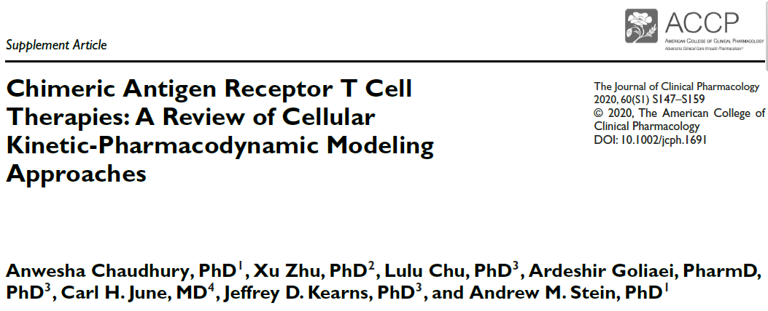
Andrew M. Stein
ACoP - November 10, 2021

Slide 2
Executive Summary
Situation
How do we apply model informed drug development for CART therapy
Unlike traditional PopPK, there is no consensus on model structures for CART.
Question
Is there a concise set of models we should explore for CART, as for PopPK?
Answer
Thorough investigation of Cellular-Kinetic – Pharmacodynamic structural models
Survey of key scientific findings from literature that show cases where a more complex model can be utilized to answer the questions of interest.

Slide 3





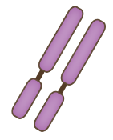










CAR-T therapy overview
Structure of Chimeric Antigen Receptor (CAR)
A living drug designed to target tumor cells (Kymriah® as an example)
Antigen-binding domain
Hinge Transmembrane
Costimulatory domain
Signaling domain
Ex vivo
In vivo
Patient’s T cell
Cancer cells
Anti-target
CAR construct
Native TCR
Target
Tumor cell
Dead tumor cell
CAR-T cell expansion
Lentiviral vector
Cytokine release

Slide 4
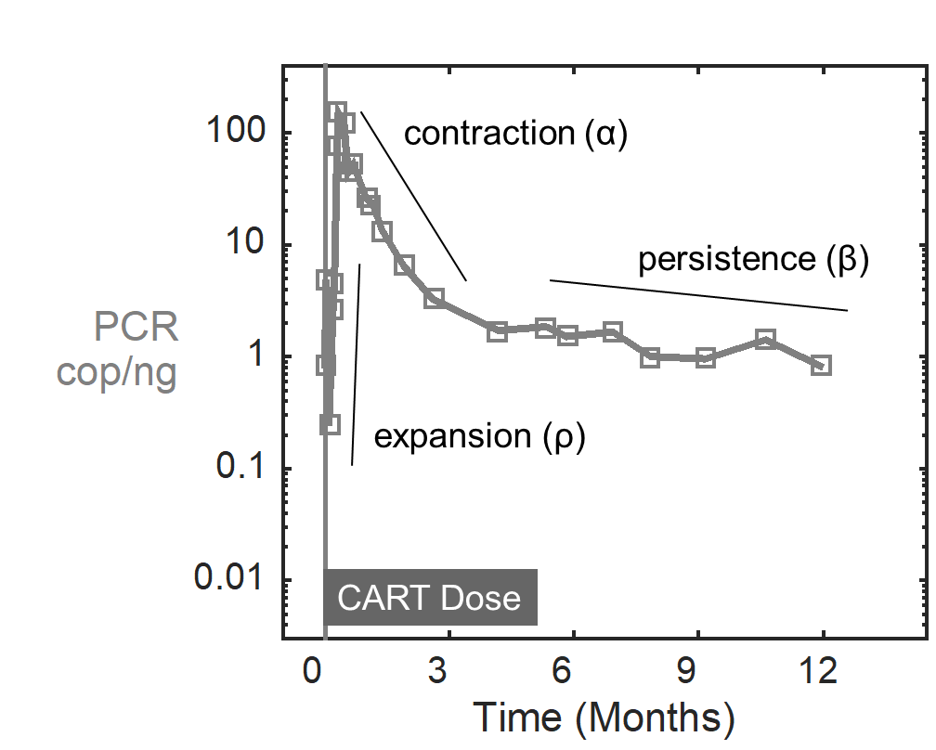
CART Cellular kinetic model
Expand until tmax
Comed
ρ
CAR-T Persister
(C_{P})
CAR-T Expander
(C_{E})
β
~α
Application: Describes CART kinetics
Demonstrated lack of impact of co-medications (tocilizumab and corticosteroids) on growth rate
Stein AM, Grupp SA, Levine JE, et al. Tisagenlecleucel model based cellular kinetic analysis of chimeric antigen receptor–T Cells. CPT Pharmacometrics Syst Pharmacol. 2019;8(5):285-295.

Slide 5
CART Cellular Kinetic – Pharmacodynamic model
ρ
g
Application
Assess impact of tumor burden on CART kinetics.
Characterize relationship between dose, cellular kinetics and tumor killing.
Question/Challenge
Choosing correct functional forms for growth and killing
CAR-T Persister
(C_{P})
CAR-T Expander
(C_{E})
Tumor
(U)

Slide 6




Example: Lotka-Volterra Predator-Prey Model¹⁻² is frequently used, but has cycles
ρ
g
Prey
(tumor)
CART
(C)
Tumor
(U)
Population
$$α$$
d
Predator
(CART)
CART (predator): $\frac{dC}{dT}=ρCU−αC$
Time
Cyclic behavior is not observed
in the clinic.
Tumor (prey): $\frac{dU}{dT}= gU$
$$− dCU$$
https://en.wikipedia.org/wiki/Lotka%E2%80%93Volterra_equations
Wodarz, Dominik. J PKPD 41.5 (2014): 415-429.

Slide 7
List of criteria a CellK-PD model should have
Exponential expansion
Fast initial decline
Slow long term slow decline
No cyclic behavior
Antigen drives expansion
CART expansion is not infinite, despite large antigen burden

Slide 8
EC50 expansion + EC50 killing model had all desired properties
Criteria | Mayer et al. + Gompertz | Sahoo et al. | Kuznetsov et al. | Lotka-Volterra | Newly proposed model structure
1. Exponential Expansion | yes | yes | yes | yes | yes
2. Fast initial decline | yes | yes | yes | yes | yes
3. Slow long term slow decline | no | no | no | no | yes
4. Antigen drives expansion | yes | no | yes | yes | yes
5. CART expansion not infinite | no | no | no | no | yes
6. No cyclic behavior | possibly | possibly | possibly | no | yes

Slide 9
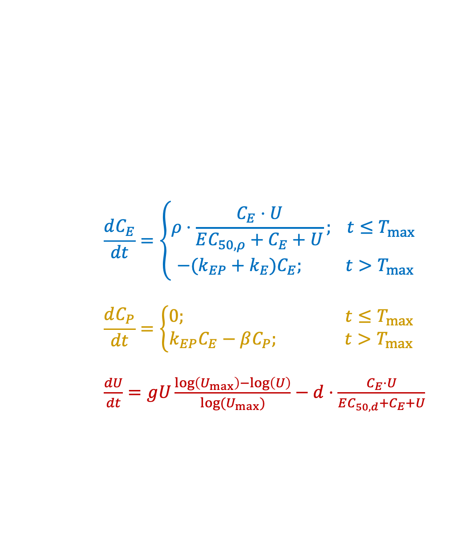
Newly proposed CART CellK-PD model structure that meets all criteria
$$\frac{dC_{E}}{dt}=\left\{\begin{matrix}ρ⋅\frac{C_{E}⋅U}{EC_{50,ρ}+C_{E}+U}; t≤T_{max} \\ −(k_{EP}+k_{E})C_{E}; t>T_{max}\end{matrix}\right.$$
$$\frac{dC_{P}}{dt}=\left\{\begin{matrix}0; t≤T_{max} \\ k_{EP}C_{E}−βC_{P}; t>T_{max}\end{matrix}\right.$$
$\frac{dU}{dt}=gU\frac{\log\left(U_{max}\right)−\log\left(U\right)}{log⁡(U_{max})}−d⋅\frac{C_{E}⋅U}{EC_{50,d}+C_{E}+U}$
ρ
g
CAR-T Persister
(C_{P})
k_{PE}
CAR-T Expander
(C_{E})
Tumor
(U)
k_{EP}
d
EC50 formula is derived from a traditional binding model.
Mayer, Andreas, et al. "Regulation of T cell expansion by antigen presentation dynamics." Proceedings of the National Academy of Sciences 116.13 (2019): 5914-5919.

Slide 10
Confounding factors that make E-R analyses challenging¹⁻³
Antigen Expression
Immune cell phenotypes
T cell exhaustion
Genotype
Challenge
Factors that can affect both exposure and response mean that E-R relationship may not be causal
Path Forward
Measure as many confounders as possible
Build more mechanistic models
CAR-T Persister
(C_{P})
CAR-T Expander
(C_{E})
Tumor
(U)
https://en.wikipedia.org/wiki/Simpson%27s_paradox
https://sites.google.com/site/andrewsteinphd/causality
Yang, Jun, et al. "The combination of exposure‐response and case‐control analyses in regulatory decision making." The Journal of Clinical Pharmacology 53.2 (2013): 160-166.

Slide 11
Introduction of binding kinetics to account for antigen burden
Application
Assess optimal binding affinity
Assess impact on cellular antigen density on CART kinetics
Challenge: potential umbrella shaped affinity-response curve [1]
Exhaustion (excessive signaling),
Restrict T cell killing to only one tumor cell due to lasting synapse
Restrict the T cell’s ability to generate persistent memory cells.
T cell loss via activation-induced cell death
C_{P}
C_{P}
U
+
U
+
C_{E}
C_{E}
U
Watanabe K, Kuramitsu S, Posey AD, June CH. Expanding the therapeutic window for CAR-T cell therapy in solid tumors: The knowns and unknowns of CAR-T cell biology. Front Immunol. 2018;9(OCT):1-12.

Slide 12
Immunophenotype modeling framework
CART
Naive
CART
Stem Cell
Memory
CART
Central
Memory
CART
Effector
Memory
CART
Effector
Tumor
Application
Understanding how immunophenotype properties of the product impact tumor kinetics
Challenge
Choosing which cell surface markers to use.
Identifying the right structural model to characterize both expanding cells and persistent cells. Published preclinical models currently focus on the expansion phase [1]
Collecting sufficient clinical data to inform model (more subsets mean more BLOQ data)
Buchholz VR, Flossdorf M, Hensel I, et al. Disparate individual fates compose robust CD8+ T cell immunity. Science. 2013;340(6132):630-635.

Slide 13
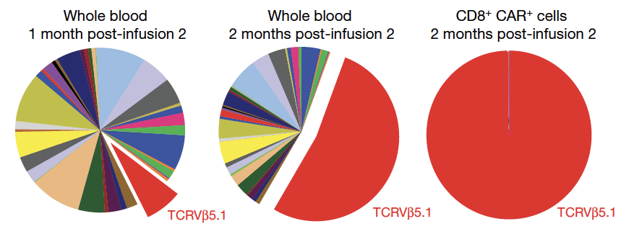
Importance of genotype heterogeneity
Challenge
Insertion of CAR gene can disrupt another gene (e.g. TET2 or CBL-B) [1, 2], which can lead to a single clone that contributes to response.
Path Forward
Collection of clonal heterogeneity data is crucial to understanding response.
C_{P,1}
C_{E,1}
C_{P,2}
C_{E,2}
U
…
…
C_{P,n}
C_{E,n}
Fraietta JA, Nobles CL, Sammons MA, et al. Disruption of TET2 promotes the therapeutic efficacy of CD19-targeted T cells. Nature. 2018;558(7709):307-312.
Shah NN, Qin H, Yates B, et al. Clonal expansion of CAR-T cells harboring lentivector integration in the CBL gene following anti-CD22 CAR-T cells therapy. Blood Adv. 2019;3(15):2317-2322.

Slide 14
Summary
We propose a framework for cellular kinetic pharmacodynamic (CellK-PD) model structure to try out for future preclinical and clinical studies.
Many model extensions were proposed, but each have challenges associated with them.

Slide 15
Acknowledgements
Coauthors:
Anwesha Chaudhury
Sue Zhu
Lulu Chu
Ardeshir Goliaei
Carl June
Jeff Kearns
Kymriah, YTB323, and PHE885 clinical teams
Boris Engels
Attilio Bondanza
Karen Thudium Mueller

