Slide 1
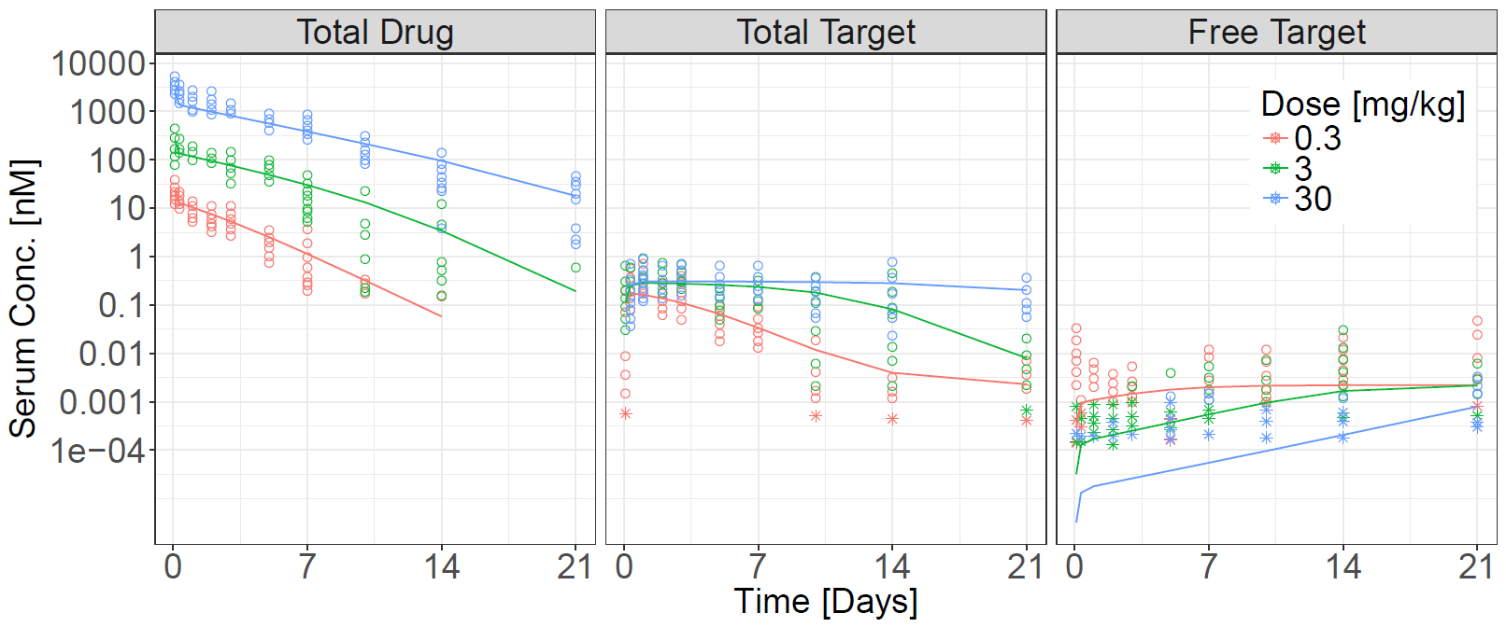
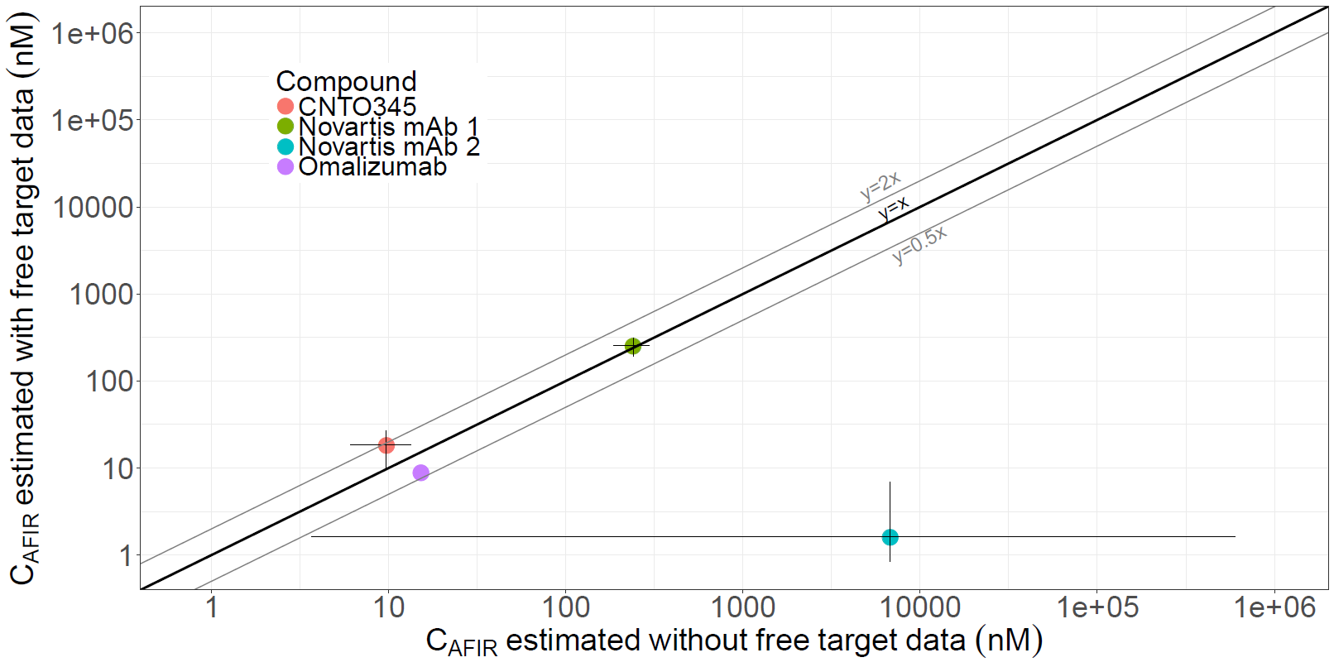
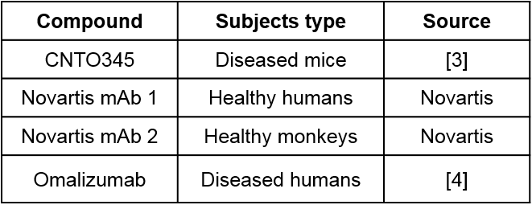
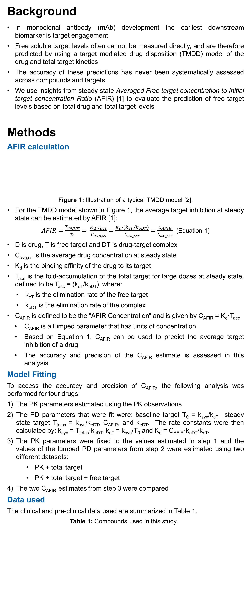
Predicting the Free Target Levels Based on Total drug and Total Target Levels for Monoclonal Antibodies
This orange box can be deleted
This layout is preferred when there is a need to insert study logo and a poster number is not available.
Authors: Konstantinos Biliouris¹, Etienne Pigeolet², Philip J. Lowe², Ramprasad Ramakrishna¹, Andrew Stein¹
¹Novartis Institute of Biomedical Research, Cambridge, MA, USA; ²Novartis Pharma AG, Basel, Switzerland
Background
In monoclonal antibody (mAb) development the earliest downstream biomarker is target engagement
Free soluble target levels often cannot be measured directly, and are therefore predicted by using a target mediated drug disposition (TMDD) model of the drug and total target kinetics
The accuracy of these predictions has never been systematically assessed across compounds and targets
We use insights from steady state Averaged Free target concentration to Initial target concentration Ratio (AFIR) [1] to evaluate the prediction of free target levels based on total drug and total target levels
Methods
AFIR calculation
Figure 1: Illustration of a typical TMDD model [2].
For the TMDD model shown in Figure 1, the average target inhibition at steady state can be estimated by AFIR [1]:
$AFIR=\frac{T_{avg,ss}}{T_{0}}= \frac{K_{d}·T_{acc}}{C_{avg,ss}}=\frac{K_{d}·(k_{eT}/k_{eDT})}{C_{avg,ss}}=\frac{C_{AFIR}}{C_{avg,ss}}$ (Equation 1)
D is drug, T is free target and DT is drug-target complex
C_{avg,ss} is the average drug concentration at steady state
K_{d} is the binding affinity of the drug to its target
T_{acc} is the fold-accumulation of the total target for large doses at steady state, defined to be T_{acc} = (k_{eT}/k_{eDT}), where:
k_{eT} is the elimination rate of the free target
k_{eDT} is the elimination rate of the complex
C_{AFIR} is defined to be the “AFIR Concentration” and is given by C_{AFIR} = K_{d}·T_{acc}
C_{AFIR} is a lumped parameter that has units of concentration
Based on Equation 1, C_{AFIR} can be used to predict the average target inhibition of a drug
The accuracy and precision of the C_{AFIR} estimate is assessed in this analysis
Model Fitting
To access the accuracy and precision of C_{AFIR}, the following analysis was performed for four drugs:
The PK parameters estimated using the PK observations
The PD parameters that were fit were: baseline target T₀ = k_{syn}/k_{eT} steady state target T_{totss} = k_{syn}/k_{eDT}, C_{AFIR}, and k_{eDT}. The rate constants were then calculated by: k_{syn} = T_{totss}·k_{eDT}, k_{eT} = k_{syn}/T₀ and K_{d} = C_{AFIR}·k_{eDT}/k_{eT}.
The PK parameters were fixed to the values estimated in step 1 and the values of the lumped PD parameters from step 2 were estimated using two different datasets:
PK + total target
PK + total target + free target
The two C_{AFIR} estimates from step 3 were compared
Data used
The clinical and pre-clinical data used are summarized in Table 1.
Table 1: Compounds used in this study.
Results
Model fit for CNTO345
Figure 2: Model fit to CNTO345. The observations were digitized from [3]. The lines correspond to the predictions (using the dataset with PK + total target + free target data), the circles (○) correspond to the observations and asterisks (*) correspond to the observations below the limit of quantification.
C_{AFIR} values estimated with and without free target data (step 4)
Figure 3: Relationship between the C_{AFIR} values estimated with (y-axis) and without (x-axis) free target data. The circles (●) correspond to the estimated value and the error-bars correspond to the 5th - 95th confidence interval, as calculated from the NONMEM Covariance Matrix (CNTO345), Monolix (Novartis mAb 1) or the log-likelihood profile (Novartis mAb 2). For Novartis mAb 2, the large confidence intervals (100,000-fold) indicate that insufficient data were available to estimate C_{AFIR}.
Conclusions and future work
For three compounds, the average free target levels were predicted within 2-fold accuracy by using only the total drug and total target data.
For one compound, the average free target levels could not be accurately predicted by using only the total drug and total target data. This is attributed to the lack of sufficient data: only single dosing data, initial target below limit of quantification and limited follow-up.
Additional examples are currently being analyzed to assess the predictability of C_{AFIR} without the use of free target data.
References
Stein AM and Ramakrishna R, CPT: PSP. 2017, 6, 258-266
Mager DE and Jusko, WJ, JPKPD. 2001, 28(6), 507-532
Chen X, et al., JPKPD. 2016, 43(3), 291-304
Lowe PJ, et al., Basic & Clinical Pharmacology & Toxicology. 2010, 106(3): 195-209
Acknowledgments
Novartis’ support of this work is greatly acknowledged
This orange box can be deleted
Position of this text box is Horizontal position 18.97 and Vertical position is at 9.91
The first text box, or chart is anchored at the Horizontal position of 18.97. The width of all object in this column is 15”.
D
+
k_{syn}
K_{d}
Dose_{iv}
k₂₁
T
DT
D_{P}
k₁₂
k_{eD}
k_{eT}
k_{eDT}

