Slide 1
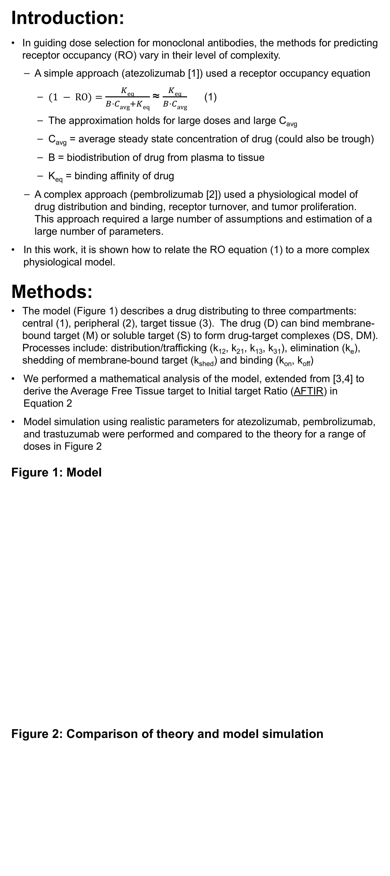
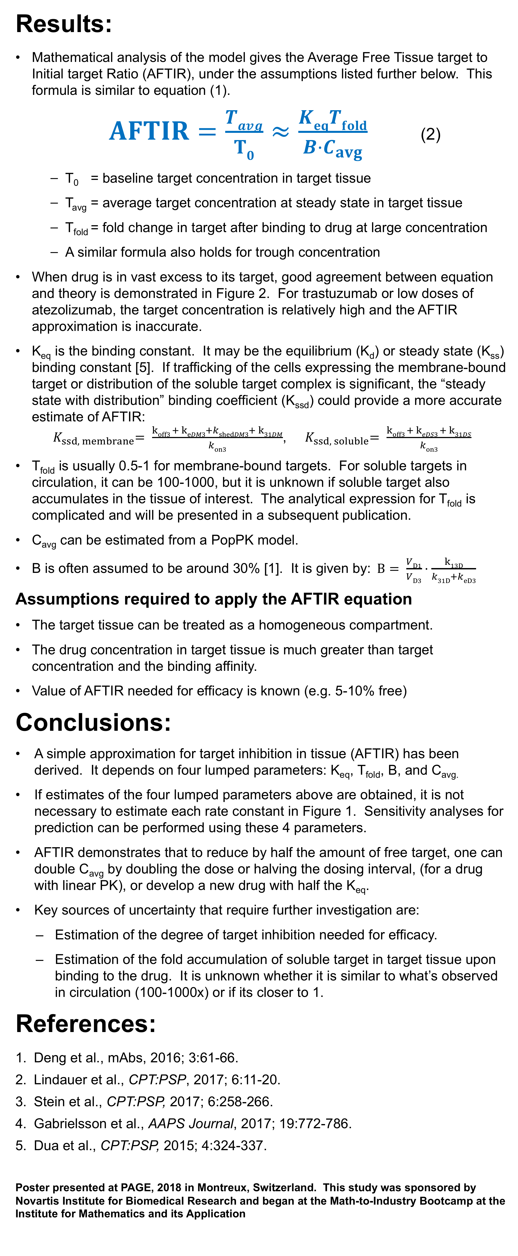
Guiding dose selection of monoclonal antibodies using a new parameter (AFTIR) for characterizing ligand binding systems
P8446
Sameed Ahmed^{1*}, Miandra Ellis^{2*}, Hongshan Li^{3*}, Luca Pallucchini^{4*}, Andrew M. Stein⁵
(1) Department of Mathematics, University of South Carolina (2) School of Mathematical and Statistical Sciences, Arizona State University (3) Department of Mathematics, Purdue University (4) Department of Mathematics, Temple University (5) Novartis Institute for BioMedical Research (*) These authors contributed equally to this abstract
Introduction:
In guiding dose selection for monoclonal antibodies, the methods for predicting receptor occupancy (RO) vary in their level of complexity.
A simple approach (atezolizumab [1]) used a receptor occupancy equation
$(1 − RO)=$ $\frac{Keq}{B·Cavg+Keq}$ ≈ $\frac{Keq}{B·Cavg}$ (1)
The approximation holds for large doses and large C_{avg}
C_{avg} = average steady state concentration of drug (could also be trough)
B = biodistribution of drug from plasma to tissue
K_{eq} = binding affinity of drug
A complex approach (pembrolizumab [2]) used a physiological model of drug distribution and binding, receptor turnover, and tumor proliferation. This approach required a large number of assumptions and estimation of a large number of parameters.
In this work, it is shown how to relate the RO equation (1) to a more complex physiological model.
Methods:
The model (Figure 1) describes a drug distributing to three compartments: central (1), peripheral (2), target tissue (3). The drug (D) can bind membrane-bound target (M) or soluble target (S) to form drug-target complexes (DS, DM). Processes include: distribution/trafficking (k₁₂, k₂₁, k₁₃, k₃₁), elimination (k_{e}), shedding of membrane-bound target (k_{shed}) and binding (k_{on}, k_{off})
We performed a mathematical analysis of the model, extended from [3,4] to derive the Average Free Tissue target to Initial target Ratio (AFTIR) in Equation 2
Model simulation using realistic parameters for atezolizumab, pembrolizumab, and trastuzumab were performed and compared to the theory for a range of doses in Figure 2
Figure 1: Model
Figure 2: Comparison of theory and model simulation
Results:
Mathematical analysis of the model gives the Average Free Tissue target to Initial target Ratio (AFTIR), under the assumptions listed further below. This formula is similar to equation (1).
$AFTIR=\frac{Tavg}{T0}≈\frac{KeqTfold}{B·C_{avg}}$ (2)
T₀ = baseline target concentration in target tissue
T_{avg} = average target concentration at steady state in target tissue
T_{fold} = fold change in target after binding to drug at large concentration
A similar formula also holds for trough concentration
When drug is in vast excess to its target, good agreement between equation and theory is demonstrated in Figure 2. For trastuzumab or low doses of atezolizumab, the target concentration is relatively high and the AFTIR approximation is inaccurate.
K_{eq} is the binding constant. It may be the equilibrium (K_{d}) or steady state (K_{ss}) binding constant [5]. If trafficking of the cells expressing the membrane-bound target or distribution of the soluble target complex is significant, the “steady state with distribution” binding coefficient (K_{ssd}) could provide a more accurate estimate of AFTIR: ${ K}_{ssd, membrane}= \frac{koff3 + keDM3+kshedDM3+ k31DM}{kon3}$, ${ K}_{ssd, soluble}= \frac{koff3 + keDS3 + k31DS}{kon3}$
T_{fold} is usually 0.5-1 for membrane-bound targets. For soluble targets in circulation, it can be 100-1000, but it is unknown if soluble target also accumulates in the tissue of interest. The analytical expression for T_{fold} is complicated and will be presented in a subsequent publication.
C_{avg} can be estimated from a PopPK model.
B is often assumed to be around 30% [1]. It is given by:$B= \frac{VD1}{VD3}·\frac{k13D}{k31D+keD3}$
Assumptions required to apply the AFTIR equation
The target tissue can be treated as a homogeneous compartment.
The drug concentration in target tissue is much greater than target concentration and the binding affinity.
Value of AFTIR needed for efficacy is known (e.g. 5-10% free)
Conclusions:
A simple approximation for target inhibition in tissue (AFTIR) has been derived. It depends on four lumped parameters: K_{eq}, T_{fold}, B, and C_{avg.}
If estimates of the four lumped parameters above are obtained, it is not necessary to estimate each rate constant in Figure 1. Sensitivity analyses for prediction can be performed using these 4 parameters.
AFTIR demonstrates that to reduce by half the amount of free target, one can double C_{avg} by doubling the dose or halving the dosing interval, (for a drug with linear PK), or develop a new drug with half the K_{eq}.
Key sources of uncertainty that require further investigation are:
Estimation of the degree of target inhibition needed for efficacy.
Estimation of the fold accumulation of soluble target in target tissue upon binding to the drug. It is unknown whether it is similar to what’s observed in circulation (100-1000x) or if its closer to 1.
References:
Deng et al., mAbs, 2016; 3:61-66.
Lindauer et al., CPT:PSP, 2017; 6:11-20.
Stein et al., CPT:PSP, 2017; 6:258-266.
Gabrielsson et al., AAPS Journal, 2017; 19:772-786.
Dua et al., CPT:PSP, 2015; 4:324-337.
Poster presented at PAGE, 2018 in Montreux, Switzerland. This study was sponsored by Novartis Institute for Biomedical Research and began at the Math-to-Industry Bootcamp at the Institute for Mathematics and its Application
M₃
k_{synM3}
DM₃
+
k_{on3}
k_{off3}
Target
Tissue (3)
D₃
k_{shedM3}
k_{eM3}
k_{shedDM3}
k_{eDM3}
+
S₃
k_{synS3}
DS₃
k_{eD3}
k_{on3}
k_{off3}
k_{eDS3}
k_{13D}
k_{31D}
k_{13M}
k_{31M}
k_{13S}
k_{31S}
k_{eS3}
k_{13DS}
k_{31DS}
k_{13DM}
k_{31DM}
S₁
k_{synS1}
DS₁
Central (1)
+
k_{on1}
k_{off1}
k_{eDS1}
Dose_{iv}
D₁
k_{shedM1}
k_{eS1}
k_{shedDM1}
+
M₁
k_{synM1}
DM₁
k_{12D}
k_{21D}
k_{eD1}
k_{on1}
k_{off1}
Peripheral (2)
D₂
k_{eM1}
k_{eDM1}
Model for predicting target occupancy in the tissue of interest.
AFTIR formula matches simulation when drugs that are in vast excess to target (bevacizumab, pembrolizumab, and atezolizumab at high doses), but not when target concentration is high (trastuzumab and atezolizumab at low doses). This is expected (see assumptions). For both pembrolizumab and atezolizumab, the Kssd model approximation was more accurate. The Kssd term accounts for cells expressing the target trafficking between tissue and circulation,

