Slide 1
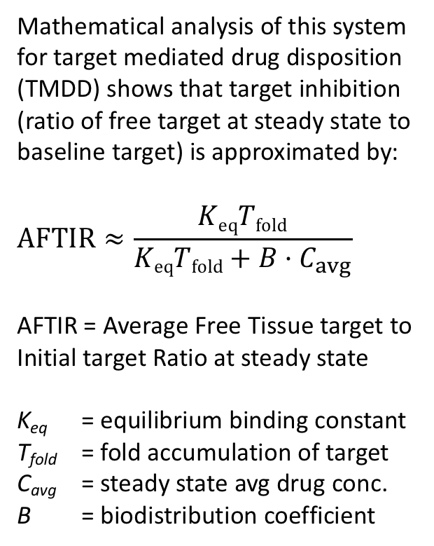
k_{synM3}
M₃
k_{on3}
k_{off3}
DM₃
+
Target Tissue (3)
D₃
k_{eM3}
k_{eDM3}
k_{shedM3}
k_{synS3}
k_{shedDM3}
+
Mathematical analysis of this system for target mediated drug disposition (TMDD) shows that target inhibition (ratio of free target at steady state to baseline target) is approximated by:
$$AFTIR≈\frac{KeqTfold}{KeqTfold+B·C_{avg}}$$
AFTIR = Average Free Tissue target to Initial target Ratio at steady state
K_{eq} = equilibrium binding constant
T_{fold} = fold accumulation of target
C_{avg} = steady state avg drug conc.
B = biodistribution coefficient
k_{eD3}
S₃
k_{on3}
k_{off3}
DS₃
k_{eS3}
k_{eDS3}
k_{13D}
k_{31D}
k_{13M}
k_{31M}
k_{13S}
k_{31S}
k_{13DS}
k_{31DS}
k_{synS1}
k_{13DM}
k_{31DM}
S₁
k_{on1}
k_{off1}
DS₁
+
Central (1)
D₁
k_{eS1}
k_{eDS1}
Dose_{iv}
k_{shedM1}
k_{shedDM1}
+
k_{synM1}
k_{eD1}
M₁
k_{on1}
k_{off1}
DM₁
k_{12D}
k_{21D}
k_{eM1}
k_{eDM1}
Peripheral (2)
D₂
D = drug
S = soluble target
M = membrane-bound target

