Slide 1
Code Assisted Iterative Channel Estimation for OFDM Systems over Multipath Fast-Fading Channel
Speaker : Yi-Ru Chen
Advisor : Prof. Mao-Chao Lin, Prof. Huang-Chang Lee
June 06, 2020

Slide 2
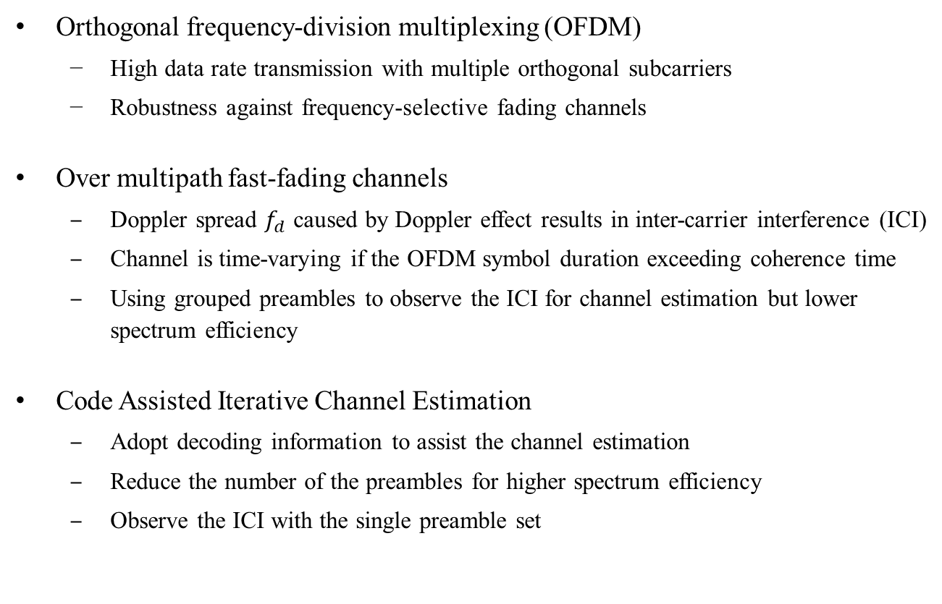
Motivation
Orthogonal frequency-division multiplexing (OFDM)
High data rate transmission with multiple orthogonal subcarriers
Robustness against frequency-selective fading channels
Over multipath fast-fading channels
Doppler spread $f_{d}$ caused by Doppler effect results in inter-carrier interference (ICI)
Channel is time-varying if the OFDM symbol duration exceeding coherence time
Using grouped preambles to observe the ICI for channel estimation but lower spectrum efficiency
Code Assisted Iterative Channel Estimation
Adopt decoding information to assist the channel estimation
Reduce the number of the preambles for higher spectrum efficiency
Observe the ICI with the single preamble set

Slide 3
Outline
Multipath Fast-Fading Channel
Channel Characteristics
Simulated Channel Model
Coded OFDM System
System Model and Derivation
Polynomial-Basis Expansion Model
Frequency-Domain Equalization Techniques for ICI Mitigation
Preamble and Codeword Arrangement
Code Assisted Iterative Channel Estimation
Least Square Based Model
Kalman filter Based Model

Slide 4
Outline
Multipath Fast-Fading Channel
Channel Characteristics
Simulated Channel Model
Coded OFDM System
System Model and Derivation
Polynomial-Basis Expansion Model
Frequency-Domain Equalization Techniques for ICI Mitigation
Preamble and Codeword Arrangement
Code Assisted Iterative Channel Estimation
Least Square Based Model
Kalman filter Based Model

Slide 5
Channel Characteristics
Channel gain varies as frequency and time, caused by Multipath propagation and Doppler effect
Frequency selectivity and Doppler spread lead to inter-symbol interference(ISI) and inter-carrier interference(ICI) respectively
ISI and ICI result in the performance loss and error floor
ISI can be eliminated by exploiting the cyclic prefix (CP)
OFDM systems are more sensitive to the time-varying channel
In high Doppler spread environment, how to efficiently reduce ICI effect is critical for the receiver design

Slide 6
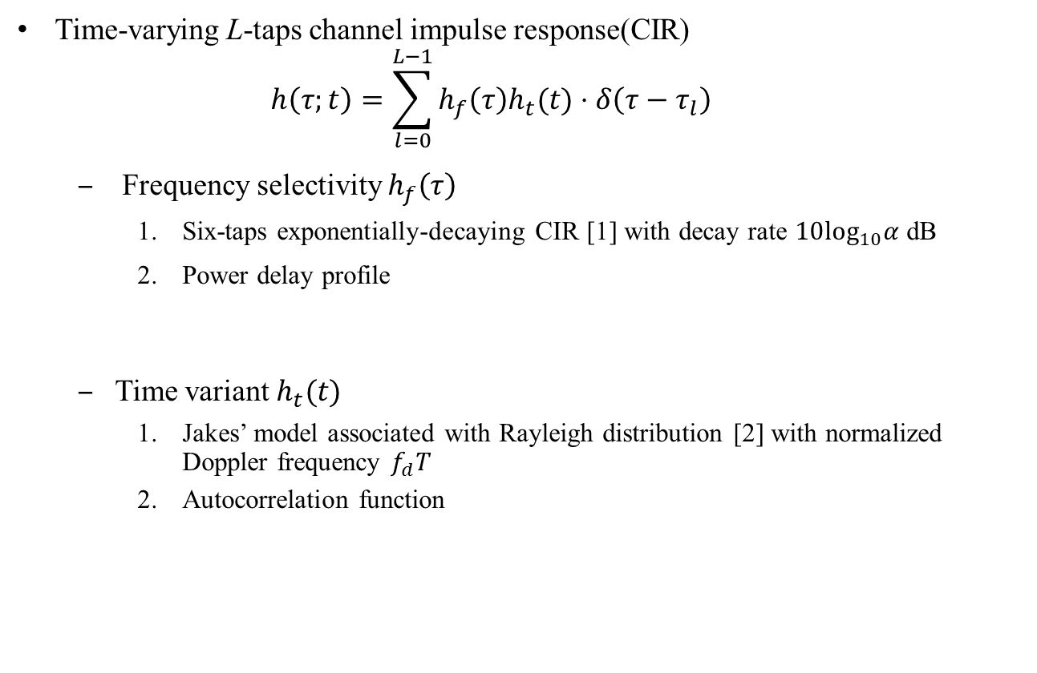
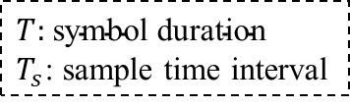

Simulated Channel Model
Time-varying L-taps channel impulse response(CIR)
$$h\left(τ;t\right)=\sum_{l=0}^{L−1}{h_{f}\left(τ\right)h_{t}(t)⋅δ\left(τ−τ_{l}\right)}$$
Frequency selectivity $h_{f}\left(τ\right)$
Six-taps exponentially-decaying CIR [1] with decay rate $10\log_{10}α$ dB
Power delay profile
Time variant $h_{t}(t)$
Jakes’ model associated with Rayleigh distribution [2] with normalized Doppler frequency $f_{d}T$
Autocorrelation function
$T:$ $\text{symbol} \text{duration}$
$T_{s}$: sample time interval
$$ρ\left(τ\right)=𝔼\left\{{\left|h_{f}\left(τ\right)\right|}^{2}\right\}=\frac{1−α}{1−α^{L}}α^{\frac{τ}{T_{s} }},τ∈\left\{0,T_{s},…, \left(L−1\right)T_{s}\right\}$$
$$R_{t}\left(t_{d}\right)=𝔼\left\{h_{t}\left(t\right)h_{t}^{∗}\left(t−t_{d}\right)\right\}=J_{0}(2πf_{d}t_{d})$$
[1] D.R. Morgan, “Analysis and Realization of an Exponentially-Decaying Impulse Response Model for Frequency-Selective Fading Channels,” IEEE Signal Process. Lett., vol.15, pp.441-444, 2008
[2] Zheng, Y., Xiao, C.: ‘Improved models for the generation of multiple uncorrelated Rayleigh fading waveforms’, IEEE Commun. Lett., 2002

Slide 7
Outline
Multipath Fast-Fading Channel
Channel Characteristics
Simulated Channel Model
Coded OFDM System
System Model and Derivation
Polynomial-Basis Expansion Model
Frequency-Domain Equalization Techniques for ICI Mitigation
Preamble and Codeword Arrangement
Code Assisted Iterative Channel Estimation
Least Square Based Model
Kalman filter Based Model

Slide 8
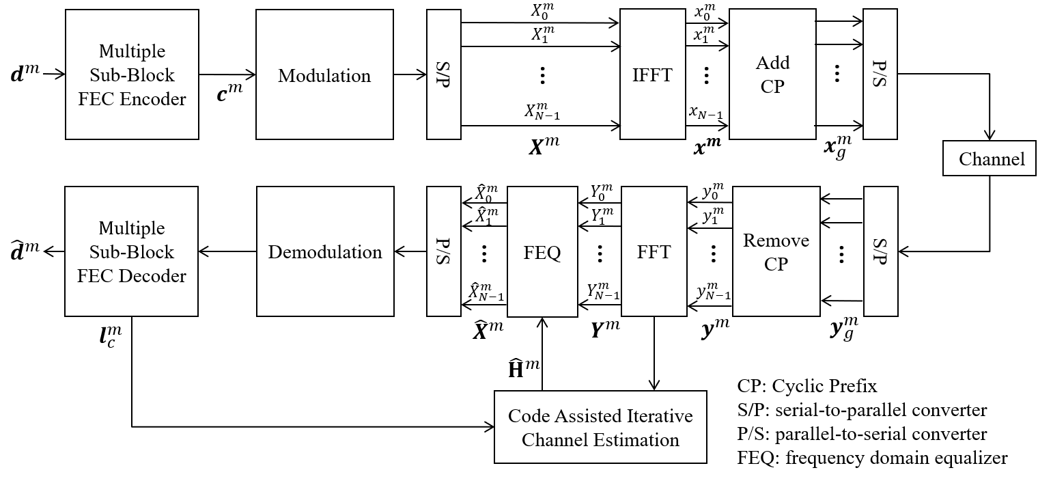
System Model and Derivation

Slide 9

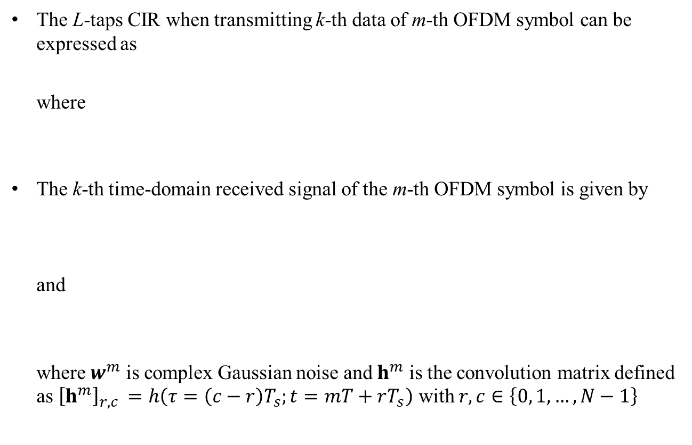



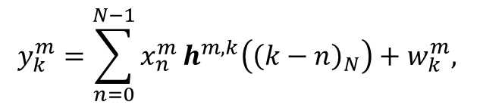
System Model and Derivation
The L-taps CIR when transmitting k-th data of m-th OFDM symbol can be expressed as where
The k-th time-domain received signal of the m-th OFDM symbol is given by and where $w^{m}$ is complex Gaussian noise and $h^{m}$ is the convolution matrix defined as ${\left[h^{m}\right]}_{r,c }=h\left(τ=\left(c−r\right)T_{s};t=mT+rT_{s}\right)$ with $r,c∈\left\{0, 1, …, N−1\right\}$
$$h^{m,k}=\left[\begin{matrix}\begin{matrix}h_{0}^{m,k} & h_{1}^{m,k}\end{matrix} & \begin{matrix}… & h_{L−1}^{m,k}\end{matrix}\end{matrix}\right],$$
$$h_{l}^{m,k}=h\left(τ=lT_{s};t=mT+kT_{s}\right)$$
$$y_{k}^{m}=\sum_{n=0}^{N−1}{x_{n}^{m}}h^{m,k}\left({\left(k−n\right)}_{N}\right)+w_{k}^{m},$$
$$y^{m}={\left[\begin{matrix}\begin{matrix}y_{0}^{m} & y_{1}^{m}\end{matrix} & \begin{matrix}… & y_{N−1}^{m}\end{matrix}\end{matrix}\right]}^{T}$$
$$=h^{m}x^{m}+w^{m}$$

Slide 10
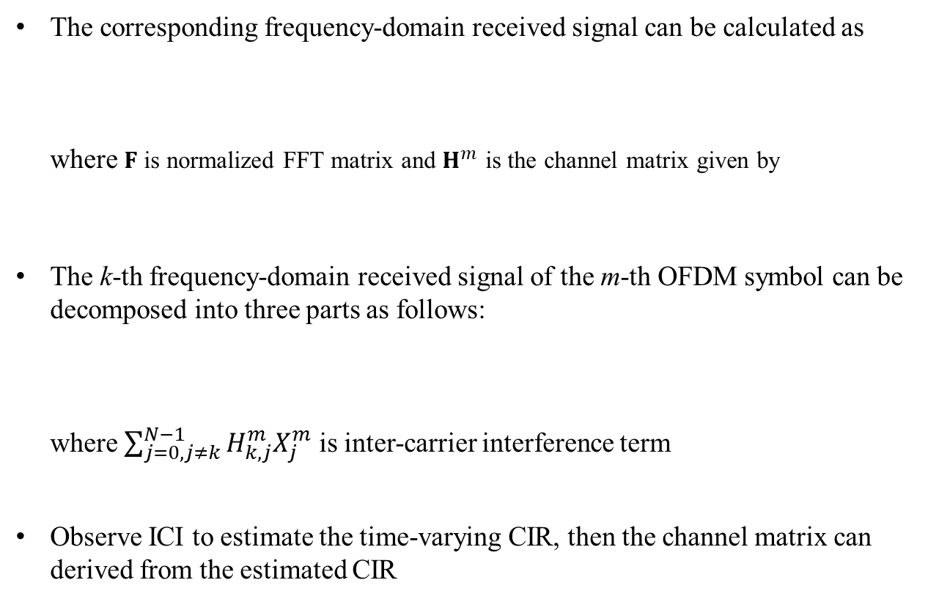
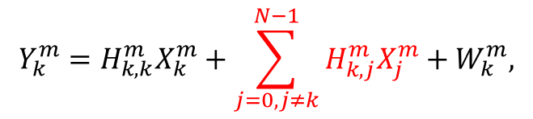



System Model and Derivation
The corresponding frequency-domain received signal can be calculated as where $F$ is normalized FFT matrix and $H^{m}$ is the channel matrix given by
The k-th frequency-domain received signal of the m-th OFDM symbol can be decomposed into three parts as follows: where $\sum_{j=0,j≠k}^{N−1}{H_{k,j}^{m}X_{j}^{m}}$ is inter-carrier interference term
Observe ICI to estimate the time-varying CIR, then the channel matrix can derived from the estimated CIR
$$Y^{m}=Fy^{m}$$
$$=H^{m}X^{m}+W^{m},$$
$$H^{m}=Fh^{m}F^{H}$$
$$Y_{k}^{m}=H_{k,k}^{m}X_{k}^{m}+\sum_{j=0,j≠k}^{N−1}{H_{k,j}^{m}X_{j}^{m}}+W_{k}^{m},$$

Slide 11

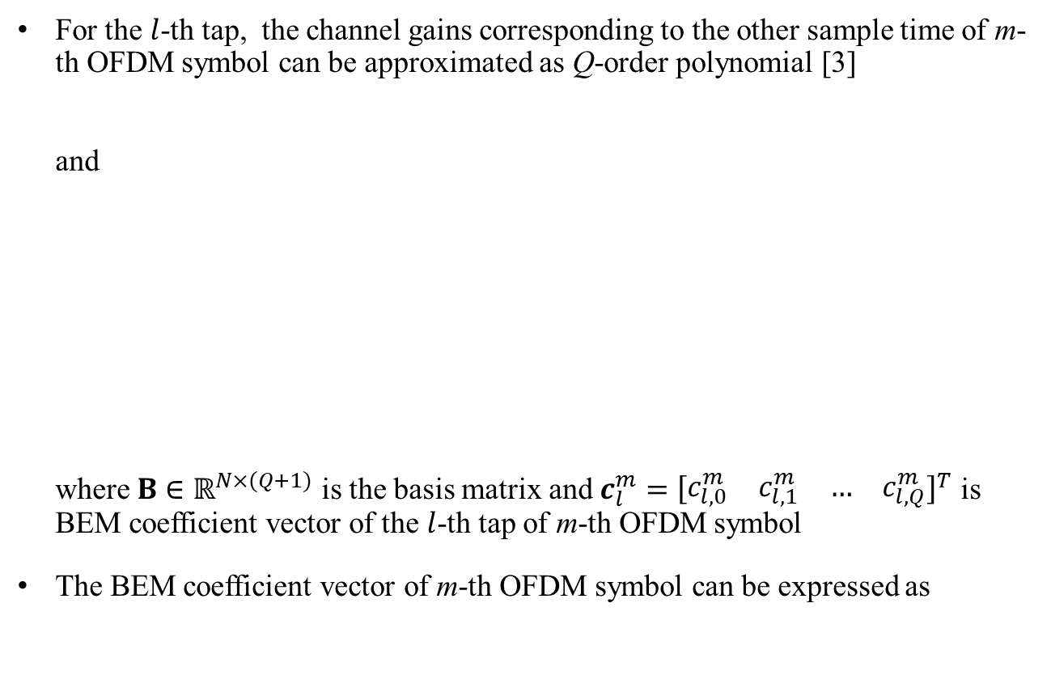

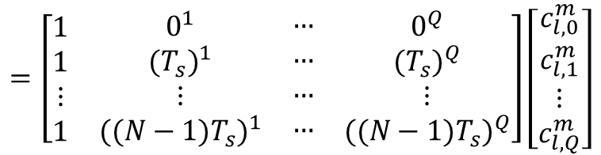

Polynomial-Basis Expansion Model (P-BEM)
For the $l$-th tap, the channel gains corresponding to the other sample time of m-th OFDM symbol can be approximated as Q-order polynomial [3] and where $B∈ℝ^{N×(Q+1)}$ is the basis matrix and $c_{l}^{m}={\left[\begin{matrix}\begin{matrix}c_{l,0}^{m} & c_{l,1}^{m}\end{matrix} & \begin{matrix}… & c_{l,Q}^{m}\end{matrix}\end{matrix}\right]}^{T}$ is BEM coefficient vector of the $l$-th tap of m-th OFDM symbol
The BEM coefficient vector of m-th OFDM symbol can be expressed as
$$h\left(τ=lT_{s}, t\right)≈c_{l,0}^{m}+c_{l,1}^{m}∙t+…+c_{l,Q}^{m}∙t^{Q}, t=mT, mT+T_{s},…,mT+\left(N−1\right)T_{s}$$
$$h_{l}^{m}={\left[\begin{matrix}\begin{matrix}h_{l}^{m,0} & h_{l}^{m,1}\end{matrix} & \begin{matrix}… & h_{l}^{m,N−1}\end{matrix}\end{matrix}\right]}^{T}$$
$$=\left[\begin{matrix}\begin{matrix}\begin{aligned}1 \\ 1 \\ ⋮ \\ 1\end{aligned} & \begin{aligned}0^{1} \\ {(T_{s})}^{1} \\ ⋮ \\ {({(N−1)T}_{s})}^{1}\end{aligned}\end{matrix} & \begin{matrix}\begin{aligned}… \\ … \\ … \\ …\end{aligned} & \begin{aligned}0^{Q} \\ {(T_{s})}^{Q} \\ ⋮ \\ {({(N−1)T}_{s})}^{Q}\end{aligned}\end{matrix}\end{matrix}\right]\left[\begin{aligned}c_{l,0}^{m} \\ c_{l,1}^{m} \\ ⋮ \\ c_{l,Q}^{m}\end{aligned}\right]$$
$$=Bc_{l}^{m},$$
$$c^{m}={\left[\begin{matrix}\begin{matrix}{c_{0}^{m}}^{T} & {c_{1}^{m}}^{T}\end{matrix} & \begin{matrix}… & {c_{L−1}^{m}}^{T}\end{matrix}\end{matrix}\right]}^{T}$$
[3] Z. Tang, R. C. Cannizzaro, G. Leus, and P. Banelli, “Pilot-assisted time-varying channel estimation for OFDM systems,” IEEE Trans. Signal Process., vol. 55, no. 5, pp. 2226–2238, May 2007.

Slide 12


Frequency-Domain Equalization Techniques for ICI Mitigation
Assume that the channel matrix is perfectly estimated
MMSE equalizer [4]
To minimize the cost function $E\left\{{\left|X^{m}−{\hat{X}}^{m}\right|}^{2}\right\}$ according to orthogonality principle
The detected signal can be calculated by where $σ_{w}^{2}$ is the variance of channel noise
It has high complexity due to $N×N$ matrix inversion
$${\hat{X}}^{m}={{H^{m}}^{H}(H^{m}{H^{m}}^{H}+σ_{w}^{2}I_{N})}^{−1} Y^{m},$$
[4] Kwanghoon Kim, Hyuncheol Park, “A Low Complexity ICI Cancellation Method for High Mobility OFDM Systems”

Slide 13
Frequency-Domain Equalization Techniques for ICI Mitigation
ICI power distribution show that if the subcarrier distance d is greater than a certain value then the power is almost negligible

Slide 14





Frequency-Domain Equalization Techniques for ICI Mitigation
Only keep the elements of the channel matrix satisfied that $\left|d\right|≤D$
$$H^{m}$$
$$\underset{↔}{ D }$$
$${\tilde{H}}^{m}$$
$$\underset{↔}{ D }$$

Slide 15





Frequency-Domain Equalization Techniques for ICI Mitigation
Only keep the elements of the channel matrix satisfied that $\left|d\right|≤D$
Partial Equalization [4] Replace $H^{m}$ with a partial channel matrix ${\tilde{H}}_{k}^{m}$
Input:
$$Y_{k}^{m}=\left[\begin{matrix}\begin{matrix}\begin{matrix}Y_{k−D}^{m} & …\end{matrix} & Y_{k−1}^{m}\end{matrix} & \begin{matrix}Y_{k}^{m} & Y_{k+1}^{m} & \begin{matrix}⋯ & Y_{k+D}^{m}\end{matrix}\end{matrix}\end{matrix}\right]$$
Output: where ${\tilde{h}}_{k}^{m}$is k-th column of ${\tilde{H}}_{k}^{m}$
$$H^{m}$$
$$\underset{↔}{ D }$$
$${\tilde{H}}^{m}$$
$$\underset{↔}{ D }$$
$${\tilde{H}}_{k}^{m}$$
$$2D+1$$
$$4D+1$$
$${\hat{X}}_{k}^{m}={{\tilde{h}}_{k}^{m}}^{H}{({\tilde{H}}_{k}^{m}{{\tilde{H}}_{k}^{m}}^{H}+σ_{w}^{2}I)}^{−1}Y_{k}^{m},$$
[4] Kwanghoon Kim, Hyuncheol Park, “A Low Complexity ICI Cancellation Method for High Mobility OFDM Systems”

Slide 16
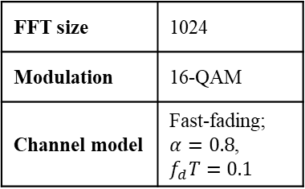
Frequency-Domain Equalization Techniques for ICI Mitigation
Uncoded OFDM
FFT size | 1024
Modulation | 16-QAM
Channel model | Fast-fading; $α=0.8$, $$f_{d}T=0.1$$

Slide 17
Outline
Multipath Fast-Fading Channel
Channel Characteristics
Simulated Channel Model
Coded OFDM System
System Model and Derivation
Polynomial-Basis Expansion Model
Frequency-Domain Equalization Techniques for ICI Mitigation
Preamble and Codeword Arrangement
Code Assisted Iterative Channel Estimation
Least Square Based Model
Kalman filter Based Model

Slide 18
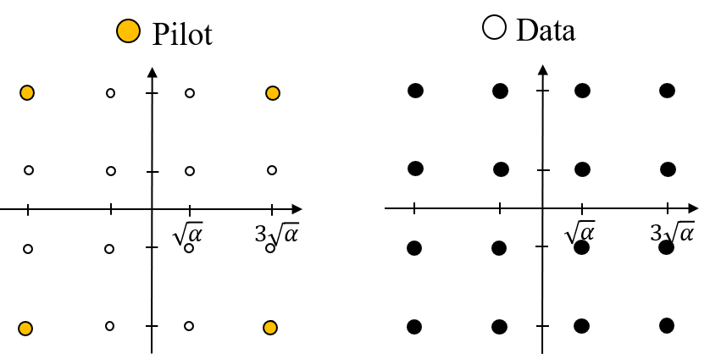






Preamble Arrangement
$$one OFDM symbol, Nsubcarriers$$
$$Gn$$
$$Gn$$
$$Gn$$
$$…$$
$$…$$
$$…$$
f

Slide 19

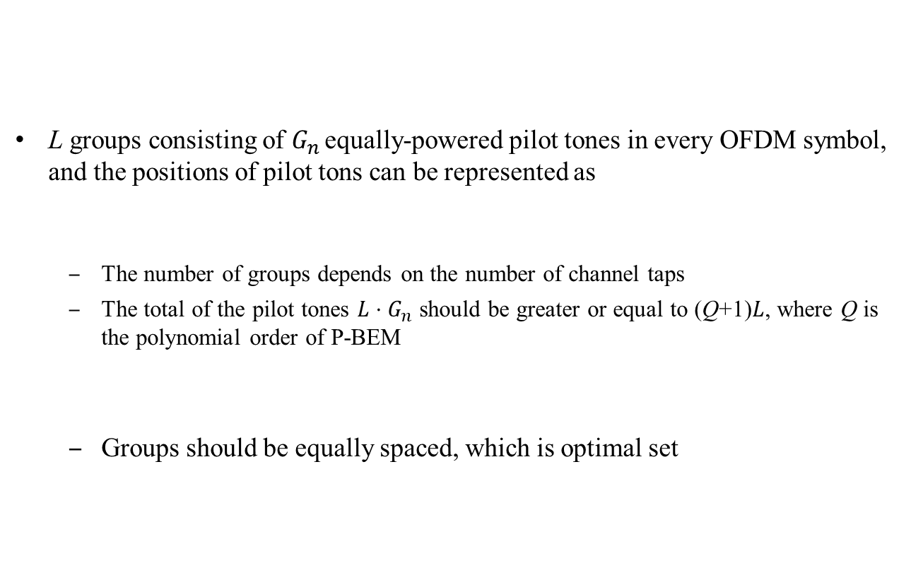
Preamble Arrangement
L groups consisting of $G_{n }$equally-powered pilot tones in every OFDM symbol, and the positions of pilot tons can be represented as
The number of groups depends on the number of channel taps
The total of the pilot tones $L⋅G_{n}$ should be greater or equal to (Q+1)$L$, where Q is the polynomial order of P-BEM
Groups should be equally spaced, which is optimal set
$$one OFDM symbol, Nsubcarriers$$
$$Gn$$
$$Gn$$
$$Gn$$
$$…$$
$$…$$
$$…$$
f
$P={\left[ \begin{matrix}\begin{matrix}p_{0} & p_{1}\end{matrix} & {\begin{matrix}… & p\end{matrix}}_{LG_{n}−1}\end{matrix}\right]}^{T}$
Note
The proof is shown in p.22

Slide 20
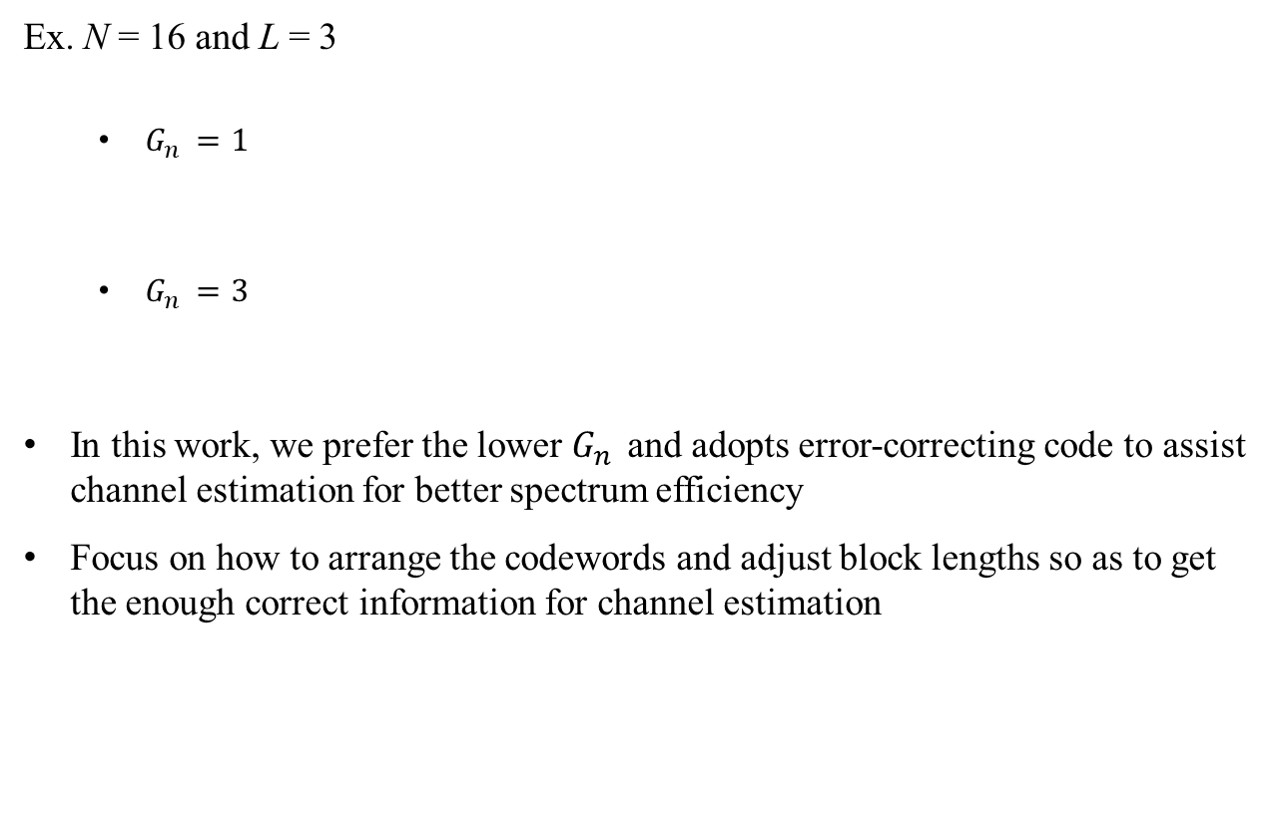


Preamble Arrangement
Ex. N = 16 and L = 3
$G_{n }=1$
$G_{n }=3$
In this work, we prefer the lower $G_{n }$and adopts error-correcting code to assist channel estimation for better spectrum efficiency
Focus on how to arrange the codewords and adjust block lengths so as to get the enough correct information for channel estimation
$$\overset{↔}{ one OFDM symbol, Nsubcarriers }$$
$$\overset{↔}{ one OFDM symbol, Nsubcarriers }$$

Slide 21
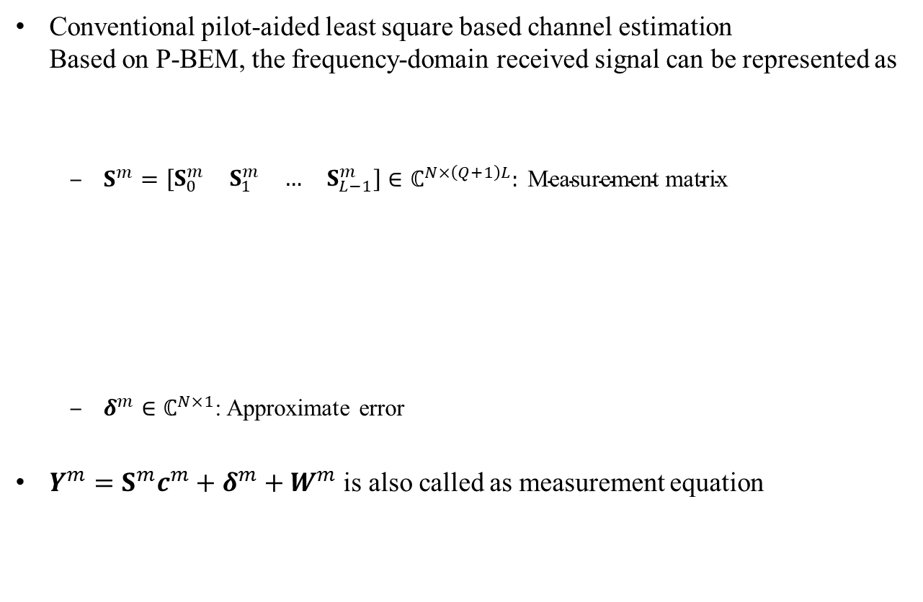
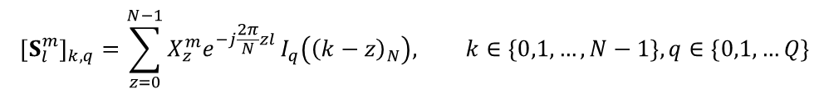
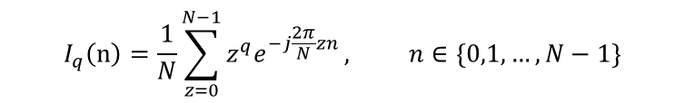


Preamble Arrangement
Conventional pilot-aided least square based channel estimation Based on P-BEM, the frequency-domain received signal can be represented as
$S^{m}=\left[\begin{matrix}\begin{matrix}S_{0}^{m} & S_{1}^{m}\end{matrix} & \begin{matrix}… & S_{L−1}^{m}\end{matrix}\end{matrix}\right]∈ℂ^{N×\left(Q+1\right)L}: \text{Measurement} \text{matrix}$
$δ^{m}∈ℂ^{N×1}$: Approximate error
$Y^{m}=S^{m}c^{m}+δ^{m}+W^{m}$ is also called as measurement equation
$$Y^{m}=H^{m}X^{m}+W^{m}$$
$$=S^{m}c^{m}+δ^{m}+W^{m}$$
$${\left[S_{l}^{m}\right]}_{k,q}=\sum_{z=0}^{N−1}{X_{z}^{m}e^{−j\frac{2π}{N}zl}}I_{q}\left({\left(k−z\right)}_{N}\right), k∈\left\{0,1,…,N−1\right\},q∈\{0,1,…Q\}$$
$$I_{q}\left(n\right)=\frac{1}{N}\sum_{z=0}^{N−1}{z^{q}e^{−j\frac{2π}{N}zn}}, n∈\{0,1,…,N−1\}$$

Slide 22
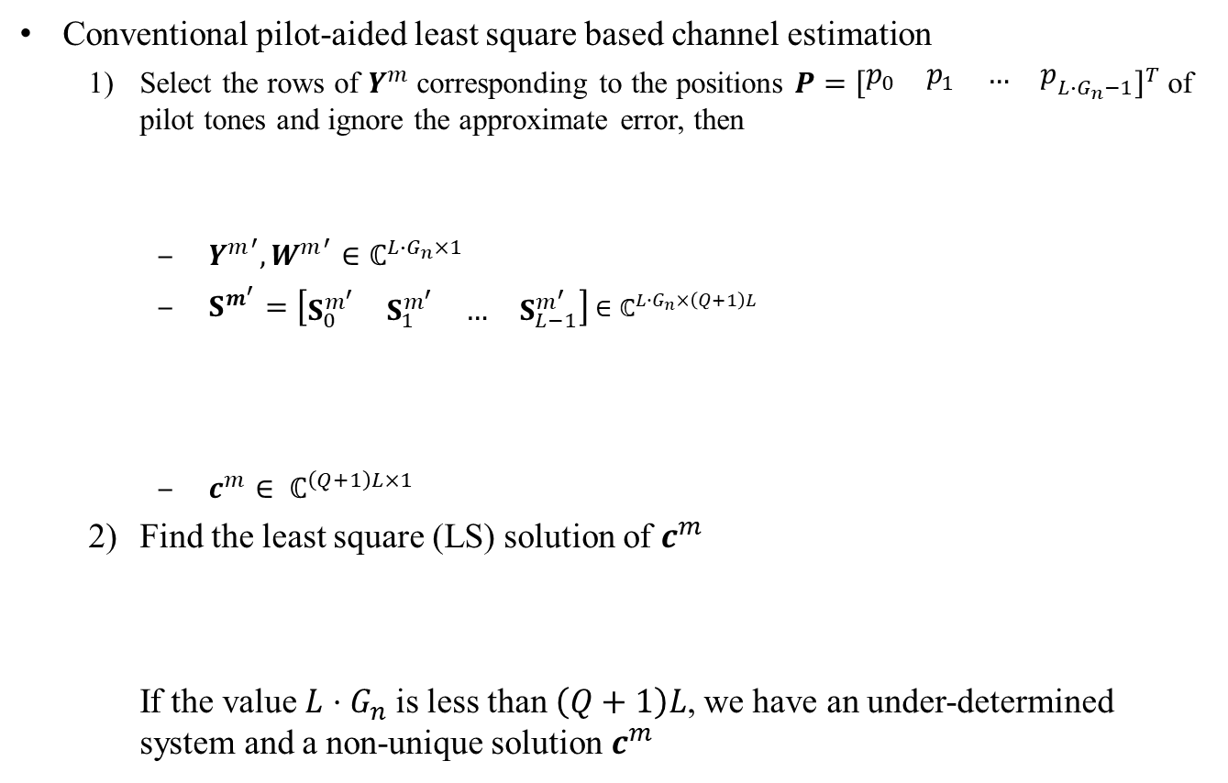

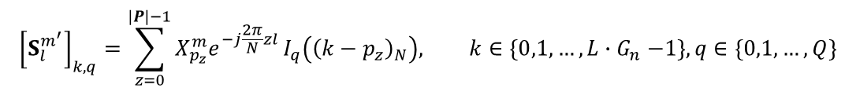

Preamble Arrangement
Conventional pilot-aided least square based channel estimation
Select the rows of $Y^{m}$corresponding to the positions $P={\left[\begin{matrix}\begin{matrix}p_{0} & p_{1}\end{matrix} & {\begin{matrix}… & p\end{matrix}}_{L{∙G}_{n}−1}\end{matrix}\right]}^{T}$ of pilot tones and ignore the approximate error, then
${Y^{m}}^{′},{W^{m}}^{′}∈ℂ^{L∙G_{n}×1}$
$S^{m^{′}}=\left[\begin{matrix}\begin{matrix}S_{0}^{m^{′}} & S_{1}^{m^{′}}\end{matrix} & \begin{matrix}… & S_{L−1}^{m^{′}}\end{matrix}\end{matrix}\right]$ $∈ℂ^{L∙G_{n}×\left(Q+1\right)L}$
$c^{m}∈ ℂ^{\left(Q+1\right)L×1}$
Find the least square (LS) solution of $c^{m}$ If the value $L{⋅G}_{n}$ is less than $\left(Q+1\right)L$, we have an under-determined system and a non-unique solution $c^{m}$
$${Y^{m}}^{′}=S^{m^{′}}c^{m}+{W^{m}}^{′}$$
$${\left[S_{l}^{m^{′}}\right]}_{k,q}=\sum_{z=0}^{\left|P\right|−1}{X_{p_{z}}^{m}e^{−j\frac{2π}{N}zl}}I_{q}\left({\left(k−p_{z}\right)}_{N}\right), k∈\left\{0,1,…,L{∙G}_{n}−1\right\},q∈\left\{0,1,…,Q\right\}$$
$${\hat{c}}^{m}={\left({S^{m^{′}}}^{H}S^{m^{′}}\right)}^{−1}{S^{m^{′}}}^{H}{Y^{m}}^{′}$$

Slide 23
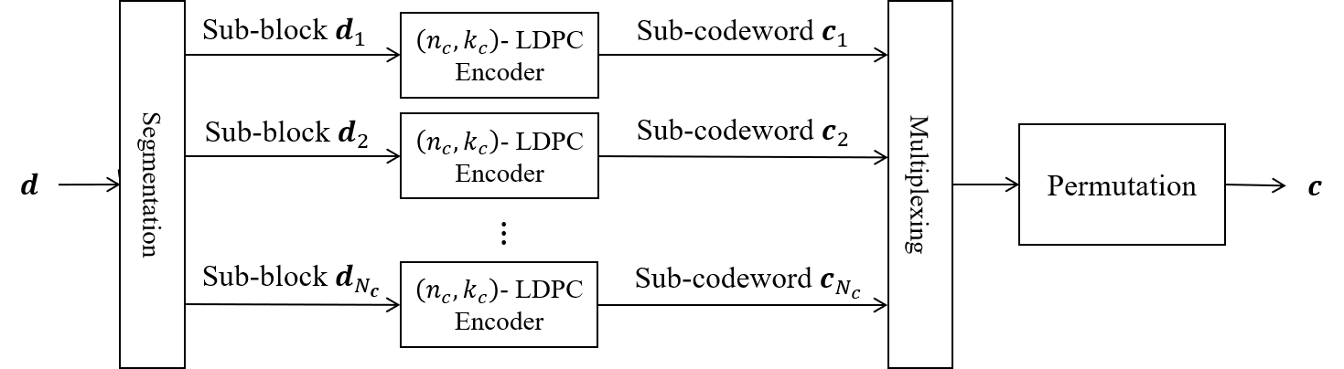

Codeword Arrangement
Since channel is frequency-selective, Arranging multiple sub-codewords can lower the probability of the event that all sub-codeword are incorrect
Criterion
$$P_{e}=\operatorname{Pr}\left\{s_{1}≠\vec{0}∩s_{2}≠\vec{0}∩…∩s_{N_{c}}≠\vec{0}\right\},$$
where $s_{j}$ is the syndrome of the sub-codeword $c_{j}$ with $j∈\left\{1,2,…,N_{c}\right\}$

Slide 24








Codeword Arrangement
Two (2048, 1024) LDPC codewords
Use $\left(2N, N\right)$-LDPC code to generate two codewords ${\overset{⃑}{c}}_{1},{\overset{⃑}{c}}_{2}$
$$1 OFDM symbol=1024 samples$$
$=4096 bits$ (16-QAM)
Pilot group bits (4*$G_{n }$ bits)
$2048 bits$
$2048 bits$
Codeword 1 $c_{1}$
Codeword 2 $c_{2}$
$512 bits$

Slide 25


Codeword Arrangement
Two (2048, 1024) LDPC codewords
Use $\left(2N, N\right)$-LDPC code to generate two codewords ${\overset{⃑}{c}}_{1},{\overset{⃑}{c}}_{2}$
$$1 OFDM symbol=1024 samples$$
$=4096 bits$ (16-QAM)
Pilot group bits (4*$G_{n }$ bits)
$2048 bits$
$2048 bits$
Codeword 1 $c_{1}$
Codeword 2 $c_{2}$

Slide 26








Codeword Arrangement
Four (1024, 512) LDPC codewords
Use $\left(2N, N\right)$-LDPC code to generate two codewords ${\overset{⃑}{c}}_{1},{\overset{⃑}{c}}_{2}$
$$1 OFDM symbol=1024 samples$$
$=4096 bits$ (16-QAM)
Pilot group bits (4*$G_{n }$ bits)
$1024 bits$
$1024 bits$
$1024 bits$
$1024 bits$
Codeword 1 $c_{1}$
Codeword 2 $c_{2}$
Codeword 3 $c_{3}$
Codeword 4 $c_{4}$
$512 bits$

Slide 27
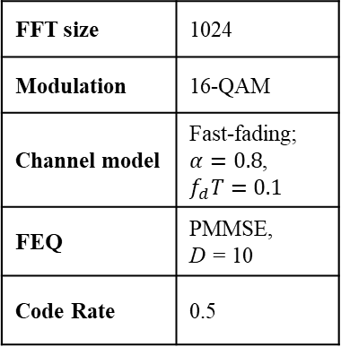
Codeword Arrangement
Coded OFDM
FFT size | 1024
Modulation | 16-QAM
Channel model | Fast-fading; $α=0.8$, $$f_{d}T=0.1$$
FEQ | PMMSE, D = 10
Code Rate | 0.5

Slide 28
Codeword Arrangement
Coded OFDM
FFT size | 1024
Modulation | 16-QAM
Channel model | Fast-fading; $α=0.8$, $$f_{d}T=0.1$$
FEQ | PMMSE, D = 10
Code Rate | 0.5

Slide 29
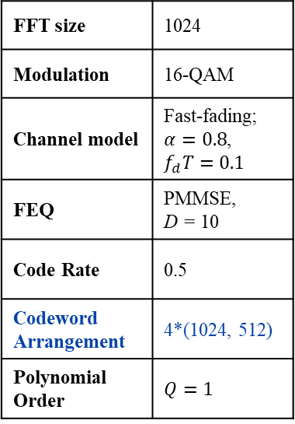
Preamble Arrangement
Coded OFDM
FFT size | 1024
Modulation | 16-QAM
Channel model | Fast-fading; $α=0.8$, $$f_{d}T=0.1$$
FEQ | PMMSE, D = 10
Code Rate | 0.5
Codeword Arrangement | 4*(1024, 512)
Polynomial Order | $$Q=1$$

Slide 30
Preamble Arrangement
Coded OFDM
FFT size | 1024
Modulation | 16-QAM
Channel model | Fast-fading; $α=0.8$, $$f_{d}T=0.1$$
FEQ | PMMSE, D = 10
Code Rate | 0.5
Codeword Arrangement | 4*(1024, 512)
Polynomial Order | $$Q=1$$

Slide 31
Preamble Arrangement
Coded OFDM
FFT size | 1024
Modulation | 16-QAM
Channel model | Fast-fading; $α=0.8$, $$f_{d}T=0.1$$
FEQ | PMMSE, D = 10
Code Rate | 0.5
Codeword Arrangement | 4*(1024, 512)
Polynomial Order | $$Q=1$$

Slide 32
Outline
Multipath Fast-Fading Channel
Channel Characteristics
Simulated Channel Model
Coded OFDM System
System Model and Derivation
Polynomial-Basis Expansion Model
Frequency-Domain Equalization Techniques for ICI Mitigation
Preamble and Codeword Arrangement
Code Assisted Iterative Channel Estimation
Least Square Based Model
Kalman filter Based Model

Slide 33
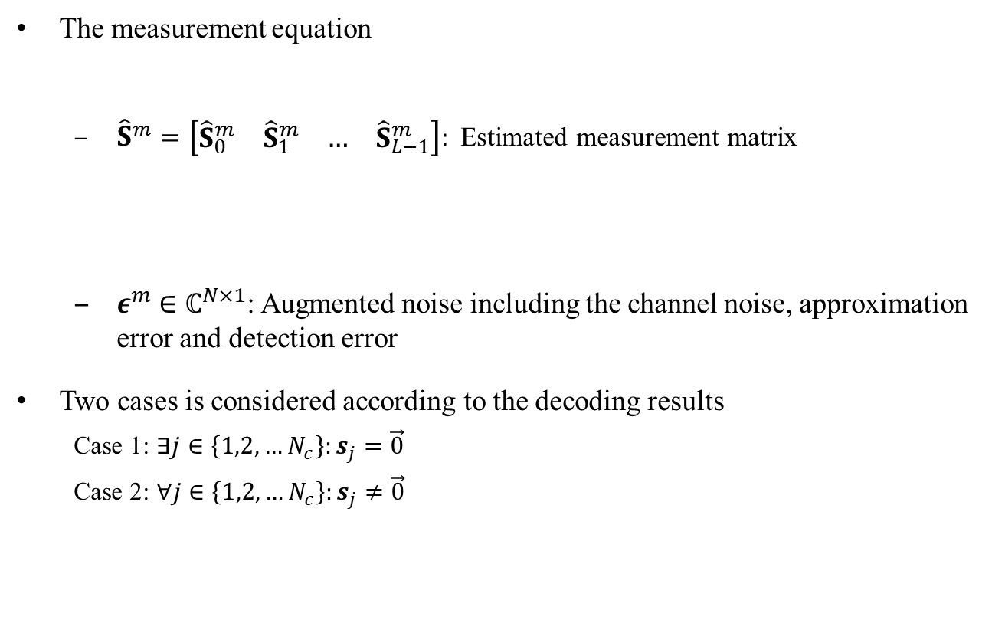
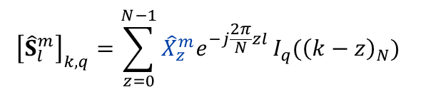

Code Assisted Iterative Channel Estimation
The measurement equation
${\hat{S}}^{m}=\left[\begin{matrix}\begin{matrix}{\hat{S}}_{0}^{m} & {\hat{S}}_{1}^{m}\end{matrix} & \begin{matrix}… & {\hat{S}}_{L−1}^{m}\end{matrix}\end{matrix}\right]:$Estimated measurement matrix
$ε^{m}$ $∈ℂ^{N×1}$: Augmented noise including the channel noise, approximation error and detection error
Two cases is considered according to the decoding results
Case 1: $∃j∈\left\{1,2,…N_{c}\right\}:s_{j}=\vec{0}$
Case 2: $∀j∈\left\{1,2,…N_{c}\right\}:s_{j}≠\vec{0}$
$$Y^{m}={\hat{S}}^{m}{\hat{c}}^{m}+ε^{m}$$
$${\left[{\hat{S}}_{l}^{m}\right]}_{k,q}=\sum_{z=0}^{N−1}{{\hat{X}}_{z}^{m}e^{−j\frac{2π}{N}zl}}I_{q}({\left(k−z\right)}_{N})$$

Slide 34
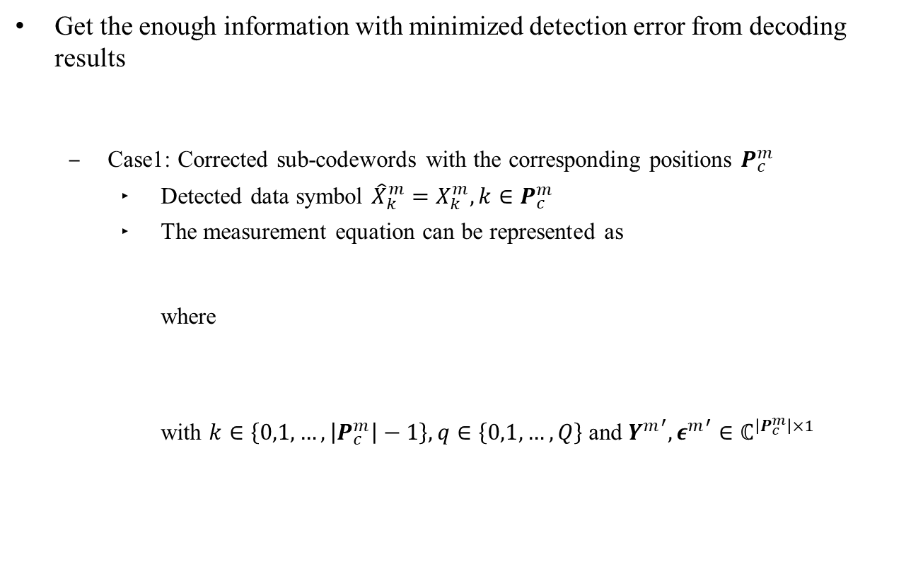
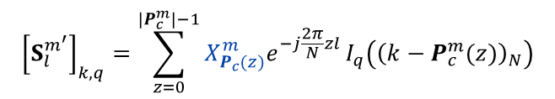


Code Assisted Iterative Channel Estimation
Get the enough information with minimized detection error from decoding results
Case1: Corrected sub-codewords with the corresponding positions $P_{c}^{m}$
Detected data symbol ${\hat{X}}_{k}^{m}=X_{k}^{m}, k∈P_{c}^{m}$
The measurement equation can be represented as where with $k∈\left\{0,1,…,\left|P_{c}^{m}\right|−1\right\},q∈\left\{0,1,…,Q\right\}$and ${Y^{m}}^{′},{ε^{m}}^{′}∈ℂ^{\left|P_{c}^{m}\right|×1}$
${\tilde{X}}_{k}^{m}=$ $X_{k}^{m}−{\hat{X}}_{k}^{m}, k∈\{0,1,…N−1\}$
$${Y^{m}}^{′}=S^{m^{′}}{\hat{c}}^{m}+{ε^{m}}^{′},$$
$${\left[S_{l}^{m^{′}}\right]}_{k,q}=\sum_{z=0}^{\left|P_{c}^{m}\right|−1}{X_{P_{c}(z)}^{m}e^{−j\frac{2π}{N}zl}}I_{q}\left({\left(k−P_{c}^{m}(z)\right)}_{N}\right)$$

Slide 35
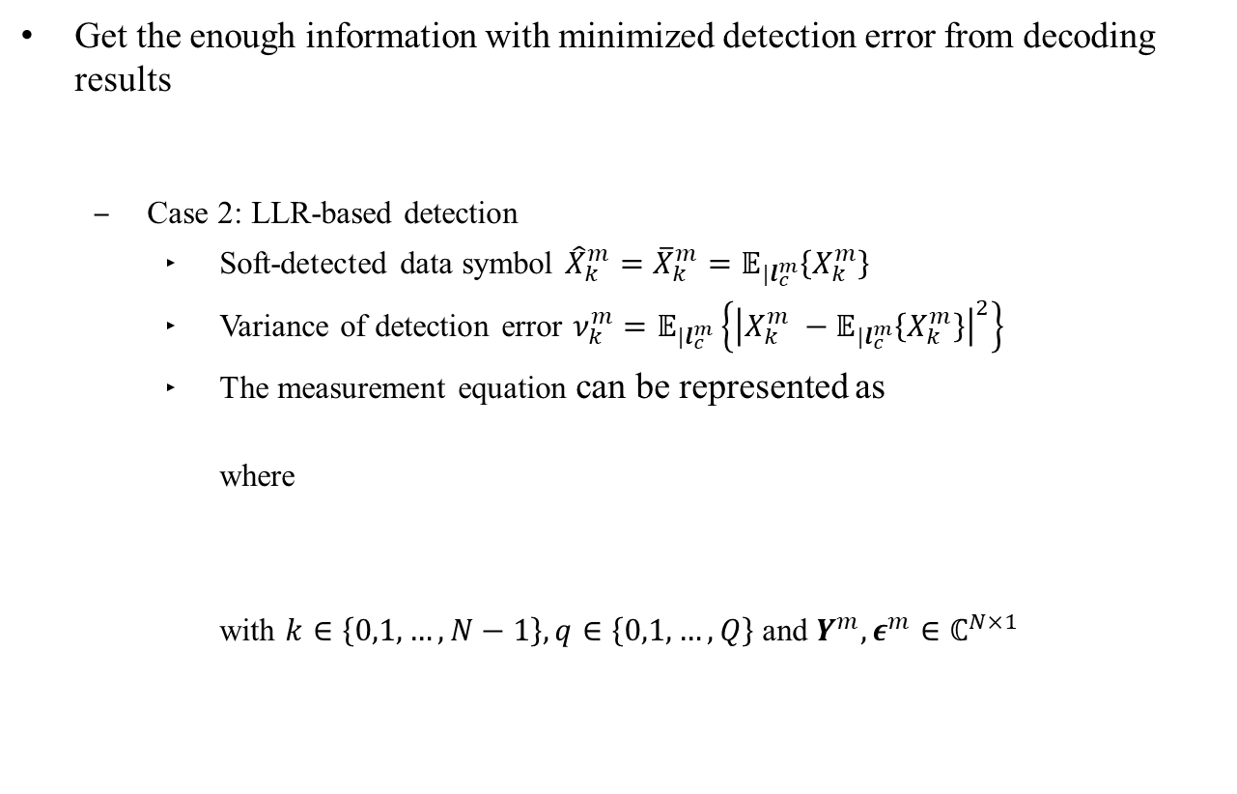
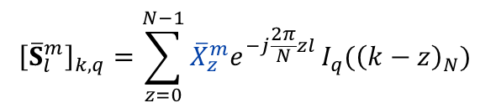

Code Assisted Iterative Channel Estimation
Get the enough information with minimized detection error from decoding results
Case 2: LLR-based detection
Soft-detected data symbol ${\hat{X}}_{k}^{m}={\overline{X}}_{k}^{m}=𝔼_{|l_{c}^{m}}\left\{X_{k}^{m}\right\}$
Variance of detection error $ν_{k}^{m}=𝔼_{|l_{c}^{m}}\left\{{\left|X_{k}^{m} −𝔼_{|l_{c}^{m}}\left\{X_{k}^{m}\right\}\right|}^{2}\right\}$
The measurement equation can be represented as where with $k∈\left\{0,1,…,N−1\right\},q∈\left\{0,1,…,Q\right\}$and $Y^{m},ε^{m}∈ℂ^{N×1}$
${\tilde{X}}_{k}^{m}=$ $X_{k}^{m}−{\hat{X}}_{k}^{m}, k∈\{0,1,…N−1\}$
$$Y^{m}={\overline{S}}^{m}{\hat{c}}^{m}+ε^{m}$$
$${\left[{\overline{S}}_{l}^{m}\right]}_{k,q}=\sum_{z=0}^{N−1}{{\overline{X}}_{z}^{m}e^{−j\frac{2π}{N}zl}}I_{q}({\left(k−z\right)}_{N})$$

Slide 36







Least Square Based Model
$$Y^{m}$$
$m$: OFDM symbol index
Pilot-Aided LS-based Channel Estimation (p.22)
$${\hat{H}}^{m}$$
Partial MMSE
Equalizer
Code-Assisted
LS-based Iterative
Channel Estimation
$${\hat{X}}^{m}$$
$$l_{c}^{m}$$
$${{\hat{X}}^{m}}^{′}$$
Multiple LDPC
Sub-Blocks Decoding
$${\hat{d}}^{m}$$
Remodulation
End

Slide 37

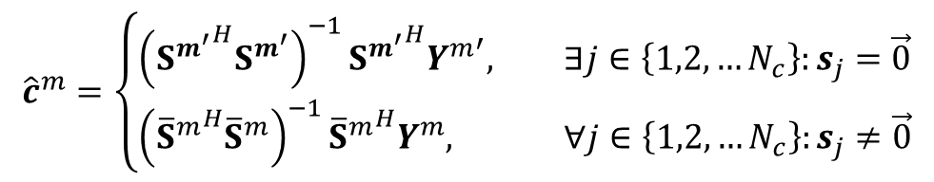
Least Square Based Model
The channel statistical property is unnecessary
The estimated BEM coefficients ${\hat{c}}^{m}$ from least square solution is given by
$${\hat{c}}^{m}=\left\{\begin{aligned}{\left({S^{m^{′}}}^{H}S^{m^{′}}\right)}^{−1}{S^{m^{′}}}^{H}{Y^{m}}^{′}, ∃j∈\left\{1,2,…N_{c}\right\}:s_{j}=\vec{0} \\ {\left({{\overline{S}}^{m}}^{H}{\overline{S}}^{m}\right)}^{−1}{{\overline{S}}^{m}}^{H}Y^{m}, ∀j∈\left\{1,2,…N_{c}\right\}:s_{j}≠\vec{0}\end{aligned}\right.$$

Slide 38
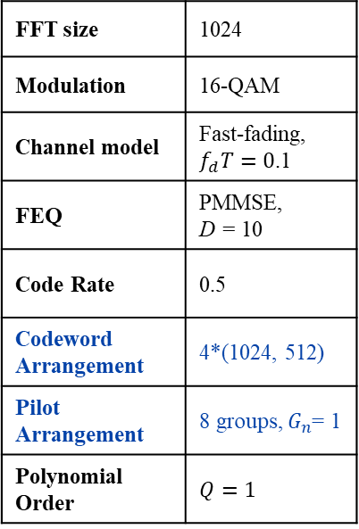
Least Square Based Model
Coded OFDM
FFT size | 1024
Modulation | 16-QAM
Channel model | Fast-fading, $f_{d}T=0$.1
FEQ | PMMSE, D = 10
Code Rate | 0.5
Codeword Arrangement | 4*(1024, 512)
Pilot Arrangement | 8 groups, $G_{n}$= 1
Polynomial Order | $$Q=1$$

Slide 39
Least Square Based Model
Coded OFDM
FFT size | 1024
Modulation | 16-QAM
Channel model | Fast-fading, $f_{d}T=0$.1
FEQ | PMMSE, D = 10
Code Rate | 0.5
Codeword Arrangement | 4*(1024, 512)
Pilot Arrangement | 8 groups, $G_{n}$= 1
Polynomial Order | $$Q=1$$

Slide 40
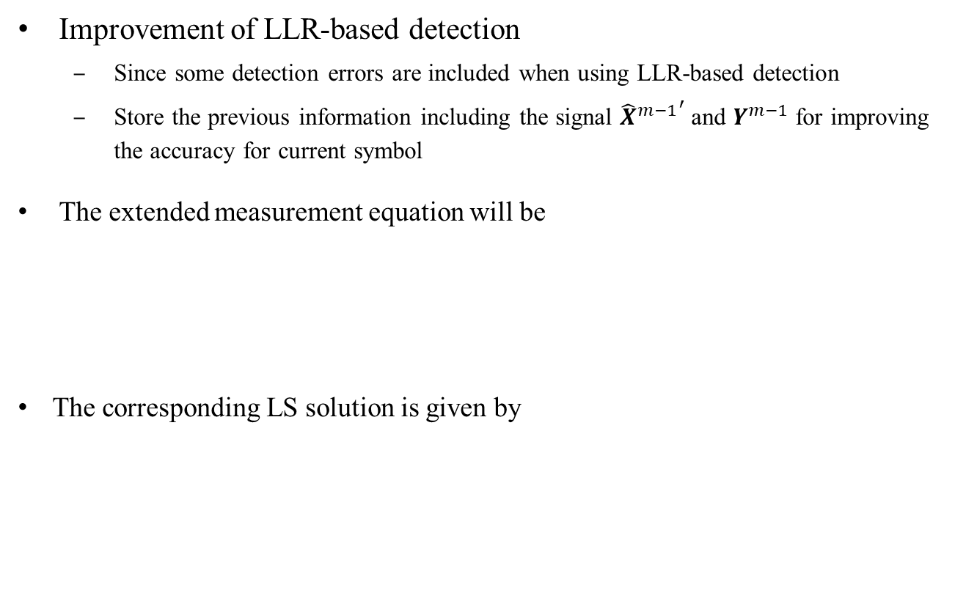



Least Square Based Model
Improvement of LLR-based detection
Since some detection errors are included when using LLR-based detection
Store the previous information including the signal ${{\hat{X}}^{m−1}}^{′}$ and $Y^{m−1}$ for improving the accuracy for current symbol
The extended measurement equation will be
The corresponding LS solution is given by
$$\left[\begin{matrix}Y^{m−1} \\ Y^{m}\end{matrix}\right]=\left[\begin{matrix}{{\hat{S}}^{m−1}}^{′} & {\overline{S}}^{m}\end{matrix}\right]{\hat{c}}^{m}+\left[\begin{matrix}ε^{m−1} \\ ε^{m}\end{matrix}\right]$$
$${Y^{m}}^{(1)}={S^{m}}^{(1)}{\hat{c}}^{m}+{ε^{m}}^{(1)}$$
$${{\hat{c}}^{m}}^{(1)}={\left({{S^{m}}^{(1)}}^{H}{S^{m}}^{(1)}\right)}^{−1}{{S^{m}}^{(1)}}^{H}{Y^{m}}^{(1)}$$

Slide 41









Least Square Based Model
$$Y^{m}$$
$m$: OFDM symbol index
Pilot-Aided LS-based Channel Estimation
$${\hat{H}}^{m}$$
Partial MMSE
Equalizer
Code-Assisted
LS-based Iterative
Channel Estimation
$${\hat{X}}^{m}$$
$$l_{c}^{m}$$
Multiple LDPC
Sub-Blocks Decoding
$${\hat{d}}^{m}$$
Remodulation
$${{\hat{X}}^{m}}^{′}$$
Store Data ${(\hat{X}}^{m})′ and Y^{m}$
$${(\hat{X}}^{m−1})′ and Y^{m−1}$$
End

Slide 42
Least Square Based Model
Coded OFDM
FFT size | 1024
Modulation | 16-QAM
Channel model | Fast-fading, $f_{d}T=0$.1
FEQ | PMMSE, D = 10
Code Rate | 0.5
Codeword Arrangement | 4*(1024, 512)
Pilot Arrangement | 8 groups, $G_{n}$= 1
Polynomial Order | $$Q=1$$

Slide 43
Least Square Based Model
Coded OFDM
FFT size | 1024
Modulation | 16-QAM
Channel model | Fast-fading, $f_{d}T=0$.1
FEQ | PMMSE, D = 10
Code Rate | 0.5
Codeword Arrangement | 4*(1024, 512)
Pilot Arrangement | 8 groups, $G_{n}$= 1
Polynomial Order | $$Q=1$$

Slide 44

Least Square Based Model
Coded OFDM
FFT size | 1024
Modulation | 16-QAM
Channel model | Fast-fading, $f_{d}T=0$.1
FEQ | PMMSE, D = 10
Code Rate | 0.5
Codeword Arrangement | 4*(1024, 512)
Pilot Arrangement | 8 groups, $G_{n}$= 3
Polynomial Order | $$Q=1$$

Slide 45
Least Square Based Model
Coded OFDM
FFT size | 1024
Modulation | 16-QAM
Channel model | Fast-fading, $f_{d}T=0$.1
FEQ | PMMSE, D = 10
Code Rate | 0.5
Codeword Arrangement | 4*(1024, 512)
Pilot Arrangement | 8 groups, $G_{n}$= 3
Polynomial Order | $$Q=1$$

Slide 46
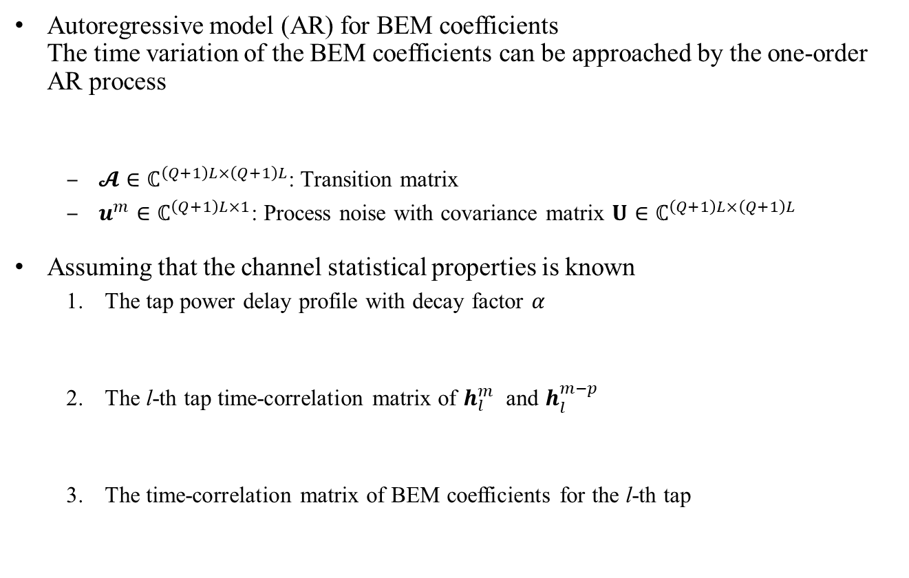


Kalman Filter-Based Model
Autoregressive model (AR) for BEM coefficients The time variation of the BEM coefficients can be approached by the one-order AR process
$𝓐∈ℂ^{\left(Q+1\right)L×\left(Q+1\right)L}$: Transition matrix
$u^{m}∈ℂ^{\left(Q+1\right)L×1}$: Process noise with covariance matrix $U∈ℂ^{\left(Q+1\right)L×\left(Q+1\right)L}$
Assuming that the channel statistical properties is known
The tap power delay profile with decay factor 𝛼
The l-th tap time-correlation matrix of $h_{l}^{m}$ and $h_{l}^{m−p}$
The time-correlation matrix of BEM coefficients for the l-th tap
$$c^{m}=𝓐c^{m−1}+u^{m}$$
$$σ_{l}^{2}=\frac{1−α}{1−α^{L}}α^{l}, l∈\{0,1,…,L−1\}$$
$$R_{h_{l}^{m}}^{(p)}=𝔼\left[h_{l}^{m}{h_{l}^{m−p}}^{H}\right], {\left[R_{h_{l}^{m}}^{(p)}\right]}_{r,c}= σ_{l}^{2}J_{0}(2πf_{d}{((r−c)T}_{s}+pT))$$
$$R_{c_{l}^{m}}^{(p)}=𝔼\left[c_{l}^{m}{c_{l}^{m−p}}^{H}\right]=MR_{h_{l}}^{(p)}M^{H}, M={\left(B^{H}B\right)}^{−1}B^{H}$$

Slide 47


Kalman Filter-Based Model
Autoregressive model (AR) for BEM coefficients The time variation of the BEM coefficients can be approached by the one-order AR process
$𝓐∈ℂ^{\left(Q+1\right)L×\left(Q+1\right)L}$: Transition matrix
$u^{m}∈ℂ^{\left(Q+1\right)L×1}$: Process noise with covariance matrix $U∈ℂ^{\left(Q+1\right)L×\left(Q+1\right)L}$
Assuming that the channel statistical properties is known
$$c^{m}=𝓐c^{m−1}+u^{m}$$
$$𝓐=blkdiag\left\{\begin{matrix}\begin{matrix}{\text{A}}_{0} & {\text{A}}_{1}\end{matrix} & \begin{matrix}… & {\text{A}}_{L−1}\end{matrix}\end{matrix}\right\}, A_{l}=R_{c_{l}^{m}}^{\left(1\right)}{\left(R_{c_{l}^{m}}^{\left(0\right)}\right)}^{−1}$$
$$\text{U}=blkdiag\left\{\begin{matrix}\begin{matrix}{\text{U}}_{0} & {\text{U}}_{1}\end{matrix} & \begin{matrix}… & {\text{U}}_{L−1}\end{matrix}\end{matrix}\right\}, U_{l}=R_{c_{l}^{m}}^{\left(0\right)}−A_{l}R_{c_{l}^{m}}^{\left(−1\right)}$$
$$R_{c^{m}}^{(0)}=blkdiag\left\{\begin{matrix}\begin{matrix}R_{c_{0}^{m}}^{\left(0\right)} & R_{c_{1}^{m}}^{\left(0\right)}\end{matrix} & \begin{matrix}… & R_{c_{L−1}^{m}}^{\left(0\right)}\end{matrix}\end{matrix}\right\}$$

Slide 48




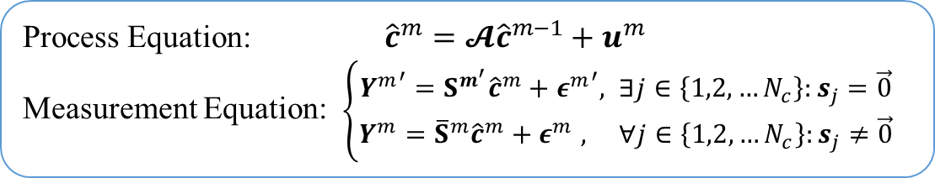

Kalman Filter-Based Model
Iterative Kalman-based AR model
Correlation matrix of augment noise(${ε^{m}}^{′}$ and $ε^{m}$ )
${ε^{m}}^{′}∈ℂ^{\left|P_{c}\right|×1}$: Partial augmented noise with correlation matrix${ R}_{{ε^{m}}^{′}}∈ℂ^{\left|P_{c}^{m}\right|×\left|P_{c}^{m}\right|}$
$ε^{m}$ $∈ℂ^{N×1}$: Augmented noise with correlation matrix $R_{ε^{m}}∈ℂ^{N×N}$ where
Process Equation: ${\hat{c}}^{m}=𝓐{\hat{c}}^{m−1}+u^{m}$
Measurement Equation: $\left\{\begin{aligned}{Y^{m}}^{′}=S^{m^{′}}{\hat{c}}^{m}+{ε^{m}}^{′}, ∃j∈\left\{1,2,…N_{c}\right\}:s_{j}=\vec{0} \\ Y^{m}={\overline{S}}^{m}{\hat{c}}^{m}+ε^{m} , ∀j∈\left\{1,2,…N_{c}\right\}:s_{j}≠\vec{0}\end{aligned}\right.$
$${ε^{m}}^{′}={W^{m}}^{′}+{δ^{m}}^{′}$$
$R_{{ε^{m}}^{′}}=σ_{W}^{2}I_{\left|P_{c}^{m}\right|}$ for ${δ^{m}}^{′}=\vec{0}$
$$ε^{m}={\tilde{S}}^{m}c^{m}+W^{m}+δ^{m}$$
$R_{ε^{m}}=𝔼\left\{ε^{m}{ε^{m}}^{H}\right\}=σ_{W}^{2}I_{N}+{\tilde{S}}^{m}R_{c^{m}}^{(0)}{{\tilde{S}}^{m}}^{H}$ for $δ^{m}=\vec{0},$
$${\left[{\tilde{S}}_{l}^{m}\right]}_{k,q}=\sum_{z=0}^{N−1}{(X_{k}^{m}−{\hat{X}}_{k}^{m})e^{−j\frac{2π}{N}zl}}I_{q}({\left(k−z\right)}_{N})$$

Slide 49
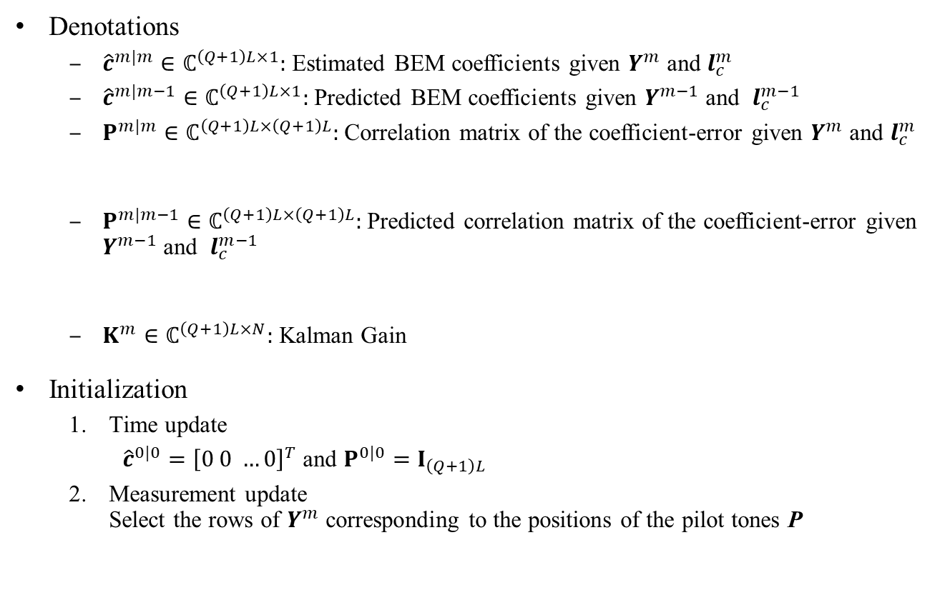

Kalman Filter-Based Model
Denotations
${\hat{c}}^{m|m}∈ℂ^{\left(Q+1\right)L×1}:$ Estimated BEM coefficients given $Y^{m}$ and $l_{c}^{m}$
${\hat{c}}^{m|m−1}∈ℂ^{\left(Q+1\right)L×1}:$Predicted BEM coefficients given $Y^{m−1}$ and $l_{c}^{m−1}$
$P^{m|m}∈ℂ^{\left(Q+1\right)L×\left(Q+1\right)L}:$ Correlation matrix of the coefficient-error given $Y^{m}$ and $l_{c}^{m}$
$P^{m|m−1}∈ℂ^{\left(Q+1\right)L×\left(Q+1\right)L}:$ Predicted correlation matrix of the coefficient-error given $Y^{m−1}$ and $l_{c}^{m−1}$
$K^{m}∈ℂ^{\left(Q+1\right)L×N}:$ Kalman Gain
Initialization
Time update
${\hat{c}}^{0|0}={\left[0 0 …0\right]}^{T}$ and $P^{0|0}=I_{\left(Q+1\right)L}$
Measurement update Select the rows of $Y^{m}$ corresponding to the positions of the pilot tones P
$$P^{m|m}=𝔼\left\{(c^{m}−{\hat{c}}^{m}){(c^{m}−{\hat{c}}^{m})}^{H}\right\}$$
$$P^{m|m−1}=𝔼\left\{(c^{m}−{\hat{c}}^{m|m−1}){(c^{m}−{\hat{c}}^{m|m−1})}^{H}\right\}$$
Measurement Equation: ${Y^{m}}^{′}=S^{m^{′}}{\hat{c}}^{m}+{ε^{m}}^{′}$

Slide 50
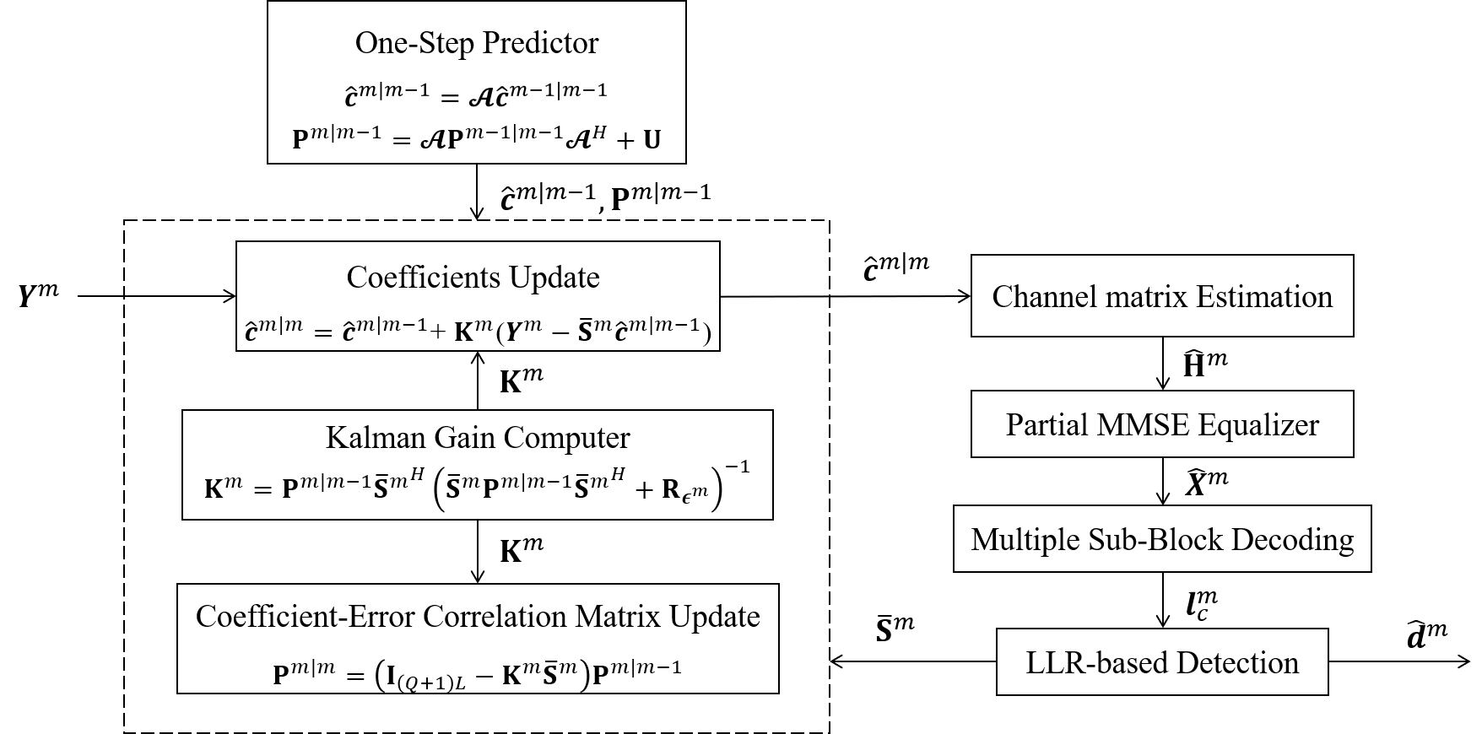
Kalman Filter-Based Model

Slide 51
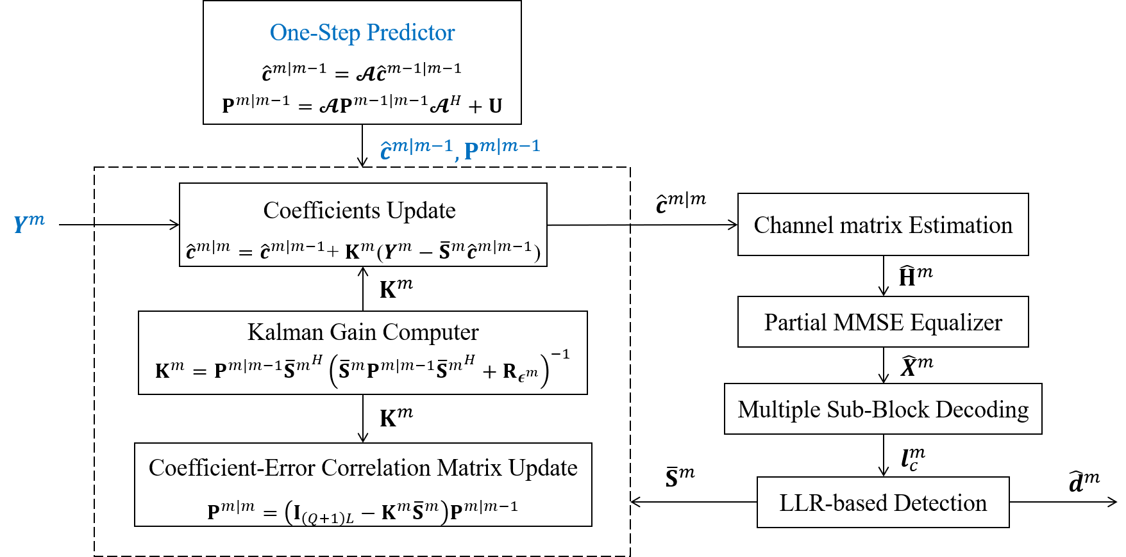
Kalman Filter-Based Model

Slide 52
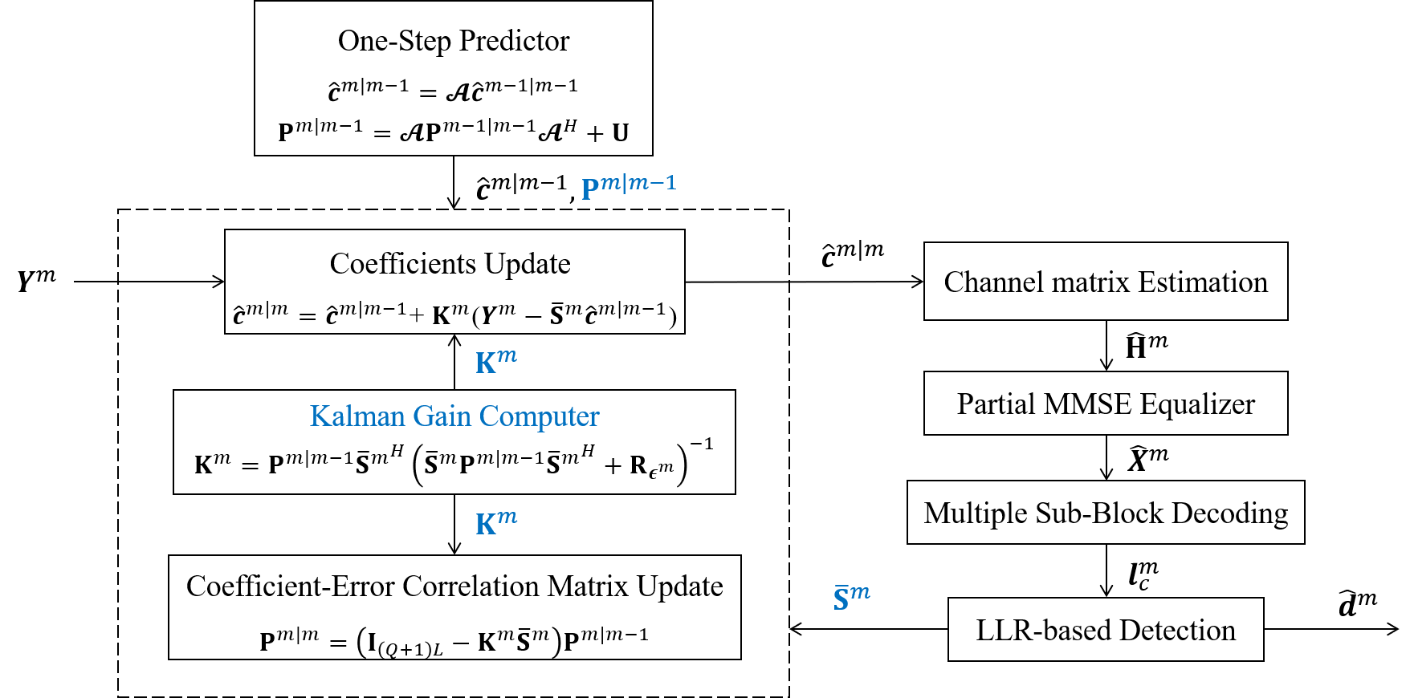
Kalman Filter-Based Model

Slide 53
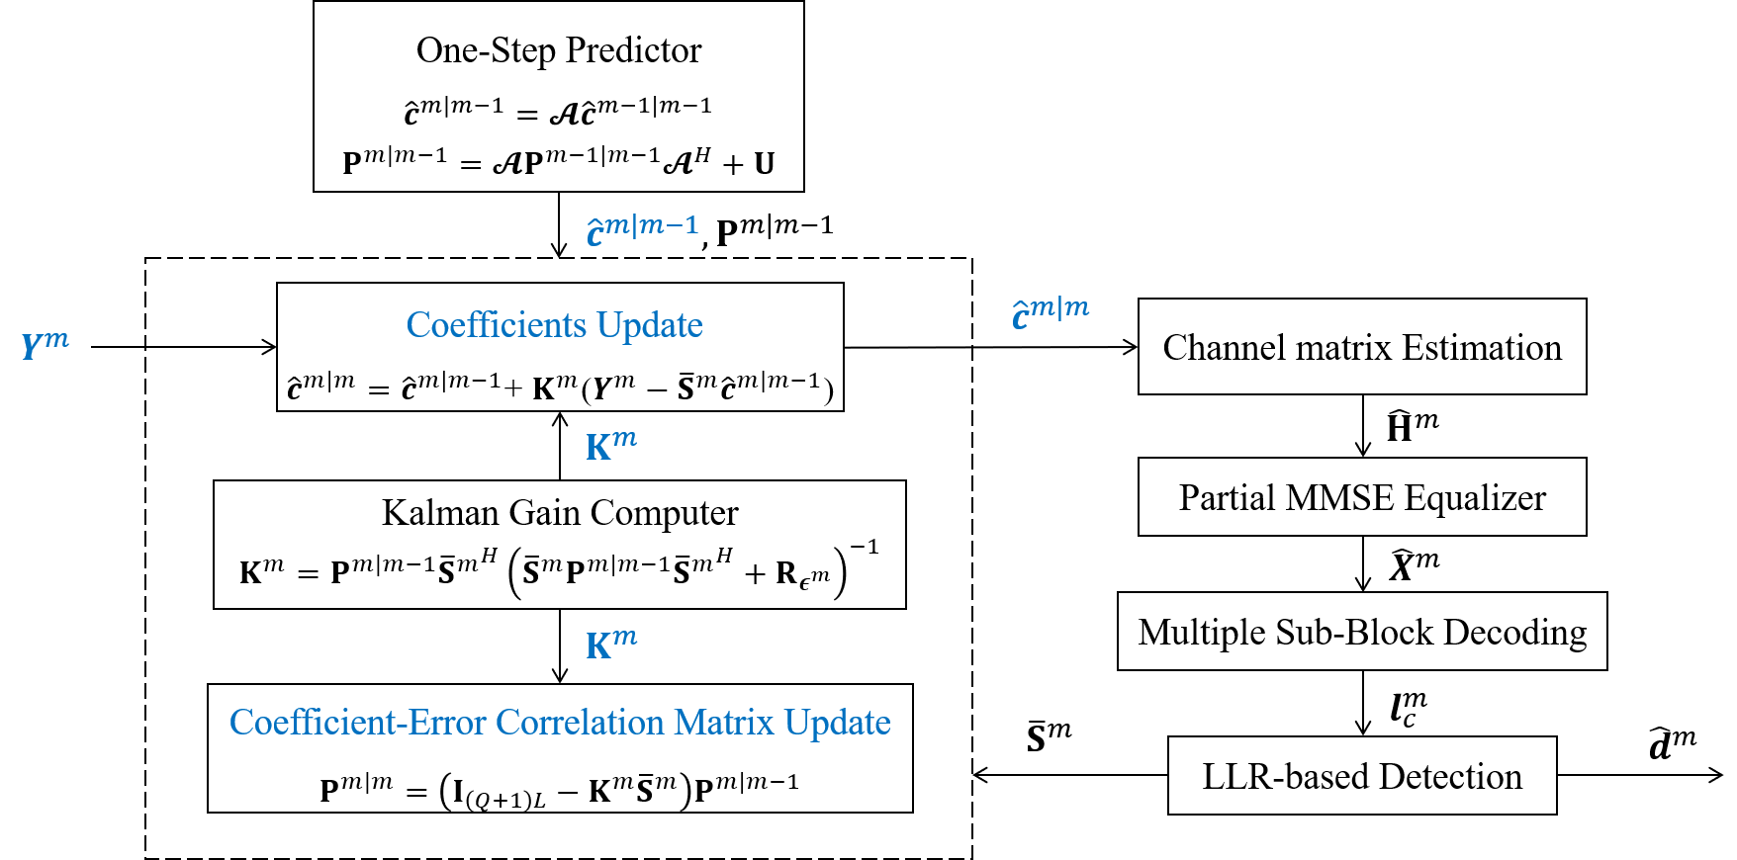
Kalman Filter-Based Model

Slide 54
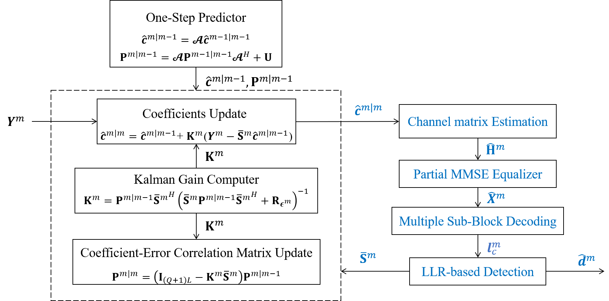
Kalman Filter-Based Model

Slide 55
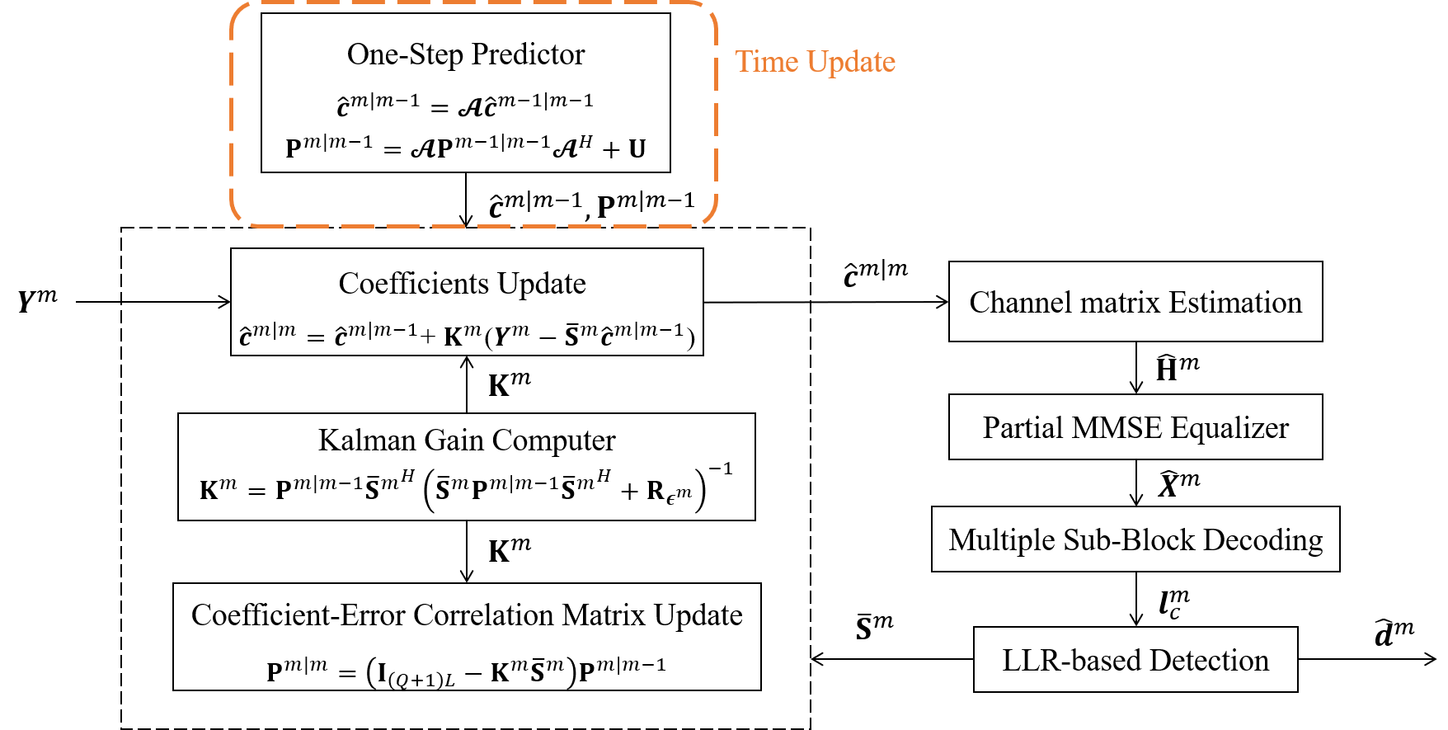
Kalman Filter-Based Model

Slide 56
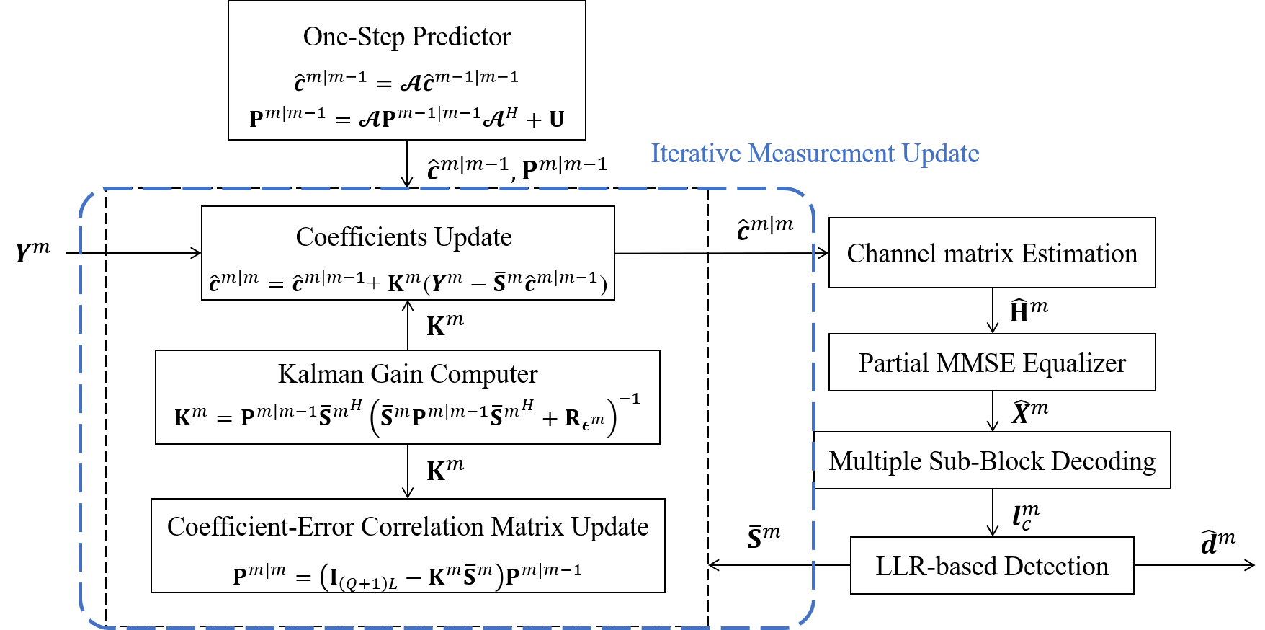
Kalman Filter-Based Model

Slide 57
Kalman Filter-Based Model
Coded OFDM
FFT size | 1024
Modulation | 16-QAM
Channel model | Fast-fading, $f_{d}T=0$.1
FEQ | PMMSE, D = 10
Code Rate | 0.5
Codeword Arrangement | 4*(1024, 512)
Pilot Arrangement | 8 groups, $G_{n}$= 3
Polynomial Order | $$Q=1$$

Slide 58
Kalman Filter-Based Model
Coded OFDM
FFT size | 1024
Modulation | 16-QAM
Channel model | Fast-fading, $f_{d}T=0$.1
FEQ | PMMSE, D = 10
Code Rate | 0.5
Codeword Arrangement | 4*(1024, 512)
Pilot Arrangement | 8 groups, $G_{n}$= 3
Polynomial Order | $$Q=1$$

Slide 59
Kalman Filter-Based Model
Coded OFDM
FFT size | 1024
Modulation | 16-QAM
Channel model | Fast-fading, $f_{d}T=0$.1
FEQ | PMMSE, D = 10
Code Rate | 0.5
Codeword Arrangement | 4*(1024, 512)
Pilot Arrangement | 8 groups, $G_{n}$= 3
Polynomial Order | $$Q=1$$

Slide 60
Kalman Filter-Based Model
Coded OFDM
FFT size | 1024
Modulation | 16-QAM
Channel model | Fast-fading, $f_{d}T=0$.1
FEQ | PMMSE, D = 10
Code Rate | 0.5
Codeword Arrangement | 4*(1024, 512)
Pilot Arrangement | 8 groups, $G_{n}$= 3
Polynomial Order | $$Q=1$$

Slide 61
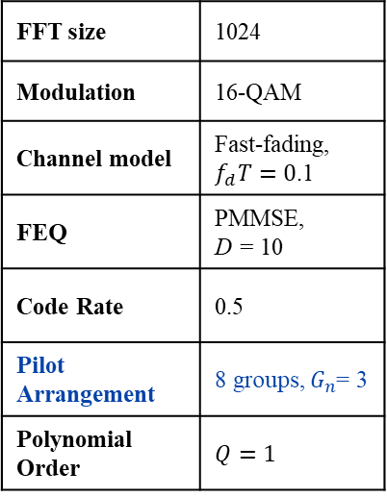
Kalman Filter-Based Model
Coded OFDM
FFT size | 1024
Modulation | 16-QAM
Channel model | Fast-fading, $f_{d}T=0$.1
FEQ | PMMSE, D = 10
Code Rate | 0.5
Pilot Arrangement | 8 groups, $G_{n}$= 3
Polynomial Order | $$Q=1$$

Slide 62
Kalman Filter-Based Model
Coded OFDM
FFT size | 1024
Modulation | 16-QAM
Channel model | Fast-fading, $f_{d}T=0$.1
FEQ | PMMSE, D = 10
Code Rate | 0.5
Pilot Arrangement | 8 groups, $G_{n}$= 3
Polynomial Order | $$Q=1$$

Slide 63
References
[1]
D.R. Morgan, “Analysis and Realization of an Exponentially-Decaying Impulse Response Model for Frequency-Selective Fading Channels,” IEEE Signal Process. Lett., vol.15, pp.441-444, 2008
Y. P. Lin, S. M. Phoong, and P. P. Vaidyanathan, Filter Zheng, Y., Xiao, C.: ‘Improved models for the generation of multiple uncorrelated Rayleigh fading waveforms’, IEEE Commun. Lett., 2002
Z. Tang, R. C. Cannizzaro, G. Leus, and P. Banelli, “Pilot-assisted time-varying channel estimation for OFDM systems,” IEEE Trans. Signal Process., vol. 55, no. 5, pp. 2226–2238, May 2007.
Kwanghoon Kim, Hyuncheol Park, “A Low Complexity ICI Cancellation Method for High Mobility OFDM Systems”
Huang-Chang Lee, Alex Gong, “A Compressed Sensing Estimation Technique for Doubly Selective Channel in OFDM Systems”
H. Nguyen-Le, T. Le-Ngoc and N. H. Tran, "Iterative Receiver Design With Joint Doubly Selective Channel and CFO Estimation for Coded MIMO-OFDM Transmissions," Oct. 2011.
Stefania, Sesia Issam, Toufik, Matthew Baker, “LTE – The UMTS Long Term Evolution: From Theory to Practice, Second Edition”
B. Lu, G. Yue, and X. Wang, ‘‘Performance analysis and design optimization of LDPC-coded MIMO OFDM systems,’’ IEEE Trans. Signal Process., vol. 52, no. 2, pp. 348–361, Feb. 2004
[2]
[3]
[4]
[5]
[6]
[7]
[8]

Slide 64
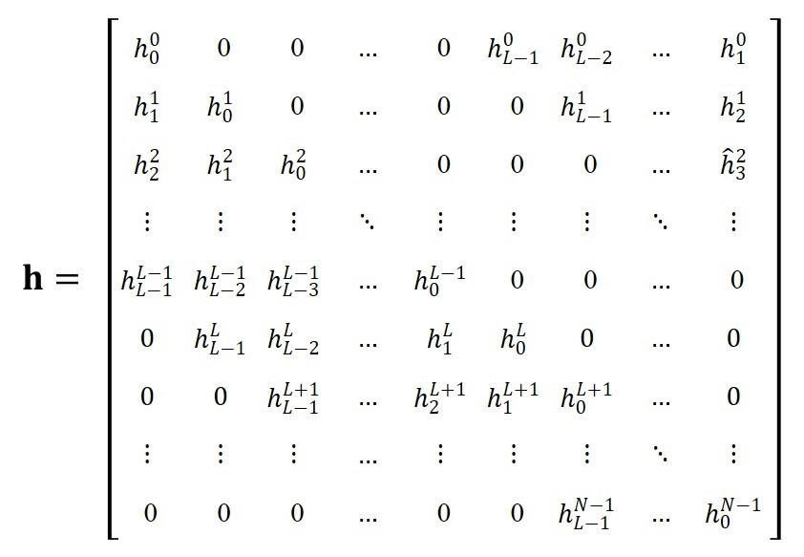
Convolution Matrix
,
Superscript: sample time index
Subscript: delay tap index

