Slide 1
Real Estate: Predicting Rental Prices
Group 6
Appidi Moni
Mohammad Feroz Ahmad Qureshi
Ravina Ingole Ringo
Sai Gowtham Reddy kallu
Sudip Adhikari

Slide 2
Problem Statement
With increasing city regulations, long waitlists for student housing and overpopulation, renting an apartment leaves many desperate for the first opportunity available, becoming vulnerable to scams and overpriced contracts.
Renting a house for international students is always daunting, it often seems impulsive and risky.
We wanted to find the next best flat to rent but there was no sophisticated real-estate-portal out there except zillow.
01
02
03

Slide 3
Solution
We will be developing a machine learning model for predicting rental price based on different features like location, prices listed on different website, so that user can get best deals.
Creating user based reporting and visualization for making decision.

Slide 4
Business Model
Our solution will help students, employees and normal people to find their dream apartment/place at minimum price based on their requirements.
In the future, the product can be used as a mediator between homeowners and buyers/renters, making the product as a commercial business

Slide 5
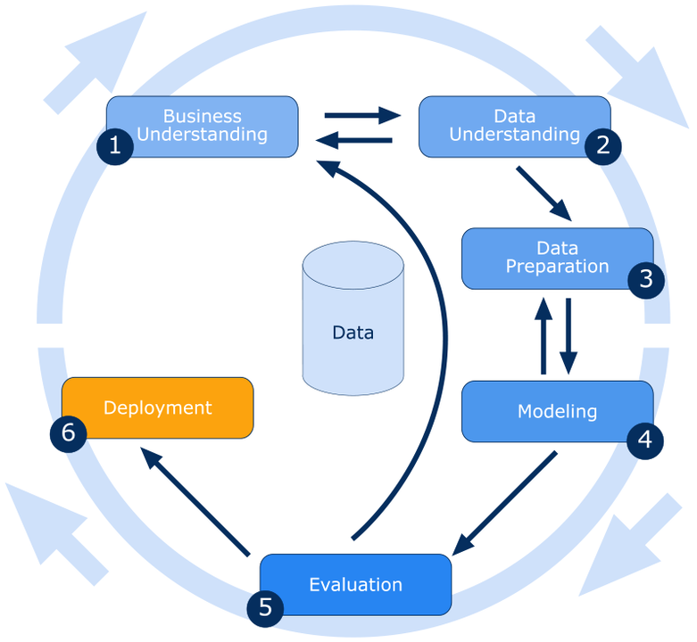
Working Methodology: CRISP DM

Slide 6
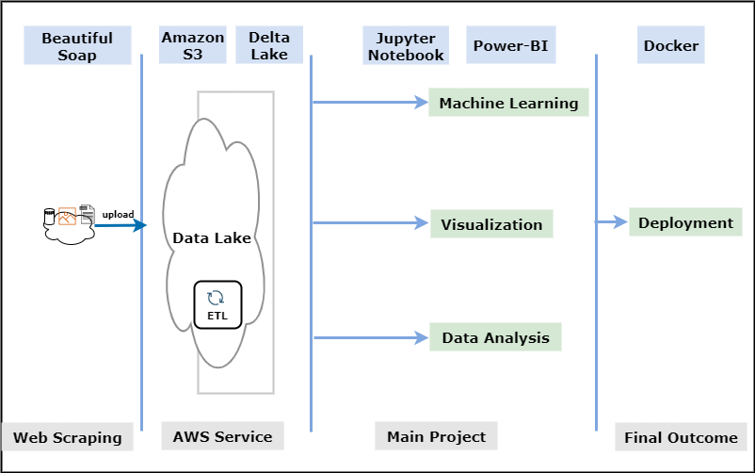
Project Roadmap & Technology:

Slide 7
Data Source
Web Scraping using BeautifulSoup or Scrapy library to get the latest data as possible
Dataset from kaggle is always the backup plan if were unable to get the required features for the prediction from scrapping
Top sites to scrape data from: https://www.zillow.com https://www.realtor.com https://www.trulia.com https://www.apartments.com
Kaggle Data: https://www.kaggle.com/competitions/zillow-prize-1/data

Slide 8
Team Roles and Skills
Data Extraction and ETL Process
Ravina (Beautiful Soap | Scrapy)
Machine Learning Model
Sudip Adhikari (Python | SQL | AWS)
Visualisation
Appidi Moni & Sai Gowtham Kallu(Power-BI | Tableau)
Deployment System To Cloud
Mohammad Feroz Ahmad Qureshi (Docker)

Slide 9
Project Evaluation
We will be using Root Mean Squared Error, Mean Absolute Error metrics, R square/Adjusted R square for Evaluation

Slide 10
Any Queries?

