Slide 1
IOT Car Park System
Internet of Things Car Park System

Slide 2
Introduction
IOT Car Park System:
An Internet based system that allows users to check for car park availability and to be able to precisely identify the exact parking lots

Slide 3
Problem statement
Car drivers face problems looking for car parks
Time and fuel wasted in waiting in queues
Causes traffic congestions
Extra fume exhaust is also not eco-friendly

Slide 4
Proposed Solution
IOT Car Park System allows users to use their mobile phones to check if car park is available for a specific building and to know exactly where
Allows users to go directly to the correct floor and exact parking lot
Users can also check for alternative car parks with empty parking lots

Slide 5
Project Objectives
Should be low cost
Easy to deploy
Pervasive (Accessible anywhere)

Slide 6
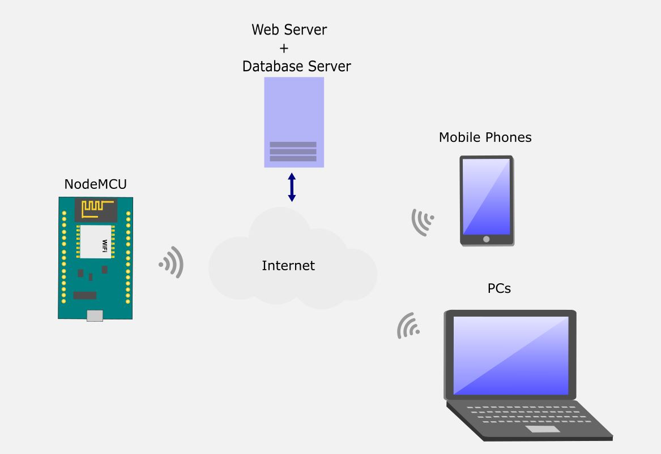
IOT Architecture

Slide 7
Advantages of IOT Carpark system
Low cost
Easy to deploy: Internet

Slide 8
How it works (Part 1)
LDR (Light Dependent Resistor)
Detects light intensity
Installed on the floor of each parking lot
When a vehicle parks, it blocks the light
LDR detects decreased light and signals NodeMCU microcontroller

Slide 9
How it works (Part 2)
NodeMCU sends data to Web Server using Wifi
WebServer stores data on Database Server
Anyone can access Web Server to see this data

Slide 10
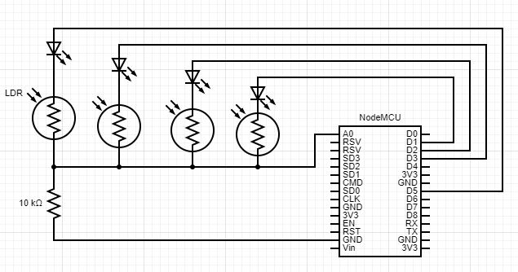
Circuit Diagram

Slide 11
How the Circuit Works (Part 1)
One analog pin (A0) measures light intensity across 8 LDRs
There are 8 LDRS
Each LDR is individually powered by the digital pins D1 to D8
The A0 pin measures light intensity one at a time

Slide 12
How the Circuit Works (Part 2)
D1 is powered on, while D2 to D8 is powered off
A0 then measures light intensity for LDR1
Next, D2 is powered on, whilst others are powered off
A0 now measures light intensity across LDR2
And the process repeats until all 8 LDRs are measured,
Repeat from LDR1 again

Slide 13
How the Circuit Works (Part 3)
The LEDs for each LDR acts as diodes to prevents backflow of current
When one LDR is powered on, the LED allows current to flow for it whilst blocking other LDRs
This prevents LDRs from affecting each other

Slide 14
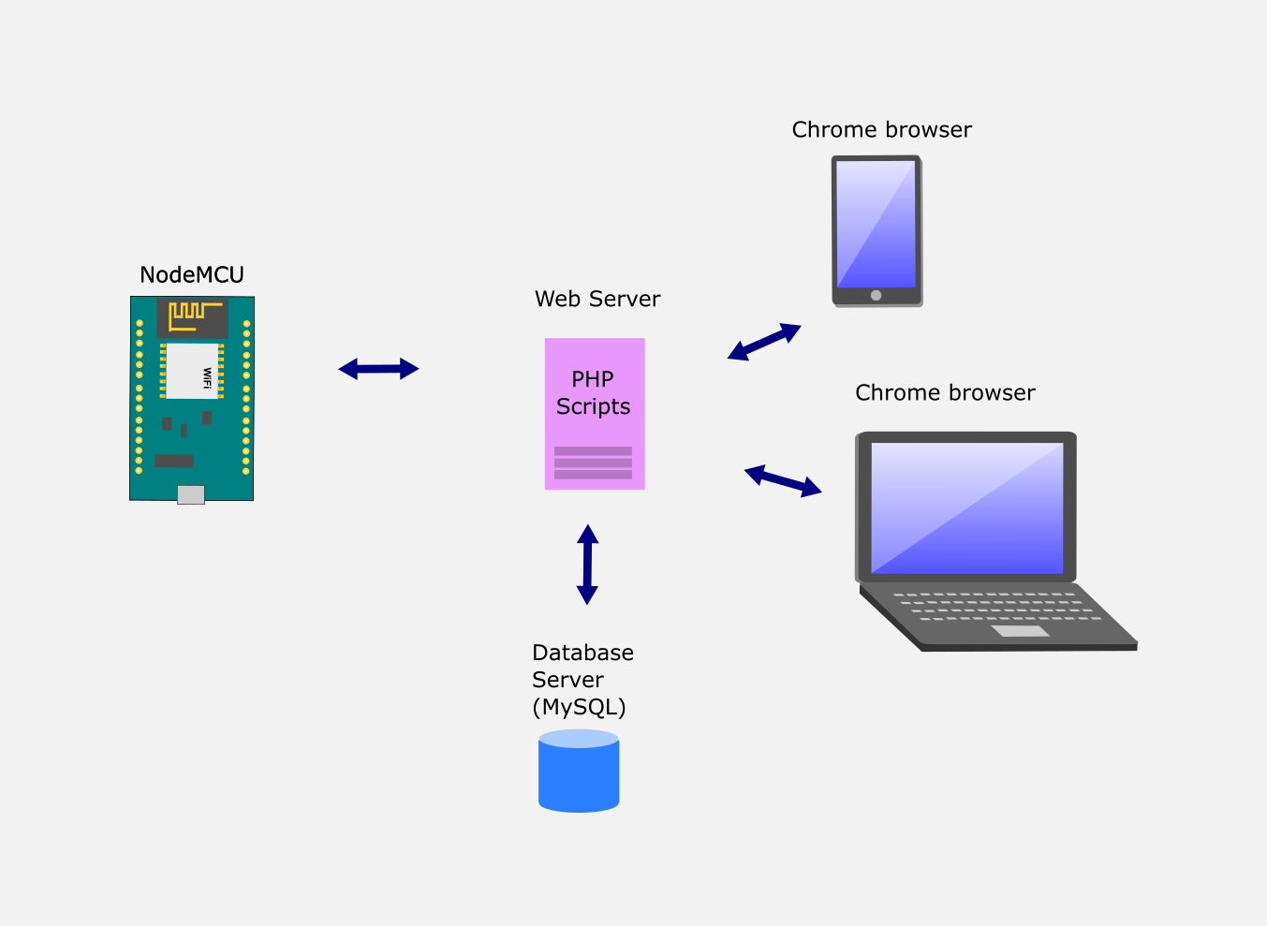
Web and Database Server

Slide 15
How the Web & Database Server Works (Pt 1)
NodeMCU communicates with Web Server by sending light intensity values
The Web server uses PHP scripts to store this data in the Database Server

Slide 16
How the Web & Database Server Works (Pt 2)
Anyone can access the Web Server to view this data using mobile phones or PCs
The web server is accessed using any Web Browser
The web server then uses PHP scripts to retrieve data from the Database Server and sends it back to the Web Browser

Slide 17
Thank you

