Slide 1
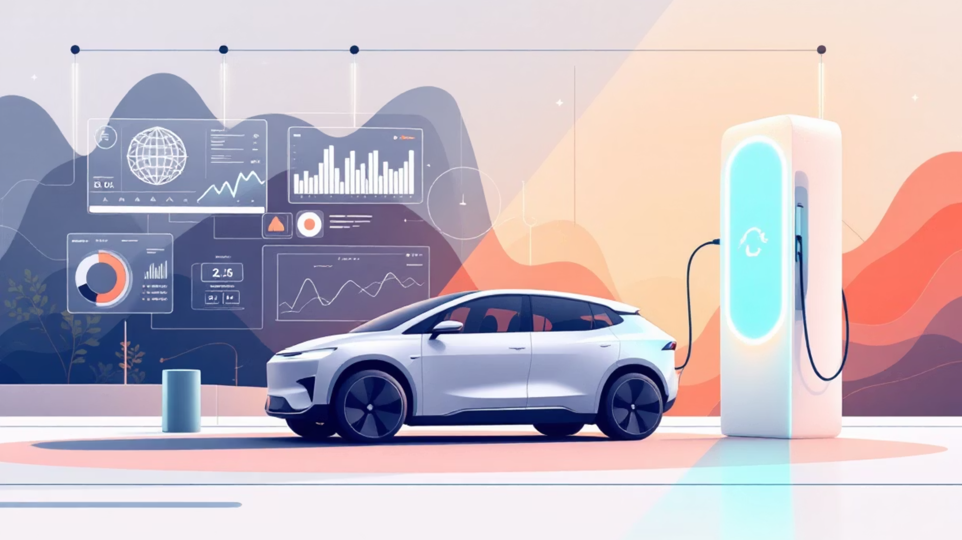
Electric Vehicle Analytics using MySQL
Uncovering Efficiency, Cost & Environmental Insights
By: Suman Saha
Tools Used: MySQL, CTEs, Window Functions, Aggregation, Correlation

Slide 2
Introduction
Electric Vehicles (EVs) are transforming transportation worldwide.
This project uses realistic EV data to explore:
Goal: Derive insights that help manufacturers, policymakers, and customers.
Performance (Range, Acceleration)
Cost (Maintenance, Charging, Insurance)
Sustainability (CO₂ Savings, Battery Health)

Slide 3
Dataset Description
Database: EV_ANALYTICS
Key Columns:
Table: ELECTRIC_VEHICLES
⚡ Battery_Capacity_kWh — Total energy capacity
🔋 Battery_Health_Percent — Battery efficiency
Total Columns: 24
🛣️ Range_km — Distance per charge
💰 Maintenance_Cost_USD, Insurance_Cost_USD, Resale_Value_USD
🌍 CO2_Saved_tons — Environmental impact
🚗 Usage_Type — Personal or Commercial

Slide 4
Problem Statement
Main Questions:
Which EVs offer the best efficiency and value?
How does battery health affect performance?
Which regions contribute most to CO₂ savings?
What patterns can help in EV cost optimization?

Slide 5
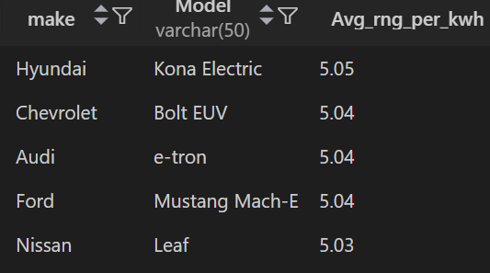

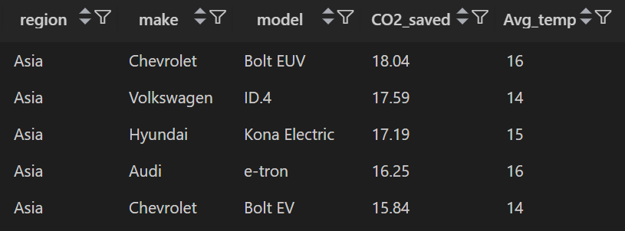
Q1 : Find the top 5 EV models with the highest range efficiency (km per kWh).
SQL Code:
SELECT
make,
model,
ROUND(AVG(Range_km / Battery_Capacity_kWh), 2) AS Avg_rng_per_kwh
FROM electric_vehicles
GROUP BY make, model
ORDER BY Avg_rng_per_kwh DESC
LIMIT 5;
Insight: ⚡ Reveals the most energy-efficient EV models, helping manufacturers benchmark performance.
Q2 : Identify which region has the highest average CO₂ savings per vehicle.
SQL Code:
SELECT
region,
make,
model,
ROUND(AVG(CO2_Saved_tons),2) AS CO2_saved,
ROUND(AVG(Temperature_C)) AS Avg_temp
FROM electric_vehicles
GROUP BY region, make, model
ORDER BY region, CO2_saved DESC;
Insight: 🌍 Finds eco-friendly regions, helping target green
incentives and government policies.

Slide 6


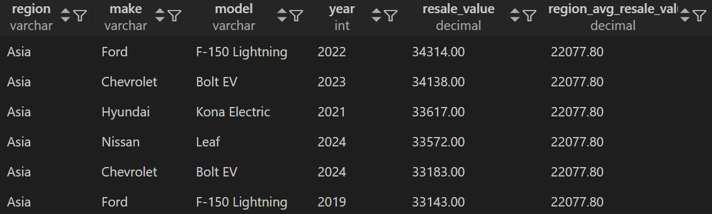

Q3 : Determine correlation between battery health and mileage.
SQL Code:
SELECT
ROUND(
( (AVG(Battery_Health_Percent * Mileage_km) - (AVG(Battery_Health_Percent) * AVG(Mileage_km)))
/ (STDDEV(Battery_Health_Percent) * STDDEV(Mileage_km)) ), 3 ) AS Battery_Mileage_Correlation
FROM electric_vehicles;
Insight: 🔋 Helps engineers understand battery degradation
patterns over time.
Q4 : Find vehicles that have resale value above their region's average.
SQL Code:
WITH cte_avg_resale_value AS (
SELECT
region,
make,
model,
year,
Resale_Value_USD AS resale_value,
ROUND(AVG(Resale_Value_USD) OVER(PARTITION BY region),2) AS region_avg_resale_value
FROM electric_vehicles
)
SELECT region, make, model, year, resale_value, region_avg_resale_value FROM cte_avg_resale_value
WHERE resale_value > region_avg_resale_value
ORDER BY region, resale_value DESC;
Insight: 💵 Highlights brands with strong resale market value —
ideal for resale strategy or pricing.

Slide 7


Q5 : Compare average monthly charging costs between personal and commercial usage.
SQL Code:
SELECT
ROUND(AVG(CASE WHEN Usage_Type = 'Personal' THEN Monthly_Charging_Cost_USD END), 2) AS Personal_Avg_Cost,
ROUND(AVG(CASE WHEN Usage_Type = 'Commercial' THEN Monthly_Charging_Cost_USD END), 2) AS Commercial_Avg_Cost
FROM electric_vehicles;
Insight: 💰 Commercial users spend more — useful for
pricing energy plans or fleet cost forecasting.
Q6 : Find the make with the lowest maintenance cost per km.
SQL Code:
SELECT
make,
ROUND(SUM(Maintenance_Cost_USD) / SUM(Mileage_km), 4) AS Avg_Maintenance_cost_per_km
FROM electric_vehicles
GROUP BY make
ORDER BY Avg_Maintenance_cost_per_kmLIMIT 1;
Insight:⚙️ Determines most cost-efficient manufacturers
for long-term ownership.

Slide 8
Slide 10: Q6 — Maintenance Efficiency
Question:Find the make with the lowest maintenance cost per km.
SQL Code:

Slide 9
Slide 11: Q7 — Fastest Vehicles per Region
Question:Top 3 fastest vehicle types in each region.
SQL Code:
WITH cte_acc AS ( SELECT region, Vehicle_type, ROUND(AVG(Acceleration_0_100_kmh_sec),2) AS Avg_acc, RANK() OVER(PARTITION BY region ORDER BY AVG(Acceleration_0_100_kmh_sec) ASC) AS Rnk FROM electric_vehicles GROUP BY region, Vehicle_Type)SELECT region, vehicle_type, Avg_acc, RnkFROM cte_accWHERE Rnk <= 3;
Insight:🚀 Reveals performance champions by region — for marketing and product positioning.

Slide 10
Q4 — High Resale Value Vehicles
Question: Find vehicles that have resale value above their region's average.
SQL Code:
WITH cte_avg_resale_value AS ( SELECT region, make, model, year, Resale_Value_USD AS resale_value, ROUND(AVG(Resale_Value_USD) OVER(PARTITION BY region),2) AS region_avg_resale_value FROM electric_vehicles)SELECT region, make, model, year, resale_value, region_avg_resale_value FROM cte_avg_resale_value WHERE resale_value > region_avg_resale_value ORDER BY region, resale_value DESC;

Slide 11
Slide 12: Q8 — Best Manufacturing Year
Question:Find the year offering the best range-to-battery health balance.
SQL Code:
SELECT year, ROUND(AVG(Range_km),2) AS avg_range, ROUND(AVG(Battery_Health_Percent),2) AS avg_battery, ROUND(AVG(Range_km) / AVG(Battery_Health_Percent), 2) AS range_to_batteryFROM electric_vehiclesGROUP BY yearORDER BY range_to_battery DESCLIMIT 1;
Insight:📅 Identifies optimal production years with superior energy-to-performance ratio.

Slide 12


Slide 13: Q9 — Cost Consistency Check
Question: Detect inconsistent electricity cost vs monthly charging cost.
SELECT make, model, ROUND(AVG(Charging_Power_kW) / AVG(Charging_Time_hr),2) AS electricity_cost, ROUND(AVG(Monthly_Charging_Cost_USD),2) AS monthly_charging_cost, ROUND(AVG(Monthly_Charging_Cost_USD) - (AVG(Charging_Power_kW) / AVG(Charging_Time_hr)),2) AS inconsistencyFROM electric_vehiclesGROUP BY make, modelORDER BY inconsistency DESC;
Insight: ⚠️ Detects billing or data recording issues in energy systems.

Slide 13
Slide 14: Q10 — Economical Ownership Ranking
Question:Rank vehicle models by total ownership cost.
SQL Code:
SELECT make, model, SUM(Maintenance_Cost_USD + Insurance_Cost_USD + Monthly_Charging_Cost_USD) AS total_ownership_cost, RANK() OVER(ORDER BY SUM(Maintenance_Cost_USD + Insurance_Cost_USD + Monthly_Charging_Cost_USD) ASC) AS RnkFROM electric_vehiclesGROUP BY make, model;
Insight:🏆 Helps identify most budget-friendly EV models for long-term ownership.

Slide 14
Slide 15: Key Insights Summary
1
2
Top 5 efficient EVs by range/kWh
CO₂ leadership by region
3
4
Battery-miles correlation for longevity
Cost-efficient brands & models
5
6
Optimal production years for design reference
Data-driven improvements for pricing & sustainability

Slide 15








🟩 Slide 16: Future Scope
Add predictive modeling for EV lifespan
Include charging station data for geo-analysis
Combine with weather & grid data for deeper sustainability metrics
Build Power BI dashboards for management insights

Slide 16

Thank You
Electric Vehicle Analytics using MySQL
Uncovering Efficiency, Cost & Environmental Insights
By: Suman Saha

Slide 17
